Slide 1
WEEK 12 CRYPTOGRAPHY
VIC Cipher / Spy App
Assigned Topic
Team 6
VIC Cipher
(spy app)
Professor-ready: W5H1 + Python source-code demo + cracking possibilities
Name / Student ID: ____________________

Slide 2
TOPIC MATCH
Professor Requirement Match
Week 12 asks for cryptography, Python demo, cracking possibilities, and presentation.
Assigned Team 6 topic: VIC Cipher / spy app.
Presentation format: PPT/PDF.
Demo format: Python source-code demo.
Required analysis: W5H1 and cracking possibilities.
Presentation point
Say the main idea first, then connect it to the demo.
Week 12 Cryptography | VIC Cipher / Spy App
02

Slide 3
REQUIRED BY PROFESSOR
W5H1: VIC Cipher
Who, What, When, Where, Why, and How.
Who
Soviet intelligence users; connected to Reino Hayhanen.
What
A hand cipher that encrypts messages into number groups.
When
Cold War period; publicly known after espionage investigations.
Where
Covert communication contexts where messages could be intercepted.
Why
To protect secret messages without needing a computer.
How
Keyed alphabet, numeric substitution, transposition, and secret key material.
Week 12 Cryptography | VIC Cipher / Spy App
03

Slide 4
HISTORICAL CONTEXT
What Is The VIC Cipher?
A Cold War hand cipher used for covert communication.
Uses secret key material to protect messages.
Turns readable text into number groups.
Combines substitution and transposition ideas.
Important as a strong paper-and-pencil cipher.
Presentation point
Say the main idea first, then connect it to the demo.
Week 12 Cryptography | VIC Cipher / Spy App
04

Slide 5
VOCABULARY
Core Cryptography Terms
Terms needed to explain the demo.
Plaintext: original readable message.
Ciphertext: encrypted protected message.
Key: secret information used to encrypt and decrypt.
Substitution and transposition: changing values and order.
Presentation point
Say the main idea first, then connect it to the demo.
Week 12 Cryptography | VIC Cipher / Spy App
05

Slide 6
ALGORITHM EXPLANATION
How The VIC-Inspired Demo Works
The demo uses two serious classical cipher ideas.
1
2
3
4
5
Normalize
Keyed alphabet
Checkerboard
Transposition
Ciphertext
MEET AT NOON → MEETATNOON
Alphabet order depends on SECRET 1970
Letters become variable-length digits
Digits are rearranged by key order
00151 88722 59012 02597 20
Week 12 Cryptography | VIC Cipher / Spy App
06

Slide 7
DEMO DESIGN
Why My Demo Is VIC-Inspired
It is not the full historical VIC cipher, but it models serious classical techniques.
It uses a keyed alphabet from the secret key.
It uses straddling checkerboard substitution.
It uses columnar transposition to rearrange digits.
It demonstrates correct-key and wrong-key behavior.
Presentation point
Say the main idea first, then connect it to the demo.
Week 12 Cryptography | VIC Cipher / Spy App
07

Slide 8
REQUIRED BY PROFESSOR
Python Source Code Demo
File to submit/show: vic_cipher_professional_demo.py
python3 vic_cipher_professional_demo.py encrypt \
--key "SECRET 1970" \
--text "MEET AT NOON" \
--show-steps
Keyed straddling checkerboard substitution
Keyed columnar transposition
Correct key recovers MEETATNOON
Wrong key produces incorrect text or decryption failure
The source code demonstrates substitution, transposition, encryption, correct-key decryption, and wrong-key behavior.
Week 12 Cryptography | VIC Cipher / Spy App
08

Slide 9
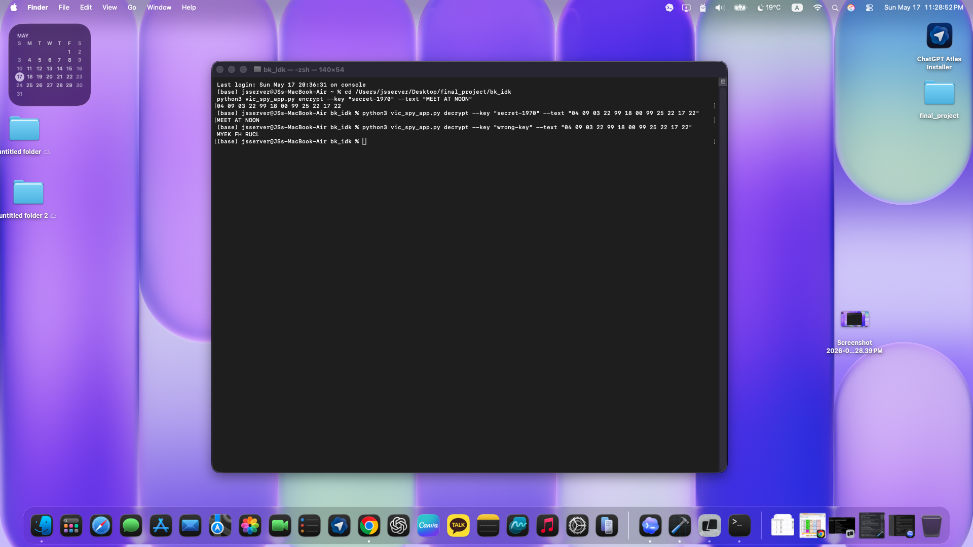
DEMO PROOF
Correct Key vs Wrong Key
Replace this screenshot with the new professional-demo screenshot after you run it.
Correct key should recover the original message.
Wrong key should not recover the original message.
This proves why secret key control matters.
Week 12 Cryptography | VIC Cipher / Spy App
09

Slide 10
REQUIRED BY PROFESSOR
Cracking Possibilities
How an attacker might try to break a classical cipher.
Possible weaknesses
Defense lesson
Weak or guessed keys
Human mistakes in encryption steps
Reused keys or repeated messages
Enough ciphertext for pattern analysis
Use strong, unique key material
Avoid repeating keys
Reduce predictable message patterns
Use modern cryptography for real security
Week 12 Cryptography | VIC Cipher / Spy App
10

Slide 11
ETHICS
Security And Ethics
Cryptography protects privacy, but demos must stay educational.
Use demos only for legal and authorized learning.
Do not claim a classroom cipher is real-world secure.
Modern security requires reviewed algorithms like AES, RSA, and ECC.
The lesson is understanding how keys protect messages.
Presentation point
Say the main idea first, then connect it to the demo.
Week 12 Cryptography | VIC Cipher / Spy App
11

Slide 12
Conclusion
The VIC cipher shows strong pre-computer cryptography.
The demo explains key-based substitution and transposition.
Cracking becomes easier with weak keys, mistakes, or repeated patterns.
For real security, modern reviewed algorithms are required.
Deliverables
PPT/PDF
Python source code
Live demo commands
Thank you

