Slide 1


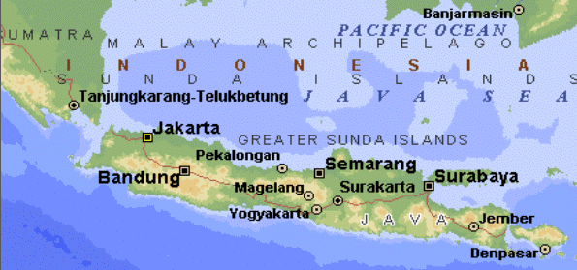
Java Syntax
Written by Amir Kirsh

Slide 2
Lesson’s Objectives
By the end of this lesson you will:
Be familiar with Java environment and characteristics
Know the Java language basic syntax
Know how to write Java based Object Oriented programs

Slide 3
Agenda
Java History
What can be done with Java?
Language Characteristics
The Java Environment
Hello World
Basic Syntax
Java API
Java as an OO language
Exercise

Slide 4
Java History
Started as an internal project at Sun Microsystems in Dec-1990
Main architect of the language - James Gosling
Initially designed for use in a set top box project and called OAK
Starting from Java 6 the source code of Java is released by Sun as open source under GNU GPL
Today Java progress is ruled by the Java Community Process (JCP) based on Java Specification Requests (JSRs)

Slide 5
Java History - Chronology
Dec-1990: Internal project at Sun (OAK, OS Green project)
May-1995: 1st Java public release as part of the HotJava browser
Jan-1996: JDK 1.0
Feb-1997: JDK 1.1 (added inner classes, JDBC, AWT changes)
Dec-1998: J2SE 1.2 (added reflection, Swing, Collections utils)
…
Sep-2004: J2SE 5.0 (added Generics, annotations, …)
Dec-2006: Java SE 6 (support in code compilation, scripting, …)
July-2011: Java SE 7 (strings in switch, try-with-resource, type inference for Generics …)
Mar-2014: Java SE 8 (Lambda expressions, Streams, …)
Sep-2017: Java SE 9 (Modularization, Reactive Streams …)

Slide 6
Agenda
Java History
What can be done with Java?
Language Characteristics
The Java Environment
Hello World
Basic Syntax
Java API
Java as an OO language
Exercise

Slide 7
What can be done with Java?
Simple Console Applications: Hello world, Utilities…
Desktop Applications: Swing, JavaFX, SWT, e.g. – Eclipse
Web Applications: Servlets, JSPs …
Server Side – DB connectivity, Client-Server, Networking, Web-Services …
Mobile Applications – Android

Slide 8
When would Java not be our choice?
Real-Time applications (though Java is taking some steps in this direction)
Device Drivers – when you need access to device memory and specific resources (C/C++ would be a choice)
When the device does not support Java/Android
Java can still be layered on top of native code, using JNI or Inter-Process-Communication:
User Interface above a Device Driver or other native code
Management of the Real-Time part of an application

Slide 9
Agenda
Java History
What can be done with Java?
Language Characteristics
The Java Environment
Hello World
Basic Syntax
Java API
Java as an OO language
Exercise

Slide 10
Language Characteristics
You know you've achieved perfection in design, Not when you have nothing more to add, But when you have nothing more to take away.
Antoine de Saint Exupery
This is NOT related, but he also wrote:
We do not inherit the Earth from our ancestors, we borrow it from our children
Antoine de Saint Exupery

Slide 11
Language Characteristics
You know you've achieved perfection in design, Not when you have nothing more to add, But when you have nothing more to take away.
Antoine de Saint Exupery
Stated in "The Java Language Environment", a white paper by James Gosling and Henry McGilton, May 1996, Chapter 2:
http://java.sun.com/docs/white/langenv/Simple.doc.html

Slide 12
Language Characteristics
You know you've achieved perfection in design, Not when you have nothing more to add, But when you have nothing more to take away.
Antoine de Saint Exupery
Becoming a bit shaky starting from Java 5 and on
Generics, Annotations, Lambda, Streams etc.
The language is becoming more and more complex

Slide 13
Language Characteristics
Java: A simple, object-oriented, network-savvy, interpreted, robust, secure, architecture neutral, portable, high-performance, multithreaded, dynamic language.
"The Java Language: An Overview", http://java.sun.com/docs/overviews/java/java-overview-1.html

Slide 14
Language Characteristics
Java: A simple, object-oriented, network-savvy, interpreted, robust, secure, architecture neutral, portable, high-performance, multithreaded, dynamic language.
Based on C++ but without some complicated or annoying elements of C++ (e.g. pointers, operator overloading, header files)
Automatic Garbage Collection!
Useful libraries that are part of the language

Slide 15
Language Characteristics
Java: A simple, object-oriented, network-savvy, interpreted, robust, secure, architecture neutral, portable, high-performance, multithreaded, dynamic language.
Inheritance and Polymorphism
Object class is base for all classes
No global variables or functions!

Slide 16
Language Characteristics
Java: A simple, object-oriented, network-savvy, interpreted, robust, secure, architecture neutral, portable, high-performance, multithreaded, dynamic language.
Local and remote files are treated similarly
Supports distributed applications
Rich libraries for network operations

Slide 17
Language Characteristics
Java: A simple, object-oriented, network-savvy, interpreted, robust, secure, architecture neutral, portable, high-performance, multithreaded, dynamic language.
Java code is compiled to intermediate language (Java byte-code class file) and is interpreted in Runtime by the Java Virtual Machine
No need to Link the application, linking is always done dynamically at Runtime
JIT (just-in-time) JVMs make the interpretation efficient

Slide 18
Language Characteristics
Java: A simple, object-oriented, network-savvy, interpreted, robust, secure, architecture neutral, portable, high-performance, multithreaded, dynamic language.
The language is much more robust compared to C++
No pointers, arrays bounds and variable initialization are checked: it is almost impossible to corrupt memory
Garbage Collection: harder (though possible) to create memory leaks
Strict type safety: very limited casting allowed

Slide 19
Language Characteristics
Java: A simple, object-oriented, network-savvy, interpreted, robust, secure, architecture neutral, portable, high-performance, multithreaded, dynamic language.
The byte-code is checked by the JVM before execution for any unsafe or vulnerable operations
Code cannot access memory directly
Additional security restrictions for code that comes from the network (e.g. Applets)

Slide 20
Language Characteristics
Java: A simple, object-oriented, network-savvy, interpreted, robust, secure, architecture neutral, portable, high-performance, multithreaded, dynamic language.
The code is agnostic to the physical architecture due to the JVM layer
Code can be written and compiled on one environment and then executed on another one!

Slide 21
Language Characteristics
Java: A simple, object-oriented, network-savvy, interpreted, robust, secure, architecture neutral, portable, high-performance, multithreaded, dynamic language.
The language clearly defines issues that in other languages are left open: exact binary form of each data type, thread behavior, GUI behavior, etc.
The JVM implementation takes care of the differences between the different environments

Slide 22
Language Characteristics
Java: A simple, object-oriented, network-savvy, interpreted, robust, secure, architecture neutral, portable, high-performance, multithreaded, dynamic language.
Java is much more efficient than other interpreted languages
Java applications are of “similar” order of performance as C/C++, based on sophisticated JVM optimizations

Slide 23
Language Characteristics
Java: A simple, object-oriented, network-savvy, interpreted, robust, secure, architecture neutral, portable, high-performance, multithreaded, dynamic language.
Multithreading and thread synchronization are part of the language
As with anything else, same multithreading API for all Operating Systems

Slide 24
Language Characteristics
Java: A simple, object-oriented, network-savvy, interpreted, robust, secure, architecture neutral, portable, high-performance, multithreaded, dynamic language.
The application can load classes after it has started
Since linking is done in Runtime adding new stuff to existing classes doesn’t break any binaries using it
Reflection (though added after the above was stated)
Can compile code in Runtime and use it (again, added after the above was stated – but what the hell…)

Slide 25
Language Characteristics
Java: A simple, object-oriented, network-savvy, interpreted, robust, secure, architecture neutral, portable, high-performance, multithreaded, dynamic language.
Sounds Good!

Slide 26
Agenda
Java History
What can be done with Java?
Language Characteristics
The Java Environment
Hello World
Basic Syntax
Java API
Java as an OO language
Exercise

Slide 27

The Java Environment
Java Program
(Text files with “.java” suffix)
Java byte-code
(Binary files with “.class” suffix)
Java Compiler
javac [<params>] <java files>
- Compile time classpath + required jars
Run your program
java [<params>] <app Main class>
- Runtime classpath + required jars
JDK
JRE (JVM + libs)

Slide 28
The Java Environment – Terms
JDK = Java Development Kit
JRE = Java Runtime Environment
JVM = Java Virtual Machine (part of the JRE)
GC = Garbage Collector (part of the JVM)
JSE = Java Standard Edition (the “basic Java” / “pure java”)
JEE = Java Enterprise Edition (some more classes…)
Java API = The Java Application Programming Interface
Classpath = Where to look for classes (we’ll talk about it)
JAR = a file packaging many classes together
IDE = Integrated Development Environment (not a must, one can use notepad or vi – but we will use Eclipse)

Slide 29
The Java Environment – JVM
Usage: java [-options] class [args...] (to execute a class)
or: java [-options] -jar jarfile [args...] (to execute a jar file)
where options include:
-client to select the "client" VM
-server to select the "server" VM
…
-cp <class search path of directories and zip/jar files>
-classpath <class search path of directories and zip/jar files>
A ; separated list of directories, JAR archives,
and ZIP archives to search for class files.
-D<name>=<value> set a system property
…
-? -help print this help message
…
-Xms<size> set initial Java heap size
-Xmx<size> set maximum Java heap size
-Xss<size> set java thread stack size
-Xprof output cpu profiling data
…

Slide 30
The Java Environment – GC
Why GC?
Saves the need to deallocate memory explicitly, freeing the developer from explicit heap handling
Eliminates the possibility of:
Memory Leaks (well, in fact there can be Leaks, or "Loiterers", also with GC)
Releasing memory that is in use (creating a "dangling pointer")
Use of memory that was released or has not been allocated
➔ Increases productivity while making applications robust

Slide 31
The Java Environment – GC
GC History
Invented by John McCarthy around 1959 for Lisp
Integral part of many other programming languages
Smalltalk, Eiffel, Haskell, ML, Scheme, Modula-3, VB, C# and almost all of the scripting languages (Perl, Python, Ruby, PHP)
Trends in hardware and software made garbage collection far more practical:
Empirical studies in the 1970s and 1980s show garbage collection consuming between 25 percent and 40 percent of the runtime in large Lisp programs

Slide 32
The Java Environment – GC
GC Roles
Detect unused memory and free it
Manage the heap to allow fast allocations
Compact the heap
Manage a "list" of free spots and their sizes

Slide 33
The Java Environment – GC
GC Tracing Techniques
Reference Counting
Problems: cyclic references, sync-lock costs
Never used by Java GC, not used by modern GCs
Trace by reachability
Objects should be kept alive if they are reachable from:
Static references
References on Stack
References from reachable objects on heap
Use of hints and tricks!

Slide 34
Agenda
Java History
What can be done with Java?
Language Characteristics
The Java Environment
Hello World
Basic Syntax
Java API
Java as an OO language
Exercise

Slide 35
Hello World
public class HelloWorld {
public static void main(String[] args) {
System.out.println("Hello World");
}
}
Method return value is similar to C. In this case void – means that the method does not return a value

Slide 36
Hello World
main in Java is a static method inside a class
main gets array of strings from the command line
public class HelloWorld {
public static void main(String[] args) {
System.out.println("Hello World");
}
}
Each type in the class should declare its access modifier
String[] means array of String objects
String is a class defined in the Java language itself
No “;” at end of class
println is a method of the static field “out” inside System class

Slide 37
Hello World – Compile and Run
Open cmd window (Start -> Run -> cmd)
Run:
javac HelloWorld.java
javac should be in your path if it is not, add the “/bin” directory of your java installation to the path
Run:
java HelloWorld
Result should be:
Hello World

Slide 38
Agenda
Java History
What can be done with Java?
Language Characteristics
The Java Environment
Hello World
Basic Syntax
Java API
Java as an OO language
Exercise

Slide 39
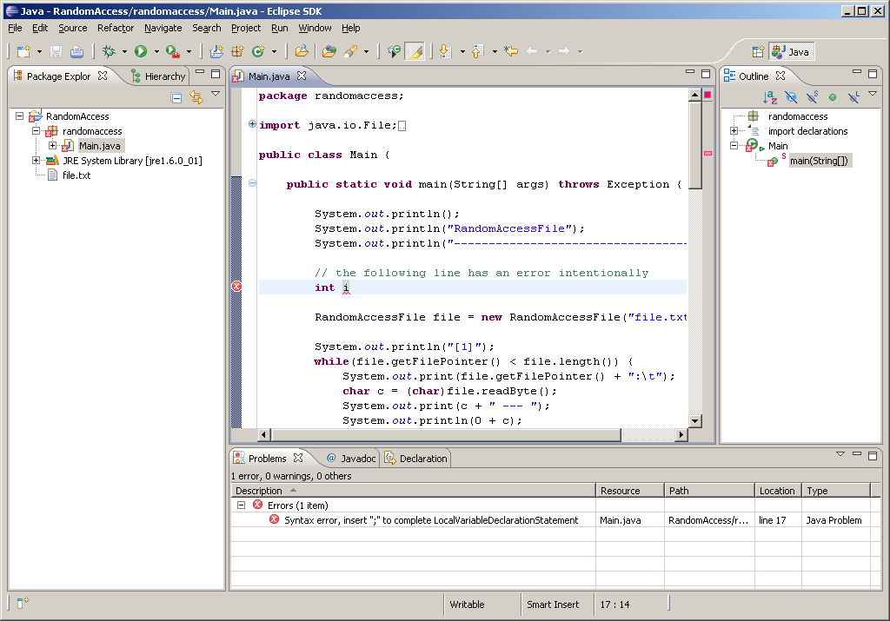
Java Syntax – but let’s first start with an IDE

Slide 40
Java Syntax
Java Syntax is very similar to C++.
In the following slides we will cover both the Java things that are similar to C++ as well as things that do not appear in C++ or work differently.

Slide 41
Data Types
Primitive Type | Class | Usage
byte | Byte | 8 bit integer number in the range of: -128 to 127
short | Short | 16 bit integer number in the range of: -32,768 to 32,767
int | Integer | 32 bit integer number in the range of: -2,147,483,648 to 2,147,483,647
long | Long | 64 bit integer number in the range of: -9,223,372,036,854,775,808 to ...807
float | Float | 32 bit floating point number
double | Double | 64 bit floating point number
boolean | Boolean | true/false, unspecified size in runtime, 1 byte when serialized
char | Character | 16-bit single Unicode character
--- | String | Characters string, as “Hello World”
For numbers that require exact accuracy use java.math.BigDecimal

Slide 42
Primitive Variables
Primitive variables are variables of primitive types (i.e. not objects) – they pass By Value
Example:
int i = 3;
foo(i);
System.out.println(i); // prints 3
void foo(int i) {
i = 5;
}
The original “i” is NOT changed!

Slide 43
Objects and References
Object variables in Java are ALWAYS a reference to an instance
Example:
void someMethod(Person p) {
p.setName("Momo");
}
The original person sent to this method is modified
(In case p is null we will get an Exception – we will talk about this later)

Slide 44
Objects and References
Object variables MUST be initialized or otherwise they are: – uninitialized in case of local variables – null in case of a field
Example 1:
void someMethod() {
Person p;
p.setName("Koko");
}
The above will not compile
(compilation error: variable ‘p’ might not have been initialized)

Slide 45
Objects and References
Object variables MUST be initialized or otherwise they are: – uninitialized in case of local variables – null in case of a field
Example 2:
class Foo {
Person p; // field p is initialized to null
void someMethod() {
p.setName("Annul");
}
}
NullPointerException thrown at runtime
Well, in fact it’s a null reference

Slide 46
Objects and References
To create an instance of an object you should use ‘new’
Example:
Person p = new Person("Noa"); // use Person c’tor
System.out.println(p.getName());
The person ‘p’ references is created on the heap
(You shouldn’t worry about the deallocation!)
We will talk about “constructors” (== c’tors) later

Slide 47
Objects and References
When setting a reference to an object variable its old reference (if existed) is detached with no harm
Example 1:
void someMethod(Person p) {
p = new Person("New Person");
p.setAge(0);
}
The original person sent to this method is unmodified!
(Which makes this method a bit useless… but this is only an example)

Slide 48
Objects and References
When setting a reference to an object variable its old reference (if existed) is detached with no harm
So how do I change a String that was sent to me?
Example 2:
void someMethod(String s) {
s = "123";
}
The original String sent to this method is unmodified!!!
(Which again makes this method a bit useless…)
You CAN’T. String is ‘Immutable’. As well as all the wrapper classes (Integer, Long etc.)

Slide 49
Objects and References
Assignment is assignment of references!
Example:
Person p = new Person("Noa");
Person q = p;
q.setName("Q");
Both ‘p’ and ‘q’ are the same person (called now “Q”)
To create a copy you should use ‘clone’ method (but we will not go through it now)

Slide 50
Objects and References
The ‘==’ checks for references equality The ‘equals’ function is for deep equality, under the responsibility of the class

Slide 51
Objects and References
The ‘==’ checks for references equality
Example 1:
Person p = new Person("Noa");
Person q = new Person("Noa");
if(p==q) {
System.out.println("Equal!");
}
else {
System.out.println("NOT Equal!");
}
Since ‘p’ and ‘q’ do not share the same reference – We will see “NOT Equal!” (‘==’ checks for reference equality)

Slide 52
Objects and References
The ‘equals’ function is for deep equality, under the responsibility of the class
Example 2:
String s1 = "Noa“, s2 = "Noa";
if(s1.equals(s2)) {
System.out.println("Equal!");
}
else {
System.out.println(“NOT Equal!");
}
Since class String implemented ‘equals’ appropriately – We will see “Equal!”

Slide 53
Arrays
Examples:
[1]
int[] intArr = {1,2,3}; // or = new int[]{1,2,3};
[2]
String[] sArr = new String[]{"a", "b", "c"};
[3]
Person[][] personArr2d = new Person[3][2];
for(int i=0; i < personArr2d.length; i++) {
for(int j=0; j < personArr2d[i].length; j++) {
personArr2d[i][j] = new Person();
}
}

Slide 54
Arrays
Examples (cont’):
[4]
String[][] strArr2d = new String[3][];
for(int i=0; i < strArr2d.length; i++) {
strArr2d = new String[i+1];
}
strArr2d
null
0
1
null
null
2
null
null
null

Slide 55
“foreach” loop
New kind of loop introduced in Java 5
Example:
String[] sArr = {"Noa", "Koko", "Momo"};
for(String str : sArr) {
System.out.println(str);
}
- "foreach" is the common name for this new type of loop, but it’s not a keyword in the language

Slide 56
Other Conditions and Loops
Switch
switch(number) {
case 1:
doSomething();
break;
case 2:
doSomethingElse();
break;
default:
doSomeDefaultThing();
}

Slide 57
Other Conditions and Loops
While, Do-While loops
while(!isDone()) {
doSomething();
}
do {
doSomething();
} while(!isDone());
What the difference between the two?

Slide 58
Exceptions
Unchecked: RuntimeException (and Error) Can throw without declaring in the method’s signature
Checked: All the rest If thrown must be declared in the method’s signature
Throwable
Error
Exception
RuntimeException
Unchecked
Unchecked

Slide 59
Exceptions
Keywords: throw, throws, try, catch, finally
Example:
void foo(String snum) throws NumberFormatException {
try {
int number = Integer.valueOf(snum);
System.out.println(Math.pow(number, 2));
} finally {
System.out.println("getting out of foo");
}
}
Example continues in next page…
Not a must, since this is a RuntimeException

Slide 60
Exceptions
Keywords: throw, throws, try, catch, finally
Example (cont’):
void bar() {
try {
foo("abc");
System.out.println("foo was OK");
} catch(NumberFormatException e) {
// an example, not really what we do with exceptions
System.out.println("foo had a problem");
throw new RuntimeException(e);
}
}

Slide 61
Exceptions
Never absorb Exceptions!!!
Bad:
try {
doSomething();
} catch(Exception e) {
// this should never happen...
System.out.println("Surprise!");
}
Instead:
try {
doSomething();
} catch(Exception e) {
// this should never happen...
throw new RuntimeException(e);
}

Slide 62
Varargs
printf in Java (yes, there is such a thing!)
System.out.printf("i = %d, with message = %s", i, msg);
The signature of printf (in classes PrintStream and PrintWriter) is:
printf(String format, Object... args)
Object... means that the user can send any number of parameters of type object (including zero number)
The function gets the Object... as an array of Objects (=Object[])

Slide 63
Varargs – Writing our own method
// here is our own example
static public String max(String... strings) {
int length = strings.length;
if(length == 0) {
return null;
}
String max = strings[0];
for(int i=1; i<length; i++) {
if(max.compareTo(strings[i]) < 0) {
max = strings[i];
}
}
return max;
}
// and calling the function can go like this:
String maxStr = max("hello", "world", "!!!");

Slide 64
Classes and Packages
A class represents an “encapsulated” Entity - with its own fields, representing the entity's info - with its own methods – the things that this entity can do
Fields and Methods can be private or public (or protected or “package friendly”)
Classes themselves can be private or public (or “package friendly”)
A package represents a set of classes, related by topic

Slide 65
Classes and Packages
Public class must sit in a file with an identical name
Classes sits in packages, having no package means being in the "default package"
Package is like a namespace in C++
Each package needs a directory with the same name
Nested packages (package inside a package) are common
To use classes from other packages without having to use their fully qualified name, the ‘import’ statement is used – import is like “using namespace” in C++ – import is NOT like “include” in C++ (Java has no .h files)

Slide 66
Classes and Packages
Example:
package com.feathersys.geno.engine;
import com.feathersys.geno.infrastructure.*; // all classes
import com.feathersys.geno.utils.StringUtils; // one class
public class EngineElement {
...
};
The class EngineElement sits in a file called “EngineElement.java” under “<project_location>/com/feathersys/geno/engine/”

Slide 67
Java Syntax – what’s not in Java
The following features that are in C++ are omitted from Java:
No default parameters
No operators overloading (methods overloading do exist)
No multiple inheritance nor private / protected inheritance (we will talk about inheritance later…)
OK, we are ready for the journey!

Slide 68
Agenda
Java History
What can be done with Java?
Language Characteristics
The Java Environment
Hello World
Basic Syntax
Java API
Java as an OO language
Exercise

Slide 69
Java API
Java API is the “Help” for Java libraries
We will start from here:
https://docs.oracle.com/javase/9/docs/api/index.html
Then take an example from here:
https://docs.oracle.com/javase/9/docs/api/java/lang/String.html

Slide 70
Agenda
Java History
What can be done with Java?
Language Characteristics
The Java Environment
Hello World
Basic Syntax
Java API
Java as an OO language
Exercise

Slide 71
Java as an OO language
Well, we talked too much so far so we will have to leave it for after the break…
BUT
Some exercise before!

Slide 72
Agenda
Java History
What can be done with Java?
Language Characteristics
The Java Environment
Hello World
Basic Syntax
Java API
Java as an OO language
Exercise

Slide 73
Exercise 1
Get strings from the command line and print to screen only those which contain the word “Java” (with a capital ‘J’).

Slide 74
Exercise 2
Get integers from the command line (well, you will get Strings but should find a way to turn them to ints), calculate the average then print to screen all the numbers and the average.

Slide 75
Exercise 3
Get Strings from the command line, present in the console a vertical bar chart of the frequency of each letter in the input.
Treat small and capital letters the same -- as capital
Ignore any char that is not an English letter
Example
For the following input: Hey how are you?
we expect the following chart:
A #
E ##
H ##
O ##
R #
Y ##
U #
W #

Slide 76
Exercise 4
This exercise is called the Rectangles game.
Get from the command line the coordinates of two rectangles.
The “winning rectangle” is set according to these rules:
If a rectangle is contained (even partially) in the other, the contained (=inner) rectangle wins
If no one contains the other, the bigger by both area and perimeter wins
If no one is bigger by both area and perimeter, we have a tie
Example
Rectangle A: 1 1 10 10 (which means: x1=1, y1=1, x2=10, y2=10)
Rectangle B: 5 5 10 10 (which means: x1=5, y1=5, x2=10, y2=10)
The winner is Rectangle B (contained in A!)

Slide 77
That concludes this chapter
kirshamir at gmail com

Slide 78
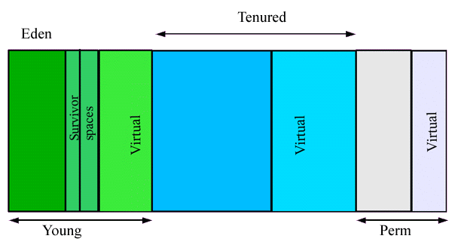
The Java Environment – GC
Java GC Generations
*
Removed in Java 8

