Slide 1

AT&T BIQ Project 2018
SQL and JDBC
© All rights reserved. Materials are for the sole use of the AT&T BIQ Project 2018. Any other use is forbidden

Slide 2

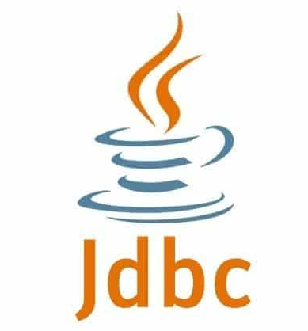
SQL and JDBC
Written by Amir Kirsh

Slide 3
Lesson’s Objectives
By the end of this lesson you will:
Be able to use SQL for SELECT, UPDATE, INSERT, DELETE
Be able to use JDBC, including prepared statements, for managing relational database from a Java application
Be able to draw a simple ERD
Be able to consider relational database design considerations

Slide 4
Agenda
Relational Databases
SQL
Database Design
Exercise
JDBC
Exercise

Slide 5
Relational Database
Data is managed in Table(s)
Each table has Columns (fields) and Rows (Records)
Each Row has its own Unique Key (Primary Key) that can be a single field or a combination of several fields
Relations between tables are managed based on tables’ fields
A relation that points to a Unique Row in another table is based on matching the Primary Key of the other table, this field in the referring table is called a Foreign Key (and it doesn’t have to be unique)
Database can have also: Indexes, Constraints, Stored Procedures (and also: dynamic and static views, and more)
Called also RDBMS = Relational Database Management System

Slide 6
SQL Crash Course
Structured Query Language
The name is a bit misleading – it’s not only for “queries”
One of the oldest Computer Languges that is still widely in use
First appeared in 1974
What made it so popular?
Simple
A declarative programming language

Slide 7
SQL – Managing the DB Schema (DDL)
DDL = Data Definition Language
Create: Schema, Table
Drop: Schema, Table
Alter Table
Truncate Table – for deleting all data in a table (faster than DELETE)

Slide 8
SQL – Create Database (=Create Schema)
Create Database (MySQL): https://dev.mysql.com/doc/refman/5.7/en/create-database.html
CREATE {DATABASE | SCHEMA} [IF NOT EXISTS] db_name
[create_specification] ...
create_specification:
[DEFAULT] CHARACTER SET [=] charset_name
| [DEFAULT] COLLATE [=] collation_name
Also relevant: SHOW DATABASES

Slide 9
SQL – Create Table
Create Table (MySQL): https://dev.mysql.com/doc/refman/5.7/en/create-table.html
CREATE TABLE [table name] ( [column definitions] ) [table parameters]
Example:
CREATE TABLE employees (
id INTEGER PRIMARY KEY,
first_name VARCHAR(50) not null,
last_name VARCHAR(75) not null,
fname VARCHAR(50) not null,
dateofbirth DATE not null
);

Slide 10
SQL – ALTER Table
Alter Table (MySQL): https://dev.mysql.com/doc/refman/5.7/en/alter-table.html
ALTER Table <table_name> <operation> <parameters> [, <operation> <parameters>]…
Example:
ALTER TABLE employees DROP Column fname, ADD Column mname VARCHAR(20)

Slide 11
SQL – Managing the DB Data (DML, CRUD)
DML = Data Manipulation Language
CRUD = Create, Read/Retrieve, Update, Delete
Select
Insert
Update
Delete

Slide 12
SQL – Managing the DB Data – Select (1)
SELECT *
FROM Book
WHERE price < 100.00
ORDER BY title;

Slide 13
SQL – Managing the DB Data – Select (2)
SELECT isbn,
title,
price,
price * 0.06 AS sales_tax
FROM Book
WHERE price > 100.00
ORDER BY title;

Slide 14
SQL – Managing the DB Data – Select (3a)
SELECT isbn, title, price, Publisher.name
FROM Book, Publisher
WHERE
Book.publisher_id = Publisher.publisher_id
AND publish_date
BETWEEN '2017-01-01 00:00:00' AND '2017-12-31 23:59:59'
ORDER BY title;
# comma between tables = Cartesian Product = Cross Join
# Book.publisher_id = Publisher.publisher_id => makes it an Inner Join
# see the use of Between on dates

Slide 15
SQL – Managing the DB Data – Select (3b)
SELECT isbn, title, price, Publisher.name
FROM Book, Publisher
WHERE
Book.publisher_id = Publisher.publisher_id
AND Date(publish_date)
BETWEEN '2017-01-01' AND '2017-12-31'
ORDER BY title;
# Between on date improved (MySQL syntax)

Slide 16
SQL – Managing the DB Data – Select (3c)
SELECT isbn, title, price, Publisher.name
FROM Book
JOIN Publisher
ON Book.publisher_id = Publisher.publisher_id
WHERE
Date(publish_date)
BETWEEN '2017-01-01' AND '2017-12-31'
ORDER BY title;
# Inner Join (which is the default JOIN) instead of “Cross Join”

Slide 17
SQL – Join Options
INNER JOIN: returns rows when there is a match in both tables.
OUTER JOIN:
LEFT JOIN: returns all rows from the left table, even if there are no matches in the right table. Fill in NULLs for missing matches on the right.
RIGHT JOIN: returns all rows from the right table, even if there are no matches in the left table. Fill in NULLs for missing matches on the left.
FULL JOIN: combines the results of both left and right outer joins. Fill in NULLs for missing matches on either side.
https://stackoverflow.com/questions/5706437/whats-the-difference-between-inner-join-left-join-right-join-and-full-join
https://dev.mysql.com/doc/refman/5.7/en/join.html

Slide 18
SQL – Inner Select (Example 1)
SELECT isbn,
title,
price
FROM Book
WHERE price < (SELECT AVG(price) FROM Book)
ORDER BY title;

Slide 19
SQL – Inner Select (Example 2)
SELECT b.isbn, b.title, b.price, sales.items_sold, sales.company_nm
FROM Book b
JOIN (SELECT SUM(Items_Sold) AS Total_Items_Sold, Company_Nm, ISBN
FROM Book_Sales
GROUP BY Company_Nm, ISBN) AS sales
ON sales.isbn = b.isbn

Slide 20
SQL – More Select Options
HAVING - includes a predicate used to filter rows resulting from the GROUP BY clause. Because it acts on the results of the GROUP BY clause, aggregation functions can be used in the HAVING clause predicate
DISTINCT - eliminates duplicate data.
LIMIT – limits the number of records to return.
-------------
Order of Execution:
SELECT <columns> ......................................... 5
FROM <table> ............................................... 1
WHERE <predicate on rows> ........................... 2
GROUP BY <columns> .......................................... 3
HAVING <predicate on groups> ....................... 4
ORDER BY <columns> ......................................... 6

Slide 21
SQL – Select Having Example
SELECT ShopID, SUM(SaleAmount)
FROM Sales
WHERE SaleDate = '01-Jan-2000'
GROUP BY ShopID
HAVING SUM(SaleAmount) < 1000

Slide 22
SQL – Operators
Operator | Description | Example
= | Equal to | Author = 'Alcott'
<> | Not equal to (many DBMSs accept != in addition to <>) | Dept <> 'Sales'
> | Greater than | Hire_Date > '2012-01-31'
< | Less than | Bonus < 50000.00
>= | Greater than or equal | Dependents >= 2
<= | Less than or equal | Rate <= 0.05
BETWEEN | Between an inclusive range | Cost BETWEEN 100.00 AND 500.00
LIKE | Match a character pattern | First_Name LIKE 'Will%'
IN | Equal to one of multiple possible values | DeptCode IN (101, 103, 209)
IS [NOT] NULL | Compare to null (missing data) | Address IS NOT NULL
IS [NOT] TRUE or IS [NOT] FALSE | Boolean truth value test | PaidVacation IS TRUE
IS NOT DISTINCT FROM | Is equal to value or both are nulls (missing data) | Debt IS NOT DISTINCT FROM Receivables
AS | Used to change a column name when viewing results | SELECT employee AS "department1"

Slide 23
SQL – Select – MySQL Reference
https://dev.mysql.com/doc/refman/5.7/en/select.html

Slide 24
SQL – Delete
https://dev.mysql.com/doc/refman/5.7/en/delete.html
DELETE FROM Book
WHERE Book.ISBN = ‘123456789';

Slide 25
SQL – Insert
https://dev.mysql.com/doc/refman/5.7/en/insert.html
INSERT INTO <table_name>
(column_name, …)
VALUES
(column_value, …)
INSERT INTO example
(column1, column2, column3)
VALUES
('test', 'N', NULL);

Slide 26
SQL – Update
https://dev.mysql.com/doc/refman/5.7/en/update.html
UPDATE <table_name>
SET assignment_list
[WHERE where_condition]
UPDATE example
SET column1 = 'updated value'
WHERE column2 = 'N';

Slide 27
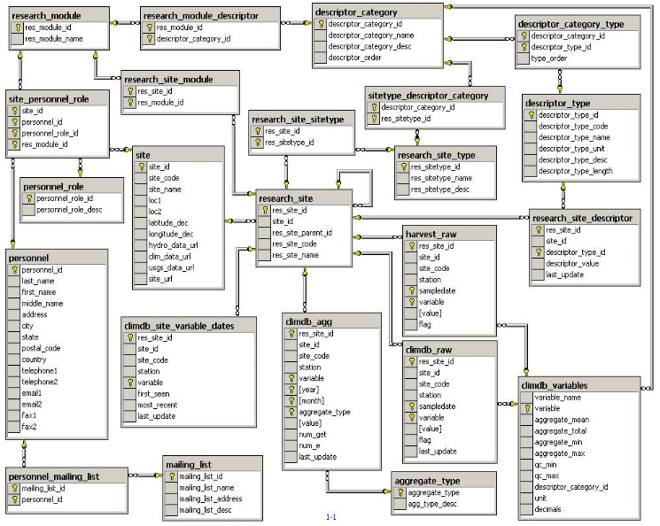
Database Design and ERD
Normalization: avoid duplication of data, including simple strings
Embedded Data: consider when embedded data in same row is suitable (e.g. 3 phone numbers – pros and cons)
Primary Key: should always be a single field with generated ID (discuss why Person’s Actual State ID is not a good ID in the DB)
How to manage many-to-many
Code Tables
ERD = Entity Relationships Diagram

Slide 28
Exercise

Slide 29
Exercise
Present a table diagram (e.g. ERD) that represents the following + create actual DB:
A group of chains of stores:
“koala bear” - chain of stores for baby clothes
“work on it” - chain of office supplies stores
“Casual wear” - chain of stores for family clothes
The group may open additional chains
Employees are associated with a shop
There are a few employees that belong to the group management (i.e. not to a certain chain / shop)
Each store has an address
Some stores are in shopping malls, the shopping mall has an address and the store has a “store number” in the mall
Several shops that belong to the group may appear in the same shopping mall
Shopping malls belong to a “mall group” (this info is relevant because when discussing with a mall on commercial terms there is a need to get the full picture of “how many stores are operated under this mall group”)

Slide 30

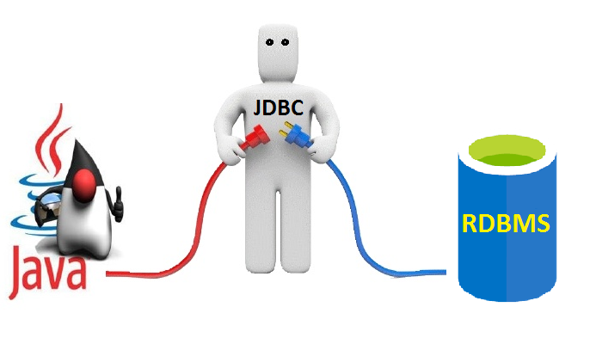
JDBC

Slide 31
JDBC
Spec for connectivity between Java and Database
It’s ALL interfaces (almost)
Database vendor creates implementation: JDBC Driver

Slide 32
JDBC – Managing the Driver(s)
Old: java.sql.DriverManager
static Connection getConnection(String url [, user, pwd])
gets the connection from the suitable driver, of all loaded JDBC drivers – according to the url string
Newer: javax.sql.DataSource
Connection getConnection([user, pwd])
non static method
gets the connection from this data source
* some work needed to create and configure a data source usually done by application server, then injecting data source to the application

Slide 33
JDBC – DriverManager Example (older)
https://docs.oracle.com/javase/9/docs/api/java/sql/DriverManager.html
Class.forName("com.mysql.jdbc.Driver");
String url = "jdbc:mysql://[host][,failoverhost...][:port]/[database]";
Connection c = DriverManager.getConnection(url);
In case the DriverManager is unable to load the driver:
DriverManager.registerDriver( (Driver) Class.forName("com.mysql.jdbc.Driver").newInstance());
// OR:
DriverManager.registerDriver(new com.mysql.jdbc.Driver());
// usually not required, as a driver is supposed to implement // a static initializer for registering itself into the DriverManager
Question: why (a) is preferred over (b) which is preferred over (c) ?
(a)
(b)
(c)

Slide 34
JDBC – DataSource (1 - Naive Example)
https://docs.oracle.com/javase/9/docs/api/javax/sql/DataSource.html
We use below directly the actual data source provided by MySQL
MysqlDataSource ds = new MysqlDataSource();
ds.setServerName("localhost");
ds.setPortNumber(3306);
ds.setDatabaseName(“WebShop");
ds.setUser(“root");
ds.setPassword(“root");

Slide 35
JDBC – DataSource (2 – with Apache DBCP)
https://commons.apache.org/proper/commons-dbcp/index.html
http://commons.apache.org/proper/commons-dbcp/api-1.4/org/apache/commons/dbcp/BasicDataSource.html
See also: http://commons.apache.org/proper/commons-dbcp/api-1.4/org/apache/commons/dbcp/datasources/package-summary.html
@Bean // spring Bean public DataSource dataSource() {
BasicDataSource ds = new BasicDataSource(); // org.apache.commons.dbcp
ds.setDriverClassName("com.mysql.jdbc.Driver");
ds.setUrl("jdbc:mysql://localhost:3306/WebShop");
ds.setUsername("root");
ds.setPassword("root");
return ds;
}

Slide 36
JDBC – DataSource (3 – with Spring)
https://docs.spring.io/autorepo/docs/spring/3.2.8.RELEASE/javadoc-api/org/springframework/jdbc/datasource/DriverManagerDataSource.html
@Bean // spring Bean public DataSource dataSource() {
// org.springframework.jdbc.datasource.DriverManagerDataSource
DriverManagerDataSource ds = new DriverManagerDataSource();
ds.setDriverClassName("com.mysql.jdbc.Driver");
ds.setUrl("jdbc:mysql://localhost:3306/WebShop");
ds.setUsername("root");
ds.setPassword("root");
return ds;
}

Slide 37
JDBC – DataSource (4 – with JNDI)
JNDI = Java Naming and Directory Interface
(locate resources in a distributed environment)
https://docs.oracle.com/javase/9/docs/api/javax/naming/InitialContext.html
Practical common usage for registering and getting DataSource
// getting DataSource from JNDI Context
Context initContext = new InitialContext();
Context envContext = (Context) initContext.lookup("java:comp/env");
DataSource ds = (DataSource) envContext.lookup("jdbc/WebShopDB");
And in a context.xml declare your DB context:
<Resource
name="jdbc/WebShopDB" auth="Container" type="javax.sql.DataSource"
maxActive="100" maxIdle="30" maxWait="10000" driverClassName="com.mysql.jdbc.Driver"
url="jdbc:mysql://localhost:3306/WebShop" username="root" password="root" />

Slide 38
Getting a Connection
With DriverManager
Connection conn = DriverManager.getConnection("jdbc:mysql://localhost:3306/WebShop");
// you may need to provide username password
With DataSource
Connection conn = getDataSource().getConnection();
// (getDataSource is our own method that returns DataSource, see previous slides)
// you may want to provide username password per connection request or per DataSource

Slide 39
First Query
Connection conn = getDataSource().getConnection();
Statement stmt = conn.createStatement();
ResultSet rs = stmt.executeQuery("SELECT version()");
if (rs.next()) {
System.out.println("Database Version : " + rs.getString(1));
}
// Must close: ResultSet, Query, Connection
// (may use try-with-resource syntax)
Note: Beware of SQL injection – DO NOT CONCATANTE SQL STATEMENTS!
Use PreparedStatment instead!!!

Slide 40
Running on ResultSet + using MetaData
Connection conn = getDataSource().getConnection();
Statement stmt = conn.createStatement();
ResultSet rs = stmt.executeQuery("SELECT * from Employees");
ResultSetMetaData metadata = rs.getMetaData();
int cols = metadata.getColumnCount();
for(int i=0; i<cols; ++i) {
System.out.print(metadata.getColumnName(i) + "\t");
}
System.out.println();
while (rs.next()) {
for(int i=0; i<cols; ++i) {
System.out.print(rs.getObject(i) + "\t");
}
}
// Must close: ResultSet, Query, Connection
// (may use try-with-resource syntax)
https://docs.oracle.com/javase/9/docs/api/java/sql/ResultSet.html

Slide 41
Insert / Update with JDBC
Statement statement = dbConnection.createStatement();
// execute the insert / update SQL statement
String sqlString = " … "; // the actual SQL string
statement.executeUpdate(sqlString); // run the statement
See: https://docs.oracle.com/javase/9/docs/api/java/sql/Statement.html#executeUpdate-java.lang.String-
Note: Beware of SQL injection – DO NOT CONCATANTE SQL STATEMENTS!
Use PreparedStatment instead!!!

Slide 42
Prepared Statements
Beware of SQL injection – DO NOT CONCATANTE SQL STATEMENTS!
>>> Use PreparedStatment instead!!! <<<
// Select example
String query = "select * from Person where last_name=? and year_born > ?";
PreparedStatement preparedStatement = conn.prepareStatement(query);
preparedStatement.setString(1, lastName); // assume we have a String lastName
preparedStatement.setInt(2, yearBorn); // assume we have an int yearBorn
ResultSet rs = preparedStatement.executeQuery();
//… don’t forget to close all (or use try-with-resource)
https://docs.oracle.com/javase/9/docs/api/java/sql/PreparedStatement.html

Slide 43
Prepared Statements
// Update example – changing last_name for ALL persons with a given last_name
String updateStr = “Update Person set last_name=? where last_name=?";
PreparedStatement preparedStatement = conn.prepareStatement(updateStr);
preparedStatement.setString(1, oldName); // assume we have a String oldName
preparedStatement.setInt(2, newName); // assume we have a String newName
preparedStatement.executeUpdate();
//… don’t forget to close all (or use try-with-resource)
// Insert example – insert a person, we assume there is an id auto_increment field
String insertStr = “Insert into Person (first_name, last_name) values (?, ?)";
PreparedStatement preparedStatement = conn.prepareStatement(insertStr);
preparedStatement.setString(1, lastName); // assume we have a String lastName
preparedStatement.setString(2, firstName); // // assume we have a String firstName
preparedStatement.executeUpdate();
//… don’t forget to close all (or use try-with-resource)

Slide 44
Calling a Stored Procedure
What is stored procedure? Why NOT to use it… and when it is reasonable using it
// Example (note: this is not the only way for doing it, you can also get return value(s) back):
stmt = conn.prepareCall("{call calcDerivedVal(?,?,?)}");
stmt.setInt(1, derived_id);
stmt.setInt(2, stock_id);
// register the OUT parameter before calling the stored procedure
stmt.registerOutParameter(3, java.sql.Types.DOUBLE);
stmt.execute();
// read the OUT parameter
Double result = stmt.getDouble(3);
//… don’t forget to close all (or use try-with-resource)
https://docs.oracle.com/javase/9/docs/api/java/sql/Connection.html#prepareCall-java.lang.String-
https://docs.oracle.com/javase/9/docs/api/java/sql/CallableStatement.html
https://dev.mysql.com/doc/connector-j/5.1/en/connector-j-usagenotes-statements-callable.html

Slide 45
Statement Caching and Batching
For both PreparedStatement and CallableStatement
Implicit caching is done automatically
Better to reuse the Statement!
Don’t close it if you still going to use it
Don’t recreate it in a loop!
You may need to use Statement.clearParameters()
Some databases allow explicit caching, e.g. Oracle:
https://docs.oracle.com/cd/B10500_01/java.920/a96654/stmtcach.htm
If you have many sequential statements – better send them to the DB as a batch rather than one by one, see example:
https://stackoverflow.com/questions/12100550/using-prepared-statement-multiple-times-efficiently/12100587#12100587

Slide 46
Managing the Database from the IDE
Intellij:
https://www.jetbrains.com/help/idea/database-console.html
https://www.jetbrains.com/help/idea/database-tool-window.html
Eclipse:
Database Development Perspective:
http://www.eclipse.org/articles/article.php?file=Article-EclipseDbWebapps/index.html
https://stackoverflow.com/questions/7923041/i-dont-have-database-development-perspective-in-eclipse-java-se-ide
Eclipse DBeaver Plugin:
https://marketplace.eclipse.org/content/dbeaver

Slide 47
Additional Stuff
With Spring you may work with JdbcTemplate that simplifies some of the JDBC operations: https://docs.spring.io/spring-framework/docs/current/javadoc-api/org/springframework/jdbc/core/JdbcTemplate.html
To bridge between Object and Relational Mapping (ORM) you may want to use JPA (and Hibernate or another provider for the actual implementation): https://docs.oracle.com/javaee/7/api/javax/persistence/package-summary.html http://www.oracle.com/technetwork/java/javaee/tech/persistence-jsp-140049.html http://hibernate.org/orm/

Slide 48
Unit Testing Database Driven Applications
Isolate the data access objects (DAO) layer – so you can mock it
Have two layers of testing:
Without a database (mocking the DAO layer)
With a Test scheme database (you can create it in the @Before)
See for example: https://stackoverflow.com/questions/145131/whats-the-best-strategy-for-unit-testing-database-driven-applications
You may want to use for assistance one of these utils for JUnit:
DBSetup: http://dbsetup.ninja-squad.com/
DBUnit: http://dbunit.sourceforge.net/
JDBDT: http://jdbdt.org/
Read also: http://callistaenterprise.se/blogg/teknik/2011/02/13/lessons-learned-using-dbunit-in-a-large-project/

Slide 49
Exercise

Slide 50
Exercise
Implement a console application for the group of chains of stores (SQL Exercise).
The program shall have the following Menu:
Create a new Chain
Add a store to a Chain
Add Employee to Chain / to Group Management
Present all shops that are in a certain Shopping Mall
Present all shops that are in a certain Shopping Mall Group
Present all Employees of a certain Chain
Present all details of a Shop
=> Add Unit Testing while you implement it.

