Slide 1

AT&T BIQ Project 2018
Threads and Multi-threading
© All rights reserved. Materials are for the sole use of the AT&T BIQ Project 2018. Any other use is forbidden

Slide 2



Threads and Multi-threading
Written by Amir Kirsh

Slide 3
Lesson’s Objectives
By the end of this lesson you will:
Be familiar with the Java threads syntax and API
Be able to create Java multithreaded applications

Slide 4
Agenda
Threads Overview
Creating threads in Java
Synchronization
Atomic Variables
wait() and notify()
Thread Pools
Exercise

Slide 5
Threads Overview
– Threads allow the program to run tasks in parallel – In many cases threads need to be synchronized, that is, be kept not to handle the same data in memory concurrently – There are cases in which a thread needs to wait for another thread before proceeding
Never use thread-per-session – this is a wrong and un-scaled architecture – use instead Thread Pools

Slide 6
Agenda
Threads Overview
Creating threads in Java
Synchronization
Atomic Variables
wait() and notify()
Thread Pools
Exercise

Slide 7
Threads in Java
The operation we want to be threaded:
public class PrintNumbers {
static public void printNumbers() {
for(int i=0; i<1000; i++) {
System.out.println(
Thread.currentThread().getId() +
": " + i);
}
}
}

Slide 8
Threads in Java
Option 1 – extending class Thread:
public class Thread1 extends Thread {
@Override
public void run() {
System.out.println("Thread1 ThreadId: " + Thread.currentThread().getId());
// do our thing
PrintNumbers.printNumbers();
// the super doesn't anything,
// but just for the courtesy and good practice
super.run();
}
}

Slide 9
Threads in Java
Option 1 – extending class Thread (cont’):
static public void main(String[] args) {
System.out.println("Main ThreadId: " + Thread.currentThread().getId());
for(int i=0; i<3; i++) {
new Thread1().start(); // don't call run! // (if you want a separate thread)
}
printNumbers();
}

Slide 10
Threads in Java
Option 2 – implementing Runnable:
public class Thread2 implements Runnable {
@Override
public void run() {
System.out.println("Thread2 ThreadId: " + Thread.currentThread().getId());
// do our thing
PrintNumbers.printNumbers();
}
}

Slide 11
Threads in Java
Option 2 – implementing Runnable (cont’):
static public void main(String[] args) {
System.out.println("Main ThreadId: " + Thread.currentThread().getId());
for(int i=0; i<3; i++) {
new Thread(new Thread2()).start();
// again, don't call run!
// (if you want a separate thread)
}
printNumbers();
}

Slide 12
Threads in Java
Option 3 – implementing Runnable as Anonymous:
static public void main(String[] args) {
System.out.println("Main ThreadId: " + Thread.currentThread().getId());
new Thread(new Runnable() {
@Override
public void run() {
System.out.println("Thread3 ThreadId: " + Thread.currentThread().getId());
// do our thing
printNumbers();
}
}).start(); // don't call run! ...
printNumbers();
}

Slide 13
Agenda
Threads Overview
Creating threads in Java
Synchronization
Atomic Variables
wait() and notify()
Thread Pools
Exercise

Slide 14
Synchronization
Synchronization of threads is needed for in order to control threads coordination, mainly in order to prevent simultaneous operations on data For simple synchronization Java provides the synchronized keyword For more sophisticated locking mechanisms, starting from Java 5, the package java.concurrent.locks provides additional locking options, see: https://docs.oracle.com/javase/9/docs/api/java/util/concurrent/locks/package-summary.html

Slide 15
Synchronization
Example 1 – synchronizing methods:
public class SynchronizedCounter {
private int c = 0;
public synchronized void increment() { c++; } public synchronized void decrement() { c--; } public synchronized int value() { return c; }
}
The synchronized keyword on a method means that if this is already locked anywhere (on this method or elsewhere) by another thread, we need to wait till this is unlocked before entering the method
Reentrant is allowed

Slide 16
Synchronization
Example 2 – synchronizing blocks:
public void addName(String name) { synchronized(this) {
lastName = name;
nameCount++;
}
nameList.add(name);
}
When synchronizing a block, key for the locking should be supplied (usually would be this) The advantage of not synchronizing the entire method is efficiency

Slide 17
Synchronization
Example 3 – synchronizing using different locks:
public class TwoCounters {
private long c1 = 0, c2 = 0;
private Object lock1 = new Object();
private Object lock2 = new Object();
public void inc1() {
synchronized(lock1) {
c1++;
}
}
public void inc2() {
synchronized(lock2) {
c2++;
}
}
}
You must be absolutely sure that there is no tie between c1 and c2

Slide 18
Synchronization
Example 4 – synchronizing static methods:
public class Screen {
private static Screen theScreen;
private Screen(){…} // private c’tor
public static synchronized getScreen() {
if(theScreen == null) {
theScreen = new Screen();
}
return theScreen;
}
}
This is a Singleton example
It is not the most efficient way to implement Singleton in Java

Slide 19
Synchronization
Example 4 – synchronizing static methods …
Having a static method be synchronized means that ALL objects of this type are locked on the method and can get in one thread at a time. The lock is the Class object representing this class. The performance penalty might be sometimes too high – needs careful attention!

Slide 20
Synchronization
Example 4’ – a better singleton:
public class Screen {
private static Screen theScreen = new Screen();
private Screen(){…} // private c’tor
public static getScreen() {
return theScreen;
}
}
No synchronization

Slide 21
Agenda
Threads Overview
Creating threads in Java
Synchronization
Atomic Variables
wait() and notify()
Thread Pools
Exercise

Slide 22
Atomic Variables
Allows atomic operations on a variable without synchronization. Usually should be more efficient. Implementation is Hardware and OS dependent but maybe using Compare and Swap (CAS).
See: https://docs.oracle.com/javase/tutorial/essential/concurrency/atomicvars.html https://docs.oracle.com/javase/9/docs/api/java/util/concurrent/atomic/package-summary.html

Slide 23
Atomic Variables - Example
import java.util.concurrent.atomic.AtomicInteger;
public class AtomicCounter {
private AtomicInteger c = new AtomicInteger(0);
public void increment() { c.incrementAndGet(); } public void decrement() { c.decrementAndGet(); }
public int value() { return c.get(); }
}

Slide 24
Agenda
Threads Overview
Creating threads in Java
Synchronization
Atomic Variables
wait() and notify()
Thread Pools
Exercise

Slide 25
wait(), notify(), notifyAll()
This is an optional topic
We may skip it…

Slide 26
wait(), notify(), notifyAll()
wait() and notify() allows a thread to wait for an event A call to notifyAll() allows all threads that are on wait() with the same lock to be released A call to notify() allows one arbitrary thread that is on a wait() with the same lock to be released Note: wait and notify are already on class Object, so you can use an object of type Object for the token to wait on.
Instead of “busy wait” or sleep loop!

Slide 27
wait(), notify(), notifyAll()
Example (based on an example from Sun’s Java Tutorial):
public class Drop {
// Message sent from producer to consumer
private String message;
// A flag, True if consumer should wait for
// producer to send message, False if producer
// should wait for consumer to retrieve message
private boolean empty = true;
...
Flag must be used, never count only on the notify

Slide 28
wait(), notify(), notifyAll()
Example (cont’)
Must be in synchronized context
public class Drop {
...
public synchronized String take() {
// Wait until message is available
while (empty) {
// we do nothing on InterruptedException
// since the while condition is checked anyhow try { wait(); } catch (InterruptedException e) {}
}
// Toggle status and notify on the status change
empty = true;
notifyAll();
return message;
}
...
}

Slide 29
wait(), notify(), notifyAll()
Example (cont’)
Must be in synchronized context
public class Drop {
...
public synchronized void put(String message) {
// Wait until message has been retrieved
while (!empty) {
// we do nothing on InterruptedException
// since the while condition is checked anyhow try { wait(); } catch (InterruptedException e) {}
}
// Toggle status, store message and notify consumer
empty = false;
this.message = message;
notifyAll();
}
...
}

Slide 30
Agenda
Threads Overview
Creating threads in Java
Synchronization
Atomic Variables
wait() and notify()
Thread Pools
Exercise

Slide 31
Thread Pools
Prevent the thread-per-session pitfall! Number of “Worker Threads” is predefined (exact number or range) In case there are more Tasks than Threads:
each available thread takes a task
unhandled tasks are waiting in a queue
when a thread finishes its task it come to the queue to take a waiting task
Class ThreadPoolExecutor: https://docs.oracle.com/javase/9/docs/api/java/util/concurrent/ ThreadPoolExecutor.html

Slide 32
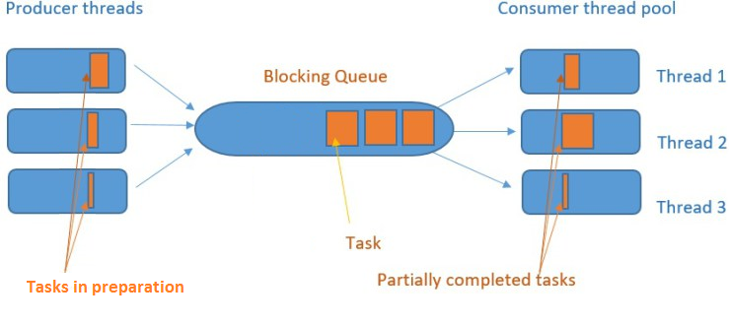
Thread Pools – Working
source: http://www.geek-programmer.com/java-blocking-queues-explained/

Slide 33
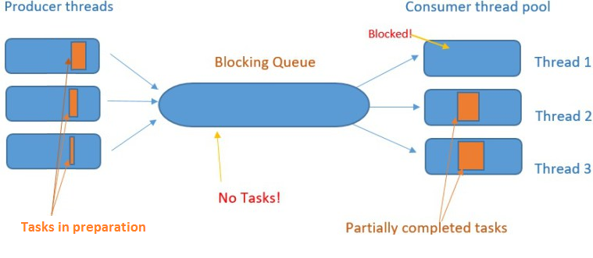
Thread Pools – Waiting for Tasks
source: http://www.geek-programmer.com/java-blocking-queues-explained/

Slide 34
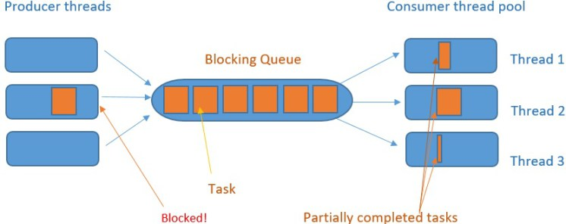
Thread Pools – Waiting for Queue
source: http://www.geek-programmer.com/java-blocking-queues-explained/

Slide 35
Additional Stuff
Other relevant concurrent stuff:
Concurrent Collections: ConcurrentHashMap, CopyOnWriteArrayList, … https://docs.oracle.com/javase/tutorial/essential/concurrency/collections.html
Futures http://www.baeldung.com/java-future https://dzone.com/articles/javautilconcurrentfuture
ForkJoin https://docs.oracle.com/javase/tutorial/essential/concurrency/forkjoin.html

Slide 36
Agenda
Threads Overview
Creating threads in Java
Synchronization
Atomic Variables
wait() and notify()
Thread Pools
Exercise

Slide 37
Exercise – X threads with a single Map
There are X text files we want to index into a Map, so we will know for each word found in any of the files where it was found (which files, which exact positions)
Name of the files to index are given in the command line. Use number of threads = number of files (not optimal, but only for this exercise).
Implement the indexing.
Implement a main that checks that the indexing works as expected.

Slide 38
Exercise – synchronize vs. atomic
Implement a Counter class with increment() and decrement() methods
Try it without synchronization and make it get wrong values (i.e. get wrong number because of race condition between threads)
Add synchronization and check that the bug was fixed
Replace the synchronization with using atomic variable
Compare the times* – which is more efficient?
* Do some research on how to benchmark java code

Slide 39
Exercise – wait-notify
Implement a BlockingStack with a predefined capacity.
The BlockingStack will have the following methods:
push – should block in case BlockingStack is full
pop – should block in case BlockingStack is empty
tryPush – shouldn’t block
tryPop – shouldn’t block
tryPush(timeout) – shouldn’t block
tryPop(timeout) – shouldn’t block
Implement Unit Tests for your class! (Preferably – TDD)

Slide 40
Exercise – Thread Pools 1
Implement a multithreaded application performing X sessions of the PrintNumbers.printNumbers task, (presented at the beginning of this lesson) – with a Thread Pool of Y threads
X and Y should be retrieved from the command-line

Slide 41
Exercise – X threads with a single Map (again)
There are X text files we want to index into a Map, so we will know for each word found in any of the files where it was found (which files, which exact positions)
Name of the files to index are given in the command line. Number of threads to use is given in the command line with the first parameter: -threads <num_threads>
(If requested num_threads > num files, use fewer threads…)
Implement the indexing.
Implement a main that checks that the indexing works as expected.

Slide 42
That concludes this chapter

