Slide 1

AT&T BIQ Project 2018
Java Networking
© All rights reserved. Materials are for the sole use of the AT&T BIQ Project 2018. Any other use is forbidden

Slide 2


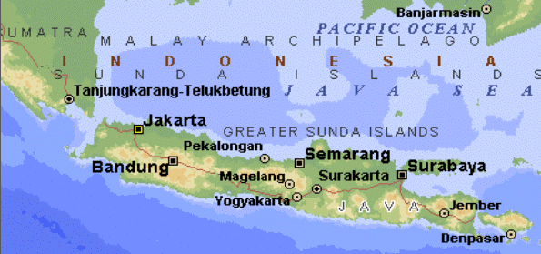
Java Networking
Written by Amir Kirsh

Slide 3
Lesson’s Objectives
By the end of this lesson you will:
Be able to implement a client-server network application in Java
Be familiar with the sockets API of Java

Slide 4
Agenda
Downloading a web page
TCP Client
TCP Server
java.nio – selectors and channels
What’s beyond
Exercise

Slide 5
Downloading a web page
public static void main (String args[]) {
String line; try { URL u = new URL(args[0]); DataInputStream htmlPage = new DataInputStream(u.openStream()); while ((line = htmlPage.readLine()) != null) { System.out.println(line); } } catch (Exception e) { System.err.println(e); // naive treatment }
}

Slide 6
Dealing with URL encoding
public static void main (String args[]) {
String line; try { URL u = new URL( URLEncoder.encode( args[0], Charset.forName("UTF-8") ) ); DataInputStream htmlPage = new DataInputStream(u.openStream()); while ((line = htmlPage.readLine()) != null) { System.out.println(line); } } catch (Exception e) { System.err.println(e); // naive treatment }
}

Slide 7
Agenda
Downloading a web page
TCP Client
TCP Server
java.nio – selectors and channels
What’s beyond
Exercise

Slide 8
Simple TCP Echo Client
public static void main(String[] args) {
Socket socket; DataInputStream inputStream; DataInputStream userInput; PrintStream outputStream; String line = ""; try { socket = new Socket("localhost", 7000); inputStream = new DataInputStream( socket.getInputStream()); // not really used here outputStream = new PrintStream( socket.getOutputStream()); userInput = new DataInputStream(System.in); while(!line.equals("!")) { line = userInput.readLine(); outputStream.println(line); System.out.println(theInputStream.readLine()); } } …

Slide 9
Simple TCP Echo Client – cont’
public static void main(String[] args) {
try { … } catch (Exception e) { System.err.println(e); } finally { try { socket.close(); } catch (IOException e) { // log and ignore } }
}

Slide 10
Agenda
Downloading a web page
TCP Client
TCP Server
java.nio – selectors and channels
What’s beyond
Exercise

Slide 11
Simple TCP Echo Server
public static void main(String[] args) {
Socket socket; ServerSocket server = new ServerSocket(7000); DataInputStream inputStream; PrintStream outputStream; String line = ""; try { socket = server.accept(); // blocking inputStream = new DataInputStream( socket.getInputStream()); outputStream = new PrintStream( socket.getOutputStream()); while(!line.equals("!")) { line = inputStream.readLine(); outputStream.println(line); System.out.println(line); } } …

Slide 12
Simple TCP Echo Server – cont’
public static void main(String[] args) {
try { … } catch (Exception e) { System.err.println(e); } finally { try { socket.close(); } catch (IOException e) { // log and ignore } }
}

Slide 13
Agenda
Downloading a web page
TCP Client
TCP Server
java.nio – selectors and channels
What’s beyond
Exercise

Slide 14
java.nio.channels
Avoid the “Thread per Session” pitfall
Single thread listens for all client sockets and dispatches the requests.
Based on OS “Select” mechanism – multiplexing https://notes.shichao.io/unp/ch6/

Slide 15
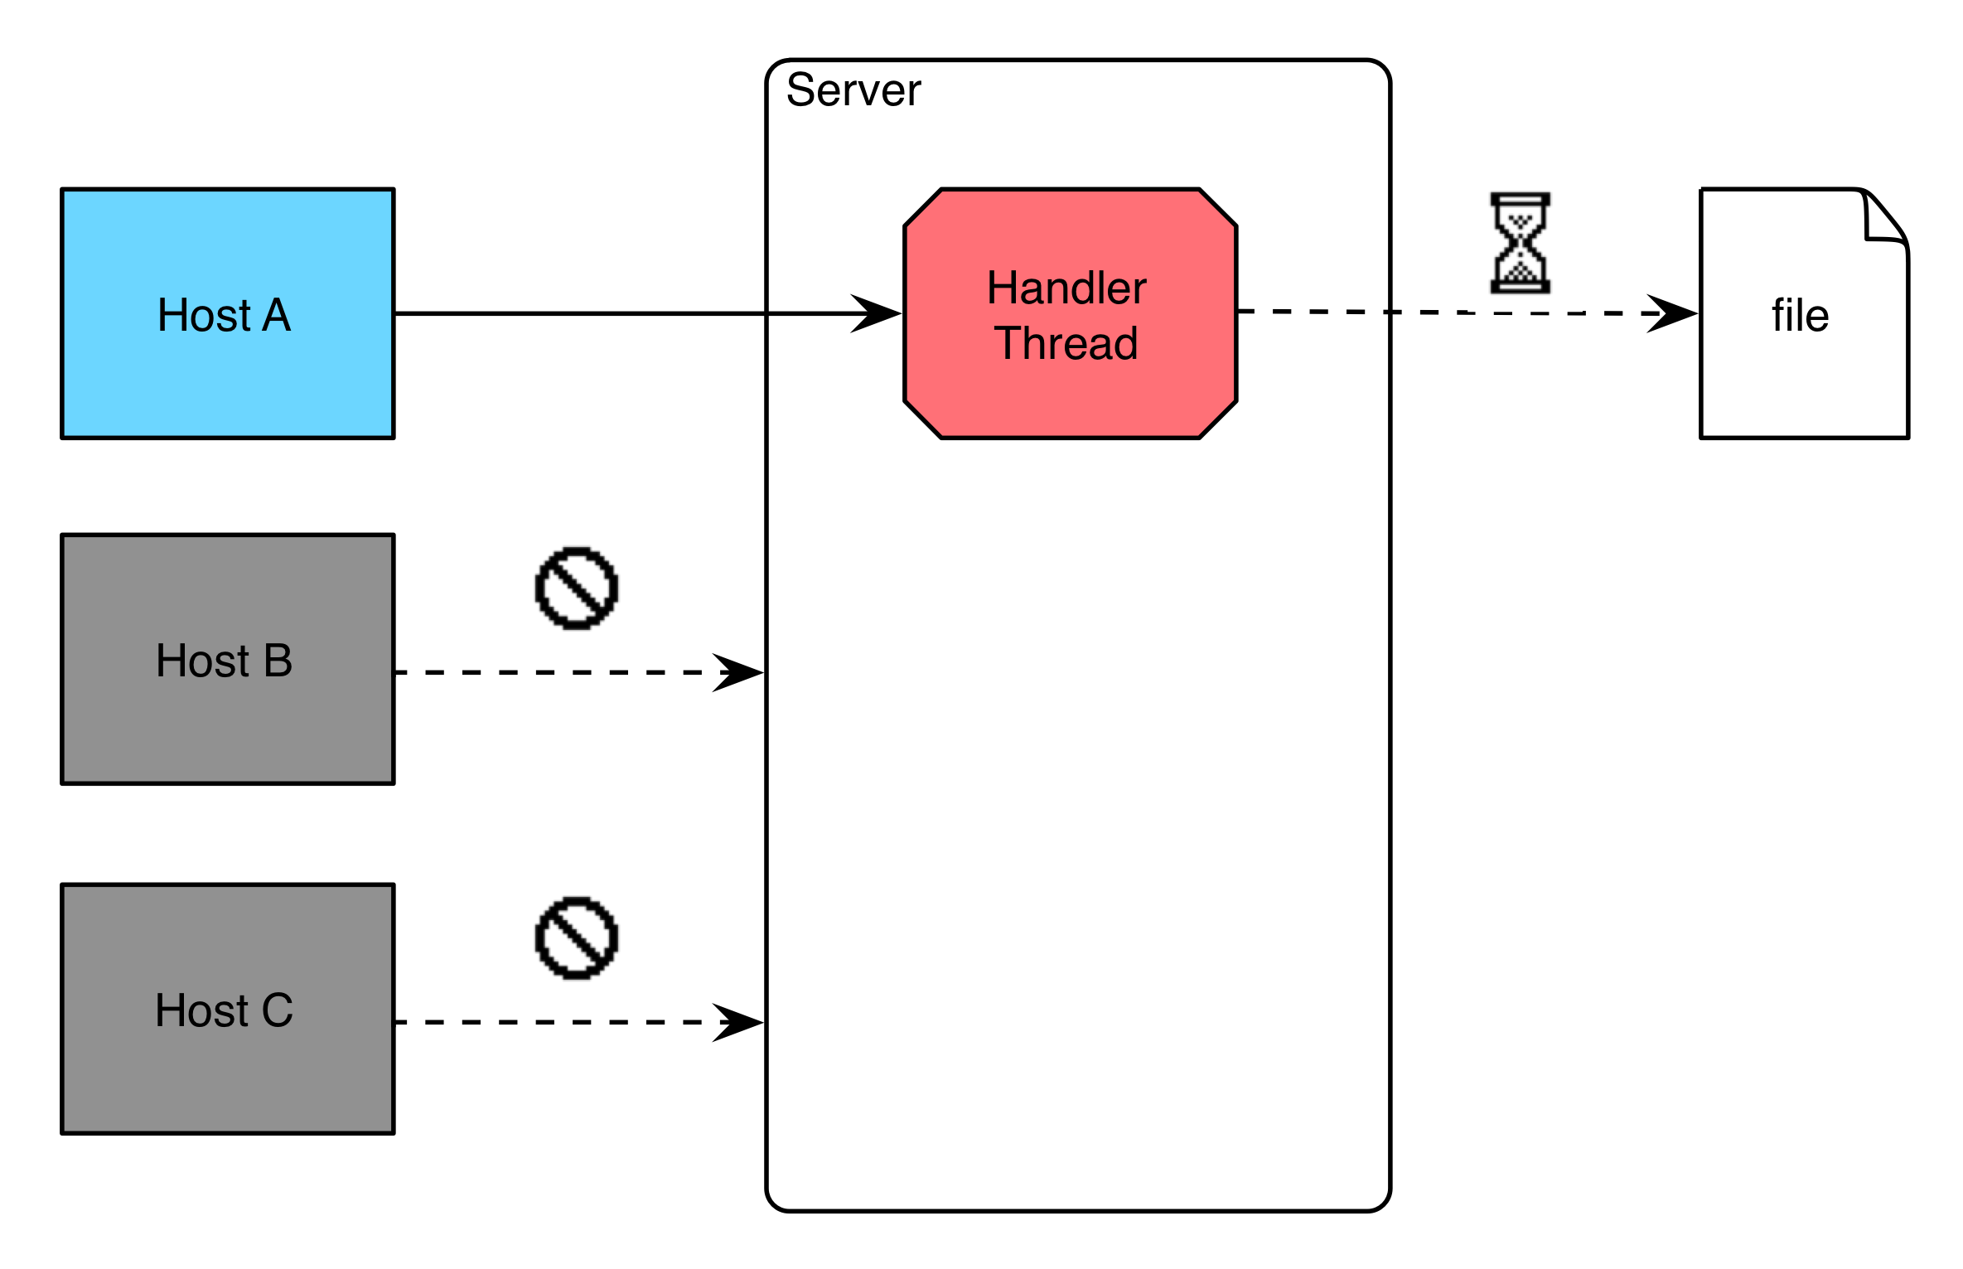
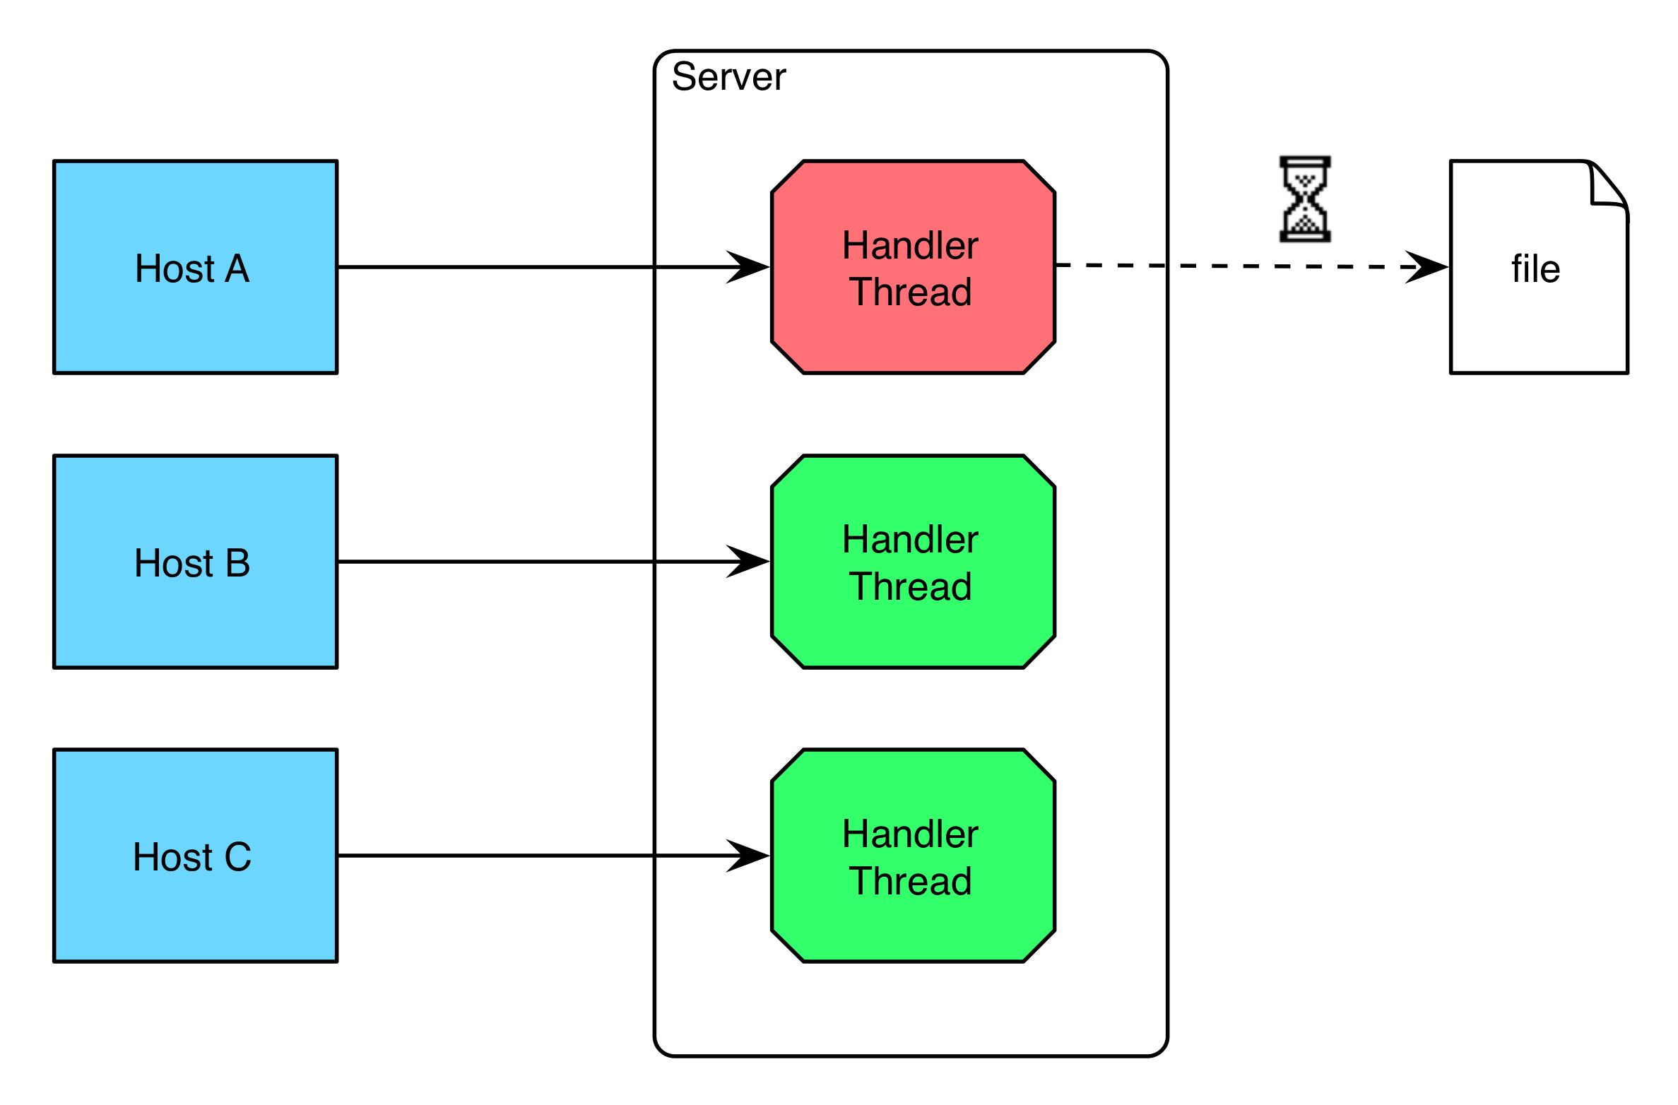
Before java.nio.channels – the “old” way
Source: http://ayedo.github.io/netty/2013/06/19/what-is-netty.html
Option A – single thread
Option B – thread per session

Slide 16
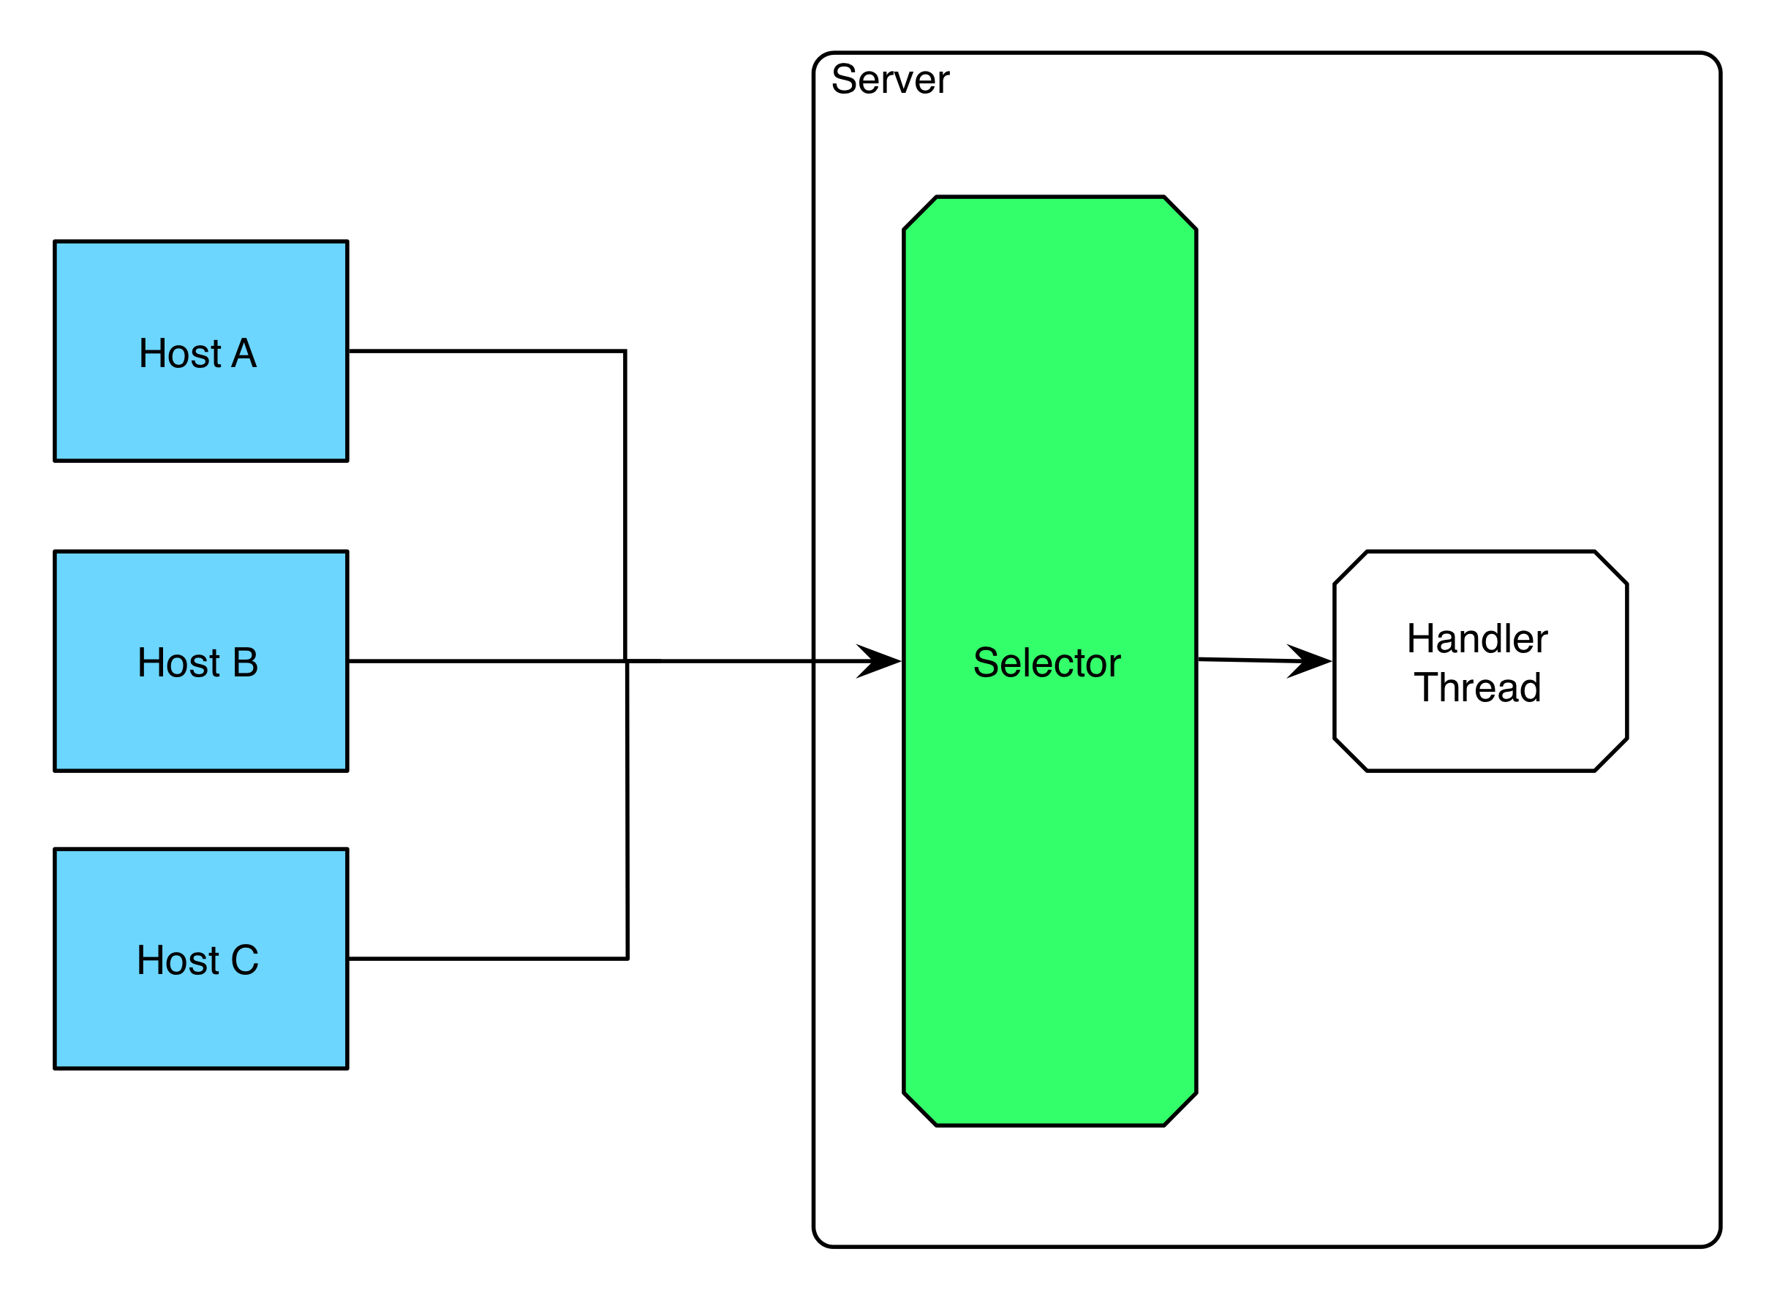
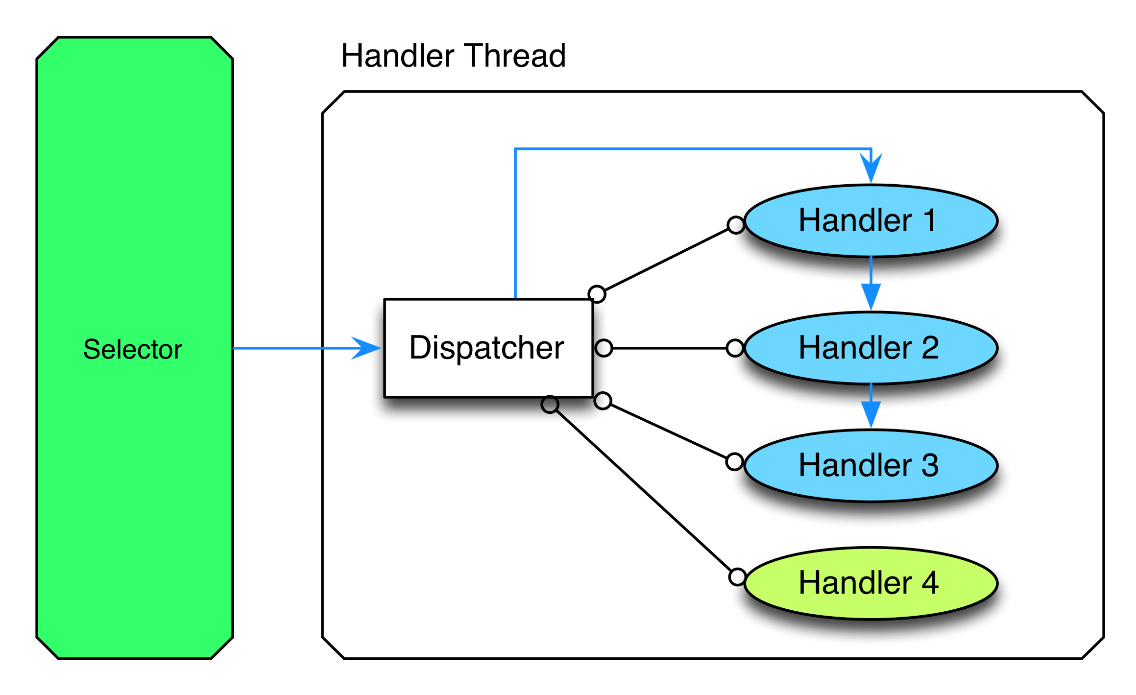
Before java.nio.channels – the “old” way
Source: http://ayedo.github.io/netty/2013/06/19/what-is-netty.html
Option C – single thread with Selector
Option D – Selector + Handlers (e.g. Thread Pool)

Slide 17
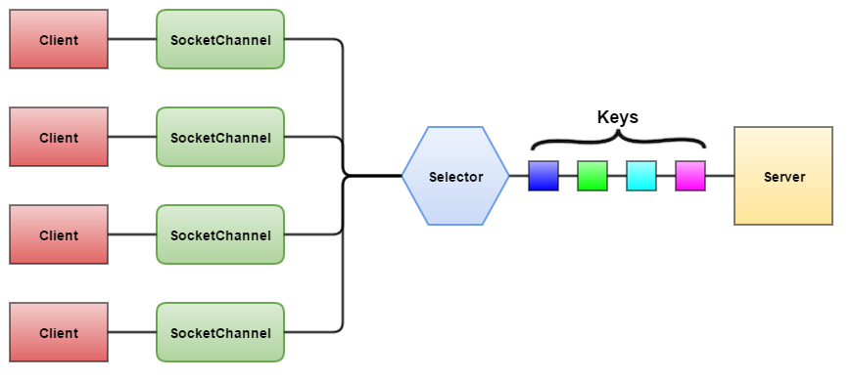
java.nio.channels
Source: https://avaldes.com/java-nio-selectors-using-nio-client-server-example/

Slide 18
java.nio.channels – Example
// https://docs.oracle.com/javase/9/docs/api/java/nio/channels/Selector.html
Selector selector = Selector.open();
ServerSocketChannel mySocket = ServerSocketChannel.open();
ServerSocket serverSocket = mySocket.socket();
InetSocketAddress address = new InetSocketAddress(hostIP, port);
serverSocket.bind(address);
mySocket.configureBlocking(false);
int ops = mySocket.validOps();
mySocket.register(selector, ops, null);

Slide 19
java.nio.channels – Example - cont’
int readyChannels = selector.select();
logger.info("Keys with ready channels....: " + readyChannels);
Set<SelectionKey> selectedKeys = selector.selectedKeys();
Iterator<SelectionKey> i= selectedKeys.iterator();
while(i.hasNext()) {
SelectionKey key = i.next();
if (key.isAcceptable()) {
processAcceptable(key); // connection accepted
} else if (key.isConnectable()) {
processConnectable(key); // connection established
} else if (key.isReadable()) {
processReadable(key); // ready for reading
} else if (key.isWritable()) {
processWritable(key); // ready for writing
}
}
// See: https://avaldes.com/java-nio-selectors-using-nio-client-server-example/

Slide 20
java.nio.channels - netty
http://netty.io/
Java Framework for embedded client-server / client / server
Open Source (Apache License)
Using java.nio.channels
Supporting many protocols and needs

Slide 21
Agenda
Downloading a web page
TCP Client
TCP Server
java.nio – selectors and channels
What’s beyond
Exercise

Slide 22
What’s beyond
UDP
java.net.DatagramSocket
Multicast
java.net.MulticastSocket
Servlets (and JSP)
Web Services
RMI; EJB

Slide 23
Agenda
Downloading a web page
TCP Client
TCP Server
java.nio – selectors and channels
What’s beyond
Exercise

Slide 24
Exercise
Write a simple chat server and chat client.
The chat client will get input from the keyboard and send it, at EOL, to the chat server. Messages from the server will be printed to the client’s Console.
The chat server will distribute all messages to all the clients, with the id of the sending client.
Use threads appropriately in the server!

Slide 25
That concludes this chapter

