Slide 1

AT&T BIQ Project 2018
Design and UML
© All rights reserved. Materials are for the sole use of the AT&T BIQ Project 2018. Any other use is forbidden

Slide 2
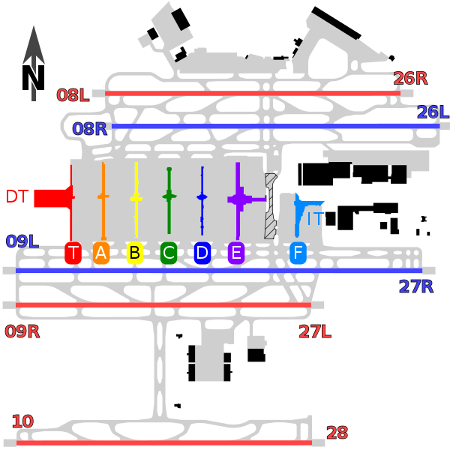
Software Design and UML
* That’s not UML
** That’s not Software Design
Written by Amir Kirsh

Slide 3
Lesson’s Objectives
By the end of this lesson you will:
Understand the process of Software Design
Be able to create UML Class Diagram and Sequence Diagram

Slide 4
What comes before Software Design?

Slide 5
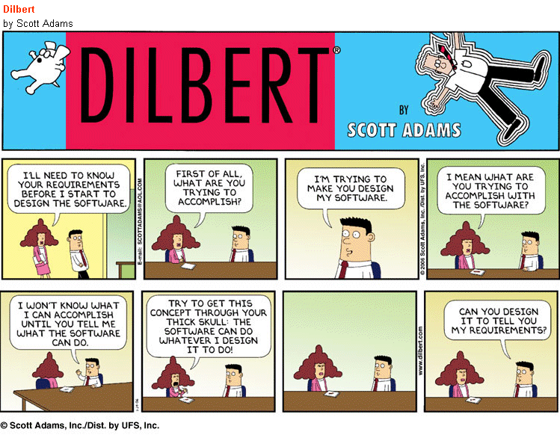
What comes before Software Design?

Slide 6
What comes before Software Design?
Requirements
Usage
Scale and Performance Requirements
Input / Output definitions
Deployment requirements
Architecture
Topology
Software Modules – Teams
Scope of each Module - Team
Communication between modules (API calls, IPC - TCP/IP, Message BUS, …)
Storage, Database
Deployment Architecture

Slide 7
Software Module
Separation of Concerns
A well define purpose / tasks
Can be implemented on its own
Can be compiled and built on its own (may require interfaces or headers of other components)
Can be tested on its own (may require stubs for other modules)
Doesn’t require the internal knowledge of other modules

Slide 8
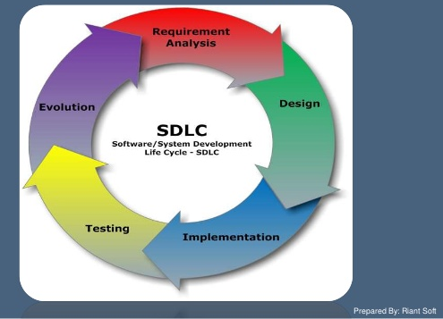
The Software Development Lifecycle
* We are not going to dive into Design Models:
Water Fall
V-Model
Spiral
Agile
…

Slide 9
Why do we do Design?
– Ask the right questions ahead – Be able to separate work between teams and team members – Be able to get feedback before writing code
Problem Domain: did we get the requirements right?
Solution Domain: is the solution approach reasonable?
– Be able to start design your tests (comp + system)
Implementing before having a stable design would require extra work in refactoring both implementation and testing

Slide 10
Design Steps
Product Requirements
Data
Configuration
Functional Requirements
Threading Model
UI
Modules
APIs and Communication
Testing

Slide 11
Design Parts
Structural Design
Modules
Inside Modules
Flow Design / Behavior Design
Between Modules
Inside Modules

Slide 12
Design Considerations
Modularity
Compatibility
Extensibility
Robustness / Fault Tolerance
Performance
Redundancy
Forward Compatibility
Error Handling
Traceability / Testability
Maintainability
Reliability
Security
Usability
Edge Cases
Portability
Scalability
Reusability
Forward Compatibility

Slide 13
Design Tips
– Consider Alternatives and Tradeoffs (where relevant)
– Keep documented tracking from the requirements to the design (so if requirements change you know what may need to change in the design)
– Avoid reinventing the wheel / NIH syndrome
– The design should be future ready for reasonable future changes and new requirements
– Design is not coding – keep abstraction (don’t impose unnecessary implementation)
– When design get into details – explain why (efficiency, fault tolerance)
– The design should convey the control hierarchy / control flow roles and responsibilities of each element (Module, Class) should be clear

Slide 14
Design Documents
SDD
Software Design Description
Defined formally in IEEE1016-1 standard
Other Related Documents
SysRS – System Requirements
SRS – Software Requirements
HLD – High Level Design
SID – Software Item Design

Slide 15
Exercise – Simulation for Factory Floor
Find SDD or SID or HLD template.
Present the design of a simulation for factory floor in a formal design document

Slide 16
Exercise – Puzzle Solver
Find SDD or SID or HLD template.
Present the design of a Puzzle Solver in a formal design document

Slide 17

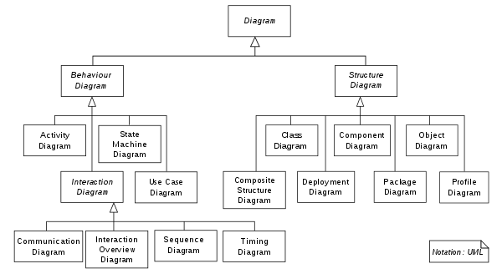
UML

Slide 18
UML
Unified Modeling Language
Mid 1990’s by Grady Booch et al. in Rational (later acquired by IBM)
Standardize the notional approach for Software Design
UML 1.0 => UML 2
Structural Diagrams
Class diagram
Component diagram
Composite structure diagram
Deployment diagram
Object diagram
Package diagram
Profile diagram
Behavioral Diagrams
Activity diagram
Communication diagram
Interaction overview diagram
Sequence diagram
State diagram
Timing diagram
Use case diagram

Slide 19
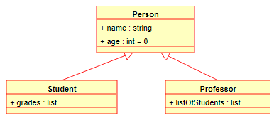
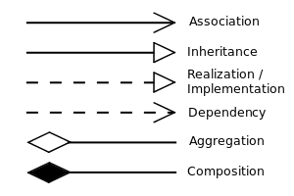
UML – Class Diagram 1

Slide 20
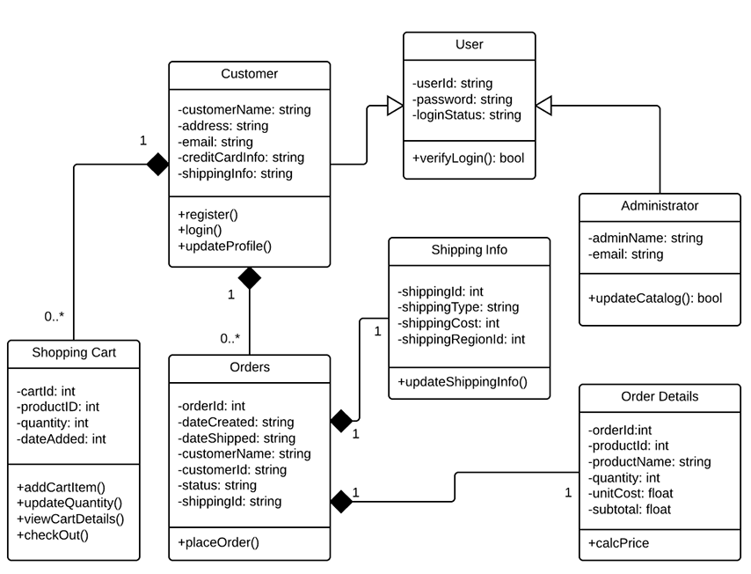
UML – Class Diagram 2

Slide 21
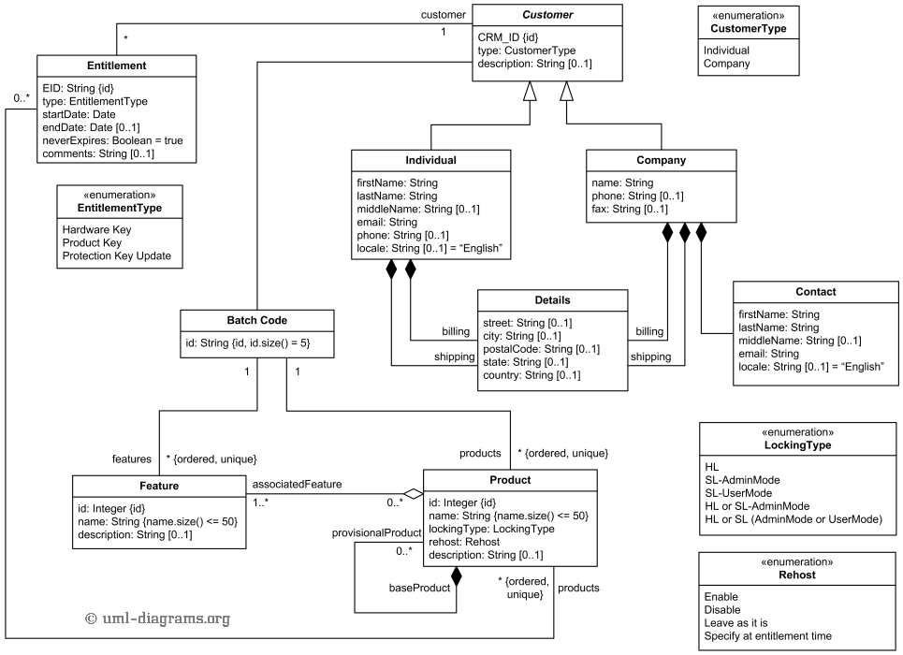
UML – Class Diagram 3

Slide 22
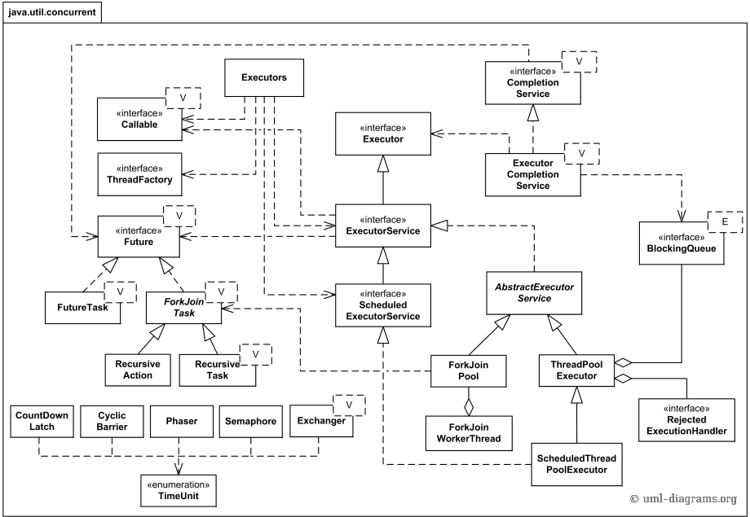
UML – Class Diagram 4

Slide 23

Class Diagram – Composition vs. Aggregation
The difference is actually not really important…
My advice: don’t use association arrow it’s confusing! Aggregation / Composition is the relevant connection in most cases.
See also: https://stackoverflow.com/questions/21967841/aggregation-vs-composition-vs-association-vs-direct-association

Slide 24
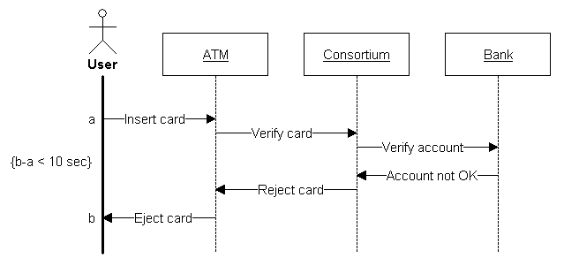
UML – Sequence Diagram 1

Slide 25
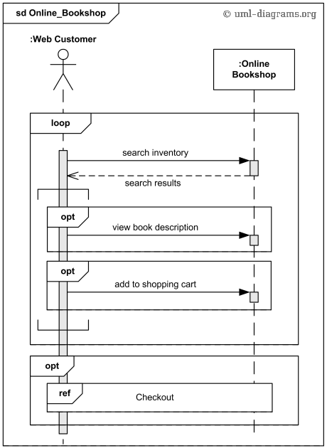
UML – Sequence Diagram 2

Slide 26
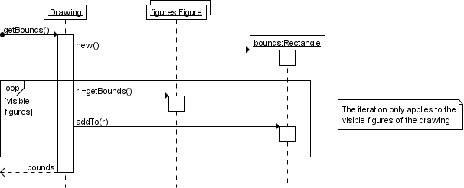
UML – Sequence Diagram - Loops

Slide 27
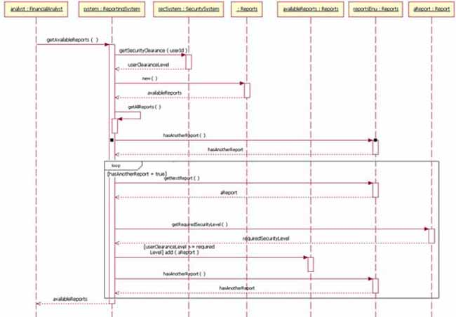
UML – Sequence Diagram 3
Self Call
Loop

Slide 28
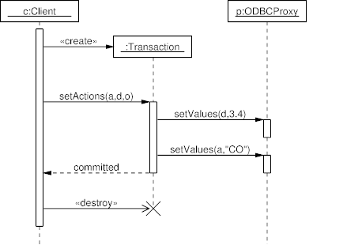
UML – Sequence Diagram – Object Creation
Object Created
Object Destroyed

Slide 29
UML – Sequence Diagram - Concurrency
Not very common
Asynchronous Messages / Calls
Parallel Operations
Race Conditions
Also Relevant: Timing Diagram

Slide 30
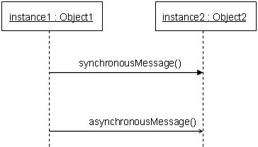
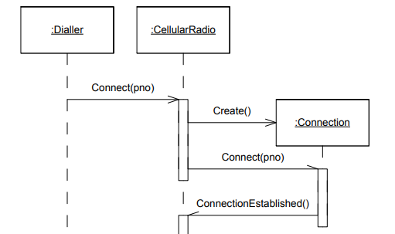
UML – Sequence Diagram - Asynchronous
Notation 1:
Notation 2 - better:
smaller arrow head
half arrow head
See: http://www.cs.umd.edu/~mvz/cmsc435-s09/pdf/cell-phone-sequence-chart.pdf

Slide 31
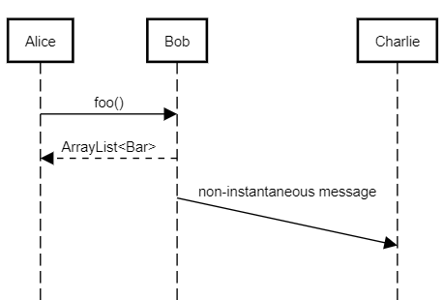
UML – Sequence Diagram – Delayed Message

Slide 32
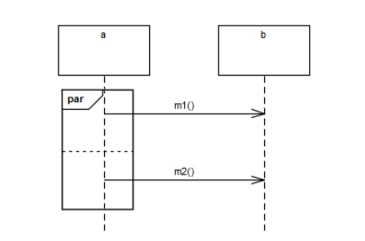
UML – Sequence Diagram – Parallel
See: https://www.omg.org/ocup-2/documents/concurrency_in_uml_version_2.6.pdf

Slide 33
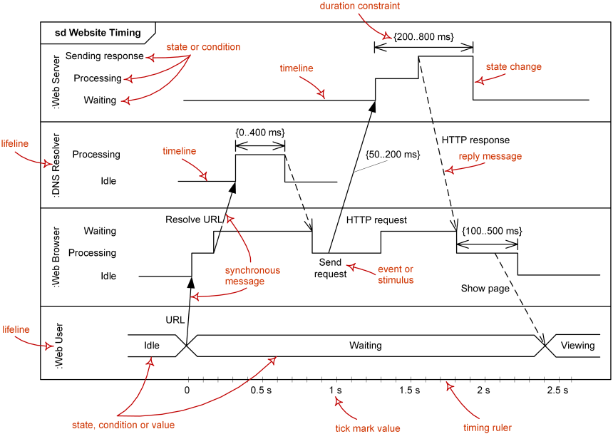
UML – Timing Diagram

Slide 34
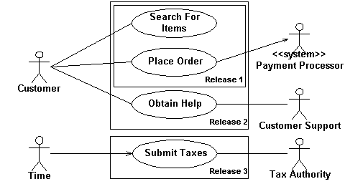
UML – Use Case Diagram

Slide 35
UML – Online Diagram Tools
https://www.lucidchart.com/pages/examples/uml_diagram_tool
https://www.draw.io/
https://www.gliffy.com/examples/uml-diagrams
https://sequencediagram.org/
https://www.websequencediagrams.com/
https://yuml.me/

Slide 36
Exercise – NumCollection
Draw Class Diagram and Sequence Diagram for the NumCollection exercise (with 3 different Strategies)

Slide 37
Exercise – Puzzle
Draw Class Diagram and Sequence Diagram for your Puzzle Project:
(a) Start with Part 1
(b) Add the relevant changes related to Part 2

Slide 38
That concludes this chapter

