Slide 1

AT&T BIQ Project 2018
Design Patterns and Idioms
© All rights reserved. Materials are for the sole use of the AT&T BIQ Project 2018. Any other use is forbidden

Slide 2
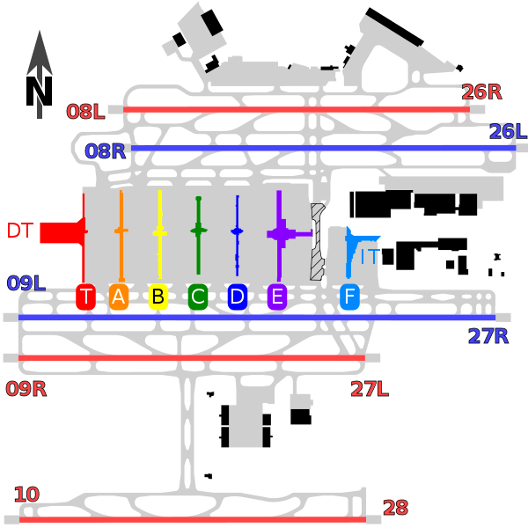
Design Patterns and Idioms
* That’s not UML
** That’s not Software Design
Written by Amir Kirsh

Slide 3
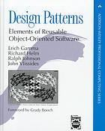
Design Patterns
General structure for solving a generic software need / problem
Mostly unspecific to a certain Programming Language
Relatively “big”
The Gang of Four (GoF): Erich Gamma, Richard Helm, Ralph Johnson, John Vlissides

Slide 4
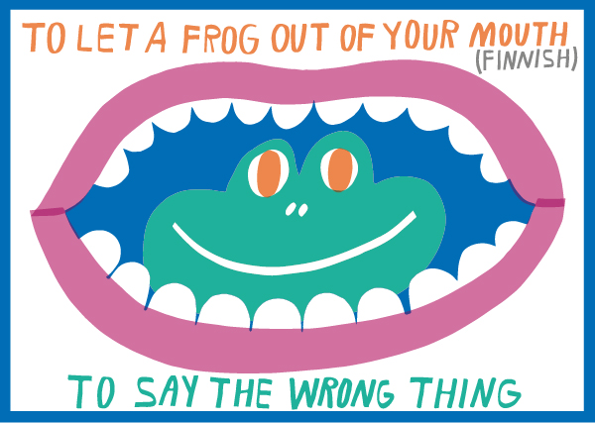
Idioms
source:
http://www.hotelclub.com/blog /idioms-of-the-world-infographic/

Slide 5
Programming Idioms
Best practices, advice, way of doing things
In many cases, specific to Programming Language
Relatively “small”
“Since large programs grow from small ones, it is crucial that we develop an arsenal of standard program structures of whose correctness we have become sure -- we call them idioms -- and learn to combine them into larger structures using organizational techniques of proven value.
A programmer should acquire good algorithms and idioms.”
Alan J. Perlis in foreword to “Structure and Interpretation of Computer Programs”
(Term “Idiom” was also influenced by Jim Coplien author of “Advanced C++ Programming Styles and Idioms”).

Slide 6
Java Idioms
Books: https://www.amazon.com/Java-Practice-Design-Styles-Effective/dp/0201360659
https://www.amazon.com/Java-Style-Idioms-Integrating-Object-Oriented/dp/0470844132
Check this: http://pl.cs.jhu.edu/oose/lectures/java-idioms.shtml
More “low level”: https://www.nayuki.io/page/good-java-idioms
For Java 8: https://www.ibm.com/developerworks/library/j-java8idioms4/index.html
All sort of: http://wiki.c2.com/?JavaIdioms

Slide 7
Design Patterns Types
Creational patterns dealing with creation of objects
Structural " relationships and structures
Behavioral " objects behavior and communication
Concurrency " system concurrent behavior

Slide 8
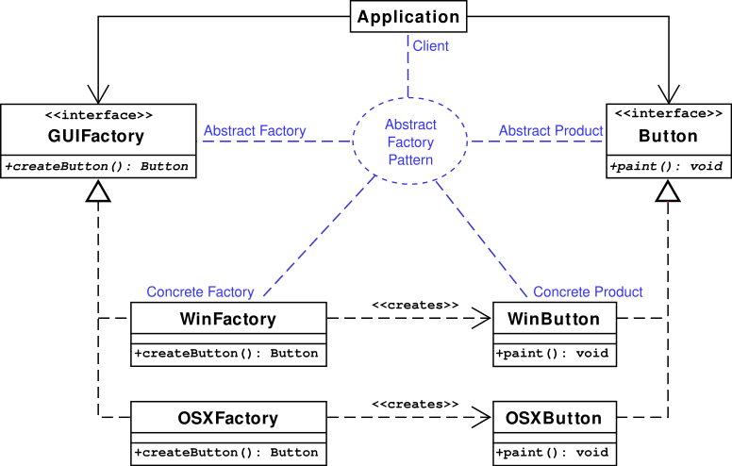
Creational Patterns
Abstract Factory
Base class for concrete factory implementation.
Advantages
Allow specific more efficient implementation.
Decision (creation of the concrete factory) is made once and “cached”.
https://en.wikipedia.org/wiki/Abstract_factory_pattern#Class_Diagram

Slide 9
Program for Interface
GoF item 20:
Program to an 'interface', not an 'implementation'.
Advantage:
Easier refactoring (e.g. changing internal data structure from list to vector without affecting public API and external users).
⇒ Relevant for most creational patterns.

Slide 10
Creational Patterns
Factory Method
Method for hiding the concrete type to be created.
Advantages
Allow specific more efficient implementation.
Allow simple refactoring for performance (or other needs).
Very simple implementation.
class MazeGame { public:
MazeGame() { Room room1 = makeRoom(); Room room2 = makeRoom(); room1.connect(room2); addRoom(room1); addRoom(room2); } protected:
Room makeRoom() { return new OrdinaryRoom(); } }
https://en.wikipedia.org/wiki/Factory_method_pattern

Slide 11
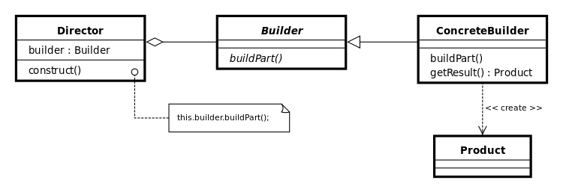
Creational Patterns
Builder / Provider
Method for hiding the concrete type to be created.
Advantages
Allow specific more efficient implementation.
Allow simple refactoring for performance (or other needs).
Can be singleton or pooled.
https://en.wikipedia.org/wiki/Builder_pattern

Slide 12

Creational Patterns
Singleton
Providing one instance of a resource.
Advantages
Allow lazy initialization.
Saving memory and resource creation.
In some cases it’s advisable to hide being a Singleton, using a generic Provider.
https://en.wikipedia.org/wiki/Singleton_pattern

Slide 13
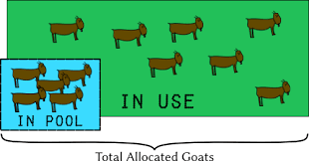
Creational Patterns
Object Pool
Keep a pool of resources / objects ready to be used.
Advantages
Performance: reuse, save object creation.
https://en.wikipedia.org/wiki/Object_pool_pattern

Slide 14
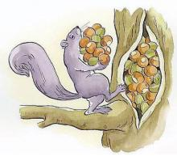
Creational Patterns
Cache
Store objects for future use, objects shall be retrieved seamlessly either from if in the Cache or if shall be created.
Can be managed to store the relevant objects (e.g. LRU).
Advantages
Performance: saves the creation and initialization of the cached objects.
Image Source: https://www.drupal.org/project/session_cache
https://en.wikipedia.org/wiki/Cache_(computing)

Slide 15
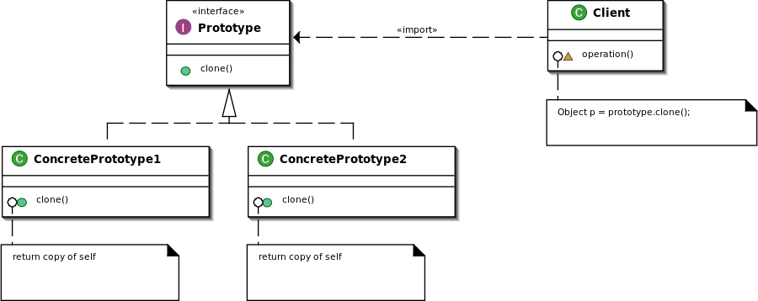
Creational Patterns
Prototype Pattern
Create new objects by cloning a prototypical instance.
Advantages
Relevant for performance mainly when the created new objects can use reference to shared resources in the prototypical instance (i.e. coupled with the Flyweight Pattern).
https://en.wikipedia.org/wiki/Prototype_pattern

Slide 16
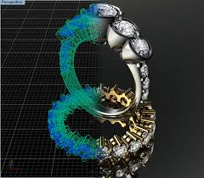
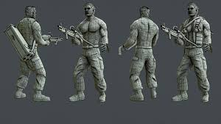
Creational Patterns
Lazy Initialization
Complete object initialization only when required.
Advantages
Delay costly operations.
In some cases the costly operation wouldn’t be required at all.
In some cases the costly operation can be combined with another or scheduled to optimized time window.
https://en.wikipedia.org/wiki/Lazy_initialization

Slide 17
Creational Patterns - Summary
Separating the actual creation details from the creation request
Programming for Interface rather than Implementation
Easier management of resources
DB ConnectionPools
UI Handlers
Threads
etc.

Slide 18
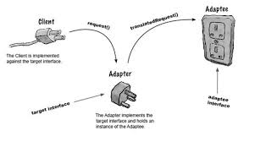
Structural Patterns
Adapter Pattern
Adapts (by wrapping, or otherwise) an Object to work with some functionality expecting an interface not supported by the original Object.
Advantages
May be cheaper than providing the Object this ability to begin with (i.e. Lazy Initialization).
May be easier than building “a whole new Object” for this purpose.
https://en.wikipedia.org/wiki/Adapter_pattern

Slide 19
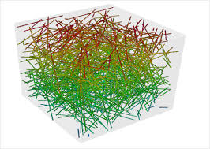
Structural Patterns
Composite Pattern
The idea of working with a single object or composition of objects the same way, e.g. performing an operation on a single node in a tree, on a sub-tree or on the entire tree.
Advantages
Easier coding and maintenance.
https://en.wikipedia.org/wiki/Composite_pattern

Slide 20
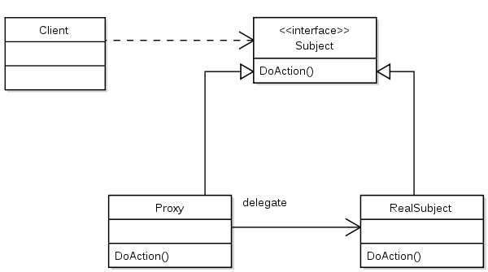
Structural Patterns
Proxy Pattern
A class functioning as an interface to something else.
Advantages
Hide complexities
Proxy can cache relevant resources
Proxy can manage load balancing
Proxy can manage throttling etc.
https://en.wikipedia.org/wiki/Proxy_pattern

Slide 21
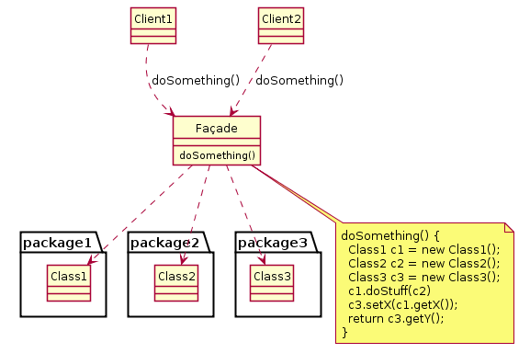
Structural Patterns
Facade Pattern
Provide a simplified interface to a larger body of code, for ease of use, ease of testing, reduced coupling and dependencies and wrap-improve poor APIs.
Advantages
Encapsulating relevant API into a single entry.
Buffer from changes in the underlying actual implementations.
https://en.wikipedia.org/wiki/Facade_pattern

Slide 22
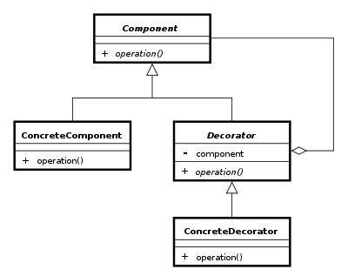
Structural Patterns
Decorator Pattern
Adds an ability to an Object. In some cases comes as a substitute to Multiple Inheritance.
Advantages
May be cheaper than providing the Object this ability to begin with (i.e. Lazy Initialization).
May be easier than building “a whole new Object” for this purpose.
https://en.wikipedia.org/wiki/Decorator_pattern

Slide 23
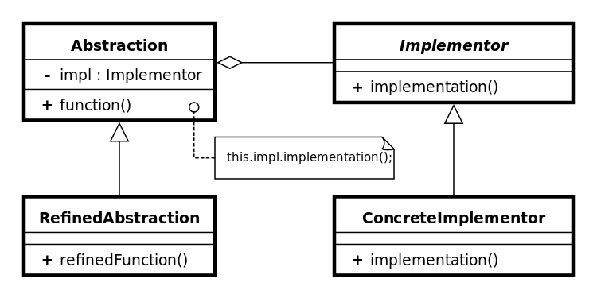
Structural Patterns
Bridge Pattern
Decouple abstraction from implementation so the two can vary independently (may be used as a tool for Dependency Injection).
Advantages
Allow specific implementations in the inheritance hierarchy.
Allow easier refactoring.
https://en.wikipedia.org/wiki/Bridge_pattern

Slide 24
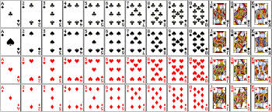
Structural Patterns
Flyweight Pattern
Minimizes memory use by sharing as much data as possible with other similar objects.
Advantages
Reduced footprint.
https://en.wikipedia.org/wiki/Flyweight_pattern
Java Code example (Enum for Suit and Rank, Deck of Cards): http://docs.oracle.com/javase/7/docs/technotes/guides/language/enums.html

Slide 25
Structural Patterns - Summary
Providing Structural design for classes, class groups and hierarchies beyond their usual use case.
Seeing and implementing the relationships required between classes, while still hiding it from the classes themselves (keeping separation of concerns).
Reducing the overhead and responsibility from classes
Do your “day job”, stop worrying about the rest.
When there will be a need to connect you, make you work with something, work better or in a different way for a specific usage, this can be done externally.

Slide 26
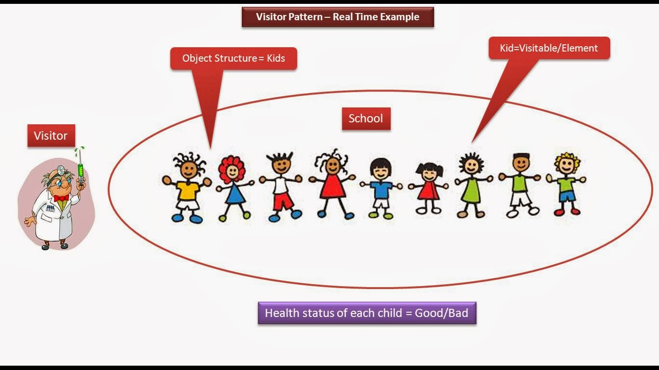
Behavioral Patterns
Visitor Pattern
Separate algorithm from Object Structure.
Advantages
May focus on optimizing the algorithm for the generic case.
Note: in some cases a specific algorithm which is more aware of the visited items may be more optimized.
Image source: http://ramj2ee.blogspot.co.il/2014/01/visitor-design-pattern-real-time.html
https://en.wikipedia.org/wiki/Visitor_pattern

Slide 27
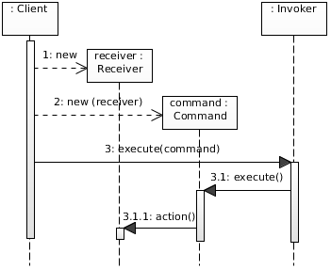
Behavioral Patterns
Command Pattern
Encapsulate the information needed to perform an action.
Classical for implementing Undo/Redo stack.
Advantages
Encapsulates the action, easier to code and maintain.
Image source: https://javaobsession.wordpress.com/2010/07/25/command-pattern/
https://en.wikipedia.org/wiki/Command_pattern

Slide 28
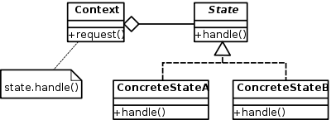
Behavioral Patterns
State Pattern
Encapsulate varying behavior based on object’s state.
Allowing combination of behaviors per characteristic, with specific State hierarchy per each.
Decoupling state from Object Structure.
Advantages
Allowing objects to dynamically change state.
Allowing objects to have more than one state.
https://en.wikipedia.org/wiki/State_pattern

Slide 29
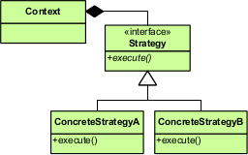
Behavioral Patterns
Strategy Pattern
Select algorithm (strategy) to be used at runtime.
Defines a family of possible algorithms for same problem.
Advantages
Can be used to pick the matching / best algorithm according to defined rules.
https://en.wikipedia.org/wiki/Strategy_pattern

Slide 30
Exercise - Numbers Collection
Implement a class for handling an efficient Numbers Collection, where numbers are entered into the collection on its creation, as a string in the format:
a-b, c, d-e, f
Where b>a, c>b, d>c, e>d, f>e
Class is Immutable.
Class shall support the operation:
bool contains(int num)
Think about memory efficiency and runtime performance as a factor of the size of the Numbers Collection.
✎

Slide 31
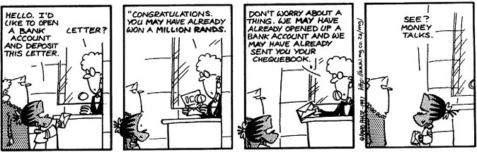
Behavioral Patterns
Chain-of-responsibility Pattern
A processor object can fulfill a job or handle it partially and assist in passing the job to the next relevant processor.
Processor can act as a dispatcher and actually perform the delegation
Processor can return the delegator back to the processing algorithm.
Advantages
Loose coupling ⇒ easier refactoring / extension
Lazy Evaluation -- see comics!
Source: https://www.safaribooksonline.com
https://en.wikipedia.org/wiki/Chain-of-responsibility_pattern

Slide 32
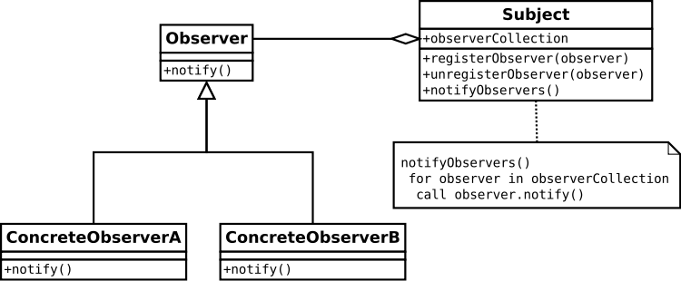
Behavioral Patterns
Observer Pattern
Distributed event system
Advantages
Loose coupling ⇒ easier refactoring /
Notifications can be processed asynchronously.
https://en.wikipedia.org/wiki/Observer_pattern

Slide 33
Behavioral Patterns - Summary
Separating the Behavior from Object’s structure or from the Data.
Behavior and Data shall be separated (separation of concerns).
Behavior can run on different Models.
Different Models can use the same Behavior.
Behavior can vary for the same data, based on different needs or requirements (e.g. optimize for speed / optimize for memory).

Slide 34
Summary
Using Design Patterns (when appropriate) improves code:
Modularity
Easier to refactor
Easier to implement performance improvements
A good resource: https://javaobsession.wordpress.com/design-patterns/

Slide 35
End of chapter - Design Patterns
☀
Questions?

