Slide 1


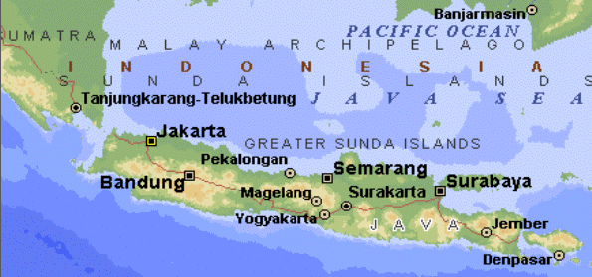
Recursion
Written by Amir Kirsh

Slide 2
Lesson’s Objectives
By the end of this lesson you will:
Be able to use recursion when needed
Know when and how to avoid recursion

Slide 3
Agenda
Recursion
Examples
Turning a Recursion to a Loop
Recursive Data Structures
Exercise

Slide 4
Recursion
We tend to divide in a computer program a Big problem into small problems, then we have “Big functions” that call smaller “helper functions”
What happens if the “smaller problem” has the same function as the “big problem”?
A recursion is an operation that uses “itself” in a more simple scenario (“smaller problem”) to solve the “bigger problem”
A recursion needs a stopping condition: a case in which the solution is not based anymore on the recursive call, allowing the recursion to terminate and fold back
If a recursion doesn’t have a stopping condition it will be an infinite recursion which results with a stack overflow runtime error!

Slide 5
Examples
How many numbers are between 0 and n?
1+ the count of numbers between 1 and n
What is the factorial of n?
n * factorial of (n-1)
What is the item n in Fibonacci series?
n + fibonacci (n-1)
Class exercise:
What is the stopping condition for each of the above?
Implement a Java program for each of the above

Slide 6
Turning a recursion into a loop
A loop should be preferable over a recursion:
Reduces the overhead of function calls
May require less memory or move the stack memory requirement to heap memory
Usually easier to debug
If you can easily turn a recursion to a loop – prefer the loop
Class exercise:
Implement factorial with a loop instead of a recursion
Implement fibonacci with a loop instead of a recursion

Slide 7
Recursive Data Structures
Recursive Data Structures define the data structure based on a “smaller set” of the data structure
A Linked List:
A linked list of N elements is a node that points to a linked list of N-1 elements
A Binary Tree:
A binary tree is a node that holds on the left a binary tree of all smaller elements and on the right a binary tree of all equal or bigger
The recursive definition doesn’t mean that the implementation will be recursive or include recursive methods, but it may.

Slide 8
Binary Tree
Looks like that:
540
120
1080
60
240
640
2023
35
180
620
670
4075

Slide 9
Exercises

Slide 10
Exercise 1
Implement a Binary Tree with the following methods:
add
toString

Slide 11
Exercise 2 – a puzzle
Write a program that reads a text input file with the following content:
First line has 2 numbers (as 2 separated strings)
The first number is the number of rows in the file
The second is the number of cols
After the first line there would be Cols * Rows
Each row contains spaces and hash tags (#)
There would be one S and one E in the file
Task: print to screen the full “puzzle” and the way between S to E that doesn’t go through # (or “no way”)

Slide 12
Exercise 3 – too deep recursion
Write a program that reads a text file in the following (bad) way:
There is a method to read the file and print it to screen, that:
Try to read one char and print it to screen
If read fails (end of file) – return
If we succeeded: call the same method again!
Try to get a stack overflow error for a big file
Try to set a bigger stack

Slide 13
That concludes this chapter

