Slide 1

AT&T BIQ Project 2018
All you need to know about Maven
© All rights reserved. Materials are for the sole use of the AT&T BIQ Project 2018. Any other use is forbidden

Slide 2
Maven
'מייבן' (אידיש)
Aviad Cohen

Slide 3
Agenda
Module 1: Introduction & basics
Module 2: Advance (but not really…)
Module 3: Miscellaneous (TBD)

Slide 4
Agenda
Module 2: advance (but not really…)
Dependencies
basic
resolution process
Classifier
Transitivity
Collision
Exclusion
Scopes
Optional
Properties
Inheritance
basics
super pom
dependency management
aggregation
Module 1: introduction & basics
History & motivation & basic concept (CoC)
File structure
Basics of POM
Gav
Packaging
Repositories
Settings
Lifecycle
Plugins
Versions

Slide 5
Agenda
Module 3: miscellaneous
Profiles
Mvn command line options
-o
-U
Plugins
dependency tree
help (e.g. effective pom)
assembly plugin

Slide 6
Build tool – what ? why ?
When you write a code, you will finally want to execute it
Compile
Where are all the files\resources ?
Dependencies ?
Test
Where are all the files\resources ?
Dependencies ?
Test runner ?
Some code Let’s use it !
Package
Where are all compile product and dependencies ?
What type is the final artifact ?
How to create it ?
How to name it ?
Visibility
How would I make my artifact accessible to others inside my company ? Outside my company ?
Notes:
The process of transforming from written, working source code to valid actionable working final product, compose of several different artifacts is rather complex and includes within a lot of considerations to take into account.
When you compile:
From where to take the source files ?
Where to put the compiled ones ?
Where are all relevant resources\dependencies ?
What version of compiler do we want to use ?
Possible flags and tuning the behavior of the compiler
When we want to test the code:
Where are all the test files lies at ?
Where to compile them ?
What about their resources ?
How should they be executed ? What test runner engine ?
When we want to package the artifact:
Where can we found all the compiled product from previous steps ?
What kind of artifact should we create (jar, war, ear, zip, etc) ?
How should we create that artifact ?
What should we do with it’s relevant dependencies ? (uber jar, flat jar, shade jar)
Installation\deployment – visibility:
How should I enable my artifacts to be used by inside my company ? And outsize of it ?
Should I perform validation on artifacts before uploading to general exposed server
A lot of concerns we need to take our mind at…

Slide 7
Build tool – what ? why ?
From source code to final artifact – not a trivial process at all !
Build Process: A process by which source code is eventually converted into a stand-alone form that can be run on a computer or to the form itself (Technopedia)
Package
Test
Compile
Build Tool
Artifacts:
Binaries to execute\use
Libraries
Rich content
Source code
Resources
Static files
Notes:
Build tool is a mechanism enables to coordinate and execute all relevant parts of the build process.

Slide 8
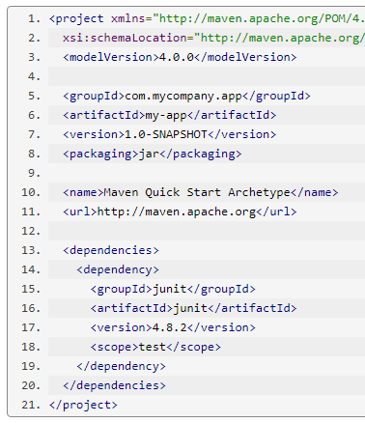
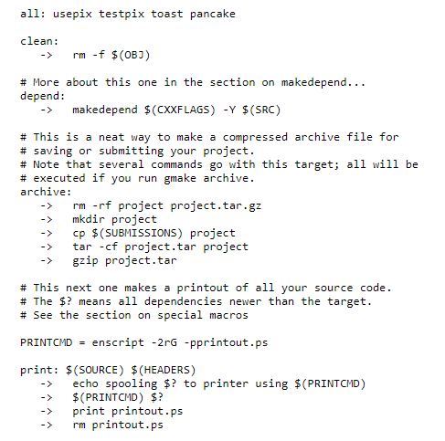
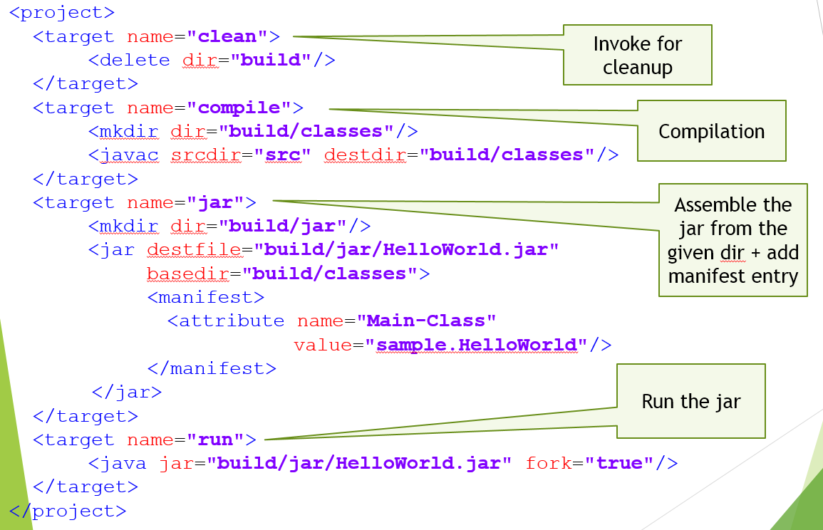
Build tool - history
Make file
Sort of batch file
Manual (=> error prone)
Ant
Script’ish
Imperative
Messy
No dependency management
Apache project - xml based
Maven
Sees the full picture (compil’ish)
Declarative
Dependency management
CoC
Apache project - xml based
Notes:
Make file – used mainly in c++
Experienced as a batch file
Written in regular notepad with no internal structure
Ant
Xml based.
Imperative (you need to explain how you perform stuff)
Very flexible – anything can be changed and needs to be fully defined (where are files located ? Where to send them ? Etc.)
Maven
Prefers convention over configuration – most stuff are known before hand, and you need to code and explicitly express only when you have exceptional flow
Xml based
Declarative (you only need to tell what you want to happen, with no need to tell how you want it to happen
Have vast, easy and sophisticated dependency management mechanism

Slide 9






Build tool - Arsenal

Slide 10

Maven – History
Maven 1 – 2002
Maven 2 – 2005
Maven 3 – 2010
(current version – 3.5.2)
Jason Van Zyl
Notes:
Van Zyl created maven mainly to cope with the messy build scripts that dominated the build world early millennium in the form of ant
Maven 2 and 1 are not backward compatible.
Maven 3 and 2 are backward compatible
Current version is 3.5.2 (02/18). Requires minimum JDK 1.7
Maven is maintained as apache project

Slide 11
Maven – Installation
Jason Van Zyl
Installation
Simple zip file.. Just unzip it..
(no installation needed)
Single executable (called mvn)
Environment variables
%M2_HOME% -> mvn folder
Add to %path%: %M2_HOME%\bin
Download from here
Notes:
Simple zip file. No installation needed (no next, next, next…)
Environment variables used by maven.
Maven command line tool (mvn) lies in bin folder. It needs to be added to the path env variable to be accessible every where.

Slide 12
Maven – CoC
COC - Convention over Configuration
Take reasonable defaults for most configurations:
Directory structure
Build steps (compile->test->pachage->install->deploy)
Invocations standards (compiler flags, test runner, artifact generation..)
Enables override defaults whenever needed
Notes:
Maven key concept, rooted among all it’s applications is CoC.
Maven comes with sets of defaults that aim to put some order and correlation between how java projects are being developed.
It is this CoC concept that allows maven to be far more declarative than imperative
All the defaults can be overridden if someone really wants. Sometime it is easier and sometimes it is totally undesired and you will need to work very hard for that to happen

Slide 13
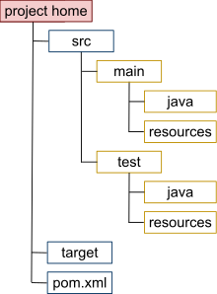
Maven – Modules
Each maven project is considered a module
module can hold other modules within
Predefined module layout (=file structure)
Each module produce one artifact
Convention, can be changed
easy to choose what type it will be (jar\war\ear)
Each module is described using single (xml) file: pom.xml
Notes:
Basic unit of work at maven is the module.
Module holds a certain, predefined (file) structure. (CoC)
Usually 1 module = 1 artifact (CoC)

Slide 14
Maven – Archetype
Preset of maven structure (project template)
Suited for different purposes (hello world, db etc.)
Holds basic pom, ready to use
Interactive command:
mvn archetype:generate
Notes:
Archetype are easy means to create the basic structure and files maven expects to work with.
Any one can create archetype where he configures the files and their content to be generated
maven-archetype-quickstart is name of archetype that creates basic maven structure, pom.xml and hello world java app file

Slide 15
Maven – POM
POM – Project Object Model
Defines a single module information, to be used later on by maven
POM consists (among other):
Module (artifact) identification
Artifact packaging
Dependencies information
Additional plugins
Many more items… (properties, profiles, plugins, repositories etc.)
Notes:
Pom – xml file that describes the various properties of the module.
Maven executable will read the pom file and according to the “instructions” written at it will know what\how to do.
The declarative approach of maven manifests itself mainly through the pom.xml

Slide 16
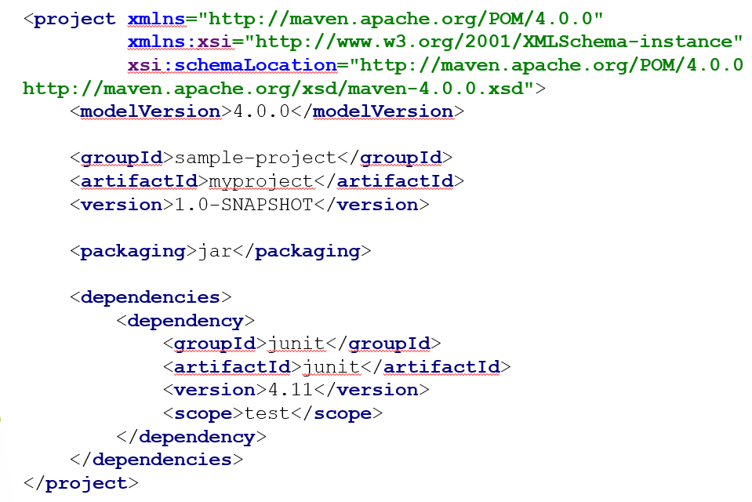
Maven – POM
Identify the project (group, artifact, version)
I want to get (what) a jar from these sources, maven should know how to achieve that (declarative style!)
My project depends on junit – maven will bring it and place it in the classpath (how)

Slide 17
Demo
Maven basics – create project using archetype
Notes:
mvn archetype:generate
Filter by: maven-archetype-quickstart (you can also with -DarchetypeArtifactId=maven-archetype-quickstart)
Give group, artifact, version and a project will be created in a folder with the name of the artifact id
One liner:
mvn archetype:generate -DgroupId=com.mycompany.app -DartifactId=my-app -DarchetypeArtifactId=maven-archetype-quickstart -DinteractiveMode=false

Slide 18
Exercise: Create simple maven project
Verify maven is installed and configured correctly
(environment variables etc)
Create basic maven project using mvn archetype:generate
(filter to maven-archetype-quickstart)
Explore the maven project folder structure

Slide 19
Maven – GAV
Maven module has unique identification:
GAV – Group, Artifact, Version
Group – name of the company\organization this module belongs to
Artifact – name of the artifact it self (a single organization can produce multiple artifacts)
Version – the version of this artifact (Maven allows multiple versions per single artifact)
Org.springframework:spring-core:4.1-RELEASE
Notes:
GAV is a unique identifier of a maven module.
Each maven module consist of 3 parts:
Group: typically the name of the organization. Convention: ‘.’ separated names
Artifact: the name of the artifact. Convention ‘-’ separated in case more than one word
Version: each artifact (module) has a version. Single artifact can have more than one version. Maven can manage them for you.
You can instruct maven to use\import certain version of a single artifact

Slide 20

POM - Packaging
Maven supports vast list of packaging types through the <packaging> element
Some known supported packaging types
jar
war
ear
pom
maven-plugin
rar
Default is jar

Slide 21
POM - Packaging
Default packaging is jar
Default final jar name
<artifact id>-<version>.jar
e.g.
test-1.0-SNAPSHOT.jar

Slide 22



Maven – Repository
Maven works with repositories that holds all maven artifacts
GAV is the way to locate a certain artifact in a repository
GAV will be treated as folders in file system
Repositories hierarchies:
Local repository
<user home dir>
\.m2
Organizational repository
Server that holds artifacts
http based (usually)
Vendors:
WWW repository
Maven repository
The central repository
Notes:
.m2 -> Hidden folder that holds (caches) all the artifacts you produce\consume (CoC). The GAV represents folders hierarchy
Organizational repository -> optional. Gives organization the ability to control what goes in and what goes out
Central repository -> several www sites that host vast amount of maven modules (artifacts) to be used freely by anyone else.
Everyone can publish to the central repository and consume artifacts from it

Slide 23
Settings.xml
Xml file that holds some maven settings, globally used across all projects.
What can be defined in settings xml ?
Location of local repository
(defaults to ${user.home}/.m2/repository)
Offline mode – true\false. Defaults to false.
Credentials for (internal) remote repository
Proxies for external network
Profile information (TBD)
And more…

Slide 24
Settings.xml
Location\scope
Global: <maven home>/conf/settings.xml
User defined: <user.home>/.m2/settings.xml
Settings are merged, such that in case of conflict the user settings.xml overrides and it is the dominant one.
Notes:
Link for settings details:
https://maven.apache.org/guides/index.html

Slide 25
Maven - lifecycle
Maven defines lifecycle:
A process through which certain activity follows (in general)
Maven will run the project (denoted by the pom.xml) through the lifecycle(s) we’ll ask.

Slide 26
Maven - lifecycle
Lifecycle structure:
Lifecycle holds steps to follow upon (called Phases)
Phases are ordered
Lifecycle doesn’t force you to follow it completely
Phases execution are accumulative:
if you stop the process at phase j, it means that all phases up to j will also be performed
Step A
Step B
Step C
Step j
Step N

Slide 27
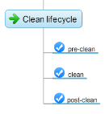
Maven - lifecycle
Maven maintains 3 internal lifecycles
Clean – used to clean any compile products exists locally. Ensures “fresh” start. Essentially deletes target folder
Site – used to create a website describing your project, holds documentation and other support materials
Default – main lifecycle, in charge of the main build process maven aims to perform

Slide 28
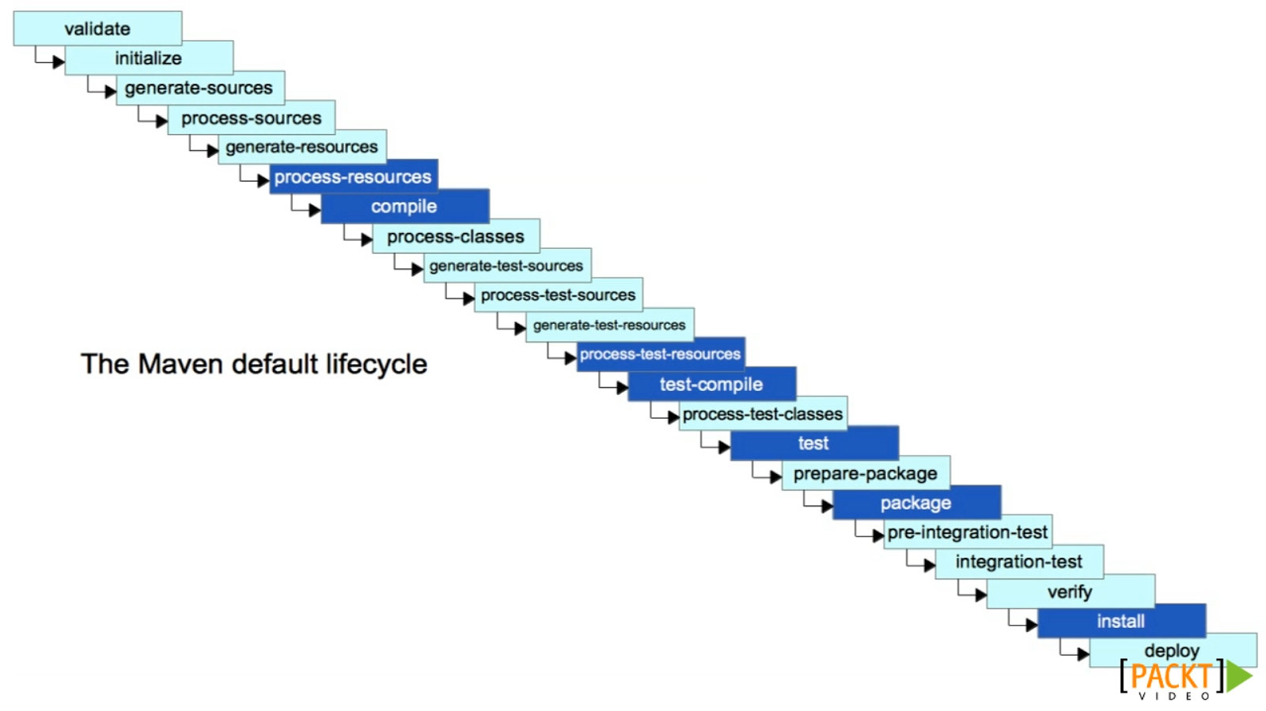
Maven – default lifecycle
Compiles the tests sources
Result is put at target\test-classes
Compiles the source code
Result is put at target\classes
Invokes the unit tests
(Defaults to junit)
Creates a jar (by default) from the source code
Main phases
Copies the jar to the local repository (.m2)
Uploads the jar to remote repository
Internal phases
Notes:
Discuss the actions associated with each main phase (compile, test, package, install)

Slide 29
Maven - lifecycle
How to invoke maven lifecycle (= phases(s)) ?
mvn <life cycle destination phase>
e.g.
mvn clean package
…will run the project through the below phases:
pre-clean -> clean -> validate -> … -> compile -> … -> test -> … -> package
Default lifecycle
Clean lifecycle
Notes:
Mvn search to see if the given phase is a known phase at any of its known lifecycles

Slide 30
Demo
Maven lifecycle execution
Notes:
mvn clean install
Explore .m2 and target later on

Slide 31
Exercise: Create simple maven project
Explore the POM.xml structure
On the root folder (where the POM.xml is located), type
mvn clean install
Go to home repository (.m2) and explore the folder structure
Run the hello world app (java –cp <jar name> <fqn App>)

Slide 32
Maven – plugins
What are actions associated with a phase ?
Maven plugin – piece of code (java) to be executed by mvn process
Each plugin has one or more goals
Goal – capability of doing something
Maven plugin is itself – a maven module… (it has pom.xml, GAV, stored at repository etc.)
Notes:
Plugin represents piece of functionality, implemented in java.
Plugin can have more than one thing it can do. It’s different capabilities are called goal(s)
Maven plugins are created using… maven itself. (not part of this course)

Slide 33
Maven – Plugins Execution (#1)
Independent execution
mvn <plugin GAV>:goal
e.g.
mvn clean:clean
Notes:
Plugin can be executed directly using mvn command… (infact this is what always happens)

Slide 34
Maven – Plugins Execution (#2)
Lifecycle execution
Maven comes with predefined set of plugins, that compose the basic maven functionality – CoC
Upon phase execution, mvn executes all the plugin (goals) associated with that phase !
Notes:
w

Slide 35
Maven – Plugins Execution (#2) - cont
These plugins are associated to certain phases in maven’s lifecycle
# | Phase (lifecycle) | Plugin:goal
1 | clean (clean) | clean:clean
2 | compile (default) | compiler:compile
3 | test-compile (default) | compiler:testCompile
4 | test (default) | surefire:test
5 | jar (default) | jar:jar (or war:war..)
6 | install (default) | install:install
Essentially, maven is a simple plugin execution machine !
When you invoke
mvn clean
…you are actually invoking:
mvn clean:clean
Notes:
Check this link for all bindings between phases and relevant plugins in all lifecycles:
https://maven.apache.org/guides/introduction/introduction-to-the-lifecycle.html

Slide 36
Demo
Maven plugins execution
Notes:
Execute mvn plugins one by one:
Mvn clean:clean
Mvn compiler:ompile
Mvn jar:jar

Slide 37
Maven – Plugins Execution – incorporate in POM.xml
Plugins appears as part of build element
There can be several plugins in single maven project – they are all concealed in plugins element
Each plugin has 3 main component:
GAV
Configuration
Execution(s)
Each execution states:
The phase to execute this plugin at
The goals of the plugin to execute
<build>
<plugins>
<plugin>
<GAV section>
<configuration>
<executions>
<execution>
<phase>
<goals>
<goal>
</goals>
</execution>
</executions>
</plugin>
…
<plugin>
</plugin>
</plugins>
</build>

Slide 38
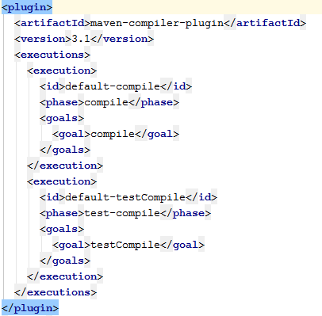
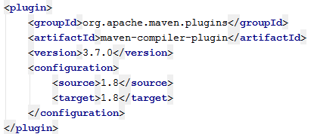
Maven – Plugins Execution – incorporate in POM.xml
Compiler plugin -> compiles the code
It has two goals:
Compile -> executed in compile phase
Test-compile -> executed in test-compile phase
It has several properties:
Source code version
Target code version
See this list of built-in maven plugins
Notes:
The source and target version of the compiler plugin are defaulting, from some reason, to version 1.5. if you are working with advance java version (and you are…) you should state this in your pom.xml by “reconfiguring” the compiler plugin…

Slide 39
Exercise: Configure plugins in pom.xml
In this exercise you will configure some plugins in the hello world project
For that you will need to add <build> element and within it <plugins> element
1. Set the compiler plugin version to use JDK version 1.8
Things to set:
group: org.apache.maven.plugins
artifact: maven-compiler-plugin
version: 3.7.0
Configuration properties:
source -> 1.8
traget -> 1.8

Slide 40
Exercise: Configure plugins in pom.xml
2. Use Exec plugin: execute code for you
It is used to invoke programs through maven.
We’ll use it to invoke the simple ‘hello world’ main we wrote:
Things to set:
group: org.codehaus.mojo
artifact: exec-maven-plugin
version: 1.6.0
goal: java
phase: verify
Configuration properties:
mainClass -> FQN of the main class

Slide 41
Demo
Set maven plugins usage:
Compiler plugin with version 1.8
Exec plugin

Slide 42


Maven version types
Maven produces 2 types of artifacts:
SNAPSHOT:
The code is still under development: it is assumed to be changed constantly.
Assumed NOT to be stable
Represents the current, last, up-to-date build state of the module (artifact), so maven will attempt to update it every day from remote repo when he can.
RELEASE:
Supposed to be stable and verified
Durable in time. Won’t be changed in the future.
Artifact types are set by version:
Snapshot artifact: add the suffix -SNAPSHOT
Release artifact: simply don’t use the suffix -SNAPSHOT
Notes:
In typical work process you develop your product (== artifact) and at a certain point in time you reach a stable state of it, or have reached a certain milestone.
During the development time users would might want to start work with you artifact.
What you want to tell them is that they can do that, but they need to distinguish and understand that this artifact is not yet final, might have bugs in it, not stable and ultimately – aimed to be changed. It represents the current state in time of the product.
For this cases use the suffix –SNAPSHOT (key work in maven, must start with ‘-’ and with uppercase letters). Maven will know to download it every day from remote repos to get updates
When you are done your develop you simply remove the suffix (-SNAPSHOT) and deploys the artifact with final fixed version. From now and on, maven (and your users) knows that this is a sealed artifact, won’t be change in time and that they can count on it to work as well.

Slide 43
Maven dependencies
A typical code program is compose of several artifacts
Each artifact can be maintained via other teams (within\outside the company)
How can I state to maven that I need to use a certain artifact in my product ?
Junit
3.8.1
GIT
client
log4j
1.5
SHA1
2.5
Memory-map
1.3

Slide 44
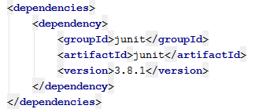
Maven dependencies
Dependencies !
POM.xml holds <dependencies> element
(holding <dependency> items…)
Each artifact has GAV.
Use it to instruct maven to use this dependency…
<dependencies>
<dependency>
<group>
<artifact>
<version>
</dependency>
…
<dependency>
</dependency>
</dependencies>

Slide 45
Maven dependencies – Resolution process
Upon compile\test, maven reads pom and analyze it’s dependencies.
The process varies according to the artifact type: SNAPSHOT or Release
Eventually all dependencies will be served ONLY from local repository (.m2)
Resolving dependencies process:
For each dependency, in case it’s a:
Release
Search for it local repository (.m2) if found -> done
If not found, attempt to search for it on remote repository(ies)
If found -> download it to the local repository
If not found -> fail.
Notes:
Maven resolves the various dependencies needed.
The process changes if its SNAPSHOT or Release.
At the end of the process, ALL dependencies will be available through the local repository (.m2), and maven will make them available through the classpath for the relevant processes (compile, test, package)

Slide 46
Maven dependencies - Resolution process
…For each dependency, in case it’s a:
SNAPSHOT
Search for it local repository (.m2)
If not found, attempt to search for it on remote repository(ies)
If found -> download it to the local repository and attach to it a timestamp…
If not found -> fail.
If found, check when was it last downloaded.
Act according to snapshot policy
Snapshot dependencies policy
Set by the repository definition in settings.xml\pom.xml file
Defaults to daily
Options: always, interval:<minutes>, never
Remember: SNAPSHOT dependencies (can be) changed by default on daily basis !
Notes:
Check this link, second answer for detailed explanation:
https://stackoverflow.com/questions/5901378/what-exactly-is-a-maven-snapshot-and-why-do-we-need-it
Main difference between release and snapshot dependencies resolution is that once and if release is found in local – it will never be searched for again outside, since it is not expected to change
SNAPSHOTS, form the other hand, will be searched (by default) on a daily basis (unless specifically told not to… CoC in action)

Slide 47
GAV - Classifier
Classifier – an optional, arbitrary string to be added to the artifact that characterize it for it’s content:
Version state (alpha\beta)
Artifact content (jar-with-dependencies, shade-jar, sources, docs)
OS related (windows, unix)
Java versions (JDK1.8, JDK1.9)
e.g.
com.my.company:my-app:1.0:windows vs com.my.company:my-app:1.0:unix
Notes:
Classifier helps distinguish some artifacts from one another.
Gives some hint on their content.

Slide 48
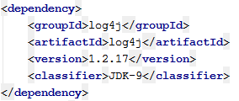
GAV - Classifier
If used (e.g. in dependency) will appear after the version:
Classifier is appended to the final artifact of a module, usually by means of other plugins (TBD), and it’s not part of the GAV definition
Notes:
When used in dependencies, helps to take the relevant artifact (of the same GAV)
Are not part of the GAV definition of the module, but rather are added to the final artifact file name as part of plugins (e.g. maven assembly plugin)

Slide 49
Maven dependencies - Transitivity
abc 1.2
Junit 1.5
def 1.3
pqr 5.3
My-module
Log4j 3.2
ghi 4.2
jkl 3.4
Sha1 2.3
mno 65.3
Notes:
Upon dependency resolution process, all transitive dependencies will be resolved as well, with the same process for the regular dependency resolution
All transitive dependencies will be available in class path as well, and will be served from local repository (.m2) ONLY

Slide 50
Maven dependencies – Dependencies collision
What if we wanted to force use of ghi 3.7 ?
abc 1.2
Shortest path wins !
Junit 1.5
def 1.3
ghi 3.7
ghi 3.7
3
My-module
Log4j 3.2
ghi 4.2
At runtime, only one version of ghi can be used.
Which one will it be ?
ghi 4.2
ghi 4.2
2
jkl 3.4
ghi 3.7
Sha1 2.3
1
mno 65.3
Notes:
In case of collision – the shortest path wins

Slide 51
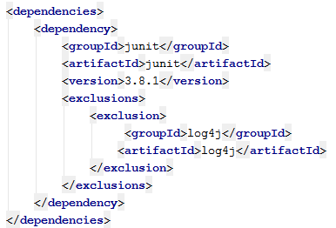
Maven dependencies – Transitive exclusion
Can I tell maven to completely ignore log4j of junit and sha1 ?
Log4j 1.2
ghi 2.2
Junit 1.5
def 1.3
pqr 5.3
My-module
Log4j 3.2
ghi 4.2
Notes for exclusion:
No version statement upon exclusion
Exclusion cuts entire branch
jkl 3.4
Sha1 2.3
Log4j 4.6
ghi 7.2
Notes:
Logging is an example for a dependency that most artifact will most likely use.
Most of the times the project owner wants to dictates the relevant logging artifact to use.
Maven enables the project owner to exclude a certain transitive dependency.
Note:
Exclusion cuts off entire branch from transitive dependencies
When excluding, no version needs to be mentioned. (no need)
We can exclude but not include the excluded dependency elsewhere. Maven won’t locate it and won’t alert us…

Slide 52
Maven dependencies - scope
Do we need junit capabilities at runtime ? After the ‘test’ phase ?
If we use logging, but we will be deployed on a ‘loggable’ system -> can’t we use the system’s logging artifact ?
Yes we can !
Maven manages scope for each dependency

Slide 53
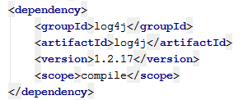
Maven dependencies - Scope
Maven offers several scopes for dependencies
Compile (default)
Provided
Runtime
Test
System (deprecated)
Import (special case, not covered as part of this course)

Slide 54
Maven dependencies Scope: compile
The dependency will be available (== in classpath) through out all the phases of the lifecycle (compile, test-compile, test, package)
Will be included as part of transitive resolution
If B->C and C is compile’d scope in B, then if A->B it also makes C available to all
Packaged together
Default value if not stated otherwise
A
Compile scope
B
Compile scope
C

Slide 55
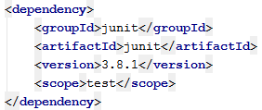
Maven dependencies Scope: test
Makes the dependency available only for test phase
Won’t be packaged
Notes:
Classical usage of junit dependency

Slide 56
Maven dependencies Scope: provided
Used when the runtime environment aims to supply the final artifact.
Dependency available in compile and test phases only
Plays in transitive resolution
Won’t be packaged in the final artifact
Notes:
Classical use is with web apps that are deployed on web containers (tomcat, jboss..): servlet-api

Slide 57
Maven dependencies Scope: runtime
Available only for execution (e.g. test and runtime)
Used with API vs actual implementation
(e.g. JPA vs Hibernate)
Does not plays in transitive resolution
Won’t be packaged
Notes:
Makes the dependency available only when we need to execute code, which happens on the test phase and on runtime
Usually used when you have an api (e.g. JPA), and it has several implementations (like hibernate, tow etc.)
At runtime (or when testing), someone will supply the actual implementation. But for compile time, we only work through the API, total agnostic to the actual implementation to be used at runtime. So in compile time we only need the API, but our module states for maven that in runtime it will actually be depends on a given implementation.
Another example is slf4j-api and the actual logging mechanism that will eventually used..
(This is by far the most convoluted and rarely used)
Won’t be packaged

Slide 58
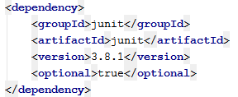
Maven dependencies: optional
Optional dependencies are used in rare cases
(and there is no real reason to use them)
Acts as regular dependencies for direct usage.
Are not included in transitive resolution
(sort of always-excluded style..)
Default value is false
A
B
optional
C
Notes:
See this link for farther details:
https://maven.apache.org/guides/introduction/introduction-to-optional-and-excludes-dependencies.html
Optional are used when you can’t separate a project to sub modules as you should have, and you don’t want to miss and forget it’s dependencies
(very rare, if at all).

Slide 59
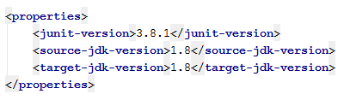
Maven Properties
POM.xml can hold Properties definitions
You set the key and value…

Slide 60
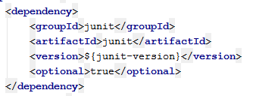
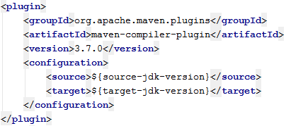
Maven Properties
Use property value using the syntax:
${<property key>}
Properties can be used (almost) everywhere:
Dependencies
Plugins configurations
etc

Slide 61
Maven Properties
There are several built-in properties ready to use:
${project.basedir} → current folder where pom.xml exists
${project.build.directory} → ‘target’ folder location
${project.build.sourceDirectory} → src\main\java folder location
${settings.*} → local user settings
${env.*} → access to environment vairables
And many more…
Auto completion in IDE…

Slide 62
Multimodule projects
Often, our project is composed of several components, where each component is an independent maven module
Some considerations:
Similar configuration between modules. (at pom.xml) can we spare it ?
Interdependencies between modules, how can we manage it ?
Transitive dependencies collision between modules
Maven offers 2 mechanism, complement each other to manage multimodule project:
Inheritance
Aggregation
Notes:
Examples for multimodule projects:
Junit: it has an engine, a validator, annotation processor, etc…
Maven itself: dependency management, pom parser, lifecycle executer, etc…

Slide 63
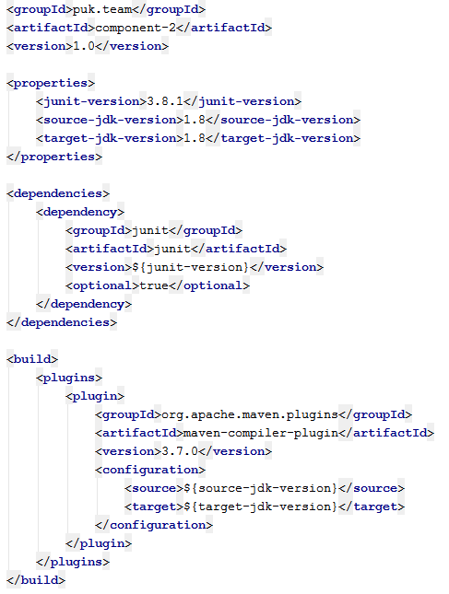
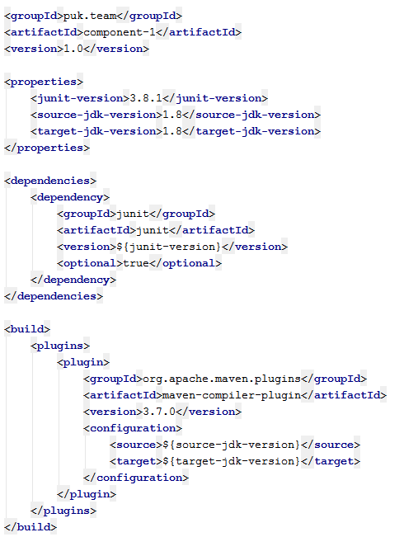
Inheritance
Component 2
Component 1
==
==
==

Slide 64
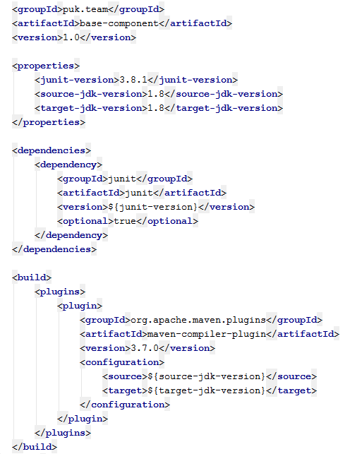
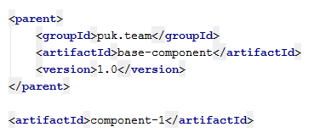
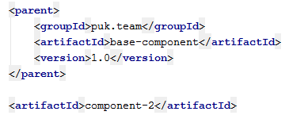
Inheritance
Base component
Component 1
Component 2

Slide 65
Inheritance
Inheritance characteristics:
Inheritance is between POMs, using <parent> element
Parent POM is identified using… GAV
What will (mainly) be inherited ?
Group
Version
Properties
Dependencies
What won’t be inherited (most important ?)
Artifact id
Notes:
Inheritance allows us to unify some common configuration in a certain POM, and have other pom inherit from it and by that get the configuration without the need to define it on their own
Helps for reducing the length of configuration done in a pom and allows reuse and share common configuration between several modules
Artifact ID is the actual final unique name of each module – so it, typically cannot be and shouldn’t be inheritted

Slide 66

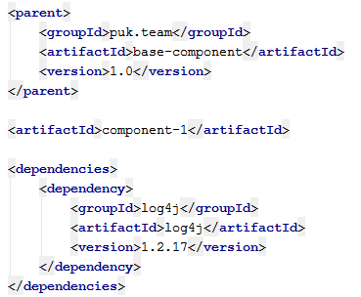
Inheritance
Inheritance characteristics continue
Child POM can either extend\override parent POM’s definition
Effective pom: the final POM a given module sees, after computing all it’s inheritance chain
mvn help:effective-pom
The parent POM can be regular module, or it can serve as parent POM container only.
Use special packaging: POM
Notes:
New items that the child adds – will be used
Existing items that the child re-defines – will be used (child overrides parent definition)
Use effective POM capability to view the final POM computed from the chain of inheritance
Usually, the parent POM serves only as such, and is not a regular module (one that contains code).
Maven defines an independent packaging type called POM to signify this. This kind of module has no compile-test-package flow and it will only be used as part of the children referring to it.
It will be installed to the repository and will contain only it’s definition

Slide 67
Inheritance: super POM
Every POM inherits by default from SUPER-POM
Super POM defines some basic, fundamental constructs of maven we all use (and love):
Folder structure: target, src\main\java, src\main\test …
Repositories (maven central)
Plugin repositories
Notes:
SUPER POM is the root of all poms.
All poms, eventually inherits basic primary configuration from the super POM

Slide 68
Inheritance: super POM
Super POM lies inside <maven home>\lib\maven-model.jar
<modelVersion>4.0.0 <modelVersion> ?
→ it’s a reference to which super POM should be used…
Currently only 4.0.0 exists..
Check the super POM on your own…

Slide 69
Inheritance: dependency management
Set all dependencies metadata information in parent POM, to be used by child POMs
Metadata information holds:
Version
Scope
Exclusions
Does not mean the child POMs are using the dependencies, but if they will, they will receive these metadata characteristics..
Notes:
A mechanism to control and summary all dependencies versions (mainly) used in our project
This element will usually appear in the parent pom, and will hold for each dependency (group-artifact) it’s desired version, scope, exclusions (if any) etc.
Setting the dependencies in the parent POM DOES NOT mean that the child POMS immediately use these dependencies. The child POMS must explicitly state that they need a certain dependency (through dependency element) and once they do this, they will receive by default the metadata defined in the parent’s dependency management element.

Slide 70
Inheritance: dependency management
Matching to dependency management is done by:
Group
Artifact
Type
Classifier
Affects also transitive dependencies… be careful!
Mostly
Defaults to jar. In case not jar needs to be stated explicitly
Defaults to null. If it’s part of the dependency – must be stated explicitly
Notes:
The child pom can now declare their use of the dependency using the group-artifact pair only, since the actual versioning, scope etc will be taken from the dependency management element (given that this dependency is defined there)
In case the type of the dependency is not a jar the element type must also be used to properly capture the correct dependency management section
If a dependency is defined using a special classifier – it also needs to be stated explicitly. (defaults to null)
In case transitive dependencies also use dependences that were defined in the dependency management section – it will affect them as well.

Slide 71
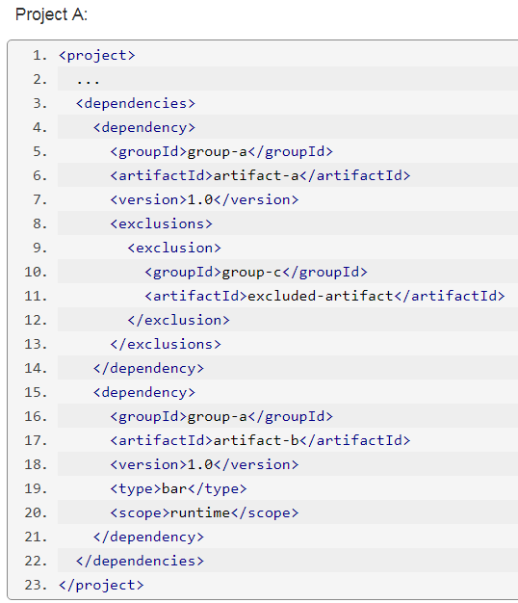
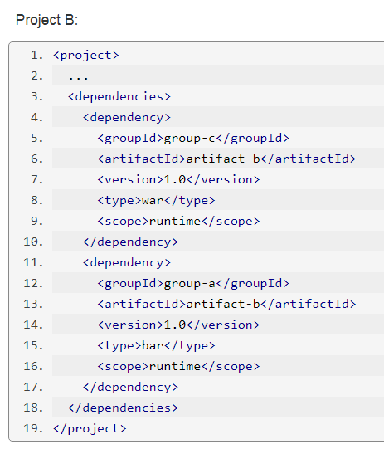
Inheritance: dependency management
Assuming both have a shared parent POM…
Notes:
Example is taken from:
https://maven.apache.org/guides/introduction/introduction-to-dependency-mechanism.html#Dependency_Management

Slide 72
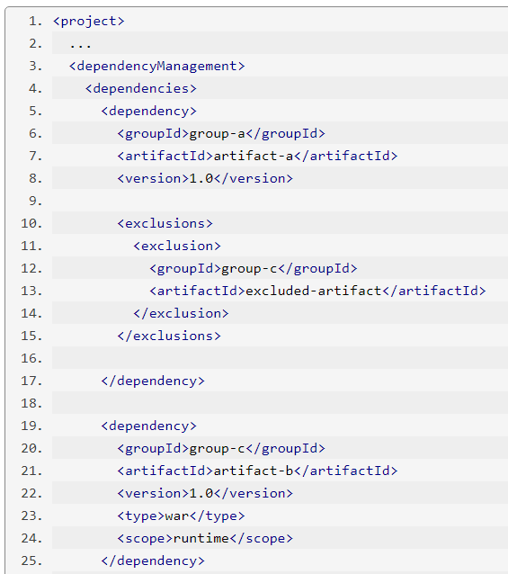
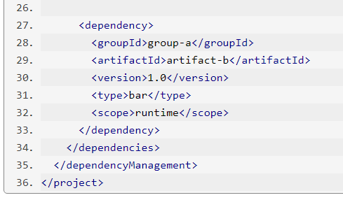
Inheritance: dependency management
Defined in parent POM of both project A and B

Slide 73
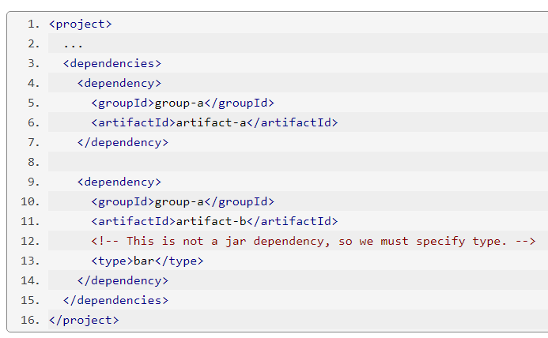
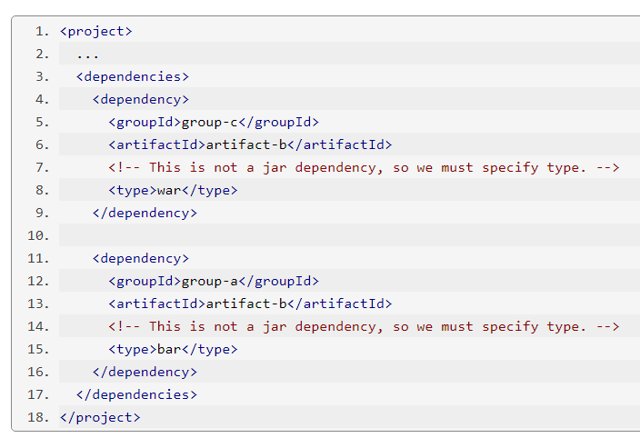
Inheritance: dependency management
Project A
Project B
Notes:
The aim of dependency management is not to spare us xml writing, but mainly to manage the dependency information in a single shared location to be used by other modules.
Notice how we needed to define the type in case it’s not a JAR for a given dependency.

Slide 74
Aggregation
Input:
Our module is composed of 4 components (individual maven modules)
My-comp-1 is developed in china branch
Concerns:
What is the order of compilation we need to have them ready ? Do we have a circular dependency problem ? Can we opt for parallel build ? How ?
Should we compile-test-package-install all of them manually ?
How should new employee get familiar with our MO ?
How can we produce one final artifact of all our product ? (uber-jar\war\ear etc..)
My-comp-1
Log4j 6.3
My-comp-1
My-module
My-comp-2
My-comp-3
Companies module
Sha1 3.2
My-comp-3
External module
My-comp-4

Slide 75
Aggregation
Aggregation (to rule them all…) !
Single POM, holding references to all sub modules, all belong to the same final product.
Characteristics:
Deduce automatically the inter-dependencies order, parallelism, cirularity between all modules
Single point where the build starts and ends at
Sees the full picture -> can produce final artifact
Quick jump for new employees
(no cheatsheet or תושב"ע…)
My-comp-1
Log4j 6.3
My-comp-1
My-module
My-comp-2
My-comp-3
Sha1 3.2
My-comp-3
My-comp-4

Slide 76
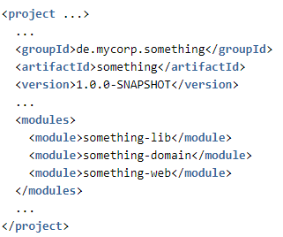
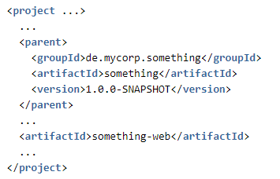
Aggregation
A POM that holds reference to other maven modules
Convention: modules are located underneath it
Can also serve as parent POM
Upon invoking lifecycle on aggregator POM, will make sure to build the entire submodules:
Deduce dependencies order
Aim for parallelism
Alerts circular dependencies
Enable continue from stop point

Slide 77
Aggregation
Perform each action per sub module
(e.g. clean install)
Can declare and use plugins to build the entire product

Slide 78
Maven
מייבן (באידיש)
Questions ?

