Slide 1







high level versus low level programming
pipelining = connecting applications via script
existing
application
perl/JS/python/R/ruby (script)
existing
application
packages/modules/libraries
your operating system
compiled C/BASIC/FORTRAN
Java runtime environment
assembly
language
your machine

Slide 2
compiled versus interpreted (i.e. scripting) languages
popularity index
Jobs blog
https://www.tiobe.com/tiobe-index/
https://raygun.com/blog/programming-languages/
 | PRO’s | CON’s
Fully-compiled (C,C#, C++, BASIC, FORTRAN, Go, Rust, Swift) | Errors arise well before runtime and can be eliminated before production. Compiled code runs most optimally on hardware | Development can be tedious and slow
Semi-compiled (Java) | Much more portable than fully compiled languages | Still need to run a compiler to JRE (java Runtime Environment) before testing code.
Mostly interpreted (python) | Compiles to bytecode in one go before it runs. Still acts much like a fully interpreted language. | Line by line compiling is avoided. Is still platform dependent
Fully interpreted (perl, R, Ruby, Lua, Groovy, Node.js) | Functional code can be developed very quickly without housekeeping (i.e. memory allocation, garbage collection etc.) Can run slow as it compiles line by line. | Most errors arise at runtime. Many of these are not type-safe (data type checked before running). Is often very platform dependent
Web browser/ server (JavaScript, PHP, Ruby on Rails) | Lives on client-side or server-side of web browser. No install or compiling. | Front-end development only…often embedded into HTML

Slide 3
Why learn more than one language? You can…
Take advantage of new tools and features specific to other languages
Better avoid the shortfalls of any given language
Make your code development more efficient
Make your coding skillset more marketable
Allow you to move with the times (language popularity is shorter-lived than you are)
Learning other language conventions makes it clearer what is happening in your favored language
Better see the commonalities of all code (unlike human languages, there is far less variation in what we tell computers to do)
Interact with computers with more power and freedom
 | PRO’s | CON’s
perl | Similarity to C, java, js, PHP and bash, ease of string methods and string interpolation, ease of system interactions and piping, lexical flexibility and freedom from convention, important for ‘legacy’ code, has no dependencies ! Great for parsing text ! | Lexical flexibility can cause lack of readability (bad for team projects), declining popularity
JavaScript (JS) | Node.js, similarity to other languages, industry standard for front end developers (check out the D3.js website for data science) | Unless used with Node for app development, it mostly lives within webpages
python | Clean and readable, lots of general modern package development, is there nothing it can’t do? Data science stack = numpy/scipy, pandas, matplotlib, scikit-learn, keras/tensorflow. | Whitespace/indent sensitivity, restrictive in convention, data type often not apparent, ‘module du jour’, ‘dependency hell(anaconda)’
R | Comprehensive statistical libraries and excellent scientific graphics, Rstudio editor brings it new life ! Now also has keras/tensorflow. | ‘old-school’ conventions, not well designed for string data types and general programming tasks, is a very niche language

Slide 4
R – popular libraries/packages/archives/resources
R software project and code archive is hosted at CRAN
R function documentation
https://cran.r-project.org/
https://www.rdocumentation.org/
The Rstudio code editor
Deep learning with keras and tensorflow
https://rstudio.com/
https://keras.rstudio.com/
A simple GUI to emulate a stats package
Publication quality scientific graphics
https://www.rcommander.com/
https://ggplot2.tidyverse.org/
Has great many sophisticated statistics and machine learning libraries
https://www.w3schools.com/r/default.asp
https://www.tutorialspoint.com/r/index.htm

Slide 5
R – functional assignment, built-in functions and library functions
An example with much more sophisticated function for support vector machine learning from kernlab library
https://www.rdocumentation.org/packages/kernlab/versions/0.9-29/topics/ksvm
Note: ‘library()’ is R command for loading a package/module/library to your script every time you use it
Note: install.packages() is the terminal command to download a library for the first time ONLY
## Another example with the famous iris data
data(iris)
library(‘kernlab’)
## Create a kernel function using the build in rbfdot function
rbf <- rbfdot(sigma=0.1)
rbf
## train a bound constraint support vector machine
irismodel <- ksvm(Species~.,data=iris,type="C-bsvc",
kernel=rbf,C=10,prob.model=TRUE)
print(irismodel)
## get fitted values
fitted(irismodel)
## Test on the training set with probabilities as output
predict(irismodel, iris[,-5], type="probabilities")
ALWAYS check R documentation carefully when using library functions
MAKE SURE YOU ARE USING ARGUMENTS EXACTLY AS REQUIRED FOR EACH FUNCTION

Slide 6
x <- 10.5 # numeric
y <- 10L # integer
z <- 1i # complex
R – syntax, commenting and style conventions
Three unusual but common symbols in R
my_var <- 30 # my_var is type of numeric my_var <- "Sally" # my_var is now of type character (aka string)
<- is the ubiquitous assignment operator in R
~ is the tilde operator in R used in formula arguments for most functions
The class() function returns data type …equivalent to type() in python
$ is the subset operator in R, often used for defining data columns
NOTE: R IS TYPICALLY WRITTEN IN PROCEDURAL STYLE WITH FUNCTIONS AND PLOTS TREATED AS OBJECTS USING THE ASSIGNMENT OPERATOR
numeric (10.5, 55, 787)
integer (1L, 55L, 100L, where the letter "L" declares this as an integer)
complex (9 + 3i, where "i" is the imaginary part)
character/string ("k", "R is exciting", "FALSE", "11.5")
logical/booleans (TRUE or FALSE)
R hosts many useful data structures
# Create a data frame Data_Frame <- data.frame ( Training = c("Strength", "Stamina", "Other"), Pulse = c(100, 150, 120), Duration = c(60, 30, 45) )
The data frame is the central data structure in R

Slide 7
R – statements, conditionals and loops
for (x in 1:10) { print(x) }
a <- 200 b <- 33 if (b > a) { print("b is greater than a") } else if (a == b) { print("a and b are equal") } else { print("a is greater than b") }
fruits <- list("apple", "banana", "cherry") for (x in fruits) { print(x) }
dice <- c(1, 2, 3, 4, 5, 6) for (x in dice) { print(x) }
fruits <- list("apple", "banana", "cherry") for (x in fruits) { if (x == "banana") { next } print(x) }
i <- 1 while (i < 6) { print(i) i <- i + 1 }

Slide 8
R – syntax, commenting and style conventions
R hosts many other useful data structures
# Vector of strings fruits <- c("banana", "apple", "orange")
# Vector of numerical values numbers <- c(1, 2, 3)
# Vector with numerical values in a sequence numbers <- 1:10
# List of strings thislist <- list("apple", "banana", "cherry")
thislist[1] # pointer to item “apple” in list
# An array with one dimension with values ranging from 1 to 24 thisarray <- c(1:24) # An array with more than one dimension multiarray <- array(thisarray, dim = c(4, 3, 2)) # Create a matrix thismatrix <- matrix(c(1,2,3,4,5,6), nrow = 3, ncol = 2)
thismatrix <- matrix(c("apple", "banana", "cherry", "orange"), nrow = 2, ncol = 2) thismatrix[1, 2] # returns item in row 1 column 2
# Create a factor (…a categorical variable in statistics) music_genre <- factor(c("Jazz", "Rock", "Classic", "Classic", "Pop", "Jazz", "Rock", "Jazz"))
indexing of arrays starts at 1 not 0 like most other languages

Slide 9
R – functional assignment, built-in functions and library functions
abs(-4.7)
sqrt(16)
ceiling(1.4) # round up floor(1.4) # round down
x <- c(5,7,8,7,2,2,9,4,11,12,9,6) y <- c(99,86,87,88,111,103,87,94,78,77,85,86) plot(x, y)
Do not use built in plotting, use ggplot2 library
my_function <- function(x, y) { a <- x + y return(a) }
my_function(2,2) # returns value of the function for these inputs
## Not assuming equal variances
oneway.test(extra ~ group, data = sleep)
## Assuming equal variances
oneway.test(extra ~ group, data = sleep, var.equal = TRUE)
## which gives the same result as
anova(lm(extra ~ group, data = sleep))
ALWAYS check R documentation carefully when using library functions
MAKE SURE YOU ARE USING ARGUMENTS EXACTLY AS REQUIRED FOR EACH FUNCTION
https://www.rdocumentation.org/packages/stats/versions/3.6.2/topics/oneway.test

Slide 10
R – basic I/O
data=read.table("/home/microcarbon/Desktop/iris_tab.txt",header=TRUE)
sepal_length=data$sepal_length
sepal_width=data$sepal_width
petal_length=data$petal_length
petal_width=data$petal_width
species=data$species
iris.data<-data.frame(
sepal_length,
sepal_width,
petal_length,
petal_width,
species
)
print(iris.data)
print(summary(iris.data))
$ subsets each column by its header and later is used to create new data frame
there is also a write table function
https://www.rdocumentation.org/packages/utils/versions/3.6.2/topics/read.table

Slide 11
R – basic I/O
# print means, ANOVA test, and summary to external file
sink(file = '/home/microcarbon/Desktop/meansIRIS.txt')
print(iris.means)
print(summary(iris.means))
print(sepal_length.anova)
print(sepal_width.anova)
print(petal_length.anova)
print(petal_width.anova)
sink()
Sink() function can be used to divert output to the R console to be stored in a text file

Slide 12
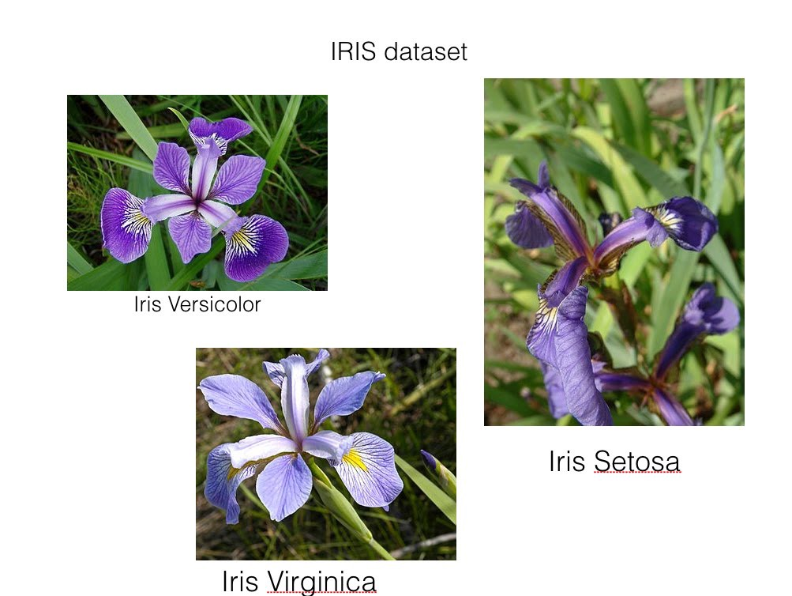
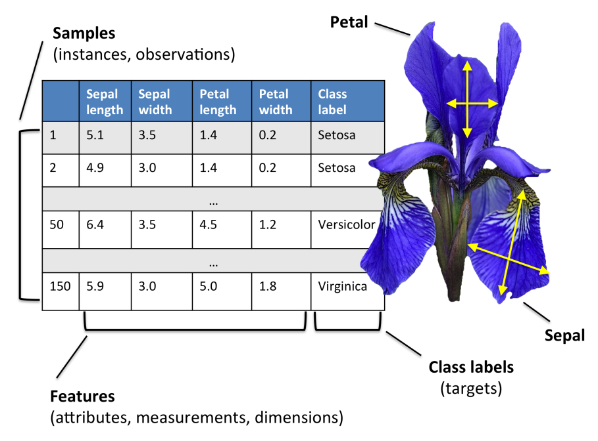
R – anatomy of a basic R script
Starter code example for anatomy of an R script
https://github.com/gbabbitt/RocASAsamples/blob/main/iris_code.R
Dr Babbitt’s starter code library
https://gbabbitt.github.io/RocASAsamples/

Slide 13
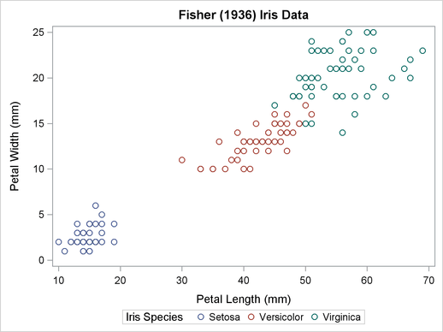
R – anatomy of a basic R script
Starter code example for anatomy of an R script
https://github.com/gbabbitt/RocASAsamples/blob/main/iris_code.R
Dr Babbitt’s starter code library
https://gbabbitt.github.io/RocASAsamples/

