Slide 1
Why learn more than one language? You can…
Take advantage of new tools and features specific to other languages
Better avoid the shortfalls of any given language
Make your code development more efficient
Make your coding skillset more marketable
Allow you to move with the times (language popularity is shorter-lived than you are)
Learning other language conventions makes it clearer what is happening in your favored language
Better see the commonalities of all code (unlike human languages, there is far less variation in what we tell computers to do)
Interact with computers with more power and freedom
 | PRO’s | CON’s
perl | Similarity to C and bash, ease of string methods and string interpolation, ease of system interactions and piping, lexical flexibility and freedom from convention, important for ‘legacy’ code, few to no dependencies | Lexical flexibility can cause lack of readability (bad for team projects), declining popularity
javascript | JS Node, similarity to C/java/perl, industry standard for front end developers | Unless used with Node for app development, it mostly lives within webpages
python | Clean and readable, lots of general modern package development, is there nothing it can’t do | Whitespace/indent sensitivity, restrictive in convention, data type often not apparent, ‘module du jour’, ‘dependency hell’
R | Best statistical library and good scientific graphics, Rstudio editor and Rcmdr GUI, freely open source | ‘old-school’ conventions, not well designed for string data types and general programming tasks, is a very niche language
ruby | Rails webserver app, clean looking code without whitespace/indent sensitivity, huge library of built-in functions, can develop GUI, can embed in HTML like JS, can also be a simple scripting language like perl | Declining in popularity. Conventions are intermediate between whitespace sensitive (python) and curly bracket style languages (perl, Java, C, JS)

Slide 2
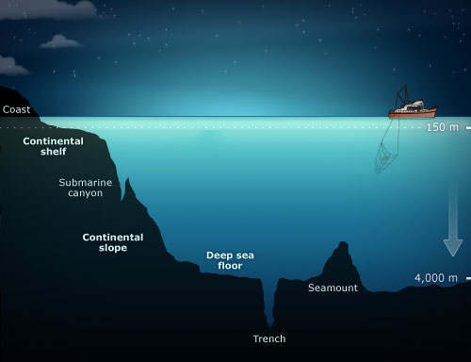






high level versus low level programming
pipelining = connecting applications via script
existing
application
perl/JS/python/R/ruby (script)
existing
application
packages/modules/libraries
your operating system
compiled C/BASIC/FORTRAN
Java runtime environment
assembly
language
your machine

Slide 3
compiled versus interpreted (i.e. scripting) languages
popularity index
Jobs blog
https://www.tiobe.com/tiobe-index/
https://raygun.com/blog/programming-languages/
 | PRO’s | CON’s
Fully-compiled (C,C#, C++, BASIC, FORTRAN, Go, Rust, Swift) | Errors arise well before runtime and can be eliminated before production. Compiled code runs most optimally on hardware | Development can be tedious and slow
Semi-compiled (Java) | Much more portable than fully compiled languages | Still need to run a compiler to JRE (java Runtime Environment) before testing code.
Mostly interpreted (python) | Compiles to bytecode in one go before it runs. Still acts much like a fully interpreted language. | Line by line compiling is avoided. Is still platform dependent
Fully interpreted (perl, R, JavaScript, PHP, Ruby, Lua, Groovy) | Functional code can be developed very quickly without housekeeping (i.e. memory allocation, garbage collection etc.) Can run slow as it compiles line by line. | Most errors arise at runtime. Many of these are not type-safe (data type checked before running). Is often very platform dependent

Slide 4
Best practices in code
Write self-referential code (make variable names clear and explanatory)
Comment extensively (time spent is future time saved)
Indent for readability but without creating large blank spaces on the page
Use a sophisticated multi-language IDE with syntax checking
Use proper versioning (GitHub is awesome!)
Get well skilled with 1-2 a primary languages best suited for your work
Learn a few more alternative languages so you can use their features/libraries
Learn to pipeline a project with multiple languages
Write graphical interfaces for your most useful tools
Develop your code on Linux, even if you eventually deploy it in Win or Mac
Use a separate laptop for coding (especially low level)
Don’t use python for everything (use R for stats and graphics; use perl for text processing)
Don’t use compiled languages unless you need ‘instant speed’ (i.e. gaming)
Scipy (python) is as fast as C and much quicker to develop and deploy
Use multi-core threading and GPU computing

Slide 5
Perl – popular libraries/packages/archives/resources
Note: ‘use’ is perl command for loading a package/module/library to your script
use Statistics::Descriptive;
my $stat = Statistics::Descriptive::Full->new();
$stat->add_data(1,2,3,4);
my $mean = $stat->mean();
my $var = $stat->variance();
my $tm = $stat->trimmed_mean(.25);
$Statistics::Descriptive::Tolerance = 1e-10;
Descriptive.pm
CPAN
https://www.cpan.org/
https://www.tutorialspoint.com/perl/index.htm
Recommended online tutorial – Perl 5
Recommended online tutorial – Perl 6/Raku
https://docs.raku.org/language.html

Slide 6
Perl 5 - basic syntax
$age = 25; # An integer assignment
$name = "John Paul"; # A string
$salary = 1445.50; # A floating point
print "Age = $age\n";
print "Name = $name\n";
print "Salary = $salary\n";
Sr.No. | Types & Description
1 | Scalar Scalars are simple variables. They are preceded by a dollar sign ($). A scalar is either a number, a string, or a reference. A reference is actually an address of a variable, which we will see in the upcoming chapters.
2 | Arrays Arrays are ordered lists of scalars that you access with a numeric index, which starts with 0. They are preceded by an "at" sign (@).
3 | Hashes Hashes are unordered sets of key/value pairs that you access using the keys as subscripts. They are preceded by a percent sign (%).
@ages = (25, 30, 40);
@names = ("John Paul", "Lisa", "Kumar");
print "\$ages[0] = $ages[0]\n";
print "\$ages[1] = $ages[1]\n";
print "\$ages[2] = $ages[2]\n";
print "\$names[0] = $names[0]\n";
print "\$names[1] = $names[1]\n";
print "\$names[2] = $names[2]\n";
%data = ('John Paul', 45, 'Lisa', 30, 'Kumar', 40);
print "\$data{'John Paul'} = $data{'John Paul'}\n";
print "\$data{'Lisa'} = $data{'Lisa'}\n";
print "\$data{'Kumar'} = $data{'Kumar'}\n";

Slide 7
Perl - commenting and style conventions
# This is a single line comment
print "Hello, world\n";
=begin comment
This is all part of multiline comment.
You can use as many lines as you like
These comments will be ignored by the
compiler until the next =cut is encountered.
=cut
Perl is the wild west (little to no convention and large lexical flexibility)

Slide 8
Perl - I/O
READ
open(DATA, “<file.txt") or die "Couldn't open file file.txt, $!";
WRITE
open(DATA, ">file.txt") or die "Couldn't open file file.txt, $!";
APPEND
open(DATA, ">>file.txt") or die "Couldn't open file file.txt, $!";
PIPE
open(DATA, “| R.exe") or die "Couldn't open R program\n";
open(DATA, "<file.txt") or die "Couldn't open file file.txt, $!";
while(<DATA>) {
print "$_";
}
close DATA;
EXAMPLE

Slide 9
Perl - string interpolation
$var = "This is string scalar!";
$quote = 'I m inside single quote - $var';
$double = "This is inside single quote - $var";
$escape = "This example of escape -\tHello, World!";
print "var = $var\n";
print "quote = $quote\n";
print "double = $double\n";
print "escape = $escape\n";
will produce …
var = This is string scalar!
quote = I m inside single quote - $var
double = This is inside single quote - This is string scalar!
escape = This example of escape - Hello, World

Slide 10
Perl - operators/concatenation/Booleans
Sr.No. | Operator & Description
1 | == (equal to) Checks if the value of two operands are equal or not, if yes then condition becomes true. Example − ($a == $b) is not true.
2 | != (not equal to) Checks if the value of two operands are equal or not, if values are not equal then condition becomes true. Example − ($a != $b) is true.
3 | <=> Checks if the value of two operands are equal or not, and returns -1, 0, or 1 depending on whether the left argument is numerically less than, equal to, or greater than the right argument. Example − ($a <=> $b) returns -1.
4 | > (greater than) Checks if the value of left operand is greater than the value of right operand, if yes then condition becomes true. Example − ($a > $b) is not true.
5 | < (less than) Checks if the value of left operand is less than the value of right operand, if yes then condition becomes true. Example − ($a < $b) is true.
6 | >= (greater than or equal to) Checks if the value of left operand is greater than or equal to the value of right operand, if yes then condition becomes true. Example − ($a >= $b) is not true.
7 | <= (less than or equal to) Checks if the value of left operand is less than or equal to the value of right operand, if yes then condition becomes true. Example − ($a <= $b) is true.
concatenation with .
$name = checkbook';
$filename = '/tmp/' . $name . '.tmp';
# $filename now contains "/tmp/checkbook.tmp"

Slide 11
Perl - statements and conditionals
$a = 10;
# check the boolean condition
if( $a < 20 ) {
# if condition is true then print the following
printf "a is less than 20\n";
}
else{
printf "a is not less than 20\n";
}
print "value of a is : $a\n";
or can write like this…
$a = 10;
# check condition
if( $a < 20 ) {printf "a is less than 20\n";} # true
else{printf "a is not less than 20\n";} # false
print "value of a is : $a\n";
or can write like this…
$a = 10;if( $a < 20 ) {printf "a is less than 20\n";}
else{printf "a is not less than 20\n";} print "value of a is : $a\n";

Slide 12
Perl - loop structure and code blocking
IMPORTANT: scoping of variables is global unless ‘my’ precedes it. Thus ‘my $i’ exists only in the for loop
for( my $i = 0; $i < 10;$i++ ) {
printf "This loop will 10 times.\n";
}
$DNA = “AATGTCCGCTATA”;
@DNA = split(/\s+/, $DNA);
for( my $i = 0; $i <= length $DNA; $i++ ) {
printf “my base is”.”@DNA[$i]\n";
}
$i = 0;
while( $i < 10 ) {
printf "This loop will 10 times.\n";
$i = $i+1;
}
for( ; ; ) {
printf "This loop will run forever.\n";
}

Slide 13
Perl - object orientation and functional assignment
package Person;
$object = new Person( "Mohammad", "Saleem", 23234345);
#### subroutines #####
sub new {
my $class = shift;
my $self = {
_firstName => shift,
_lastName => shift,
_ssn => shift,
};
# Print all the values just for clarification.
print "First Name is $self->{_firstName}\n";
print "Last Name is $self->{_lastName}\n";
print "SSN is $self->{_ssn}\n";
bless $self, $class;
return $self;
}
Object Basics
There are three main terms, explained from the point of view of how Perl handles objects. The terms are object, class, and method.
An object within Perl is merely a reference to a data type that knows what class it belongs to. The object is stored as a reference in a scalar variable. Because a scalar only contains a reference to the object, the same scalar can hold different objects in different classes.
A class within Perl is a package that contains the corresponding methods required to create and manipulate objects.
A method within Perl is a subroutine, defined with the package. The first argument to the method is an object reference or a package name, depending on whether the method affects the current object or the class.
Perl provides a bless() function, which is used to return a reference which ultimately becomes an object

Slide 14
Perl - built-in functions
$line = "Bart Lisa Maggie Marge Homer";
@simpsons = split ( /\s+/, $line );
# Splits line and uses any amount of whitespace
# as the delimiter.
split and join functions
$string = join ( '', @array ) # join to concatenate
$string = join ( “,”, @array ) # join with comma delimiter
$leadDNA = “AATGCGCGTAATGTAGC”;
$lagDNA = reverse $leadDNA;
$lagDNA =~ tr/ACGT/TGCA/
reverse and transpose
my $s = "The black cat climbed the green tree";
my $color = substr $s, 4, 5; # black
my $middle = substr $s, 4, -11; # black cat climbed the
my $end = substr $s, 14; # climbed the green tree
my $tail = substr $s, -4; # tree
my $z = substr $s, -4, 2; # t
substring
substr(EXPR, OFFSET, LENGTH)

Slide 15
Perl - regular expressions
$bar = "This is foo and again foo";
if ($bar =~m /foo/) {
print “I found foo\n";
} else {
print “no foo here\n";
}
Match Regular Expression - m//
Substitute Regular Expression - s///
Transliterate Regular Expression - tr///
$string = "The cat sat on the mat";
$string =~ s/cat/dog/;
print "$string\n";
$string = 'The cat sat on the mat';
$string =~ tr/a/o/;
print "$string\n";
$string =~ tr/a-z/A-Z/; # can use in place of uc function

Slide 16
Perl - system interaction and subroutine
system “perl myscript.pl\n”;
system “python myscript.py\n”;
subroutine_name( list of arguments );
exit;
####### my subs #######
sub subroutine_name {
body of the subroutine
}

Slide 17
Perl – popular libraries/packages/archives/resources
use Statistics::Descriptive;
my $stat = Statistics::Descriptive::Full->new();
$stat->add_data(1,2,3,4);
my $mean = $stat->mean();
my $var = $stat->variance();
my $tm = $stat->trimmed_mean(.25);
$Statistics::Descriptive::Tolerance = 1e-10;
Descriptive.pm
CPAN
https://www.cpan.org/
https://www.tutorialspoint.com/perl/index.htm
Recommended online tutorial – Perl 5
Recommended online tutorial – Perl 6/Raku
https://docs.raku.org/language.html

Slide 18
js – popular libraries/packages/archives/resources
JavaScript code is all-text and Java code must be compiled. ... JS code is run on a browser only, whereas Java creates web applications that run in a browser or virtual machine (the JRE or Java runtime environment). Java is an object-oriented programming language (OOP), and JS is specifically an object-oriented scripting language
i.e. JS code is used primarily to animate a website Think of HTML as the structure of the building in which your website lives, CSS as the furniture in the building and JS as the people who live in the building
Some useful resources –
Codepen – a social environment to share, explore, test and build front-end development projects
https://codepen.io/
React = a javascript library for user interfaces built on javascript language https://reactjs.org/
D3 = data driven documents library for interactive graphics https://d3js.org/
D3 connected to Streamlit.io (python app creator) https://discuss.streamlit.io/t/d3-in-react-in-streamlit/3166
Some basic tutorials
https://www.w3schools.com/js/default.asp
https://www.w3schools.com/nodejs/
https://www.w3schools.com/html/default.asp
https://www.w3schools.com/css/default.asp

Slide 19

js – popular libraries/packages/archives/resources
JavaScript code is all-text and Java code must be compiled. ... JS code is run on a browser only, whereas Java creates web applications that run in a browser or virtual machine (the JRE or Java runtime environment). Java is an object-oriented programming language (OOP), and JS is specifically an object-oriented scripting language
i.e. JS code is used primarily to animate a website Think of HTML as the structure of the building in which your website lives, CSS as the furniture in the building and JS as the people who live in the building
Node.js came into existence when the original developers of JavaScript extended it from something you could only run in the browser to something you could run on your machine as a standalone application.
Now you can do much more with JavaScript than just making websites interactive.
JavaScript now has the capability to do things that other scripting languages like Python can do.
Both your browser JavaScript and Node.js run on the V8 JavaScript runtime engine. This engine takes your JavaScript code and converts it into a faster machine code. Machine code is low-level code which the computer can run without needing to first interpret it.

Slide 20
js – popular libraries/packages/archives/resources
JavaScript code is all-text and Java code must be compiled. ... JS code is run on a browser only, whereas Java creates web applications that run in a browser or virtual machine (the JRE or Java runtime environment). Java is an object-oriented programming language (OOP), and JS is specifically an object-oriented scripting language
i.e. JS code is used primarily to animate a website Think of HTML as the structure of the building in which your website lives, CSS as the furniture in the building and JS as the people who live in the building
Node.js® is a JavaScript runtime built on Chrome’s V8 JavaScript engine. Node.js uses an event-driven, asynchronous, non-blocking I/O model that makes it lightweight and efficient. i.e. it eliminates queuing problems on the server-side. Node.js’ package ecosystem, npm, is the largest ecosystem of open source libraries in the world.
https://www.npmjs.com/
https://www.w3schools.com/js/default.asp
https://www.w3schools.com/nodejs/
https://www.w3schools.com/html/default.asp
https://www.w3schools.com/css/default.asp

Slide 21
js - basic syntax, commenting and style conventions
var x, y, z; // Declare Variables x = 5; y = 6; // Assign Values z = x + y; // Compute Values
// Declare at the beginning (also initiate here) var firstName, lastName, price, discount, fullPrice; // Use later firstName = "John"; lastName = "Doe"; price = 19.90; discount = 0.10; fullPrice = price - discount;

Slide 22
js - basic syntax, commenting and style conventions
var x, y, z; // Declare Variables x = 5; y = 6; // Assign Values z = x + y; // Compute Values
// Change heading: document.getElementById("myH").innerHTML = "My First Page";
/* The code below will change the heading with id = "myH" and the paragraph with id = "myP" in my web page: */ document.getElementById("myH").innerHTML = "My First Page"; document.getElementById("myP").innerHTML = "My first paragraph.";

Slide 23
js – conditionals, loops and switch statement
switch (new Date().getDay()) { case 0: day = "Sunday"; break; case 1: day = "Monday"; break; case 2: day = "Tuesday"; break; case 3: day = "Wednesday"; break; case 4: day = "Thursday"; break; case 5: day = "Friday"; break; case 6: day = "Saturday"; }
Use the switch statement to select one of many code blocks to be executed
if (hour < 18) { greeting = "Good day"; } else { greeting = "Good evening"; }
switch(expression) { case x: // code block break; case y: // code block break; default: // code block }
while (i < 10) { text += "The number is " + i; i++; }
for (i = 0; i < 5; i++) { text += "The number is " + i + "<br>"; }

Slide 24
js – data types , string methods and array methods
var length = 16; // Number var lastName = "Johnson"; // String var x = {firstName:"John", lastName:"Doe"}; // Object
var txt = "ABCDEFGHIJKLMNOPQRSTUVWXYZ"; var sln = txt.length;
Find length
var str = "Please locate where 'locate' occurs!"; var pos = str.indexOf("locate");
Find position
var fruits = ["Banana", "Orange", "Apple", "Mango"]; document.getElementById("demo").innerHTML = fruits.toString();
Join example
var fruits = ["Banana", "Orange", "Apple", "Mango"]; document.getElementById("demo").innerHTML = fruits.join(" * ");
Split example

Slide 25
js - regular expressions
var patt = /w3schools/i;
Example explained:
/w3schools/i is a regular expression.
w3schools is a pattern (to be used in a search).
i is a modifier (modifies the search to be case-insensitive).
var str = "Visit W3Schools"; var n = str.search(/w3schools/i);
n will return 6

Slide 26
js - object orientation and classes
Create class
Explicit use of constructor() to return car’s age
class Car { constructor(name, year) { this.name = name; this.year = year; } }
class Car { constructor(name, year) { this.name = name; this.year = year; } age() { let date = new Date(); return date.getFullYear() - this.year; } } let myCar = new Car("Ford", 2014); document.getElementById("demo").innerHTML = "My car is " + myCar.age() + " years old.";
Use class
let myCar1 = new Car("Ford", 2014); let myCar2 = new Car("Audi", 2019);
Let is used to redeclare variable (e.g. of scoping)
https://www.w3schools.com/js/js_let.asp

Slide 27
js - built-in functions (HTML events)
An HTML event can be something the browser does, or something a user does.
Often, when events happen, you may want to do something.
JavaScript lets you execute code when events are detected.
HTML allows event handler attributes, with JavaScript code, to be added to HTML elements.
<element event="some JavaScript">
usage
<button onclick="displayDate()">The time is?</button>
example
Event | Description
onchange | An HTML element has been changed
onclick | The user clicks an HTML element
onmouseover | The user moves the mouse over an HTML element
onmouseout | The user moves the mouse away from an HTML element
onkeydown | The user pushes a keyboard key
onload | The browser has finished loading the page

Slide 28
PHP – general scripting for web development
Acronym for ‘Hypertext preprocessor’
What is a PHP File?
PHP files can contain text, HTML, CSS, JavaScript, and PHP code
PHP code is executed on the server, and the result is returned to the browser as plain HTML
PHP files have extension ".php"
Note: echo and print are more or less the same
<!DOCTYPE html> <html> <body> <?php echo "My first PHP script!"; ?> </body> </html>
What Can PHP Do?
PHP can generate dynamic page content
PHP can create, open, read, write, delete, and close files on the server
PHP can collect form data
PHP can send and receive cookies
PHP can add, delete, modify data in your database
PHP can be used to control user-access
PHP can encrypt data
tutorial
https://www.w3schools.com/php/default.asp

Slide 29
PHP – general scripting for web development
Acronym for ‘Hypertext preprocessor’
installation
If your server has activated support for PHP you do not need to do anything.
Just create some .php files, place them in your web directory, and the server will automatically parse them for you.
You do not need to compile anything or install any extra tools.
Because PHP is free, most web hosts offer PHP support.
If your server does not support PHP, you must:
install a web server
install PHP
install a database, such as MySQL
The official PHP website (PHP.net) has installation instructions for PHP: http://php.net/manual/en/install.php

Slide 30
PHP – general scripting for web development
Acronym for ‘Hypertext preprocessor’
A PHP script can be placed anywhere in the document.
A PHP script starts with <?php and ends with ?>:
<?php // PHP code goes here ?>
The default file extension for PHP files is ".php".
A PHP file normally contains HTML tags, and some PHP scripting code.

Slide 31
PHP – commenting and style
<!DOCTYPE html> <html> <body> <?php // This is a single-line comment # This is also a single-line comment ?> </body> </html>

Slide 32
PHP – variables and data types and functions/objects/classes
<?php $txt = "Hello world!"; $x = 5; $y = 10.5; ?>
<?php function writeMsg() { echo "Hello world!"; } writeMsg(); // call the function ?>
<?php $cars = array("Volvo","BMW","Toyota"); var_dump($cars); ?>
Notice similarity to Perl and Javascript languages

Slide 33
PHP – variables and data types and functions/objects/classes
<?php class Car { public $color; public $model; public function __construct($color, $model) { $this->color = $color; $this->model = $model; } public function message() { return "My car is a " . $this->color . " " . $this->model . "!"; } } $myCar = new Car("black", "Volvo"); echo $myCar -> message(); echo "<br>"; $myCar = new Car("red", "Toyota"); echo $myCar -> message(); ?>
Notice similarity to Perl and Javascript languages

Slide 34
PHP – string functions
<?php echo strlen("Hello world!"); // outputs 12 echo str_word_count("Hello world!"); // outputs 2
echo strrev("Hello world!"); // outputs !dlrow olleH
echo strpos("Hello world!", "world"); // outputs 6
echo str_replace("world", "Dolly", "Hello world!"); // outputs Hello Dolly
?>

Slide 35
PHP – loops and conditionals and switch statement
<?php $t = date("H"); if ($t < "10") { echo "Have a good morning!"; } elseif ($t < "20") { echo "Have a good day!"; } else { echo "Have a good night!"; } ?>
<?php $favcolor = "red"; switch ($favcolor) { case "red": echo "Your favorite color is red!"; break; case "blue": echo "Your favorite color is blue!"; break; case "green": echo "Your favorite color is green!"; break; default: echo "Your favorite color is neither red, blue, nor green!"; } ?>
<?php $x = 1; while($x <= 5) { echo "The number is: $x <br>"; $x++; } ?>
<?php for ($x = 0; $x <= 10; $x++) { echo "The number is: $x <br>"; } ?>
Use the switch statement to select one of many blocks of code to be executed

Slide 36
PHP – regular expressions
<?php $str = "Visit W3Schools"; $pattern = "/w3schools/i"; echo preg_match($pattern, $str); // Outputs 1 ?>
<?php $str = "The rain in SPAIN falls mainly on the plains."; $pattern = "/ain/i"; echo preg_match_all($pattern, $str); // Outputs 4 ?>

Slide 37
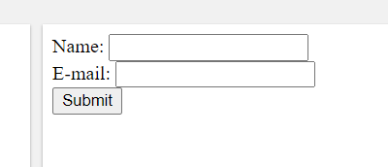
PHP – using forms
The form in HTML
The PHP script to generate it
<html> <body> <form action="welcome.php" method="post"> Name: <input type="text" name="name"><br> E-mail: <input type="text" name="email"><br> <input type="submit"> </form> </body> </html>
<html> <body> Welcome <?php echo $_POST["name"]; ?><br> Your email address is: <?php echo $_POST["email"]; ?> </body> </html>
output from welcome.php
Welcome John Your email address is john.doe@example.com

Slide 38
python – popular libraries/packages/archives/resources
Beautiful mobile device scaled GUI
The infamous python science stack
CUDA for GPU accelerated NumPy
https://kivy.org/#home
Web–based data app maker
https://www.scipy.org/about.html
https://cupy.dev/
https://streamlit.io/
Data and computation:
pandas, providing high-performance, easy-to-use data structures.
SymPy, for symbolic mathematics and computer algebra.
NetworkX, is a collection of tools for analyzing complex networks.
scikit-image is a collection of algorithms for image processing.
scikit-learn is a collection of algorithms and tools for machine learning.
h5py and PyTables can both access data stored in the HDF5 format.
Works well with many other API/frameworks
https://gstreamer.freedesktop.org/
https://keras.io/
Productivity and high-performance computing:
IPython, a rich interactive interface, letting you quickly process data and test ideas.
The Jupyter notebook provides IPython functionality and more in your web browser, allowing you to document your computation in an easily reproducible form.
Cython extends Python syntax so that you can conveniently build C extensions, either to speed up critical code or to integrate with C/C++ libraries.
Dask, Joblib or IPyParallel for distributed processing with a focus on numeric data.
Extending molecular modeling software
https://pymol.org/2/
https://www.cgl.ucsf.edu/chimera/
https://www.tutorialspoint.com/python/index.htm
https://www.w3schools.com/python/

Slide 39
python - basic syntax
Interactive mode (type command at interpreter)
$ python
Python 2.4.3 (#1, Nov 11 2010, 13:34:43)
[GCC 4.1.2 20080704 (Red Hat 4.1.2-48)] on linux2
Type "help", "copyright", "credits" or "license" for more information.
>>>
>>> print "Hello, Python!"
Script mode (put the above command in test.py file)
$ python test.py
Whitespace/indent sensitivity
if True:
print "True"
else:
print "False"
if True:
print "True"
else:
print "False"
This works
This does not work

Slide 40
python - commenting and style conventions
Always create then call a main function
print("Hello, World!") #This is a comment
def main():
print("Hello World!")
if __name__ == "__main__":
main()
""" This is a comment written in more than just one line """ print("Hello, World!")
Call all other classes and functions from main()
class Application():
#main code goes here
def main():
app = Application()
if __name__ == '__main__':
main()
Everything in python should be a function (aka ‘pythonic’ code)
Favor object orientation over procedural code
def my_function(): print("Hello from a function") my_function()
IMPORTANT: scoping is local …variables defined within a function (i.e. in def block) do not exist outside that function

Slide 41
python – data type conventions
Python does not use arrays but rather sets, tuples, or lists
myset = {"apple", "banana", "cherry"}
Unordered and unindexed
mytuple = ("apple", "banana", "cherry")
Ordered and unchangeable
mylist = ["apple", "banana", "cherry"]
Ordered, indexed and changeable
Python does not use associative arrays (i.e. hashes or hash tables) but rather defines a dictionary
mydictionary = { "brand": "Ford", "model": "Mustang", "year": 1964 }
x = int(1.0) # x will be 1 y = int(2.8) # y will be 2 z = float("3") # z will be 3.0 w = float("4.2") # w will be 4.2
Can control type with casting
Can use type() function to return data type if you are unsure (returns str, int, float, bool, list, set, tuple, dict)

Slide 42
python - statements and conditionals
a = 200 b = 33 if b > a: print("b is greater than a") elif a == b: print("a and b are equal") else: print("a is greater than b")
a = 200 b = 33 c = 500 if a > b and c > a: print("Both conditions are True")
Shorthand form
a = 2 b = 330 print("A") if a > b else print("B“)
a = 330 b = 330 print("A") if a > b else print("=") if a == b else print("B“)

Slide 43
python - loop structure and code blocking
for x in "banana": print(x)
fruits = ["apple", "banana", "cherry"] for x in fruits: print(x)
for x in range(2, 6): print(x)
for x in range(6): if x == 3: break print(x) else: print("Finally finished!")
adj = ["red", "big", "tasty"] fruits = ["apple", "banana", "cherry"] for x in adj: for y in fruits: print(x, y)
Note ‘continue’ is python equivalent of ‘next’ in perl
To ‘break’ a loop in perl you would use ‘goto’
i = 1 while i < 6: print(i) i += 1 else: print("i is no longer less than 6")
i = 0 while i < 6: i += 1 if i == 3: continue print(i)
i = 1 while i < 6: print(i) i += 1

Slide 44
python - I/O and system interaction
fo = os.open("foo.txt", "w") # Open a file
print "Name of the file: ", fo.name
fo.close() # Close file
Use open/close functions, not read/write. NOTE: the second argument of open() indicates access via read, write, or append mode
Note: ‘import’ is python command for loading a package/module/library to your script
Do not use system calls in python, instead use os or subprocess modules
import os
cmd = "git --version"
returned_value = os.system(cmd) # returns the exit code in unix
print('returned value:', returned_value)
import mymodule a = mymodule.person1["age"] print(a)
import subprocess
cmd = "git --version"
returned_value = subprocess.call(cmd, shell=True) # returns the exit code in unix
print('returned value:', returned_value)

Slide 45
python - string interpolation
Traditional string interpolation in python is rather awkward and makes use of ‘%’ or ‘+’ symbol to escape
Note: requires a list at end that is preceded by % symbol
name = 'world'
program ='python‘
print(‘Hello’+program+’! This is’+program)
print('Hello %s! This is %s.‘ % (name,program))
Python 3.6 introduced a new form of literal string interpolation (f-string)
Note the lowercase f at the head of the string …and curly braces allow the escape
name = 'World'
program = 'Python'
print(f'Hello {name}! This is {program}')

Slide 46
python - regular expressions
import re txt = "The rain in Spain" x = re.split("\s", txt) print(x)
import re txt = "The rain in Spain" x = re.findall("ai", txt) print(x)
import re txt = "The rain in Spain" x = re.search("ai", txt) print(x) #this will print an object
import re txt = "The rain in Spain" x = re.search("\s", txt) print("The first white-space character is located in position:", x.start())

Slide 47
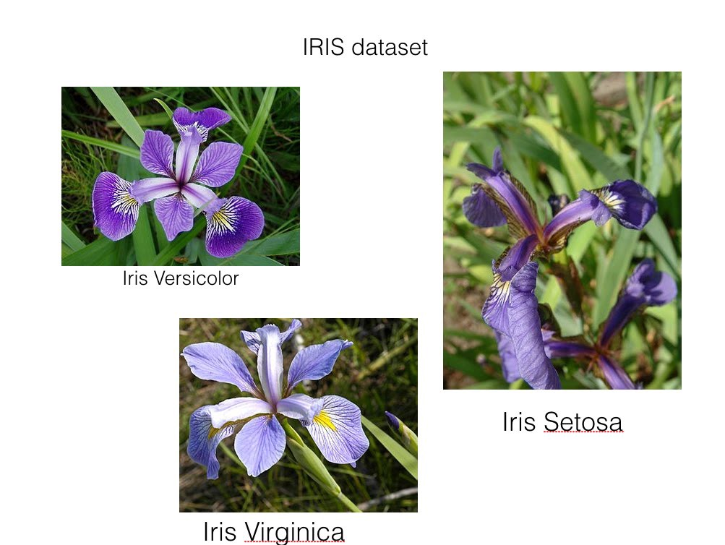
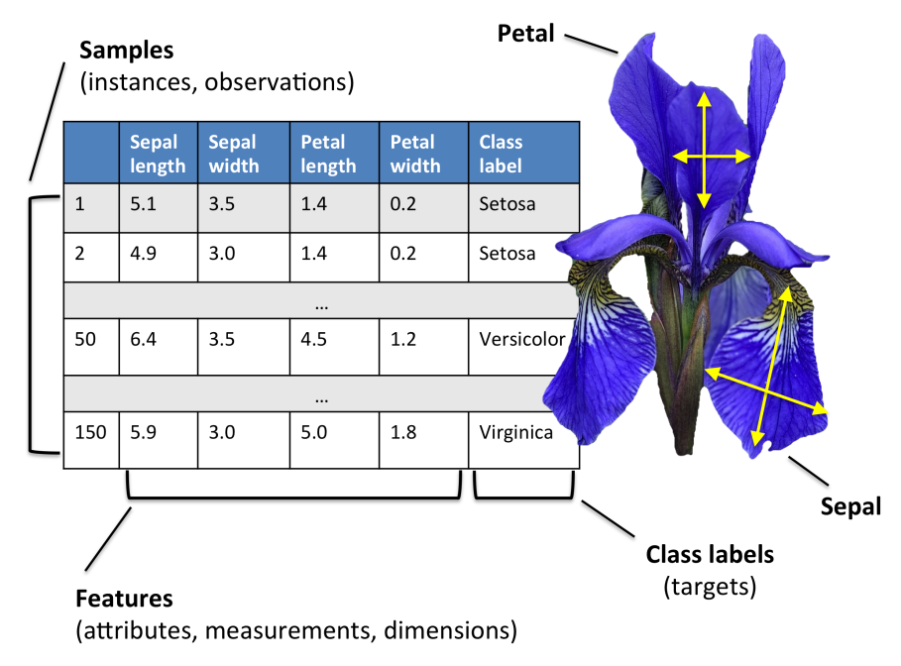
R – anatomy of a basic R script
Starter code example for anatomy of an R script
https://github.com/gbabbitt/RocASAsamples/blob/main/iris_code.R
Dr Babbitt’s starter code library
https://gbabbitt.github.io/RocASAsamples/

Slide 48
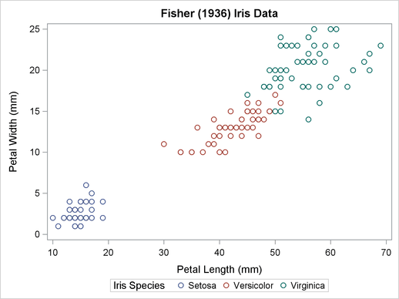
R – anatomy of a basic R script
Starter code example for anatomy of an R script
https://github.com/gbabbitt/RocASAsamples/blob/main/iris_code.R
Dr Babbitt’s starter code library
https://gbabbitt.github.io/RocASAsamples/

Slide 49
R – popular libraries/packages/archives/resources
R software project and code archive is hosted at CRAN
https://cran.r-project.org/
The Rstudio code editor
Deep learning with keras and tensorflow
https://rstudio.com/
https://keras.rstudio.com/
A simple GUI to emulate a stats package
Publication quality scientific graphics
https://www.rcommander.com/
https://ggplot2.tidyverse.org/
Has great many sophisticated statistics and machine learning libraries
https://www.w3schools.com/r/default.asp
https://www.tutorialspoint.com/r/index.htm

Slide 50
x <- 10.5 # numeric
y <- 10L # integer
z <- 1i # complex
R – syntax, commenting and style conventions
Three unusual but common symbols in R
my_var <- 30 # my_var is type of numeric my_var <- "Sally" # my_var is now of type character (aka string)
<- is the ubiquitous assignment operator in R
~ is the tilde operator in R used in formula arguments for most functions
The class() function returns data type …equivalent to type() in python
$ is the subset operator in R, often used for defining data columns
. dots are a stylistic thing in R and NOT object.method ‘dot notation’ found in other function rich languages
c(….) is a vector/array …the c means ‘combine’
NOTE: R IS TYPICALLY WRITTEN IN PROCEDURAL STYLE WITH FUNCTIONS AND PLOTS TREATED AS OBJECTS USING THE ASSIGNMENT OPERATOR
numeric (10.5, 55, 787)
integer (1L, 55L, 100L, where the letter "L" declares this as an integer)
complex (9 + 3i, where "i" is the imaginary part)
character/string ("k", "R is exciting", "FALSE", "11.5")
logical/booleans (TRUE or FALSE)
R hosts many useful data structures
# Create a data frame Data_Frame <- data.frame ( Training = c("Strength", "Stamina", "Other"), Pulse = c(100, 150, 120), Duration = c(60, 30, 45) )
The data frame is the central data structure in R

Slide 51
R – statements, conditionals and loops
for (x in 1:10) { print(x) }
a <- 200 b <- 33 if (b > a) { print("b is greater than a") } else if (a == b) { print("a and b are equal") } else { print("a is greater than b") }
fruits <- list("apple", "banana", "cherry") for (x in fruits) { print(x) }
dice <- c(1, 2, 3, 4, 5, 6) for (x in dice) { print(x) }
fruits <- list("apple", "banana", "cherry") for (x in fruits) { if (x == "banana") { next } print(x) }
i <- 1 while (i < 6) { print(i) i <- i + 1 }

Slide 52
R – syntax, commenting and style conventions
R hosts many other useful data structures
# Vector of strings fruits <- c("banana", "apple", "orange")
# Vector of numerical values numbers <- c(1, 2, 3)
# Vector with numerical values in a sequence numbers <- 1:10
# List of strings thislist <- list("apple", "banana", "cherry")
thislist[1] # pointer to item “apple” in list
# An array with one dimension with values ranging from 1 to 24 thisarray <- c(1:24) # An array with more than one dimension multiarray <- array(thisarray, dim = c(4, 3, 2)) # Create a matrix thismatrix <- matrix(c(1,2,3,4,5,6), nrow = 3, ncol = 2)
thismatrix <- matrix(c("apple", "banana", "cherry", "orange"), nrow = 2, ncol = 2) thismatrix[1, 2] # returns item in row 1 column 2
# Create a factor (…a categorical variable in statistics) music_genre <- factor(c("Jazz", "Rock", "Classic", "Classic", "Pop", "Jazz", "Rock", "Jazz"))
indexing of arrays starts at 1 not 0 like most other languages

Slide 53
R – functional assignment, built-in functions and library functions
abs(-4.7)
sqrt(16)
ceiling(1.4) # round up floor(1.4) # round down
x <- c(5,7,8,7,2,2,9,4,11,12,9,6) y <- c(99,86,87,88,111,103,87,94,78,77,85,86) plot(x, y)
Do not use built in plotting, use ggplot2 library
my_function <- function(x, y) { a <- x + y return(a) }
my_function(2,2) # returns value of the function for these inputs
## Not assuming equal variances
oneway.test(extra ~ group, data = sleep)
## Assuming equal variances
oneway.test(extra ~ group, data = sleep, var.equal = TRUE)
## which gives the same result as
anova(lm(extra ~ group, data = sleep))
ALWAYS check R documentation carefully when using library functions
MAKE SURE YOU ARE USING ARGUMENTS EXACTLY AS REQUIRED FOR EACH FUNCTION
https://www.rdocumentation.org/packages/stats/versions/3.6.2/topics/oneway.test

Slide 54
R – functional assignment, built-in functions and library functions
An example with much more sophisticated function for support vector machine learning from kernlab library
https://www.rdocumentation.org/packages/kernlab/versions/0.9-29/topics/ksvm
## Another example with the famous iris data
data(iris)
library(‘kernlab’)
## Create a kernel function using the build in rbfdot function
rbf <- rbfdot(sigma=0.1)
rbf
## train a bound constraint support vector machine
irismodel <- ksvm(Species~.,data=iris,type="C-bsvc",
kernel=rbf,C=10,prob.model=TRUE)
print(irismodel)
## get fitted values
fitted(irismodel)
## Test on the training set with probabilities as output
predict(irismodel, iris[,-5], type="probabilities")
Note: ‘library’ is R command for loading a package/module/library to your script
ALWAYS check R documentation carefully when using library functions
MAKE SURE YOU ARE USING ARGUMENTS EXACTLY AS REQUIRED FOR EACH FUNCTION

Slide 55
R - regular expressions
R has no RegEx, but can use simple grep to find match
str <- " Hello, World!" grepl("H", str) grepl("Hello", str) grepl("X", str)

Slide 56
R – basic I/O
data=read.table("/home/microcarbon/Desktop/iris_tab.txt",header=TRUE)
sepal_length=data$sepal_length
sepal_width=data$sepal_width
petal_length=data$petal_length
petal_width=data$petal_width
species=data$species
iris.data<-data.frame(
sepal_length,
sepal_width,
petal_length,
petal_width,
species
)
print(iris.data)
print(summary(iris.data))
$ subsets each column by its header and later is used to create new data frame
there is also a write table function
https://www.rdocumentation.org/packages/utils/versions/3.6.2/topics/read.table

Slide 57
R – basic I/O
# print means, ANOVA test, and summary to external file
sink(file = '/home/microcarbon/Desktop/meansIRIS.txt')
print(iris.means)
print(summary(iris.means))
print(sepal_length.anova)
print(sepal_width.anova)
print(petal_length.anova)
print(petal_width.anova)
sink()
Sink() function can be used to divert output to the R console to be stored in a text file

Slide 58
R – anatomy of a basic R script
Starter code example for anatomy of an R script
https://github.com/gbabbitt/RocASAsamples/blob/main/iris_code.R
Dr Babbitt’s starter code library
https://gbabbitt.github.io/RocASAsamples/

Slide 59
Ruby – popular libraries/packages/archives/resources
Libraries and packages are called ‘gems’
https://rubygems.org/
Ruby uses the word ‘require’ to load a ‘gem’ into your script as in require gem or require module
Is language equivalent to use package in perl, import module in python, library(package) in R
Ruby on Rails – famous Web application framework
https://www.tutorialspoint.com/ruby-on-rails/index.htm
Main tutorial
https://www.tutorialspoint.com/ruby/index.htm

Slide 60
Ruby - basic syntax
puts "This is main Ruby Program"
END {
puts "Terminating Ruby Program"
}
BEGIN {
puts "Initializing Ruby Program"
}
Ruby is always object-oriented using classes, objects and methods
‘puts’ is ‘print’ with automatic new line at end
BEGIN and END code blocks used to initiate and terminate
class Sample
def function
statement 1
statement 2
end
end
class Sample
def hello
puts "Hello Ruby!"
end
end
In Ruby, functions are called ‘methods’
code blocks are defined with indentation and an end statement

Slide 61
Ruby - commenting and style conventions
$global_variable = 10
class Class1
def print_global
puts "Global variable in Class1 is #$global_variable"
end
end
class1obj = Class1.new
class1obj.print_global
Functions=methods are called on objects using the object.method convention
.new is a built-in method
.print_global is user defined method
# This is a single line comment.
# below is a multi-line comment
=begin
This is a comment.
This is a comment, too.
This is a comment, too.
I said that already.
=end
class Customer
@@no_of_customers = 0
def initialize(id, name, addr)
@cust_id = id
@cust_name = name
@cust_addr = addr
end
end
variable scoping examples
$var is global
_var is local defined in a method
@var is local defined in a object
@@var is belonging to a class

Slide 62
Ruby - methods and classes
You can pass parameters to method new and those parameters can be used to initialize class variables.
When you plan to declare the new method with parameters, you need to declare the method initialize at the time of the class creation.
The initialize method is a special type of method, which will be executed when the new method of the class is called with parameters
class Customer
@@no_of_customers = 0
def initialize(id, name, addr)
@cust_id = id
@cust_name = name
@cust_addr = addr
end
end
In this example, you declare the initialize method with id, name, and addr as local variables. Here, def and end are used to define a Ruby method initialize.
In the initialize method, you pass on the values of these local variables to the instance variables @cust_id, @cust_name, and @cust_addr. Here local variables hold the values that are passed along with the new method.
Now, you can create objects as follows −
cust1 = Customer.new("1", "John", "Wisdom Apartments, Ludhiya")
cust2 = Customer.new("2", "Poul", "New Empire road, Khandala")
You can probably see how this language would be useful on a webserver

Slide 63
Ruby - I/O
Use sysread() and syswrite()
Read first 20 characters of a file
Write “ABCDEF” to a file
aFile = File.new("input.txt", "r")
if aFile
content = aFile.sysread(20)
puts content
else
puts "Unable to open file!"
end
aFile = File.new("input.txt", "r+")
if aFile
aFile.syswrite("ABCDEF")
else
puts "Unable to open file!"
end

Slide 64
Ruby - string interpolation
Use #{ } to interpolate output expressions
x, y, z = 12, 36, 72
puts "The value of x is #{ x }."
puts "The sum of x and y is #{ x + y }."
puts "The average was #{ (x + y + z)/3 }."
myStr = String.new("THIS IS TEST")
foo = myStr.downcase
puts "#{foo}"

Slide 65
Ruby – statements, conditionals and loops
Unless executes statement if false
begin and end as weird way to loop
x = 1
if x > 2
puts "x is greater than 2"
elsif x <= 2 and x!=0
puts "x is 1"
else
puts "I can't guess the number"
end
x = 1
unless x>=2
puts "x is less than 2"
else
puts "x is greater than 2"
end
$i = 0
$num = 5
begin
puts("Inside the loop i = #$i" )
$i +=1;
end until $i > $num
Ruby makes heavy use of ‘do’ and ‘until’ in its loops
$i = 0
$num = 5
while $i < $num do
puts("Inside the loop i = #$i" )
$i +=1
end
$i = 0
$num = 5
until $i > $num do
puts("Inside the loop i = #$i" )
$i +=1;
end
for i in 0..5
puts "Value of local variable is #{i}"
end
for i in 0..5
if i < 2 then
next
end
puts "Value of local variable is #{i}"
end

Slide 66
Ruby - regular expressions
line1 = "Cats are smarter than dogs";
line2 = "Dogs also like meat";
if ( line1 =~ /Cats(.*)/ )
puts "Line1 contains Cats"
end
if ( line2 =~ /Cats(.*)/ )
puts "Line2 contains Dogs"
end
RegEx in ruby is very like perl
Here a simple match search

Slide 67
Ruby – arrays and hashes
names = Array.new(4, "mac")
puts "#{names}
Creates [mac, mac, mac, mac]
digits = Array(0..9)
puts "#{digits}"
Creates [0, 1, 2, 3, 4, 5, 6, 7, 8, 9]
$, = ", "
months = Hash.new( "month" )
months = {"1" => "January", "2" => "February"}
keys = months.keys
puts "#{keys}"
Creates [“1”, “2”]

Slide 68

Overview
“Julia is a high-level, high-performance dynamic programing language”
Its design is for technical computing
Technical computing, according to Wikipedia, is the application of the mathematical and computational principles of scientific computing
Julia’s programming domain is imperative
It is open-source, so it can be extended and optimized by anyone
Julia can be ran on an interpreter, but has the capabilities to be statically compiled
Can easily call methods defined in C and Python

Slide 69
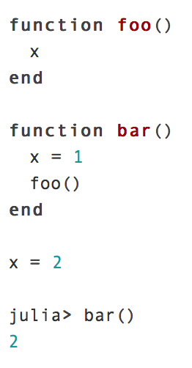
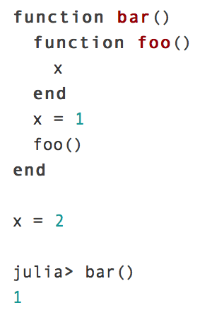
Variables
Code 1
Code 2
Execution 1
Execution 2
There is no local declaration of x for the function foo()
x is locally defined to 1 for the function foo()

Slide 70
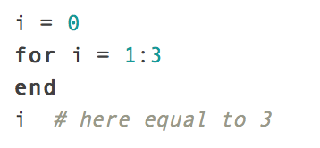
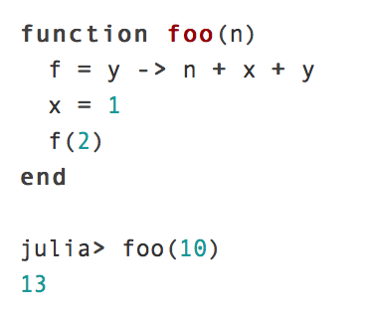
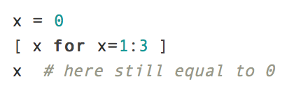
Variables
Variable names can be functions and the variable stores the value of the function
List comprehension creates a new local scope

Slide 71
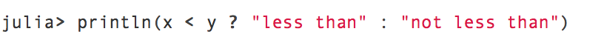
Ternary Operators
Single ternary operator
if x = 1 and y = 2 then “less than” is printed
if x = 2 and y = 1 then “not less than” is printed
Chain of multiple ternary operators
if x = 1 and y = 2 then “x is less than y” is printed
if x = 2 and y = 1 then “x is greater than y” is printed

Slide 72
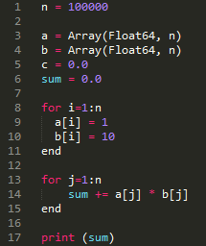
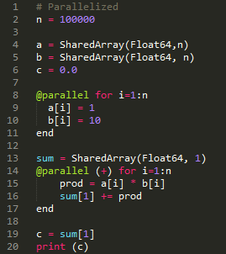
Julia By Example, Dot Product
Serial
Parallel

Slide 73
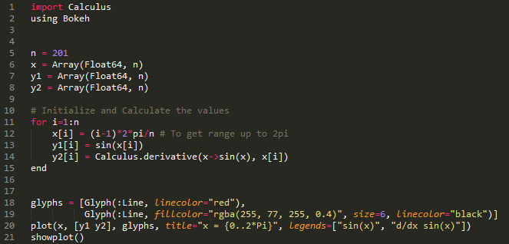
Julia By Example, Derivatives

Slide 74
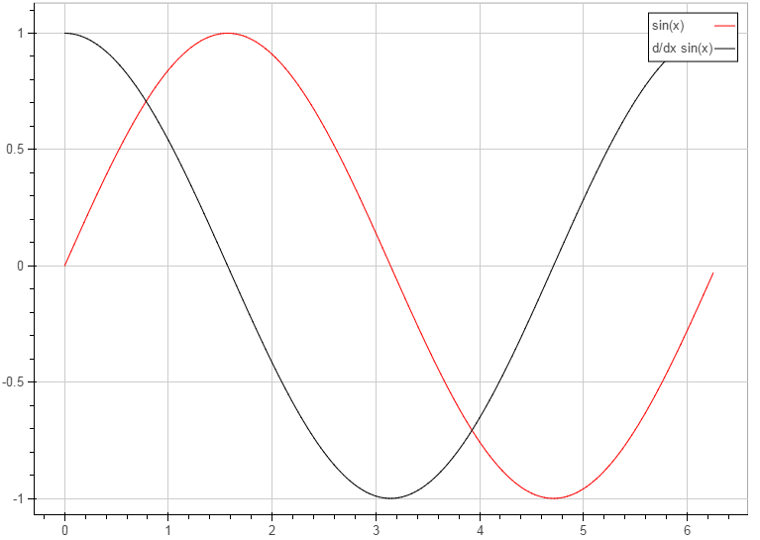
Julia By
Example
Plotted
Results

Slide 75
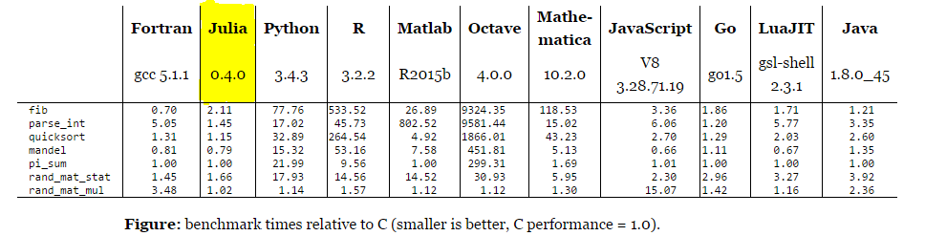
Language Comparison

Slide 76
References
www.julialang.org/
http://www.infoworld.com/article/2616709/application-development/new-julia-language-seeks-to-be-the-c-for-scientists.html
http://www.wired.com/2014/02/julia/
http://julialang.org/blog/2012/02/why-we-created-julia/

Slide 77
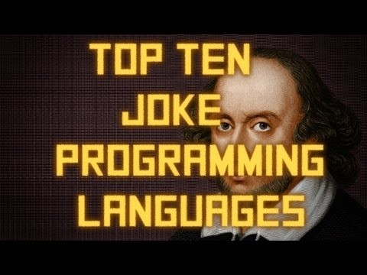
https://www.intercaloninterstates.org/

Slide 78
