Slide 1
Internet
Kubernetes control
Worker node
kubelet
kube-proxy
Master node
Docker
Master node
Pod
Pod
API server
Containers
Containers
-controller-manager
-scheduler
Worker node
kubelet
kube-proxy
replication, namespace, serviceaccounts, etc.
etcd
Docker
Pod
Pod
Containers
Containers
master components
node components

Slide 2
Internet
Kubernetes control
Worker node
kubelet
kube-proxy
Master node
Docker
Pod
Pod
API server
Containers
Containers
-controller-manager
-scheduler
Worker node
kubelet
kube-proxy
replication, namespace, serviceaccounts, etc.
etcd
Docker
Azure managed control plane
Pod
Pod
Containers
Containers
master components
node components

Slide 3
Azure managed control plane
Automated upgrades, patches
High reliability, availability
Easy, secure cluster scaling
Self-healing
API server monitoring
At no charge
Auto Scaling of Nodes
Self-managed master node(s)
App/ workload definition
Kubernetes API endpoint
etcd Store
User
API server
Scheduler
Controller Manager
Cloud Controller
Schedule pods over private tunnel
Customer Worker Node VMs
Docker
Docker
Docker
Docker
Docker
Pods
Pods
Pods
Pods
Pods
Visible to the users/administrators

Slide 4

AKS is not PaaS
Shared responsibility for agent nodes

Slide 5
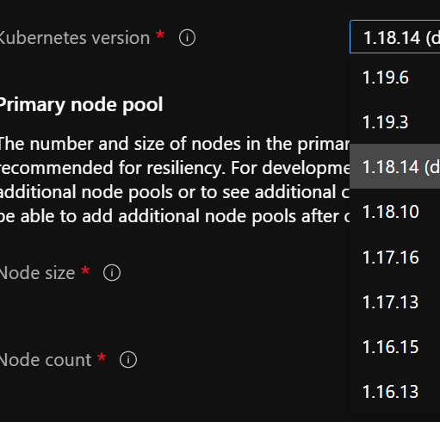
Shared Responsibility
You control the version of Kubernetes to deploy
You decide when to upgrade (with limitations)
You need to reboot the nodes to apply security updates
Linux only
You control the node image version
Notes:
https://docs.microsoft.com/en-us/azure/architecture/operator-guides/aks/aks-upgrade-practices
Node image version:
see https://docs.microsoft.com/en-us/azure/aks/node-image-upgrade
AKS provides one new image per week with latest updates (win & linux)
you can upgrade the node images WITHOUT upgrading the version of Kubernetes
requires VMSS
How:
az aks upgrade \
--resource-group myResourceGroup \
--name myAKSCluster \
--node-image-only
This does all nodes in all pools; can also be done for a specific node pool
Use –max-surge to upgrade faster (not one node at a time)
This can also be done with a GitHub Action (e.g. on a schedule): https://docs.microsoft.com/en-us/azure/aks/node-upgrade-github-actions

Slide 6
Beware of previews
Many AKS functionalities are added as previews
e.g., pod-managed identities, application gateway ingress controller
Requires Azure CLI preview extensions
Requires feature registration @ Azure subscription level

Slide 7
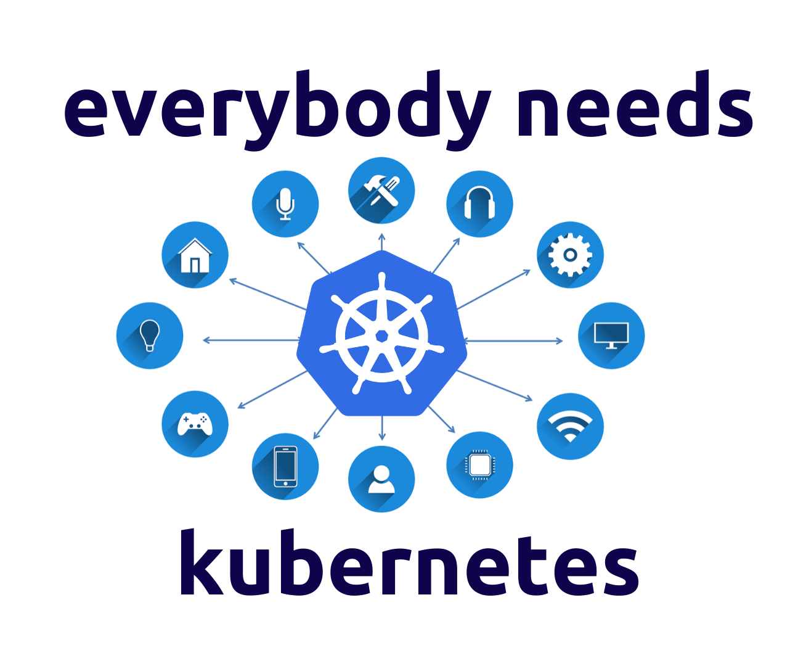
Do you need Kubernetes?
Containers on plain IaaS
Azure Container Instances (ACI)
Azure Web App
Google Cloud Run
…
Image Source: link

