Slide 1
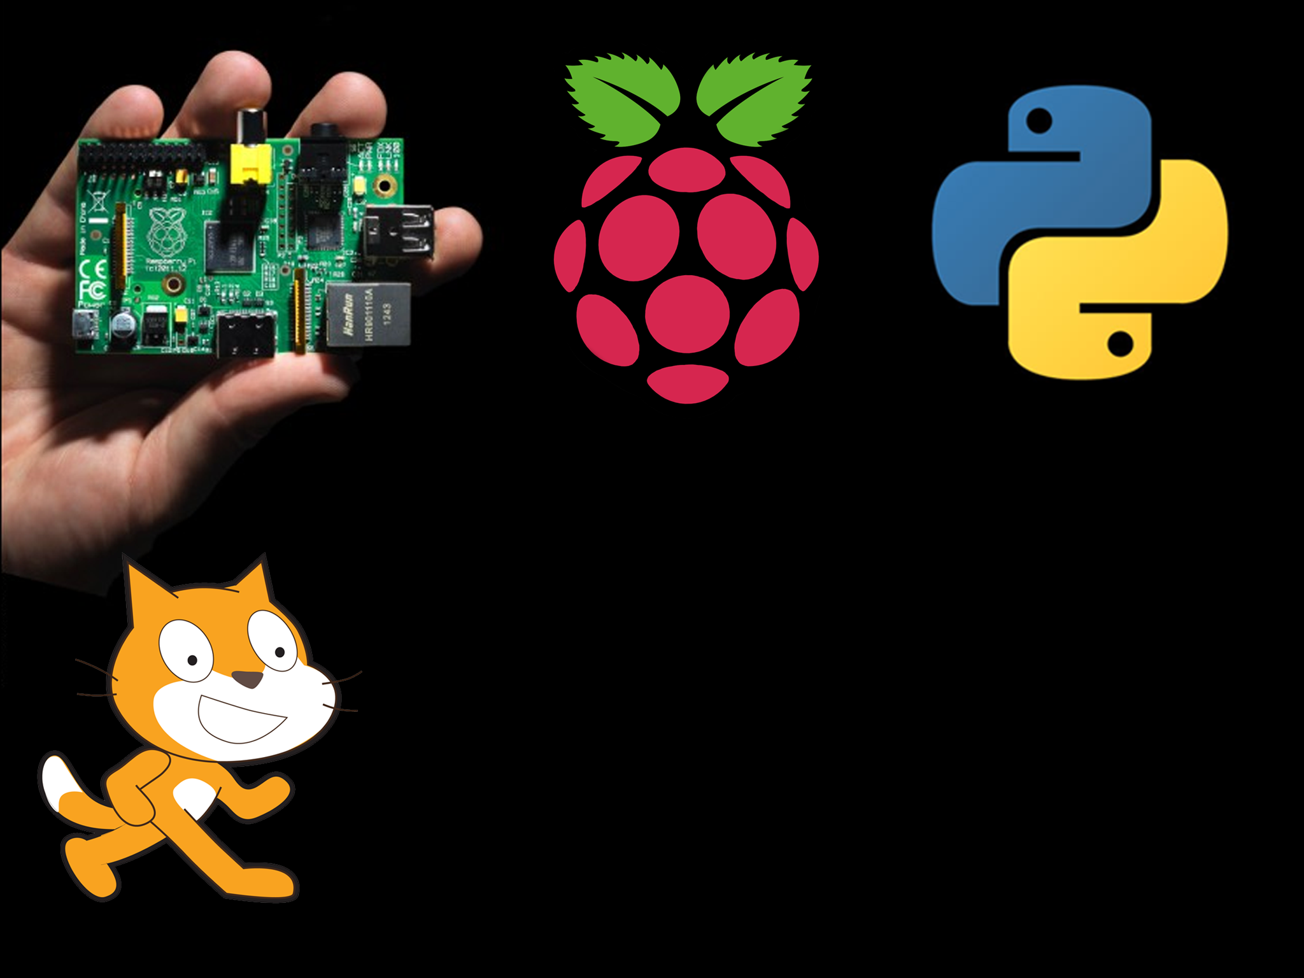
So you want to learn to code with the Raspberry Pi?

Slide 2
So what will we be doing?
What is the Pi and how to set it up
Advanced scratch
Bash
Python
Physical computing
Make your own robot!
Notes:
_x0010_

