Slide 1
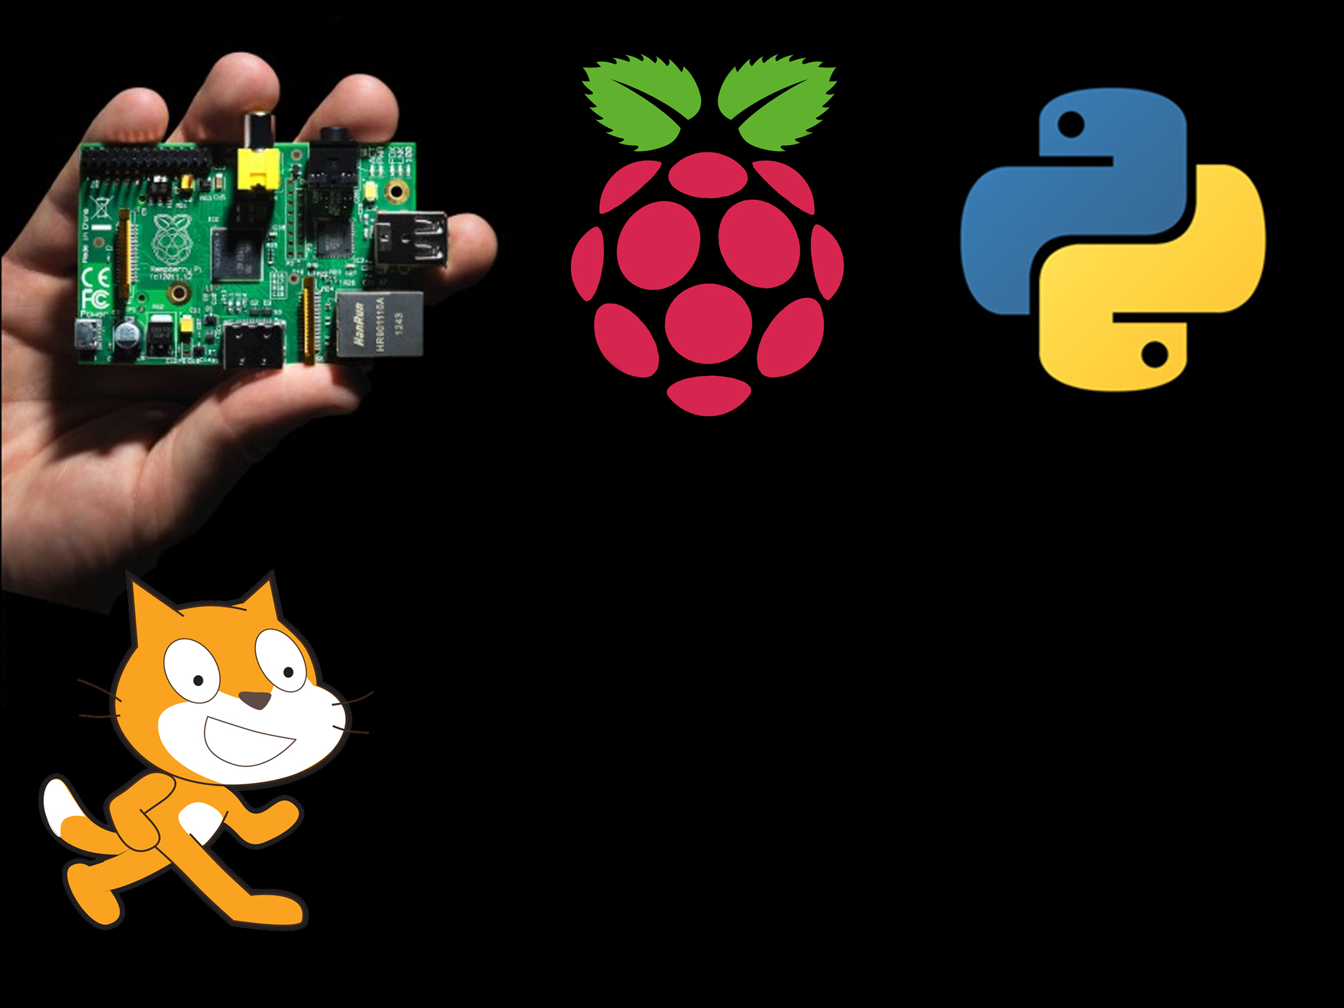
Advanced Scratch

Slide 2
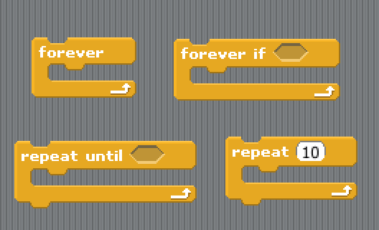
Loops
There is a few types of loops in scratch
The main loops you have been using are
Forever just keeps repeating forever and ever!
Repeat until repeats until it is fed a “True”

Slide 3
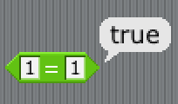
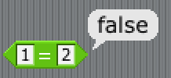
Feed a “True”?
I am sure you are wondering what? I can feed a computer True?
Computer is very good at comparing 2 values and seeing if they are the same or bigger or smaller. When a computer compares something it either returns True or False

Slide 4
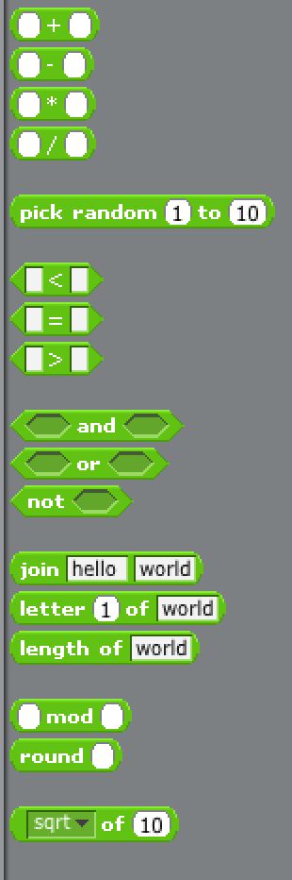
Operators
Operators are split into a few types
Mathy sort of things
Comparers and combiners
String stuff

Slide 5


Variables
But operators aren’t much use without variables!
A variable is just somewhere you can store some information
You can call it whatever you want and it can store words or numbers.
To make one hit
To change or set a variable use

Slide 6
Controlling stuff
We can also use scratch to control real world objects.
We can turn on LEDs, motors or buzzers
We can receive inputs from buttons, ultrasonic sensors or other sensors.
The Raspberry Pi has a bank of 26 pins, we can use about 10 of them for controlling.
All we can do is turn them on or off, simple?

Slide 7
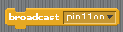
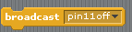

Lets turn one on
I am going to turn pin 11 on in this example
To turn the pin off again we use
Or, if you want you can just turn all the pins off

