Slide 1
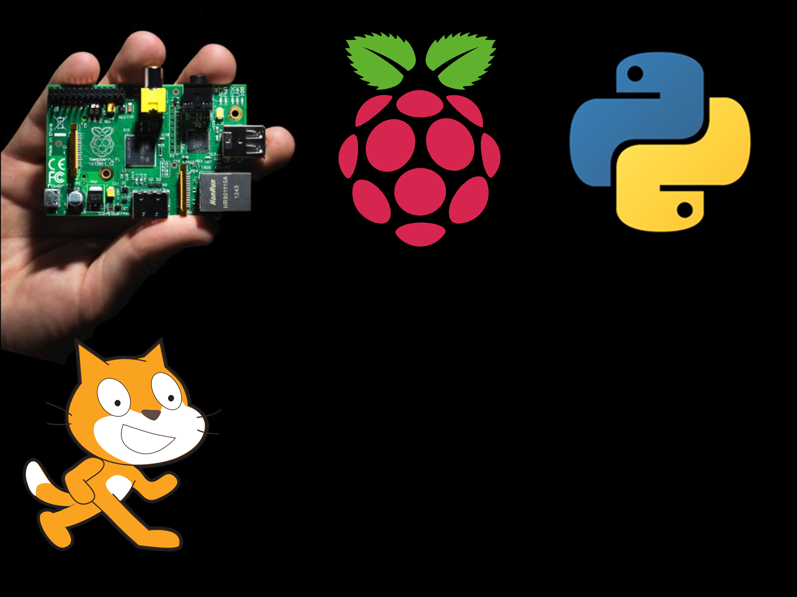
Theory

Slide 2
Why theory?
Theory underpins everything
Without knowing how the bits in the computer work, how can you know how to fix it if (when) it breaks.
It also lets us understand how a computer works.

Slide 3
Parts
A computer is made up of a pile of parts.
Each is useless on its own but together, they make something awesome
The main parts of a computer are
  CPU
  RAM
  HDD
  GPU

Slide 4
CPU
Central processing unit
The brain of the computer
It can do maths, compare stuff and save stuff
Incredibly advanced, “One of mans most advanced ever inventions”
Average processor contains about 700,000,000 transistors!
The current record is 5,000,000,000 transistors!

Slide 5
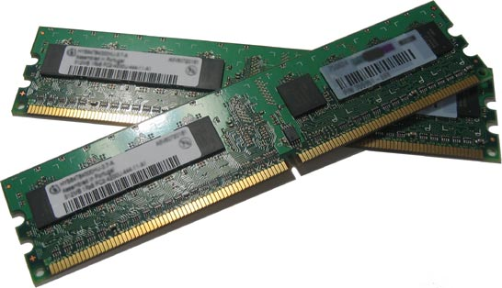
RAM
Random Access Memory
Very very fast memory used to store stuff you are working on right now or very recently
Stuff like your operating system, or scratch if it is open etc.
The more programs you open, the more ram you will need
When you unplug your computer, RAM is wiped (called volatile)

Slide 6
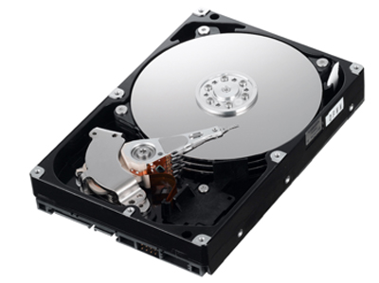
HDD
Hard Disk Drive
A much slower place to store your stuff but when you unplug your computer, it stays.
Contains a spinning disk inside with your data on it.
Come in sizes up to 3TB!
Cheap and normally reliable
Uses lots of power, is also heavy and large

Slide 7
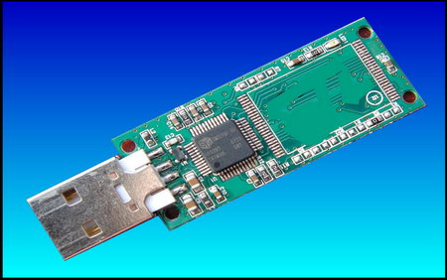
Flash memory
Newer more modern type of memory
More expensive than HDDs but more reliable
Flash drives use flash memory
Uses way less power
Faster than HDDs and smaller
Used in your phone
Used in camera SD cards
Very expensive in big sizes

Slide 8
GPU
Graphic Processing Unit
It is in charge of putting a picture on your screen.
Gamers, 3D designers or video editors need a powerful GPU.
Raspberry Pi has a very powerful GPU so can play 1080p Full HD video.

Slide 9
Tea Break
Bob is buying a new computer, he has 1000s of family photographs and so needs lots of space. Which type of memory should he use, HDD or flash memory and why?
Bob now has his new computer, he wants to transfer 2gb of music to his new computer, what could he use?

Slide 10
Other stuff
There is a pile of other stuff computers may have including
  CD drive
  Keyboard
  Mouse
  Network card
  Wifi card
  Bluetooth.

