Slide 1
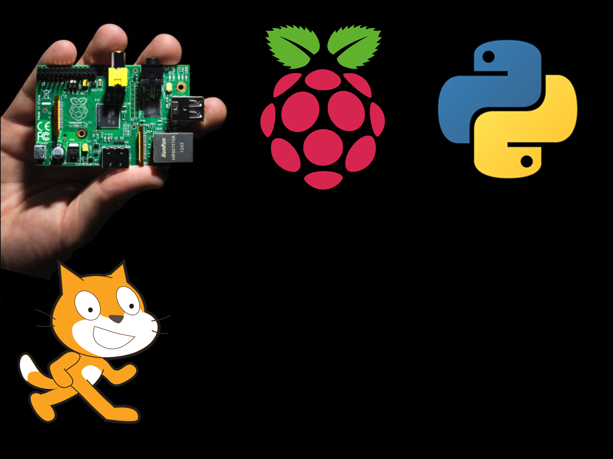
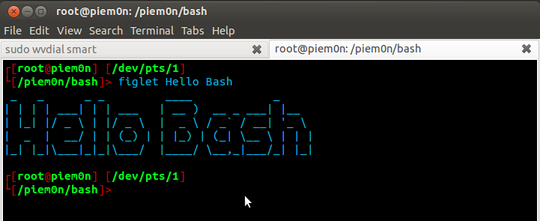
Bash
(Bourne Again Shell)

Slide 2
What is bash?
First we need to ask, what is a shell?
A shell is a layer between you and the insides of the operating system (for us, raspbian)
The most common of these is called BASH
Which stands for Bourne Again Shell
It is used in the command line and is very very powerful. There is a few commands you need to know.

Slide 3
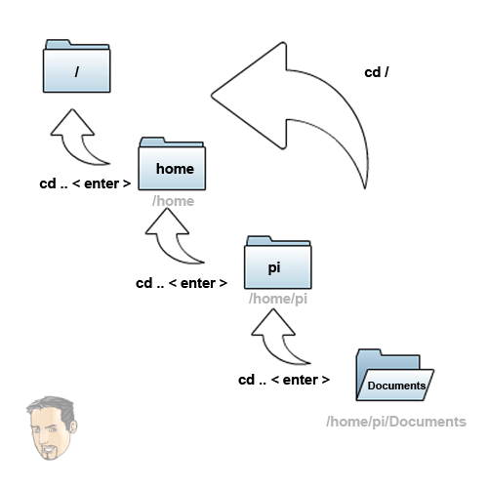
cd
Change directory
It allows us to move between folders
It is used to change our working directory (where we are currently working from) so somewhere else.
What’s a…
Directory
A directory is another name for a folder.
Code Example
$ cd / Changes directory to the top directory
$ cd /home/pi Changes directory to the /home/pi directory
$ cd test Changes directory to the test folder
$ cd .. Special version that goes up a single directory

Slide 4

ls
List contents of a directory
If it is given no parameters it will just list everything in the current directory
Code Example
$ ls Lists everything in your current working directory
$ ls / Lists everything in the / directory (aka top directory)
$ ls /home/pi Lists everything in the /home/pi directory

Slide 5
cp
Copy file or folder
It lets you copy your files and folders to a different place. It requires at least 2 parameters, what file do you want to copy and where do you want to copy it to.
Code Example
$ cp bob.txt bob2.txt Copy a file called bob.txt naming its copy bob2.txt
$ cp /home/pi/bob.txt /home/pi/bob2.txt Same as above just using full paths
$ cp -r test test2 For copying folders you need to add –r to copy everything

Slide 6
mv
Move file or folder. Also used to rename
Lets you move a file or folder but it is also used to rename files or folders as there is no rename in bash. It needs 2 parameters just like cp
Code Example
$ mv bob.txt bob2.txt Rename a file called bob.txt to bob2.txt
$ mv /home/pi/bob.txt /home/pi/bob2.txt Same as above just using full paths

Slide 7
nano
A command line text editor
Nano is a simple command line text editor for editing text files. It includes syntax highlighting for many languages including python!
To save your text file hit ctrl + x
Code Example
$ nano bob.txt Opens bob.txt or if it does not exist, makes a new one
$ nano bob.txt and ctrl+x Start editing bob.txt then save it

Slide 8
mkdir
Make new directory
Used to make a new folder/directory
Code Example
$ mkdir test Makes a new directory called test in your current working directory
$ mkdir /home/pi/test Makes a new directory called test at /home/pi/test

Slide 9
rm
Remove/delete
Lets you delete files or folders
Code Example
$ rm test.txt Deletes the file test.txt in your current working directory
$ rm -rf test Deletes a folder test. Take note of the -rf this forces it to delete everything in that folder.

Slide 10
Sudo
Run as root
It executes whatever you put after it as root. Be careful with it!
May need to enter a password
What’s a…
Root
Root can mean 2 things in linux
The base directory, you can’t go any higher than this
Root is the name for administrator in linux, it has all powers and is dangerous.
Code Example
$ sudo apt-get update
$ rm -rf test Deletes a folder test. Take note of the -rf this forces it to delete everything in that folder.

Slide 11
pwd
Print working directory
It will simply print out your current working directory, simple as that
Code Example
$ pwd Prints your current working directory

Slide 12
Miscellaneous
Startx – Starts the GUI
./filename Executes a file
Help Gives you a list of all the commands
Man commandname Opens the manual for the specified command.

Slide 13
Time to practice!
Make a directory called sandwich
Cd into sandwich
Check there is nothing inside
Make a text file called cheese.txt and add the words “ham and cheese” into it and save.
Rename the cheese.txt to ham.txt
Make a copy of ham.txt with the copy called cheese.txt
Delete the sandwich folder with you cheese.txt and ham.txt
Eat a ham and cheese sandwich (No, don’t actually eat it!)

Slide 14
Any questions?
Now’s your chance, any questions about BASH?
It really isn’t hard with a bit of practice!

