Slide 1
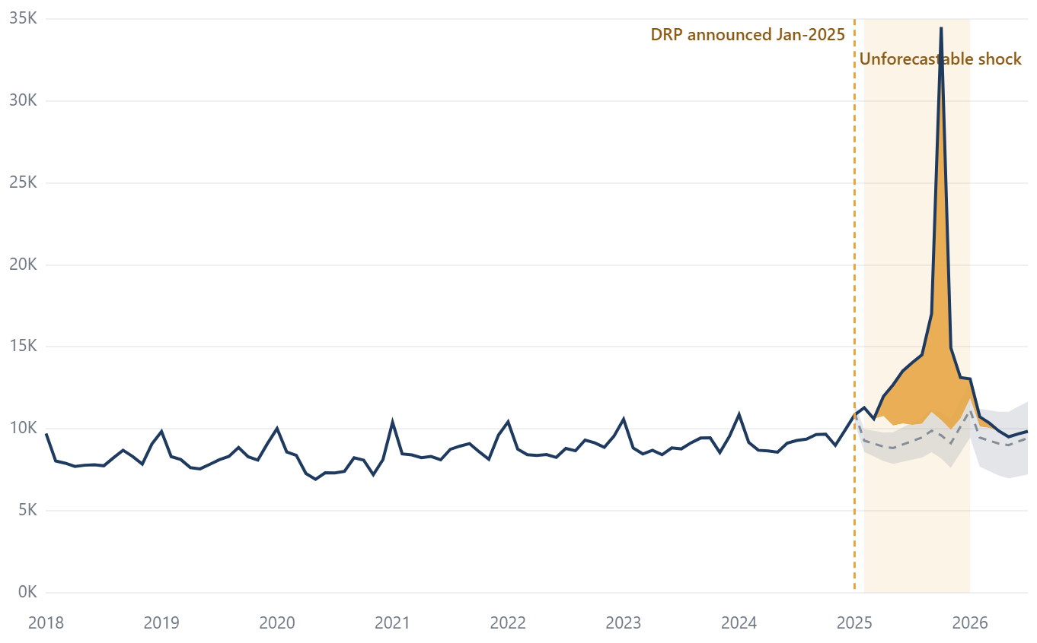
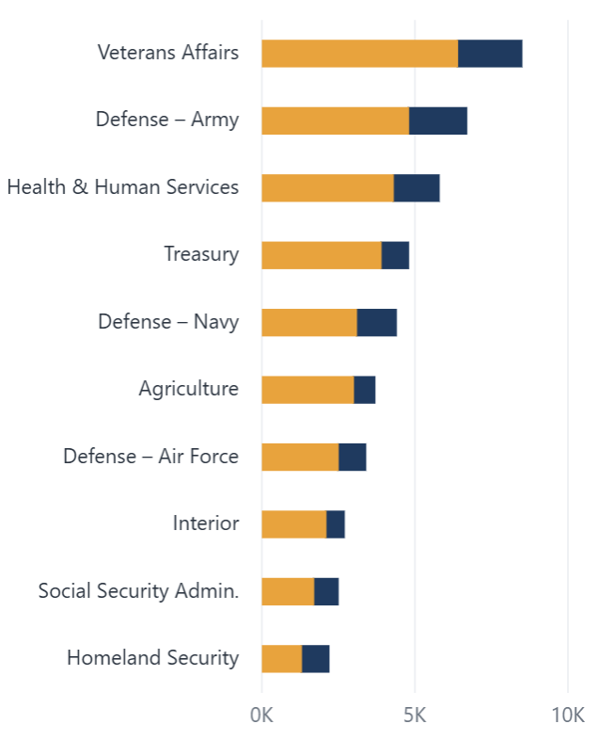
Federal Workforce Shock
Shock Overview
1
Shock
2
Risk segments
3
Pay & exit
4
Archetypes
5
Refill gap
6
Benchmark
HR Leadership · 2018–Jul 2026
How big was the 2025 shock?
FILTERS
TOTAL SEPARATIONS · 12M
Agency
Sample data
DRP SEPARATIONS
Sample data
% ABOVE FORECAST
Sample data
NET FLOW · 12M
Sample data
167.1K
43.8K
+46%
−96.9K
All agencies
▲ 26% vs prior 12 months
26% of 12-month separations
Actual vs SARIMA forecast, same 12 months
Accessions 70.2K − separations 167.1K
Occupational category
All
MONTHLY SEPARATIONS VS PRE-SHOCK FORECAST
Sample data
TOP 10 AGENCIES · EXCESS SEPARATIONS
Sample data
Grade band
Actual
SARIMA forecast (trained to Jan-2025)
95% band
DRP separations
DRP-attributed
Other excess
All
Date range
Jan 2018
Jul 2026
Reset filters
COLOUR KEY
DRP / policy shock
Observed values
Risk up
Excess = actual − forecast, last 12 months
Risk down
Source: OPM Federal Workforce Data (record-level employment snapshots, separations, accessions), Jan 2018 – Jul 2026 · BLS JOLTS quits rates
As of 31 Jul 2026 · All figures are sample placeholders
Notes:
Page 1: Shock Overview. How big was the 2025 shock? Build spec: KPI · Total separations (12m) (Card; count · separation_category · personnel_action_effective_date_yyyymm (rolling 12-month measure)) | KPI · DRP separations (Card; count · drp_indicator = Y · personnel_action_effective_date_yyyymm) | KPI · % above forecast (Card; count · personnel_action_effective_date_yyyymm · forecast table: forecast_count (SARIMA, trained ≤ 202501)) | KPI · Net flow (Card (rule-based font colour); count (accessions) − count (separations) · personnel_action_effective_date_yyyymm) | Monthly separations vs forecast (Line chart + error band (forecast_lo95/hi95) + X-axis constant line at 202501; DRP stacked area via Deneb or area-chart overlay; X: personnel_action_effective_date_yyyymm · Y: count, forecast_count, forecast_lo95, forecast_hi95 · Split: drp_indicator) | Top 10 agencies · excess separations (Stacked bar chart, Top N = 10 filter; Y: agency · X: count − forecast_count · Legend: drp_indicator)

Slide 2
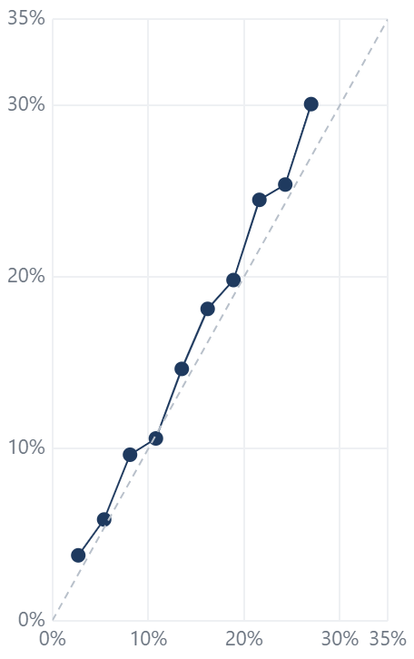
Federal Workforce Shock
Risk Segments
1
Shock
2
Risk segments
3
Pay & exit
4
Archetypes
5
Refill gap
6
Benchmark
HR Leadership · 2018–Jul 2026
Which employee segments were most likely to leave?
FILTERS
A · Dec-23 → Dec-24 (baseline)
B · Dec-24 → Dec-25 (shock)
Segment-level model — not individual prediction
Probabilities describe grouped cells and should not be applied to named employees.
Agency
COHORT
i
All agencies
12-MONTH SEPARATION PROBABILITY · GRADE × LOS
Sample data
ODDS RATIOS · GROUPED LOGISTIC REGRESSION
Sample data
MODEL FIT
Sample data
Occupational category
Cohort B · employed Dec-24, separated by Dec-25 (shock)
Higher odds
Lower odds
CI crosses 1
AUC
Brier score
All
<2
2–4
5–9
10–14
15–19
20–24
25+
0.68
0.112
Grade GS 13–14 (ref GS 7–9)
Calibration slope
Segments
Grade band
GS 1–6
13.8%
12.9%
12.2%
9.5%
12.8%
15.8%
22.3%
0.91
42 cells
All
Grade GS 15 / SES
Date range
Grade GS 1–6
Calibration by decile · predicted vs observed
Jan 2018
Jul 2026
GS 7–9
13.2%
11.7%
10.7%
10.4%
10.2%
14.9%
22.1%
LOS <2 yrs (ref 5–9)
Reset filters
LOS 20+ yrs
GS 10–12
14.2%
10.1%
10.7%
10.6%
10.2%
14.3%
21.6%
Age 55+ (ref 35–44)
Age <30
GS 13–14
13.7%
12.2%
12.4%
11.1%
12.1%
16.5%
23.2%
Supervisory: yes
Occ.: Administrative (ref Prof.)
GS 15
13.8%
12.4%
12.7%
12.7%
14.8%
18.3%
26.0%
Occ.: Technical
COLOUR KEY
Tenure: non-permanent
DRP / policy shock
SES
15.6%
13.4%
12.7%
14.2%
15.7%
21.5%
29.0%
Observed values
Veteran: yes
Risk up
Length of service (years) →
0%
30%
Odds ratio (log), 95% CI
0.25
0.5
1
2
4
Risk down
Source: OPM Federal Workforce Data (record-level employment snapshots, separations, accessions), Jan 2018 – Jul 2026 · BLS JOLTS quits rates
As of 31 Jul 2026 · All figures are sample placeholders
Notes:
Page 2: Risk Segments. Which employee segments were most likely to leave? Build spec: Cohort toggle (Slicer (tile) or bookmark buttons; cohort (derived from snapshot_yyyymm pairs 202312→202412, 202412→202512)) | Grade × LOS heatmap (Matrix, background conditional formatting (gradient); Rows: grade (banded) · Columns: length_of_service_years (banded) · Values: separations ÷ headcount using count, separation_category, snapshot_yyyymm) | Odds ratio forest plot (Deneb (Vega-Lite), or scatter with error bars on log axis; model_output: term, odds_ratio, ci_low, ci_high, cohort · terms from grade, length_of_service_years, age_bracket, supervisory_status, occupational_category, tenure, veteran) | Model fit (Multi-row card + line chart (calibration); model_metrics: auc, brier, calibration_slope, decile, predicted, observed, cohort) | Note banner (Text box; —)

Slide 3
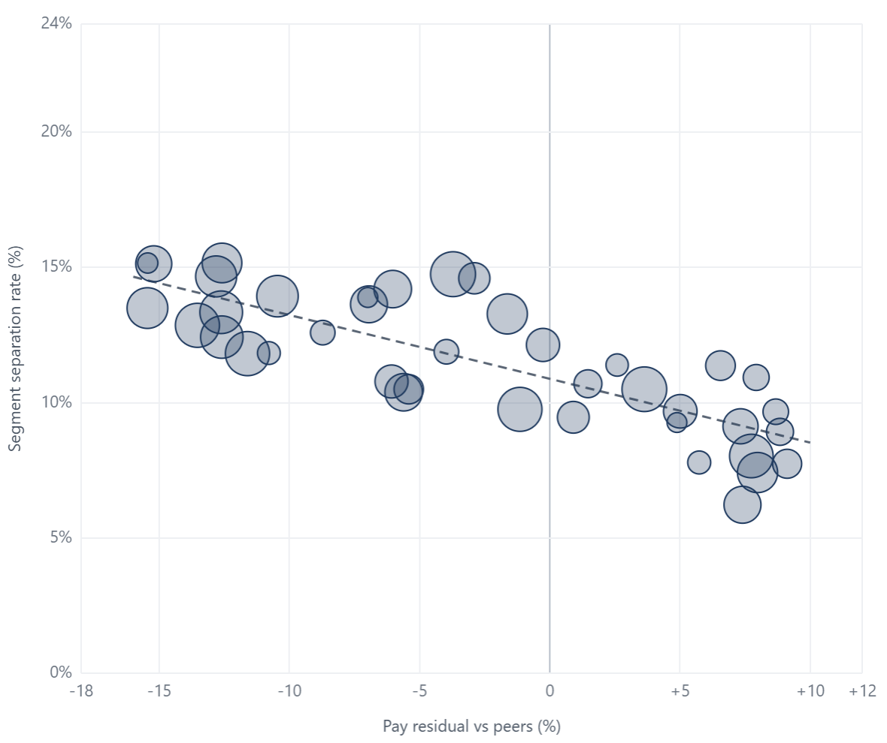
Federal Workforce Shock
Pay & Exit
1
Shock
2
Risk segments
3
Pay & exit
4
Archetypes
5
Refill gap
6
Benchmark
HR Leadership · 2018–Jul 2026
Did being paid below peers predict leaving?
FILTERS
PAY RESIDUAL DISTRIBUTION · OCCUPATIONAL CATEGORY
Agency
PAY RESIDUAL VS SEPARATION RATE · BY SEGMENT
Sample data
Sample data
Segment (occupational category × grade band) · size = headcount
OLS trend
All agencies
Professional
Occupational category
All
Administrative
Grade band
All
Technical
Date range
Jan 2018
Jul 2026
Clerical
Reset filters
Blue collar
Other white collar
Pay residual (%)
−20
−10
0
+10
+20
REGRESSION SUMMARY · SEGMENT SEPARATION RATE
Sample data
Term
β
SE
R²
Pay residual (per 1 pt)
-0.24
0.05
COLOUR KEY
0.64
LOS band (per step)
0.61
0.18
DRP / policy shock
Grade band (per step)
−0.38
0.21
Observed values
40 segments · OLS
Risk up
Pay residual = annualized adjusted basic pay vs median of peers in same occupational category and grade. Negative = paid below peers.
Intercept
10.88
0.74
Risk down
Source: OPM Federal Workforce Data (record-level employment snapshots, separations, accessions), Jan 2018 – Jul 2026 · BLS JOLTS quits rates
As of 31 Jul 2026 · All figures are sample placeholders
Notes:
Page 3: Pay & Exit. Did being paid below peers predict leaving? Build spec: Pay residual vs separation rate (Scatter chart, trend line from Analytics pane; X: pay_residual_pct = annualized_adjusted_basic_pay ÷ peer median (occupational_category × grade) − 1 · Y: segment separation rate (count, separation_category) · Size: count · Details: segment key) | Pay residual by occupational category (Box and Whisker (AppSource) or Deneb; Category: occupational_category · Value: pay_residual_pct (record level)) | Regression summary (Multi-row card or table; regression_output: term, coefficient, std_error, r_squared)

Slide 4
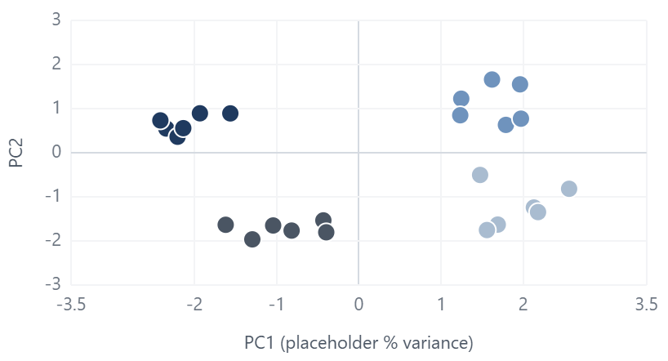
Federal Workforce Shock
Agency Archetypes
1
Shock
2
Risk segments
3
Pay & exit
4
Archetypes
5
Refill gap
6
Benchmark
HR Leadership · 2018–Jul 2026
Which agencies share the same exposure?
FILTERS
AGENCIES ON PRINCIPAL COMPONENTS · K-MEANS (K=4)
Agency
Sample data
AGENCY DETAIL
Sample data
Cluster 1
Cluster 2
Cluster 3
Cluster 4
Agency
Cluster
Headcount
Separation rate
All agencies
Health & Human Services
Cluster 1
370,987
6.9%
Occupational category
Defense – Air Force
Cluster 4
271,210
17.4%
All
Defense – Navy
Cluster 3
239,745
10.0%
Grade band
Defense – Army
Cluster 2
154,211
14.6%
All
Transportation
Cluster 1
57,565
7.2%
Justice
Cluster 2
56,960
12.5%
Date range
Interior
Cluster 1
56,934
6.4%
Jan 2018
Jul 2026
SBA
Cluster 3
55,853
10.6%
Homeland Security
Cluster 3
52,392
10.2%
Reset filters
Labor
Cluster 4
46,864
16.9%
GSA
Cluster 1
43,535
6.6%
CLUSTER 1 PROFILE
Sample data
CLUSTER 2 PROFILE
Sample data
CLUSTER 3 PROFILE
Sample data
CLUSTER 4 PROFILE
Sample data
Treasury
Cluster 2
42,022
12.4%
6 agencies · e.g. Veterans Affairs, Health & Human Services
6 agencies · e.g. Defense – Army, Treasury
6 agencies · e.g. Defense – Navy, Homeland Security
6 agencies · e.g. Defense – Air Force, Agriculture
EPA
Cluster 2
41,512
14.3%
Education
Cluster 1
40,638
7.4%
DRP %
8%
DRP %
21%
DRP %
11%
DRP %
26%
Commerce
Cluster 3
37,320
9.1%
Quit %
4.2%
3.1%
State
Cluster 3
35,073
9.0%
Quit %
Quit %
6.4%
Quit %
5.1%
HUD
Cluster 3
30,186
8.4%
Retirement %
5.2%
Retirement %
6.8%
Retirement %
3.9%
Retirement %
9.6%
Agriculture
Cluster 4
28,777
17.1%
COLOUR KEY
Hire-to-exit
0.92
Hire-to-exit
0.48
Hire-to-exit
0.81
Hire-to-exit
0.37
OPM
Cluster 2
18,509
14.8%
DRP / policy shock
Veterans Affairs
Cluster 1
16,381
7.2%
Observed values
% age 55+
24%
% age 55+
31%
% age 55+
19%
% age 55+
36%
Risk up
Social Security Admin.
Cluster 4
13,465
17.9%
All-agency average
All-agency average
All-agency average
All-agency average
Risk down
NSF
Cluster 4
12,920
17.5%
Energy
Cluster 4
5,716
16.8%
Source: OPM Federal Workforce Data (record-level employment snapshots, separations, accessions), Jan 2018 – Jul 2026 · BLS JOLTS quits rates
As of 31 Jul 2026 · All figures are sample placeholders
NASA
Cluster 2
4,732
12.3%
Notes:
Page 4: Agency Archetypes. Which agencies share the same exposure? Build spec: Agency PCA map (Scatter chart; Details: agency · X: pc1 · Y: pc2 · Legend: cluster (precomputed table joined on agency)) | Cluster profiles (×4) (Clustered bar chart with small multiples by cluster; average as reference line; DRP %: drp_indicator, count · Quit % / Retirement %: separation_category, count · Hire-to-exit: count (accessions ÷ separations) · % age 55+: age_bracket, count) | Agency table (Table; agency · cluster · headcount (count at latest snapshot_yyyymm) · separation rate)

Slide 5
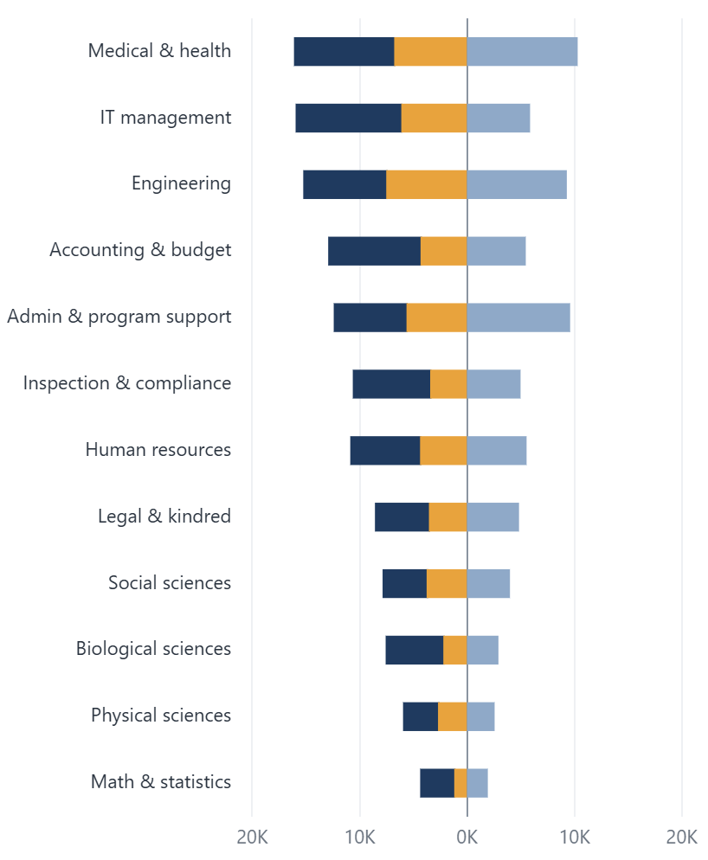
Federal Workforce Shock
Refill Gap
1
Shock
2
Risk segments
3
Pay & exit
4
Archetypes
5
Refill gap
6
Benchmark
HR Leadership · 2018–Jul 2026
Can agencies replace who left?
FILTERS
SEPARATIONS VS ACCESSIONS · OCCUPATION GROUP · 12M
Agency
Sample data
STEM REFILL RATIO
Sample data
All agencies
DRP separations
Other separations
Accessions
0.46
Separations
48.8K
← Separations
Accessions →
hires per exit
Accessions
22.3K
Occupational category
Accessions ÷ separations, last 12 months
STEM = engineering, IT, physical sciences, biological sciences, math & statistics
All
Grade band
HIRE-TO-EXIT RATIO · OCCUPATION × AGENCY
Sample data
All
VA
Army
Navy
HHS
Treas
USDA
DOI
DHS
Date range
Medical & health
1.22
1.28
0.62
0.78
0.78
0.74
0.75
1.10
Jan 2018
Jul 2026
IT management
0.42
0.66
0.55
1.35
0.48
0.31
0.93
0.55
Reset filters
Engineering
0.31
1.21
1.06
0.47
1.13
0.31
0.38
0.50
Accounting & budget
0.35
0.31
1.33
1.25
1.15
1.01
0.96
1.15
Admin & program support
0.59
0.35
0.73
0.43
0.60
0.75
0.61
0.44
Inspection & compliance
1.25
0.83
1.27
1.09
0.46
0.87
1.03
0.32
Human resources
0.73
1.07
1.21
0.72
1.00
0.79
0.53
0.93
COLOUR KEY
Biological sciences
1.37
0.52
0.38
0.66
0.84
0.64
1.13
1.37
DRP / policy shock
Physical sciences
0.76
0.70
0.43
1.06
0.78
0.58
0.43
0.32
Observed values
Risk up
< 1.0 · fewer hires than exits
≥ 1.0
Risk down
Source: OPM Federal Workforce Data (record-level employment snapshots, separations, accessions), Jan 2018 – Jul 2026 · BLS JOLTS quits rates
As of 31 Jul 2026 · All figures are sample placeholders
Notes:
Page 5: Refill Gap. Can agencies replace who left? Build spec: Separations vs accessions by occupation group (Stacked bar chart, separations as negative measure; Y: occupation_group (derived from occupation series; not in listed columns) · X: count accessions, −count separations · Legend: drp_indicator) | Hire-to-exit matrix (Matrix, rules-based background (< 1 red); Rows: occupation_group · Columns: agency · Values: count (accessions) ÷ count (separations)) | STEM refill ratio (Card + clustered bar; occupation_group (STEM filter) · count (accessions) · count (separations))

Slide 6
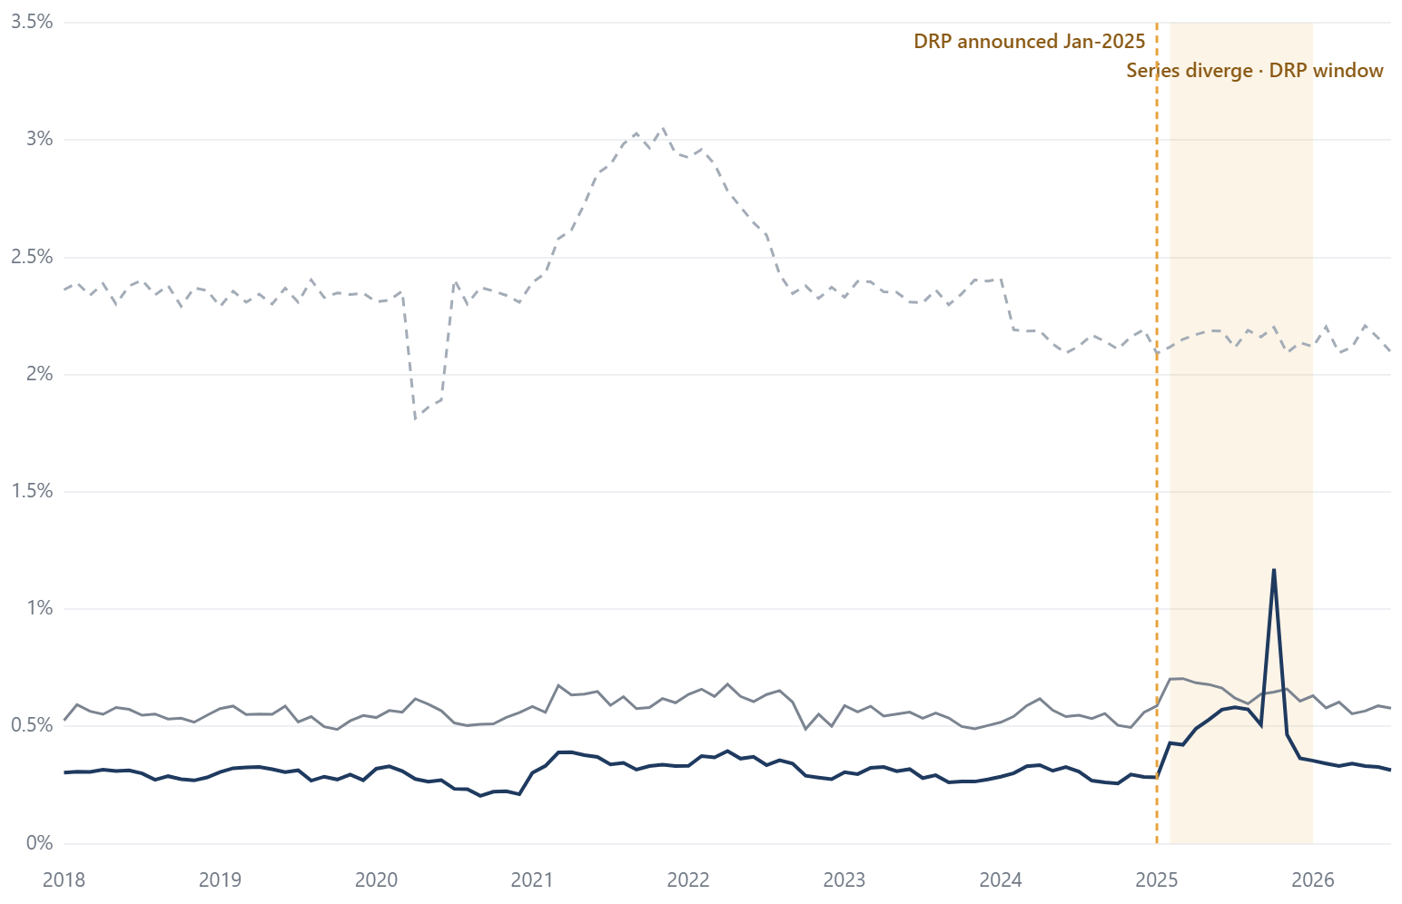
Federal Workforce Shock
Benchmark
1
Shock
2
Risk segments
3
Pay & exit
4
Archetypes
5
Refill gap
6
Benchmark
HR Leadership · 2018–Jul 2026
Was federal attrition different from the market?
FILTERS
DEFINITION NOTES ¹
Agency
MONTHLY RESIGNATION / QUITS RATE
Rate %
Index (2019 = 100)
Sample data
OPM resignation rate (federal)
JOLTS quits · federal government
JOLTS quits · total private
DRP window
What counts as leaving
All agencies
JOLTS quits are voluntary separations excluding retirements. OPM resignations are one separation_category; DRP exits may be coded as resignation or retirement.
Occupational category
All
Grade band
Source type
OPM is administrative, record-level data. JOLTS is a monthly establishment survey estimate with sampling error.
All
Date range
Jan 2018
Jul 2026
Denominator
OPM rate uses headcount at snapshot_yyyymm. JOLTS rates use its own employment estimate for the month.
Reset filters
Coverage
Agency coverage differs between the two sources (e.g. Postal Service, intelligence agencies). Compare trends, not levels.
COLOUR KEY
DRP / policy shock
Observed values
Risk up
¹ OPM resignations ≠ JOLTS quits exactly. See definition notes. Index view rebases each series to its 2019 monthly average.
Risk down
Source: OPM Federal Workforce Data (record-level employment snapshots, separations, accessions), Jan 2018 – Jul 2026 · BLS JOLTS quits rates
As of 31 Jul 2026 · All figures are sample placeholders
Notes:
Page 6: Benchmark. Was federal attrition different from the market? Build spec: OPM resignations vs JOLTS quits (Line chart + X-axis constant line + shaded range; field parameter for Rate / Index; X: personnel_action_effective_date_yyyymm · OPM rate: count where separation_category = resignation ÷ headcount at snapshot_yyyymm · JOLTS: external table series_id, period, value) | Divergence annotation (Text box over constant line / shaded range; —) | Definition notes (Text box; —)

