Slide 1
Use PowerShell & dbatools to Manage your SQL Server Environment

Slide 2








Thank you Sponsors

Slide 3



About Me - Garry Bargsley 20+ years in the IT related industry with 10+ years focused on database platforms. I have worked for various companies in the education, retail, medical, and fintech industries. My current focus is on database automation using PowerShell. Current contributor on the dbatools team. gbargsley@gmail.com @gbargsley blog.garrybargsley.com

Slide 4
Getting Started Resources
dbatools:
dbatools.io/getting-started
PowerShell:
Manning Publication
Learn Windows PowerShell in a Month of Lunches
Leanpub
PowerShell 101

Slide 5
Support
SQL Server 2000 – 2017 *
Express – Enterprise Edition
Clustered and stand-alone instances
Windows and SQL authentication
Default and named instances
Multiple instances on one server

Slide 6
System Requirements
Minimum
Client
PowerShell v3
Server
SQL Server 2000
Remoting enabled for Windows commands

Slide 7
Installing dbatools
PowerShell Gallery
Install-Module dbatools
GitHub
Invoke-Expression (Invoke-WebRequest dbatools.io/in)
Offline installer
dbatools.io/offline

Slide 8
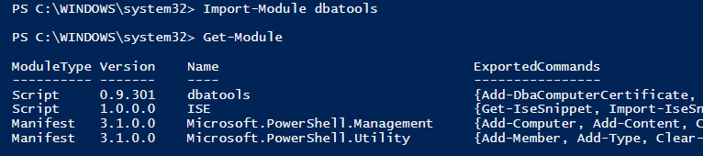
Importing dbatools

Slide 9
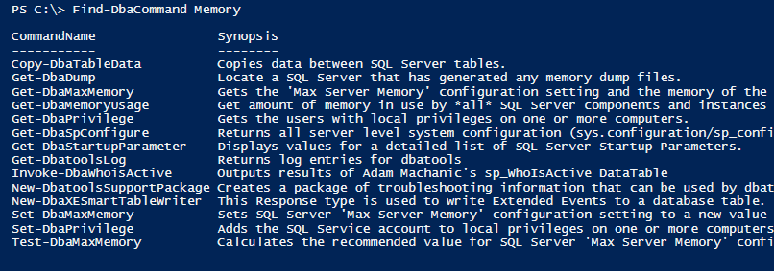
Find a Command in dbatools
From the Web
https://dbatools.io/commands
PowerShell

Slide 10
Max Memory
Commands
Get-DbaMaxMemory
Set-DbaMaxMemory
Test-DbaMaxMemory
Notes:
Get-DbaMaxMemory
Set-DbaMaxMemory
Test-DbaMaxMemory

Slide 11
Sp_Configure
Commands
Copy-DbaSpConfigure
Export-DbaSpConfigure
Get-DbaSpConfigure
Import-DbaSpConfigure
Set-DbaSpConfigure
Notes:
Copy-DbaSpConfigure
Export-DbaSpConfigure
Get-DbaSpConfigure
Import-DbaSpConfigure
Set-DbaSpConfigure

Slide 12
TempDb Configuration
Commands:
Set-DbaTempDbConfiguration
Test-DbaTempDbConfiguration
Notes:
Set-DbaTempDbConfiguration
Tetst-DbaTempDbConfiguration

Slide 13
Startup Parameter
Commands:
Get-DbaStartupParameter
Set-DbaStartupParameter
Notes:
Get-DbaStartupParameter
Set-DbaStartupParameter

Slide 14
Orphan File and User
Commands:
Find-DbaOrphanFile
Get-DbaOrphanUser
Remove-DbaOrphanUser
Repair-DbaOrphanUser
Notes:
Find-DbaOrphanFile

Slide 15
Sql Build
Commands:
Get-DbaSqlBuildReference
Test-DbaSqlBuild
sqlcollaborative.github.io/builds
Notes:
Get-DbaSqlBuildReference
Test-DbaSqlBuild

Slide 16
Agent Job
Commands:
Copy-DbaAgentJob
Find-DbaAgentJob
Get-DbaAgentJob
New-DbaAgentJob
Remove-DbaAgentJob
Set-DbaAgentJob
Start-DbaAgentJob
Stop-DbaAgentJob
Notes:
Copy-DbaAgentJob
Find-DbaAgentJob
Get-DbaAgentJob
New-DbaAgentJob
Remove-DbaAgentJob
Set-DbaAgentJob
Start-DbaAgentJob
Stop-DbaAgentJob

Slide 17
3rd Party DBA Tools
Install Ola Hallengrens
Industry utilized Backup, Integrity Check and Index Maintenance utility
Install sp_WhoIsActive
Industry standard sp_who2 replacement and troubleshooting tool
Install Brent Ozar First Responder Kit
Popular set of tools that assist with performance troubleshooting

Slide 18
- Demo -

Slide 19
Monitoring !! - Example -

Slide 20
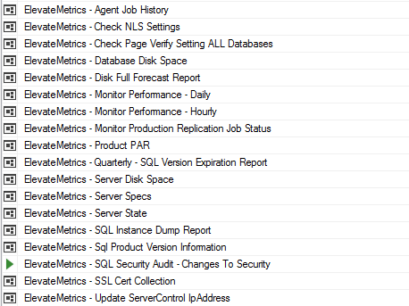

Slide 21
Alerting !! - Example -

Slide 22
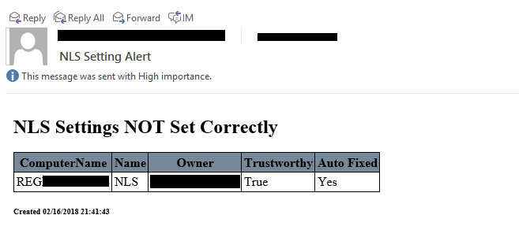
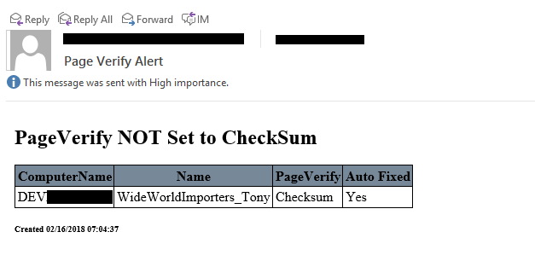

Slide 23

Join the Slack Channel
Invite yourself to Slack
dbatools.io/slack
Join #dbatools

Slide 24
Questions?

Slide 25
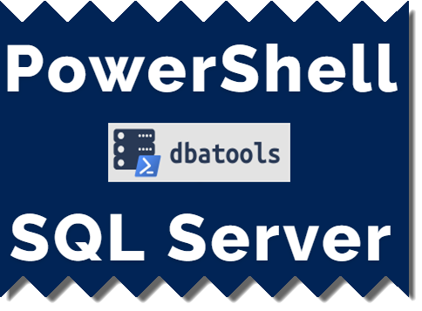
Thank You

Slide 26
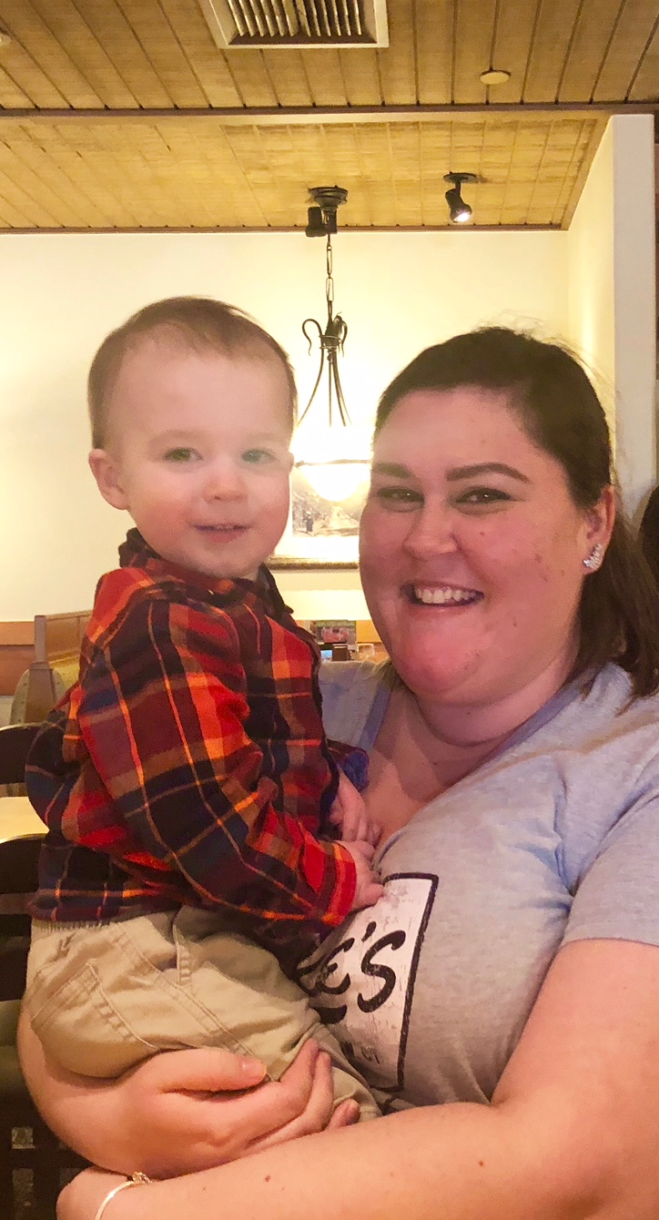
gbargsley@gmail.com @gbargsley blog.garrybargsley.com
Slides / Demo Script:
github.com/gbargsley/SQLSaturdayPhoenix

