Slide 1
Use PowerShell & dbatools to Manage your SQL Server Environment

Slide 2








Thank you Sponsors

Slide 3




About Me - Garry Bargsley 20+ years in IT related field with 10+ years focus on database platforms. Current focus on automation in the database world using PowerShell. Contributor to the dbatools.io open source project. gbargsley@gmail.com @gbargsley blog.garrybargsley.com

Slide 4
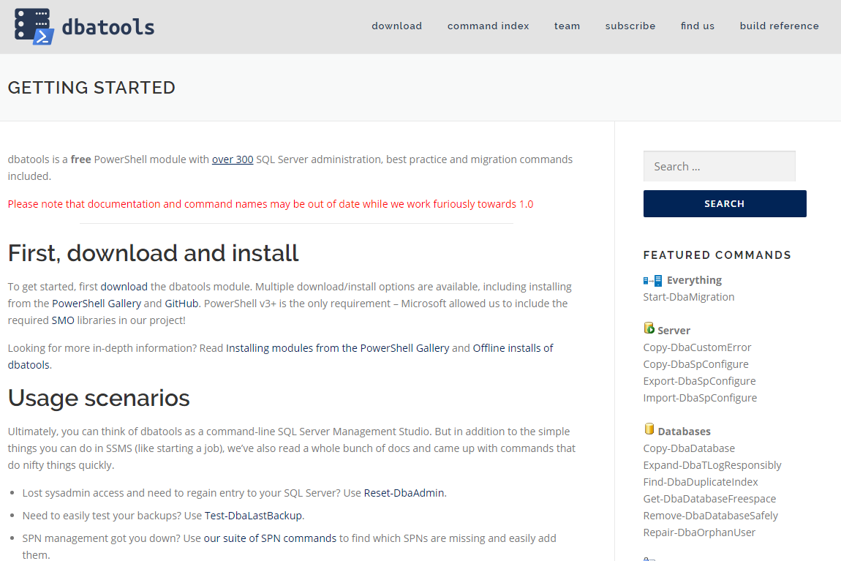
Getting Started
All information needed can be found here:
dbatools.io/getting-started

Slide 5
Support
SQL Server 2000 – 2017 *
Express – Enterprise Edition
Clustered and stand-alone instances
Windows and SQL authentication
Default and named instances
Multiple instances on one server

Slide 6
System Requirements
Minimum
Client
PowerShell v3
Server
SQL Server 2000
Remoting enabled for Windows commands

Slide 7
System Requirements
Recommended
Client
PowerShell v5.1
Server
SQL Server 2008 R2+

Slide 8
Installing dbatools
PowerShell Gallery
Install-Module dbatools
Install-Module dbatools –Scope CurrentUser
GitHub
Invoke-Expression (Invoke-WebRequest dbatools.io/in)
Offline installer
dbatools.io/offline

Slide 9
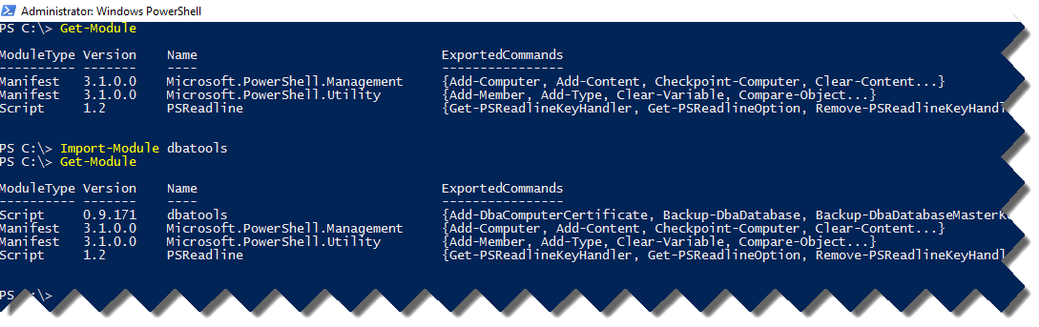
Importing dbatools

Slide 10
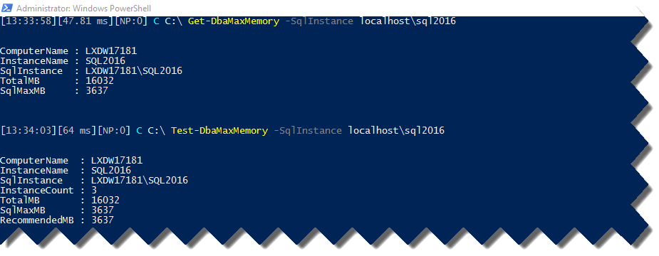
Get-DbaMaxMemory
Notes:
Get-DbaMaxMemory
Set-DbaMaxMemory
Test-DbaMaxMemory

Slide 11
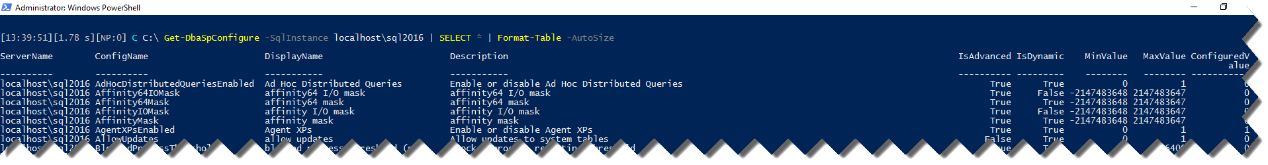
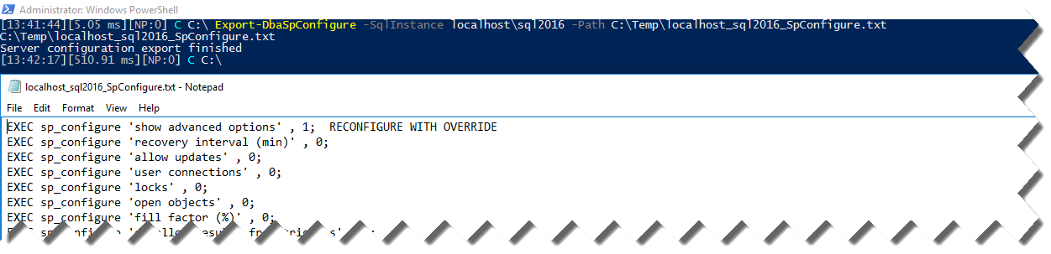
Get-DbaSpConfigure
Notes:
Copy-DbaSpConfigure
Export-DbaSpConfigure
Get-DbaSpConfigure
Import-DbaSpConfigure
Set-DbaSpConfigure

Slide 12
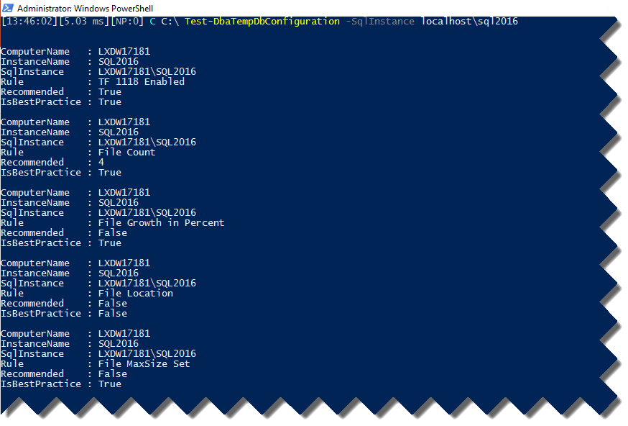
Test-DbaTempDbConfiguration
Notes:
Set-DbaTempDbConfiguration
Tetst-DbaTempDbConfiguration

Slide 13
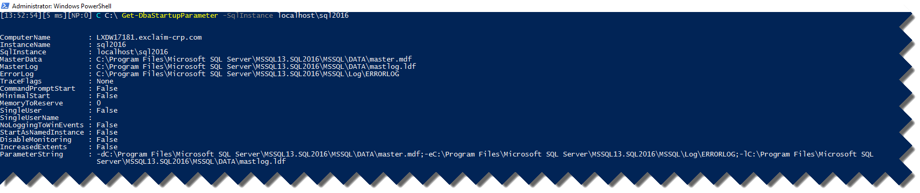
Get-DbaStartupParameter
Notes:
Get-DbaStartupParameter
Set-DbaStartupParameter

Slide 14
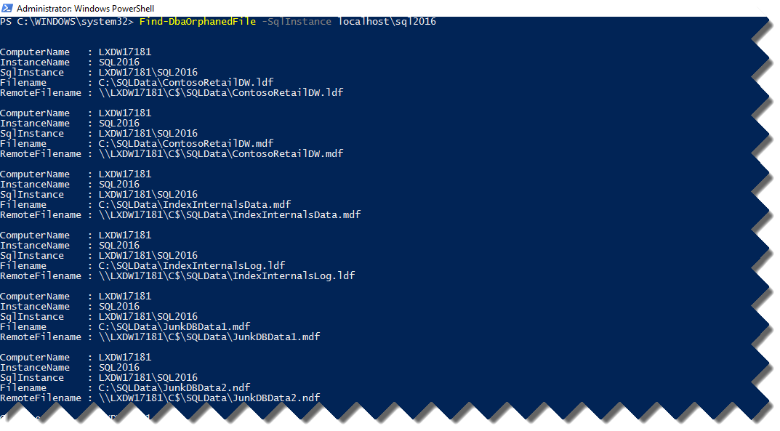
Find-DbaOrphanFile
Notes:
Find-DbaOrphanFile

Slide 15
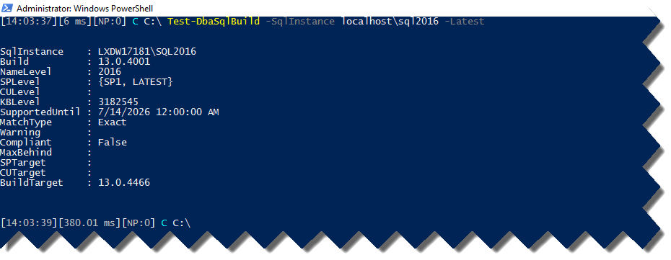
Test-DbaSqlBuild
sqlcollaborative.github.io/builds
Notes:
Get-DbaSqlBuildReference
Test-DbaSqlBuild

Slide 16
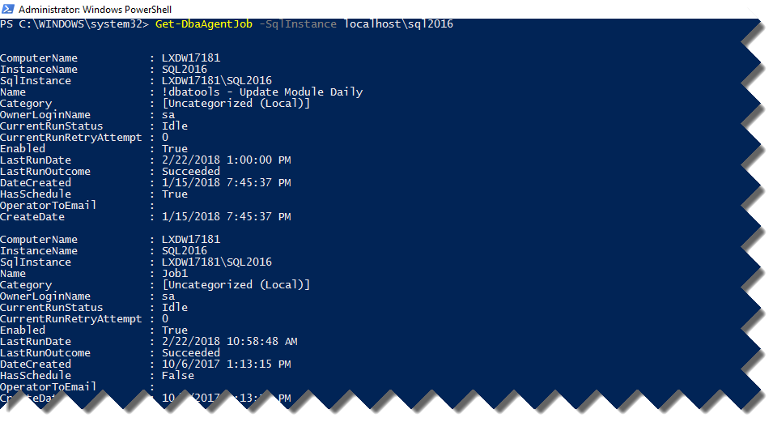
Get-DbaAgentJob
Notes:
Copy-DbaAgentJob
Find-DbaAgentJob
Get-DbaAgentJob
New-DbaAgentJob
Remove-DbaAgentJob
Set-DbaAgentJob
Start-DbaAgentJob
Stop-DbaAgentJob

Slide 17



DBA Support Tools
Install Ola Hallengrens
Install sp_WhoIsActive
Install Brent Ozar First Responder Kit

Slide 18
- DEMO -
Get-DbaMaxMemory
Get-DbaAgentJob
Get-DbaStartupParameter
Test-DbaSqlBuild
Support Tools
Find-DbaOrphanFile
Get-DbaSpConfigure
Test-DbaTempDbConfiguration

Slide 19
Monitoring !! - Example -

Slide 20
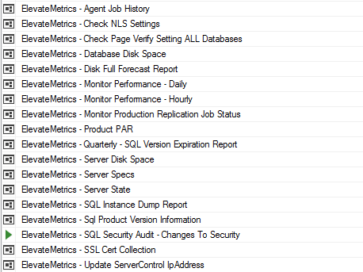

Slide 21
Alerting !! - Example -

Slide 22
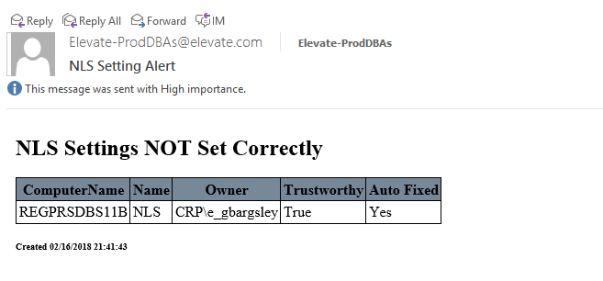
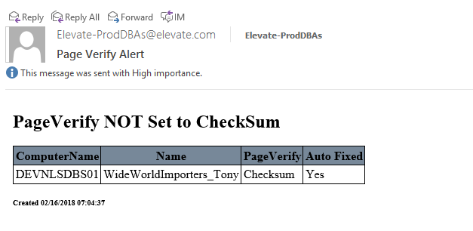

Slide 23

Join the Slack Channel
Invite yourself to Slack
dbatools.io/slack
Join #dbatools

Slide 24
Questions?

Slide 25
Thank You

Slide 26
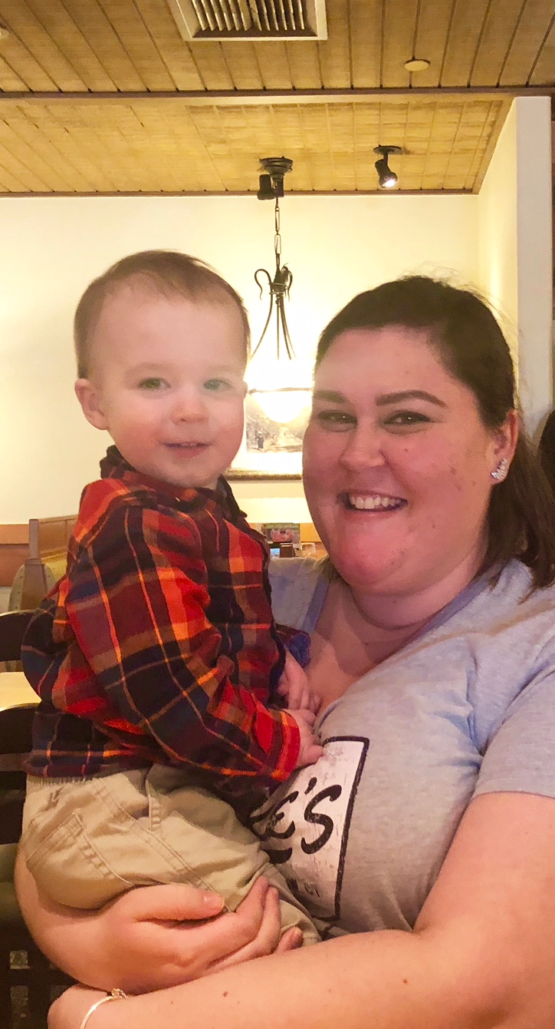
gbargsley@gmail.com @gbargsley blog.garrybargsley.com
Slides / Demo Script:
github.com/gbargsley/SQLSaturdayPhoenix

