Slide 1
Flight Delay Prediction Using AWS
Big Data Group 5
Saumit Chinchkhandi – 801305320
Mahesh Hasbi – 801315534
Thanmaiye Namburi – 801281518
Gautham Raj Bari - 801274985
Mounika Gottumukkala - 801276287

Slide 2
Dataset Description
Flight Delay Prediction Data is a database that contains vital information about flight schedules for many different flight operators globally. This information includes origin and destination airport details, flight number, flight schedules in (date, month, year), operator airlines, delays, on-time arrivals and departures, and much more. The dataset also includes additional information on flight cancellations, including the cause for the cancellation, route diversions, and weather and carrier delays that contributed to delays. Frequent updates strengthen the validity and coverage of fresh flight statistics for the flight delay forecast. In order to produce insights regarding the data for different flight operators and trips, our group plans to show relationships between various flight metrics.
Key columns in the dataset used for visualizations: Airline, Year, Month, DayofMonth, DayofWeek, DepDelay, ArrDelay, Cancelled, OriginAirportID, DestAirportID.
Number of rows in dataset which are considered for data preparation and ML model training and generation: 1,048,576

Slide 3
Problem Statement
Using Amazon Web Services(AWS) like Simple Storage Service(S3) for storage, AWS Glue for extracting table schema, AWS Athena for data preparation and cleaning, AWS Sagemaker Jupyter Notebook Instances for Data visualization and ML model training for analyzing Flight Delay data for different airline operators.
Extract meaningful insights by developing Key Performance Indicators(KPI’s) which highlight key attributes essential for evaluating performance of different flight operators and identify patterns and relationships between different dataset variables.
Designing detailed and engaging dashboard visualizations and training a ML model for determining accuracy and optimize results generated.
Future work and use cases where Flight Delay prediction could be useful.

Slide 4
Research Objectives and Questions
Number of flights delayed or cancelled for different airline operators and determine relationships and dependencies between different dataset variables if present.
Determine which airlines have the highest number of flights delayed or cancelled over a period of 3 years from 2020 to 2022 which could indicate which airlines are most likely to have similar trends following in future years.
Which Origin and Destination airports are the most and least efficient based on number of flight cancellations and delays?
Training and building machine learning model for identifying accuracy of our dataset and create optimizations for improving this accuracy.
Highlight future works and detail methodology used for implementation.

Slide 5
Data Understanding, Preparation and Visualization
Our dataset contains flight information for 2020, 2021 and 2022. We first loaded these files into an S3 bucket. We used AWS Glue Crawler to get the data out of S3 bucket and create a different table to store each year data. AWS Athena was used to remove unwanted columns from our dataset and cleanse our tables of NULL values so as to ensure high accuracy while building the machine learning model.
In AWS Sagemaker, we created a notebook instance to merge the post-transformed 2020,2021 and 2022.csv files into separate dataframes and then merged it into a single dataframe ‘combineddata.csv’. This dataframe was used for creating visualizations using Numpy and Pandas libraries.
We developed interactive visualizations like number of delays for different years, number of flights cancelled for different airlines, number of delays for different states in the United States and a scatter plot to determine relationship between Departure Time and Departure Delays (DepDelay) in Jupyter Notebook instance of AWS Sagemaker.

Slide 6
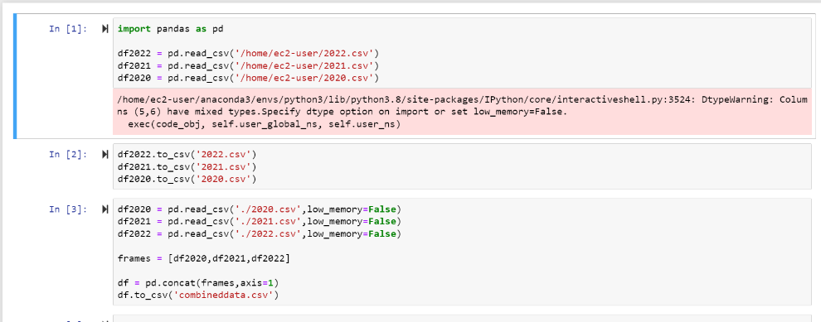
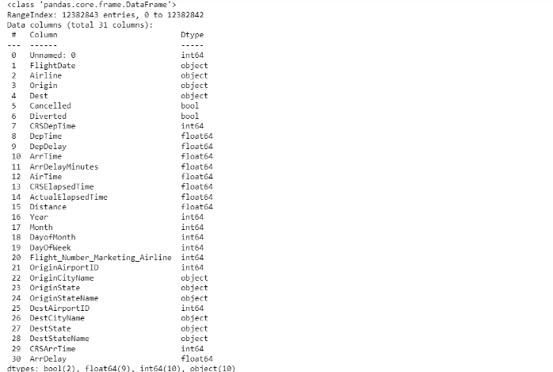
Data Visualizations
1. Merging the 3 dataframes into Combined.csv
2. Final Columns after Data Cleansing

Slide 7
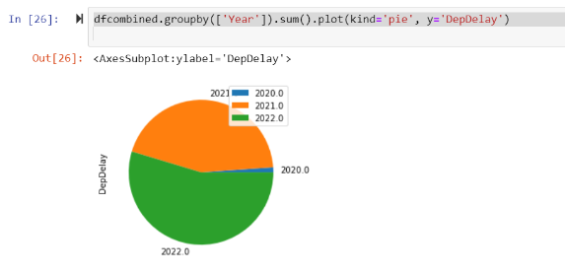
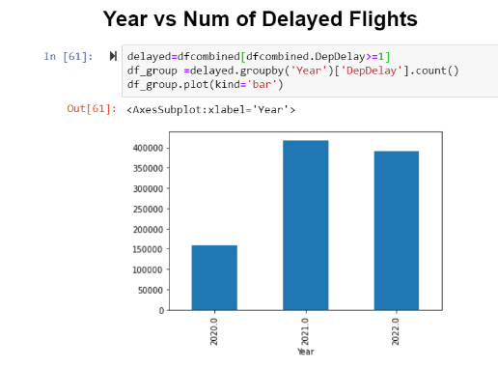
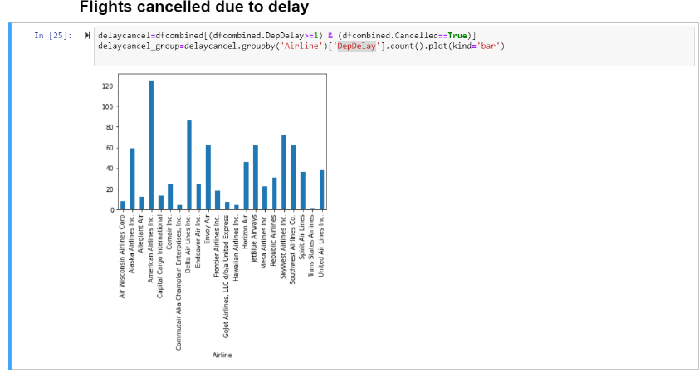
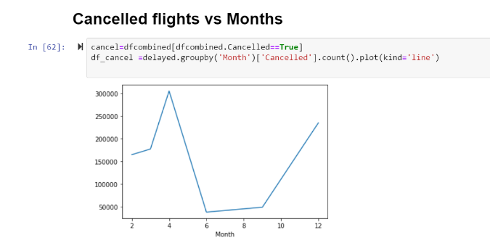
3. Visualizations for Departure Delays
4. Flights Cancelled Visualizations

Slide 8
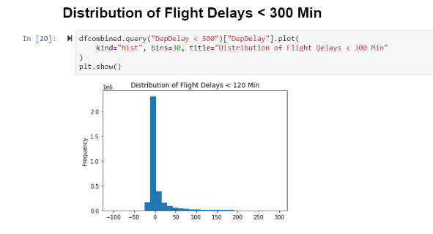
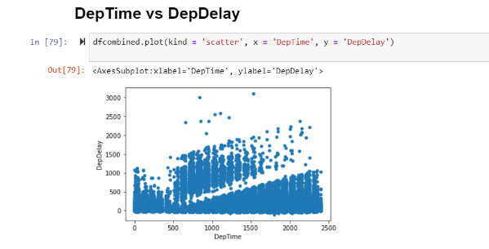
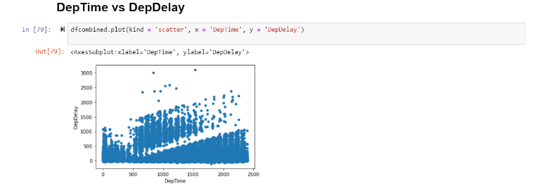
5. Visualizations for determining relationships between different dataset variables.

Slide 9
Machine Learning and Analytics
For building a machine learning model, we heavily relied on the AWS Sagemaker Notebook instances. The final output file after data understanding and visualization is used an input for the machine learning model. This file is labeled ‘mlmodeldata.csv’
We have used 2 machine learning algorithms for training the data. The 2 techniques are Linear regression and Decision Tree Regression analysis.
The supervised machine learning approach known as "linear regression" identifies the best-fitting linear line between the independent and dependent variables.
Decision tree regression trains a model in the form of a tree to predict data in the future and generate useful continuous output by observing the properties of an item.
Regression analysis is used to observe the accuracy and Mean square error. Based on the difference between the accuracies and MSE’s generated from both the models are used to identify the best suitable model for this data.

Slide 10
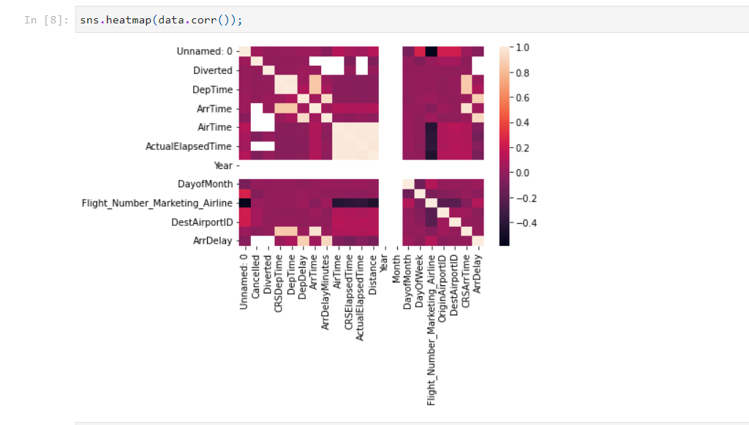
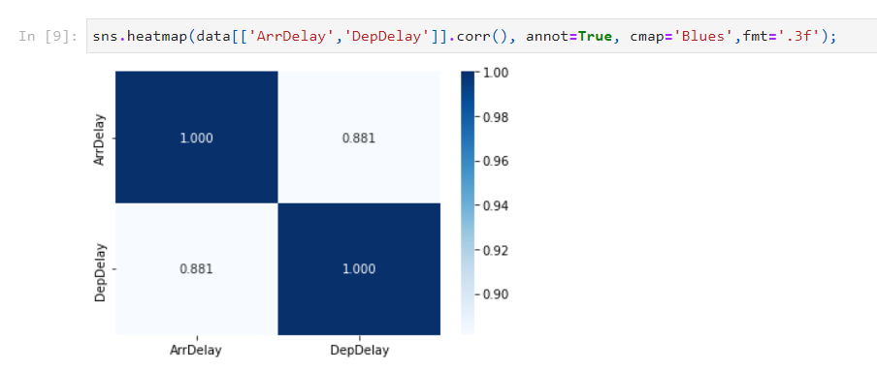
Heat maps to determine correlations between different dataset variables

Slide 11
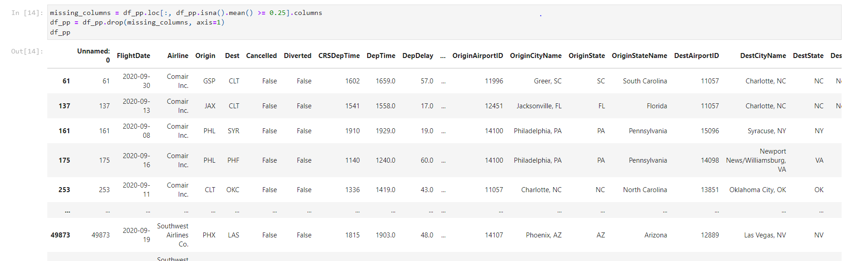
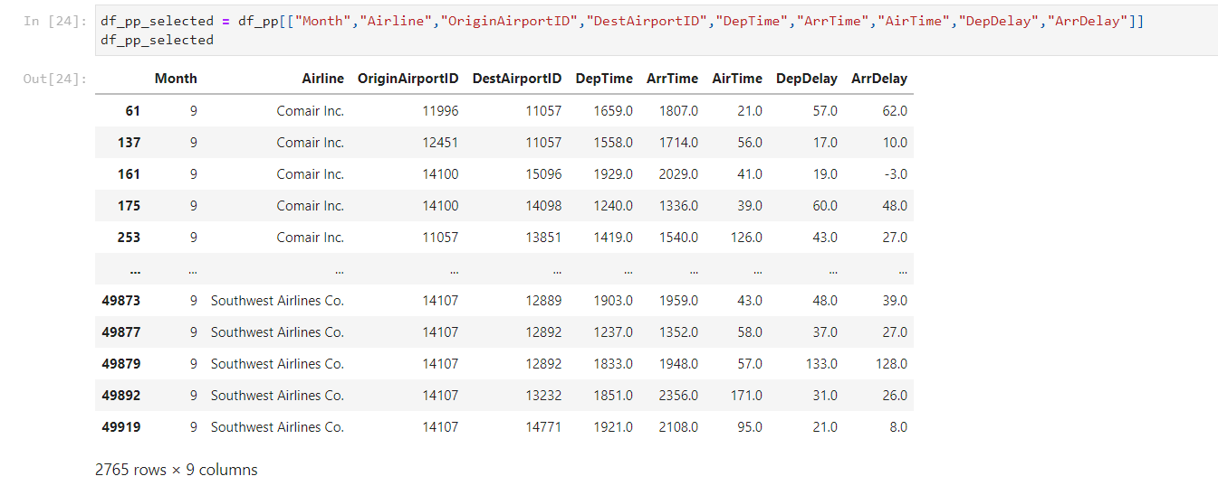
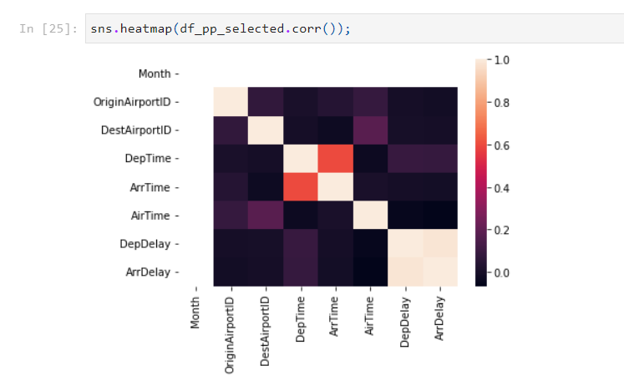
Data Preparation for the ML model

Slide 12
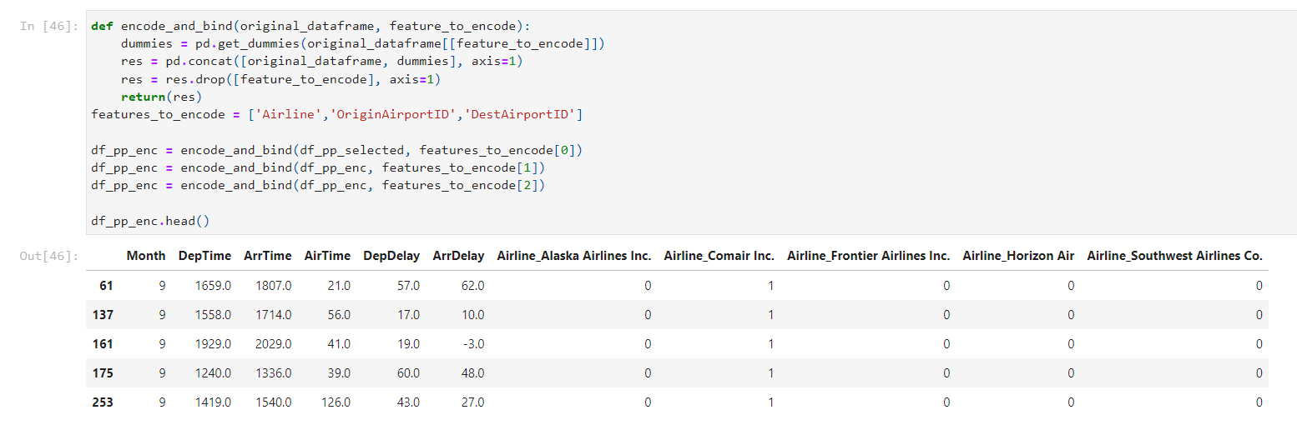
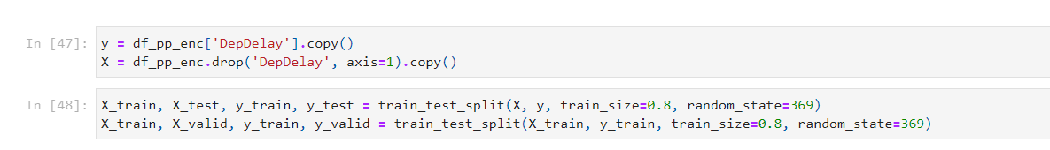
Model encoding, Training for Linear Regression
Before training the ML model, we first encode and bind. After this, we start training the dataset into 3 groups, the X_train and y_train group, the X_test and y_test group and lastly the X_valid and y_valid group. The train size considered is 0.8 which means out of 100% data, 80% would be used for training and remaining 20% would be used for testing. Now again, 80% of train data will be used for training and remaining 20% will be used for validation.

Slide 13
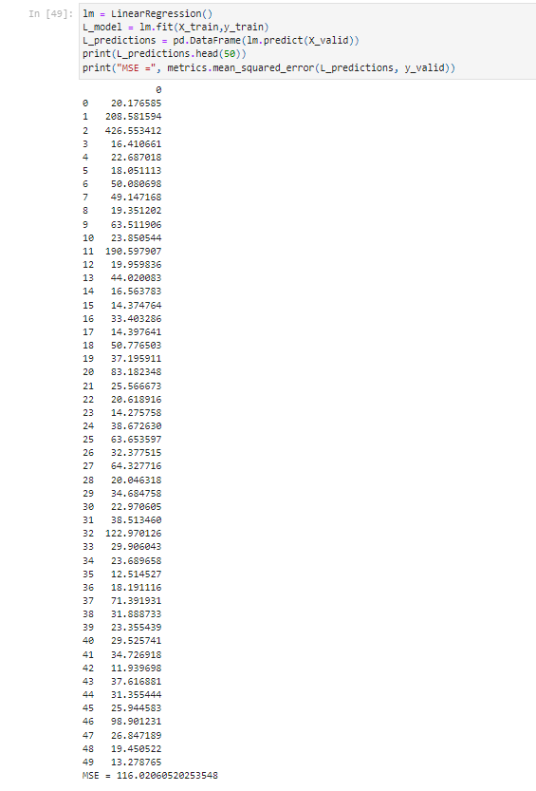
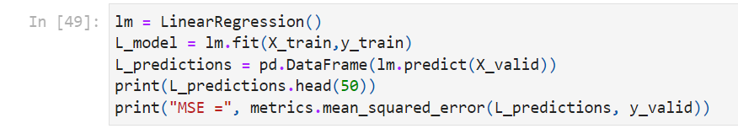
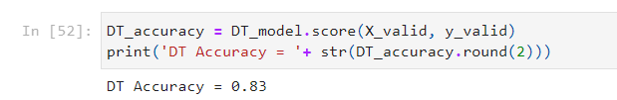
Linear Regression Model Evaluation
Mean squared error is identified to estimate the deviation of actual and estimated values.
Linear regression model:
Mean squared error after linear regression is MSE = 116.02060520253548.
The model accuracy derived using linear regression is 0.83 ~ 83%.

Slide 14
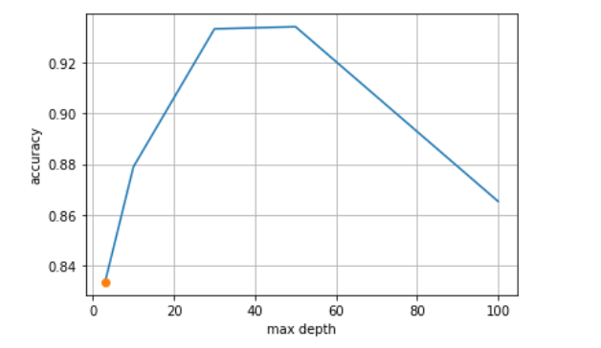
Regression Analysis
Line graph of accuracy and max depth.

Slide 15
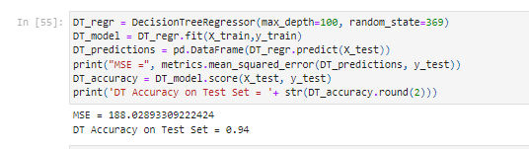
Decision Tree Regression Model Evaluation
In order to optimize the result obtained using Linear Regression, we decided to train the model using Decision Tree Regressor which implements a tree structure. It employs a tree structure that resembles a flowchart or is a model of decisions and every conceivable outcome, including outputs, input costs, and utility. The supervised learning algorithms group includes the decision-tree algorithm. It works with output variables that are categorized and continuous.
Decision tree regression model on the same X_train and Y_train data. We are again calculating the mean squared error for this technique too.
The mean squared error after decision tree regression is MSE = 188.0289.
The Accuracy achieved through this technique is 0.94 ~ 94%.

Slide 16
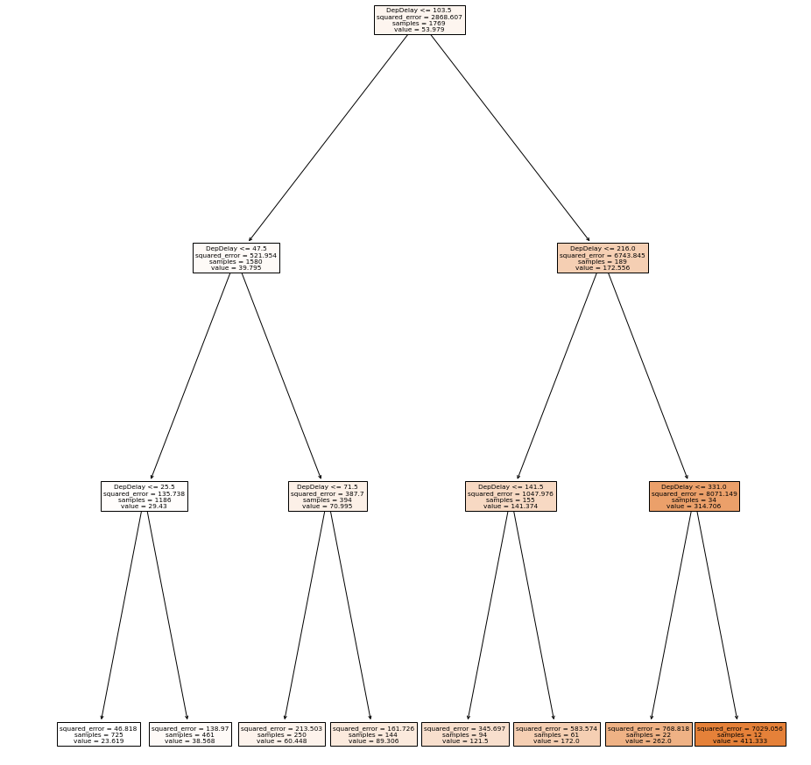
Decision Tree Graph for different departure delay values

Slide 17
Results
Linear regression and decision tree regression supervised machine learning techniques were used to build, train and test our dataset. The accuracy achieved from linear regression was 83% which is good but there is still room for improvement and optimization.
Thus, we decided to try decision tree regressor technique for building our machine learning model for the same set of inputs and this time our accuracy was 94% which is better. The 6% loss is due to the presence of outliers in our dataset where some columns have few values which are way higher/lower compared to most of the other values.
Thus, future flight delay predictions if made can be considered 94% accurate.

Slide 18
Future Work and Comments
1. What was unique about the data? Did you have to deal with imbalance? What data cleaning did you do? Outlier treatment? Imputation?
It was challenging to work with millions of rows of flight delay data. We had to do rigorous and uniform data transformation and cleansing to remove null values and outliers from our data. We also had to reduce our dataset columns count and only keep key columns which would affect and be important during our visualizations.
2. Did you create any new additional features / variables?
Yes, we had to create additional feature during the data preparation and understanding stage. Our source dataset was a single file with size ~5GB so we had to break it down into chunks and clean each batch separately to remove outliers. Once completed, we then merged all these batches into a unified single file which was then used for data visualizations and machine learning model building. AWS Sagemaker notebook instances have a strict size restriction so we had to be careful and ensure notebook instance doesn’t crash. To overcome this limitation, we had to break our dataset into parts and then unify it later.
3. What was the process you used for evaluation? What was the best result?
We used Linear regression and Decision Tree Regression supervised learning techniques for building our machine learning model. We got 83% accuracy using linear regression and 84% accuracy using Decision Tree Regression.

Slide 19
4. Is there Bias in your work? What were the problems you faced? How did you solve them?
We have worked collectively by allocating different tasks to different team members and worked collectively to resolve any roadblocks when occurred.
5. What future work would you like to do?
We want to apply other regression models or machine learning to our data to identify better accuracy and reduced mean square error.
6. Instructions for individuals that may want to use your work
People interested in using our work could keep below points in mind which would help them in implementing similar results:-
Install necessary python libraries primarily Numpy, Pandas, MatPlotlib, Sns and sklearn which are heavily used in this project implementation.
Perform thorough data cleansing, transformation and preparation so as to ensure most of the outliers are removed from the dataset. This would give accurate visualizations and machine learning model accuracies.

Slide 20
Thank You

