Slide 1
Floating Systems Optimization Check-In
Garrett Barter
August 2, 2018

Slide 2
FY18 Achievements
Full floating offshore wind energy representation in WISDEM (minus O&M)
New modules: FloatingSE, OffshoreBOS
Improvements throughout WISDEM for cohesiveness, ease of use
“Tabula rasa” (blank slate) design of floating substructure using a genetic algorithm optimizer, bounded design variables, and constraints
No initial “feasible” point, just a randomized sampling of design space
Mixed-integer optimization for continuous (e.g. diameter) and discrete (e.g. # mooring lines) design variables
Visualization of results

Slide 3
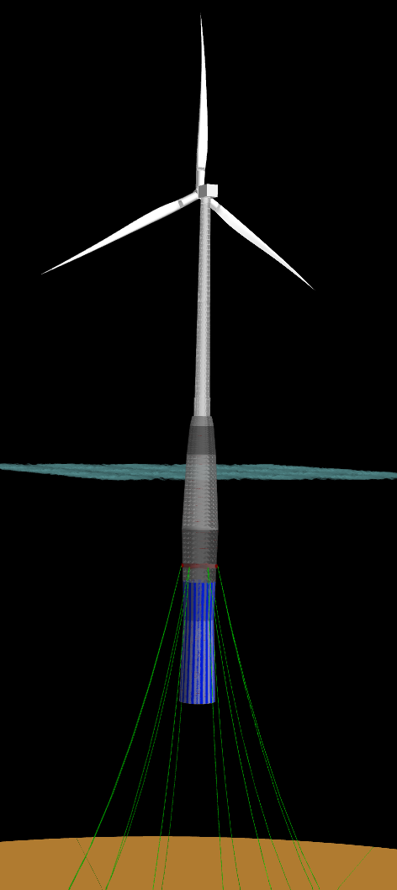
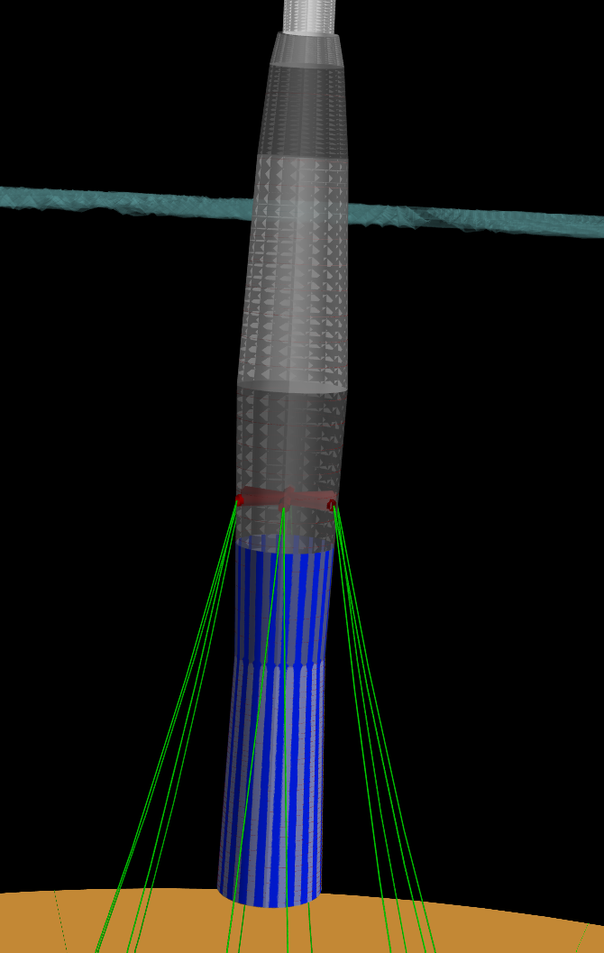
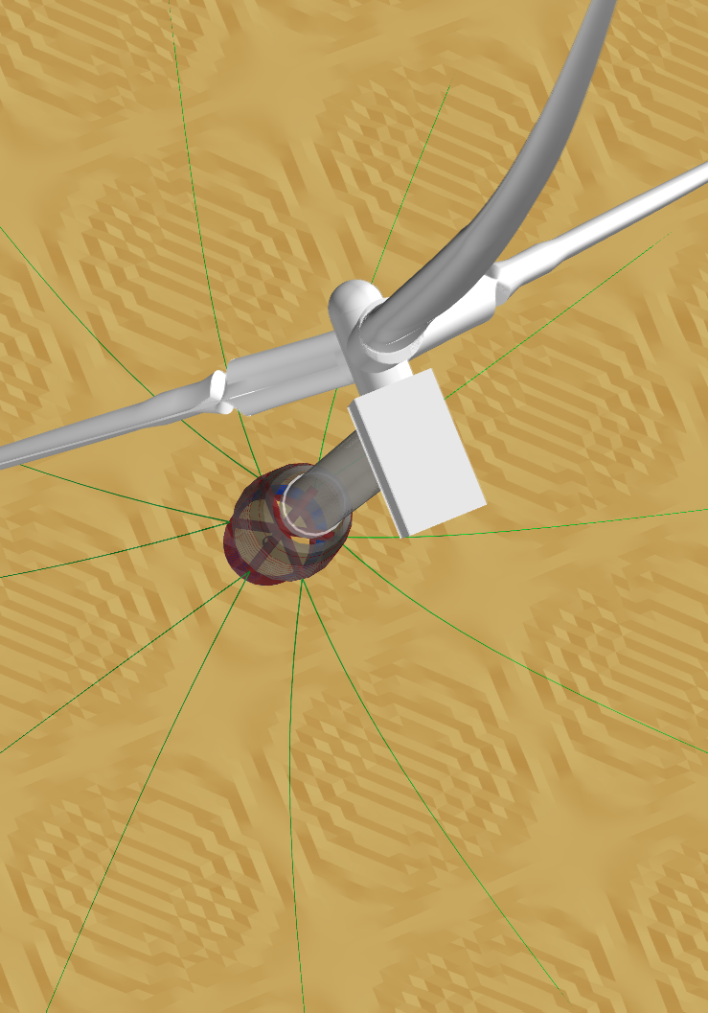
Spar optimization
Full view
Spar design seems most reasonable
Tough to get it wrong
Lots of mooring lines for reasons not yet completely understood
Would not invalidate any substructure weight sensitivity studies
Zoom
Top view

Slide 4
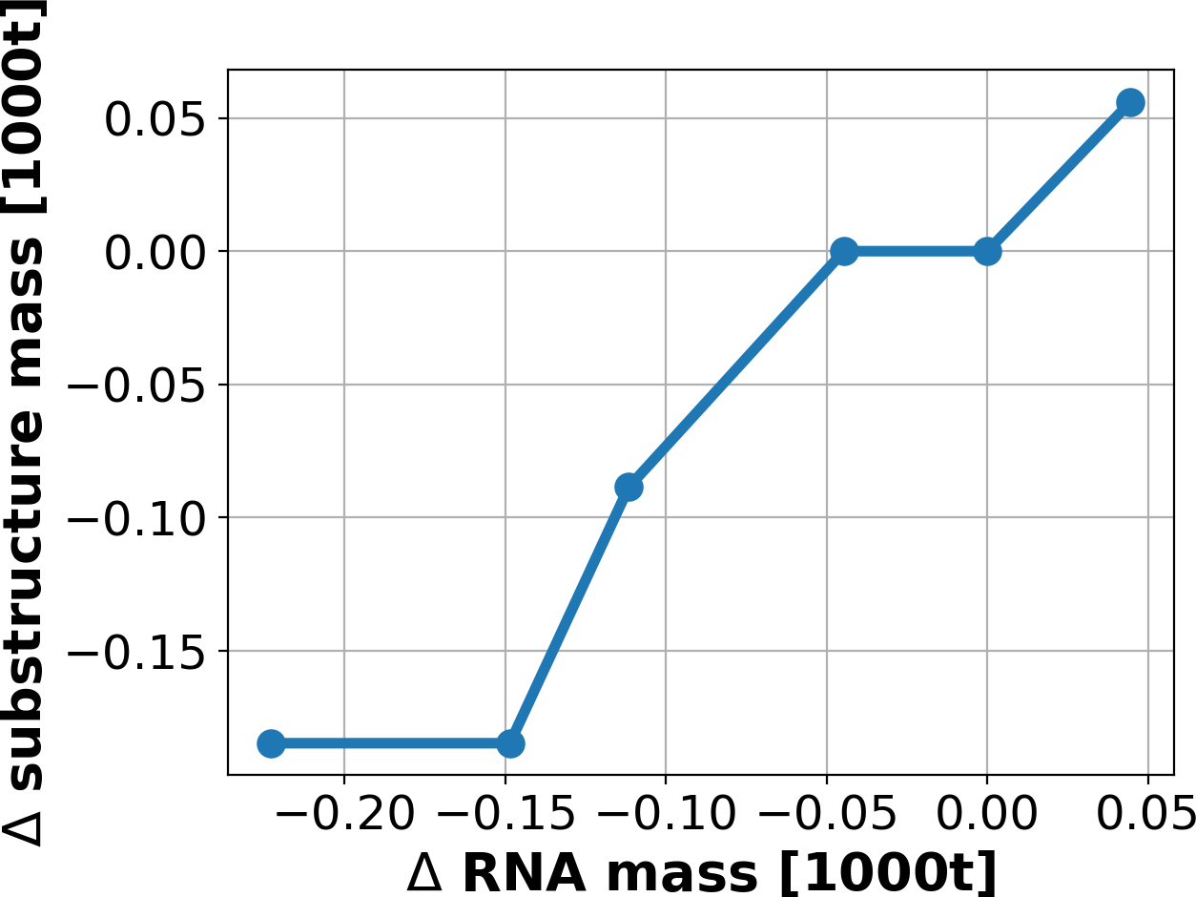
Sensitivity around optimized spar design
Have already run initial weight sensitivity study on final spar design
Results are not yet “fully optimized”, but show a clear trend
Approximately linear 1:1 reduction in substructure mass for reduction in RNA mass

Slide 5
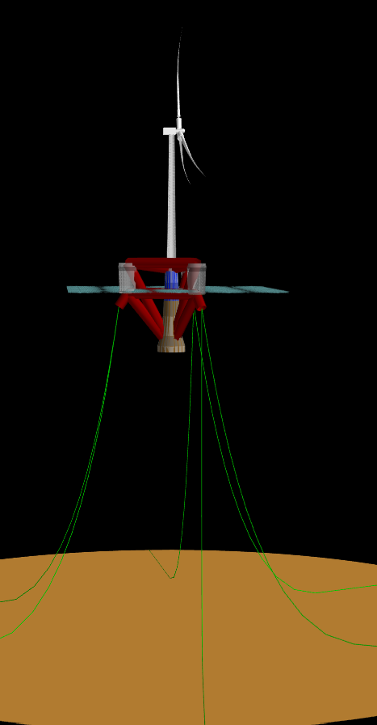
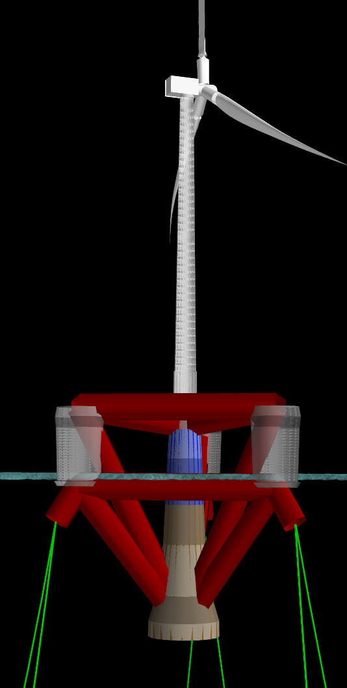
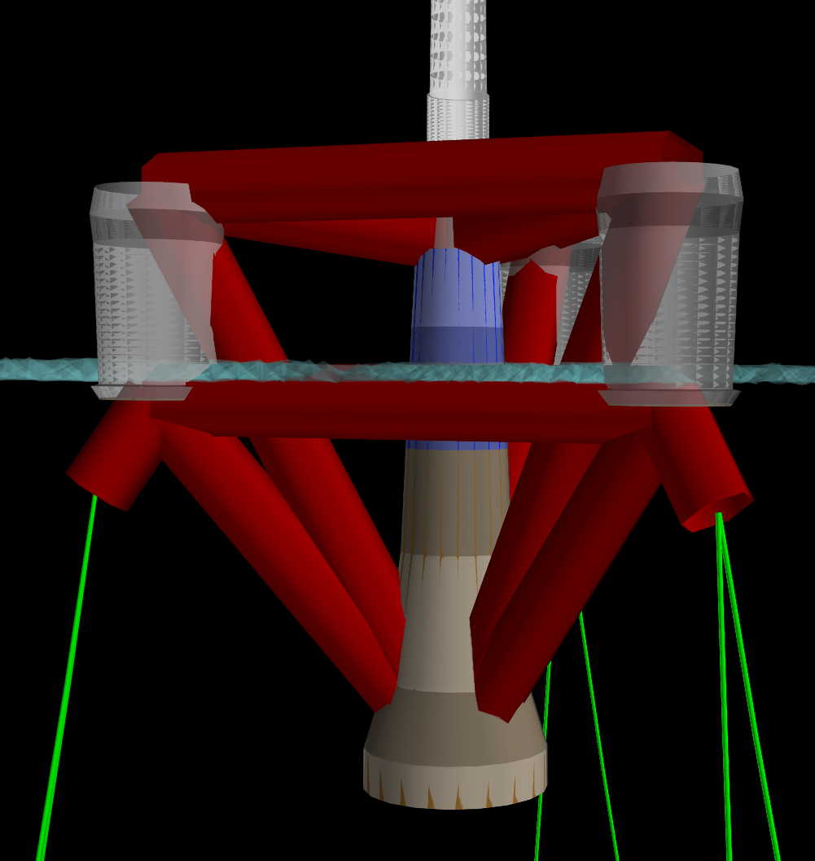
Semisubmersible optimization
Most of buoyancy is coming from main column and pontoons
Large pontoons because need stiff cross members and only have pipe-cross section available (still requires further scrutiny)
Needed improvements:
Heave plates so that the optimizer doesn’t try to flare the columns
Need to add some constraints so that offset columns don’t emerge from water during heel
Would argue can still run weight sensitivity study
Full view
Zoom
Zoom-ier

Slide 6
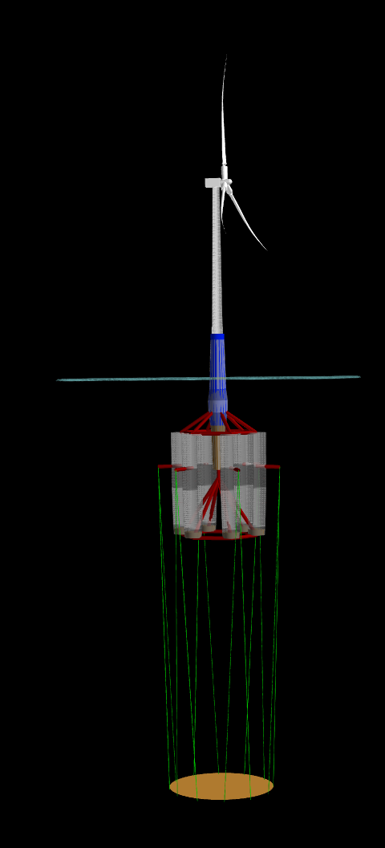
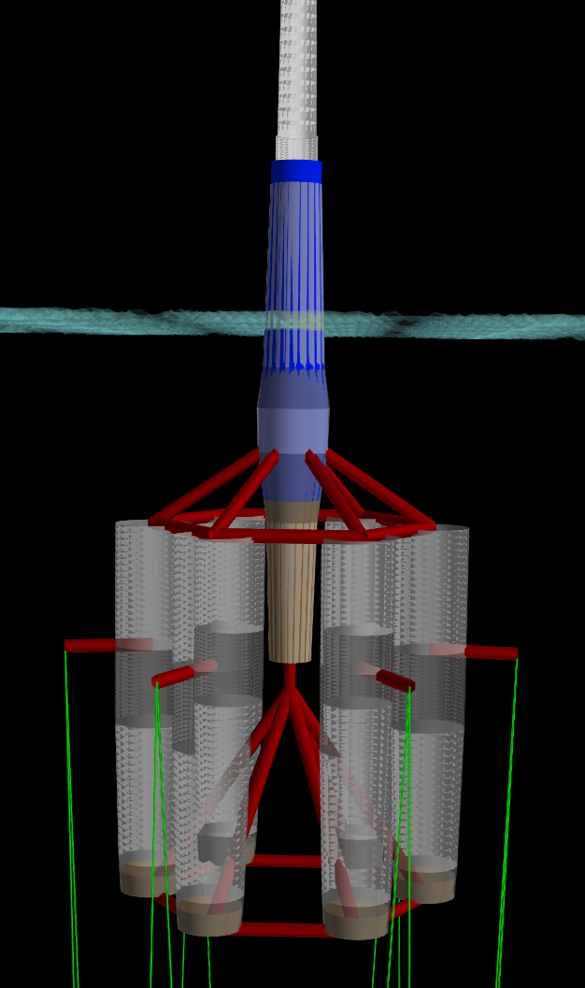
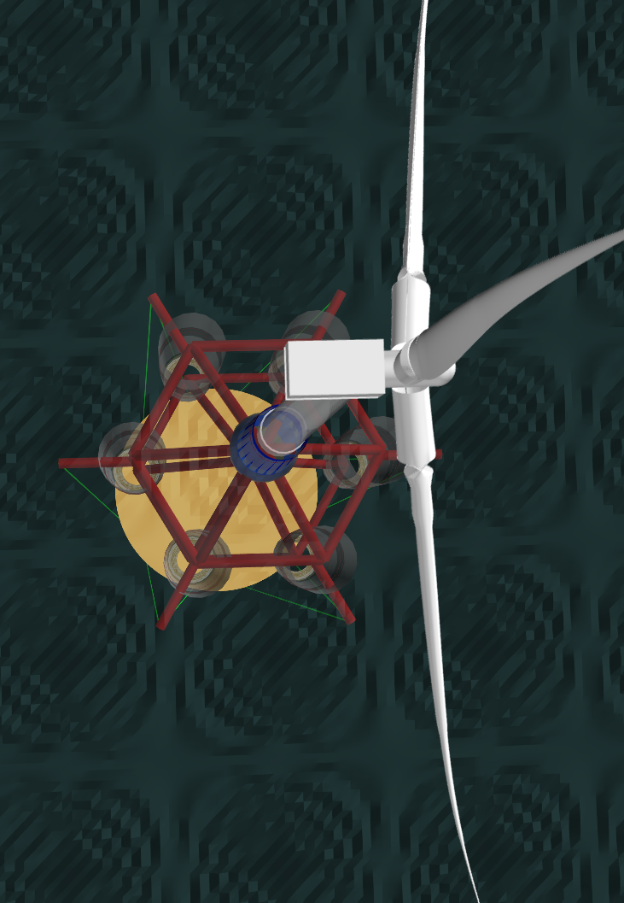
TLP optimization
Design that is most suspect
Too many offset columns(6)
Draft is too deep
What we see is not yet ”fully optimized”
Would like to re-run before committing to weight sensitivity study
Full view
Zoom
Top view

Slide 7
Next Steps
Near Term (by end of FY18)
Dive in to sensitivity more
What is changing: Diameter / ballast / thicknesses, etc?
Compare to Senu’s old results
Breakeven cost analysis
Do a sensitivity for tower mass as well?
Include semisubmersible sensitivity analysis too
Write a study report detailing methodology and findings, polish FloatingSE documentation
Long Term (FY19 and beyond)
Hydrostatics-only, single DLC approach might be too low of fidelity to give credible results
A linear potential-flow, frequency-domain approach might be more credible yet still fast enough for optimization
(this improvement will be part of “Concept Paper Proposal”)

