Slide 1
Floating Systems Optimization Check-In
Garrett Barter
August 2, 2018

Slide 2
FY18 Achievements
Full floating offshore wind energy representation in WISDEM (minus O&M)
New modules: FloatingSE, OffshoreBOS
Improvements throughout WISDEM for cohesiveness, ease of use
“Tabula rasa” (blank slate) design of floating substructure using a genetic algorithm optimizer, bounded design variables, and constraints
No initial “feasible” point, just a randomized sampling of design space
Mixed-integer optimization for continuous (e.g. diameter) and discrete (e.g. # mooring lines) design variables
Visualization of results

Slide 3
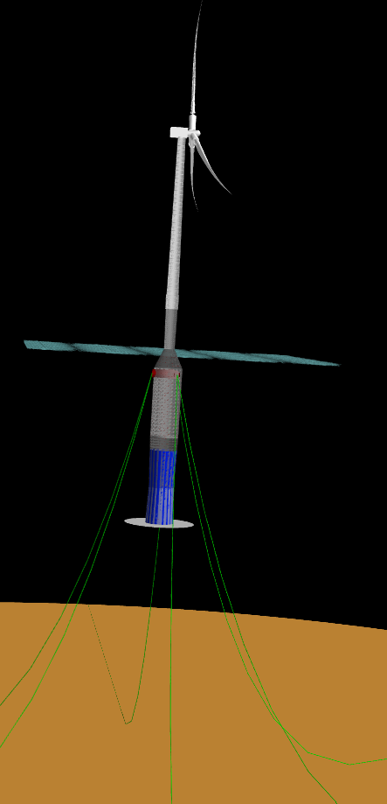
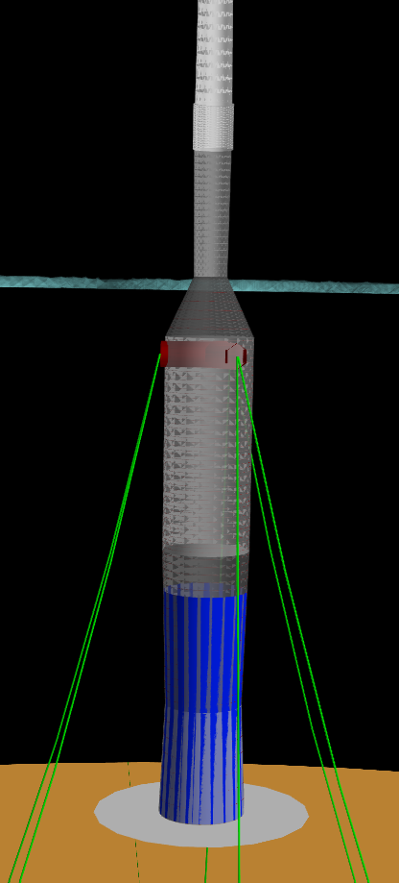
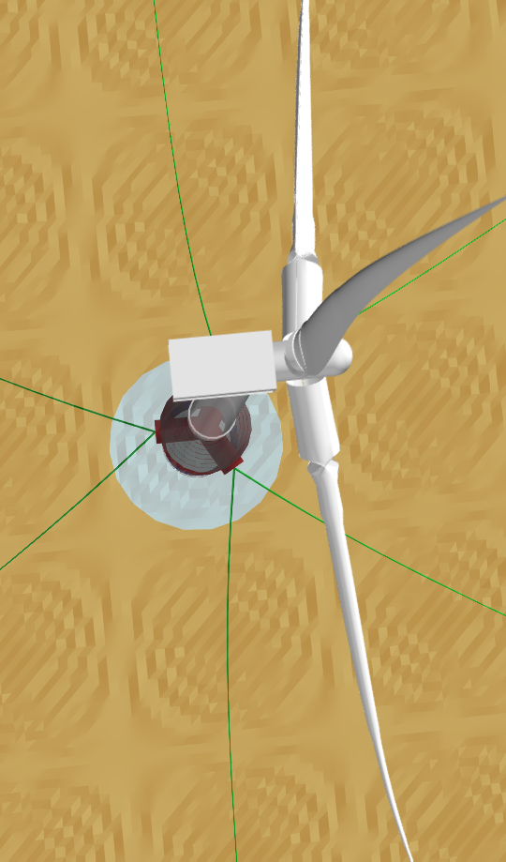
Spar
Full view
Spar design seems most reasonable
Tough to get it wrong
Excessive mooring line issue has been fixed (I think)
Zoom
Top view

Slide 4
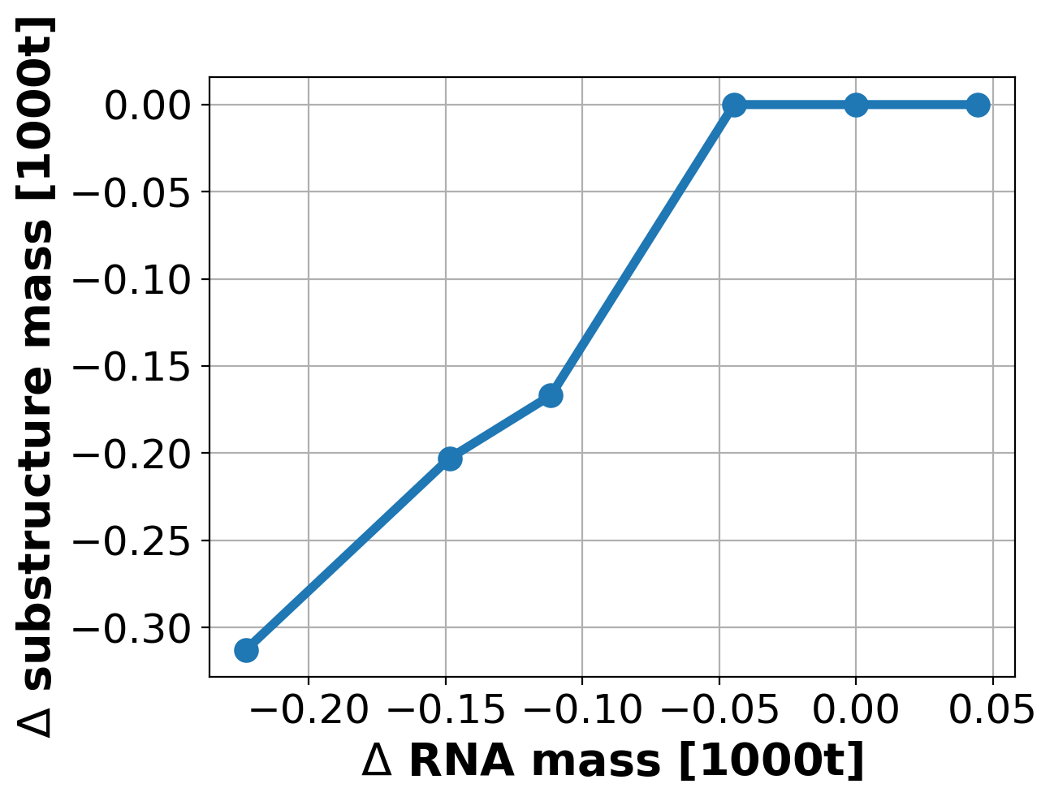
Sensitivity around optimized spar design
Have already run initial weight sensitivity study on final spar design
Results are not yet “fully optimized”, but show a clear trend
Approximately linear 1:1 reduction in substructure mass for reduction in RNA mass

Slide 5
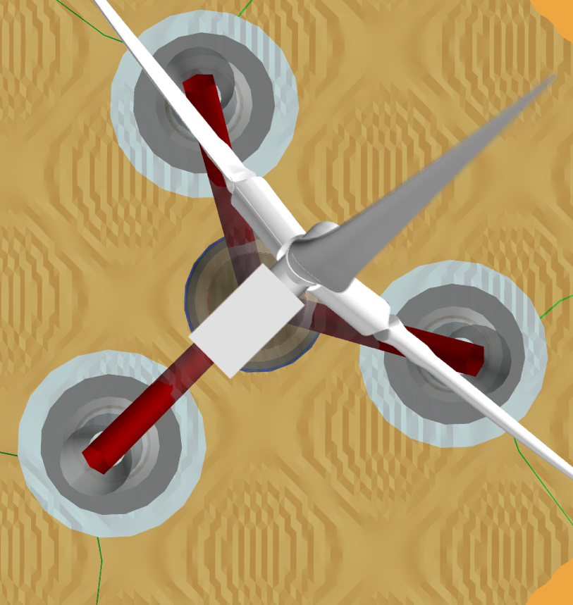
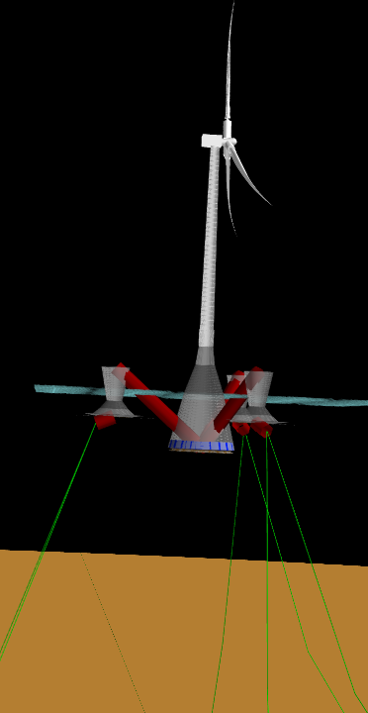
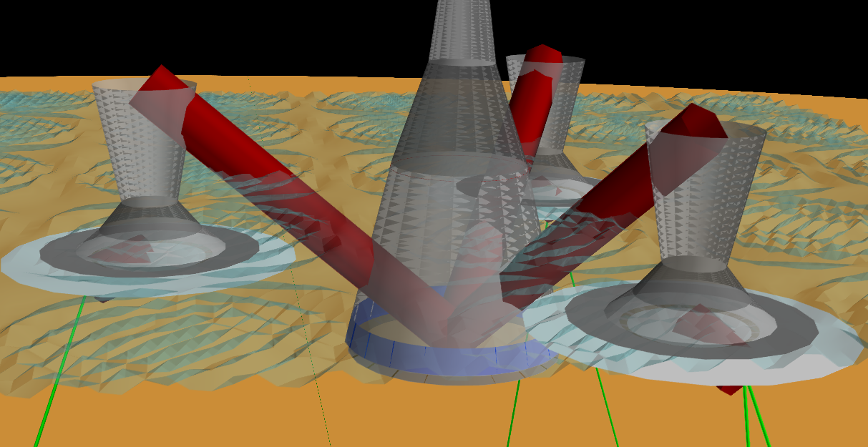
Semi
Added heave plates and resolved some other issues
Results look more reasonable
Have started weight sensitivity study
Full view
Top-view
Zoom

Slide 6
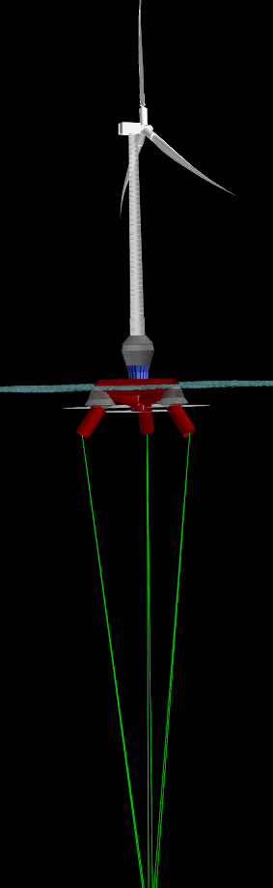
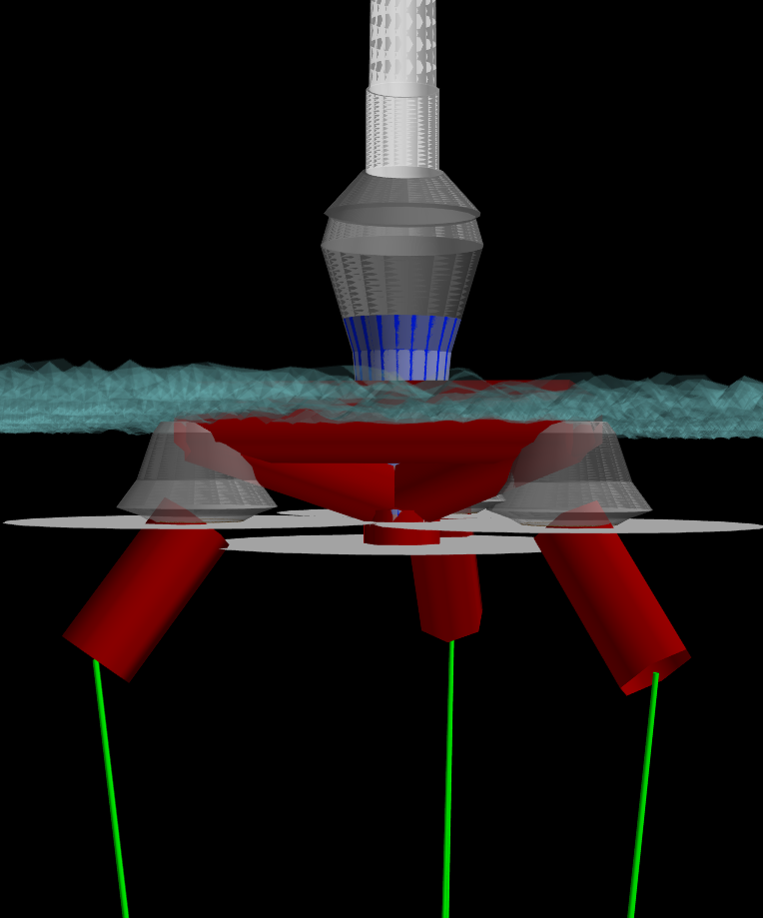
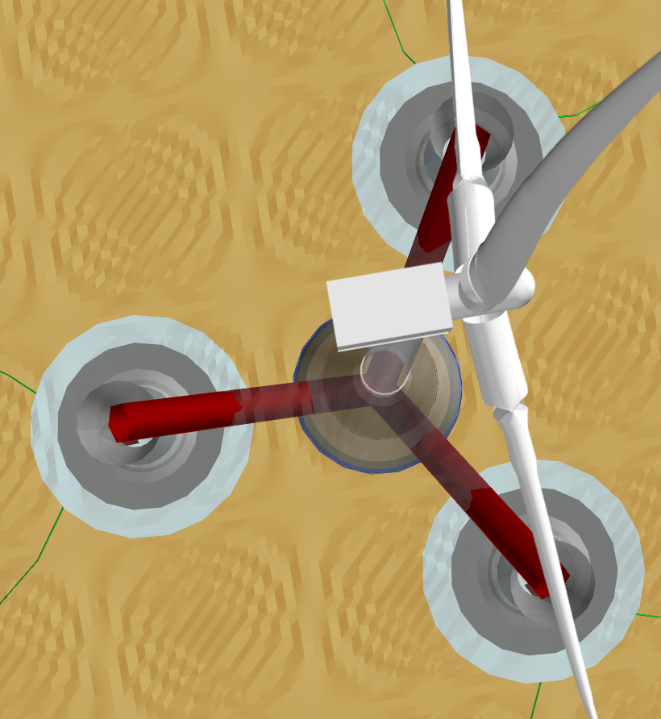
TLP
Looks similar to semi with taut moorings
Significantly improved over last version
Also started running weight sensitivity study
Full view
Zoom
Top view

Slide 7
Next Steps
Near Term (by end of FY18)
Dive in to sensitivity more
What is changing: Diameter / ballast / thicknesses, etc?
Compare to Senu’s old results
Breakeven cost analysis
Do a sensitivity for tower mass as well?
Include semisubmersible sensitivity analysis too
Write a study report detailing methodology and findings, polish FloatingSE documentation
Long Term (FY19 and beyond)
Hydrostatics-only, single DLC approach might be too low of fidelity to give credible results
A linear potential-flow, frequency-domain approach might be more credible yet still fast enough for optimization
(this improvement will be part of “Concept Paper Proposal”)

