Slide 1
Floating Systems Optimization Check-In
Garrett Barter
August 20, 2018

Slide 2
Design approach uses WISDEM, customized optimization routines, variable bounds, and constraints
Objective: Design floating substructure for DTU10MW reference turbine to minimize LCOE
Full floating offshore wind energy representation in WISDEM (minus O&M)
New modules: FloatingSE, OffshoreBOS
Improvements throughout WISDEM for cohesiveness, ease of use
“Tabula rasa” (blank slate) design of floating substructure using a genetic algorithm optimizer, bounded design variables, and constraints
No initial “feasible” point, just a randomized sampling of design space
Mixed-integer optimization for continuous (e.g. diameter) and discrete (e.g. # mooring lines) design variables
Constraints enforced with penalty function
Followed by “Local” design space optimization (continuous variables only) using Nelder-Mead simplex algorithm
Constraints enforced with penalty function

Slide 3
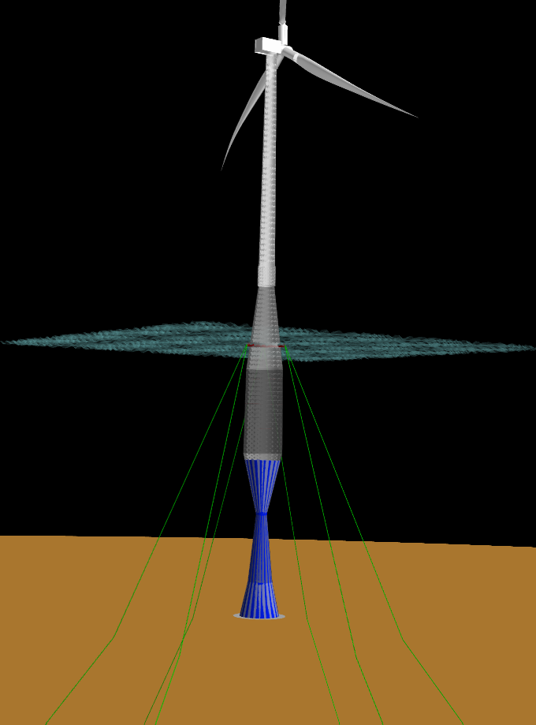
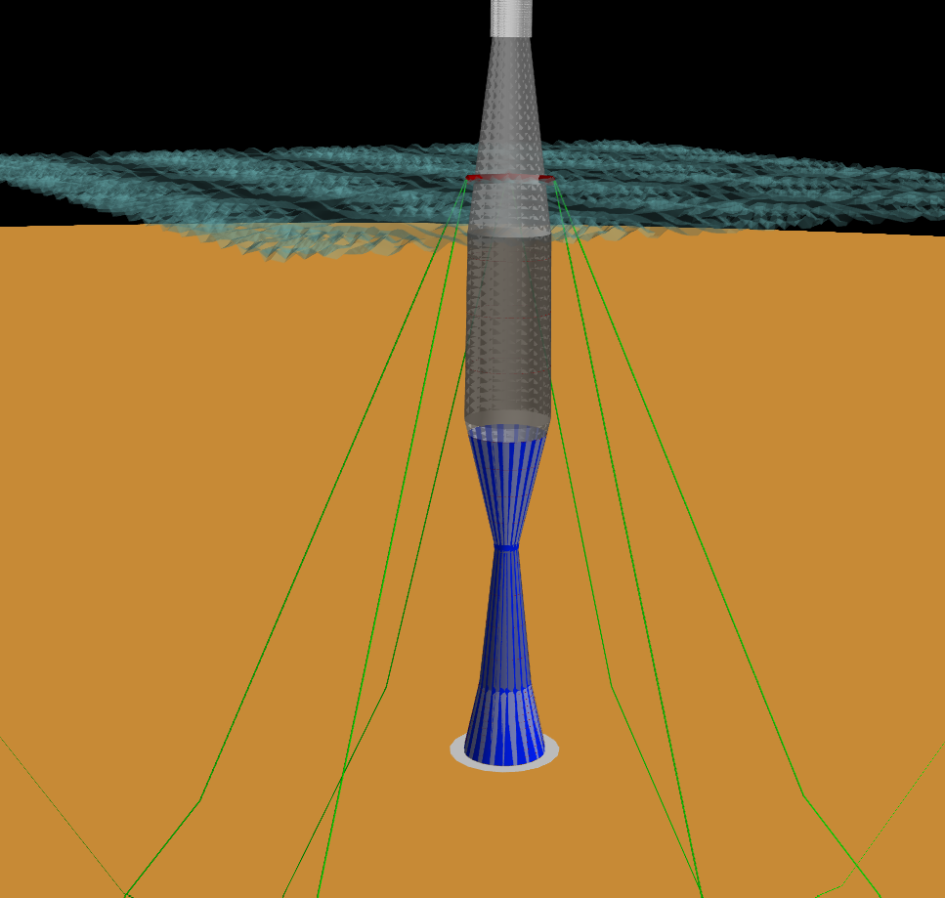
Spar Optimization
Spar optimization minimizes mass while maintaining hydrostatic stability
Chooses extensive water ballast instead of paying for own ballast

Slide 4
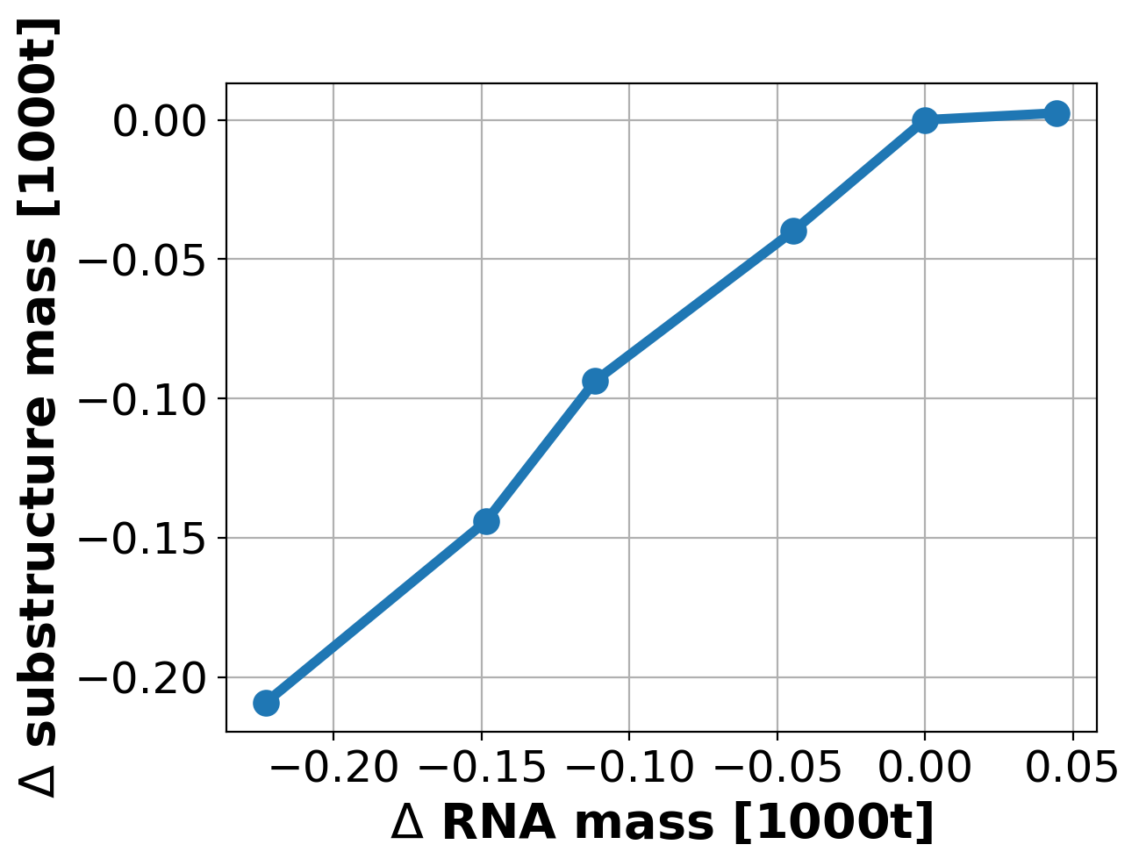
Sensitivity around optimized spar design
When minimizing weight, mass removed from the turbine means mass removed from the substructure
Approximately linear 1:1 reduction in substructure mass for reduction in RNA mass
Mass sensitivity around optimized Spar design

Slide 5
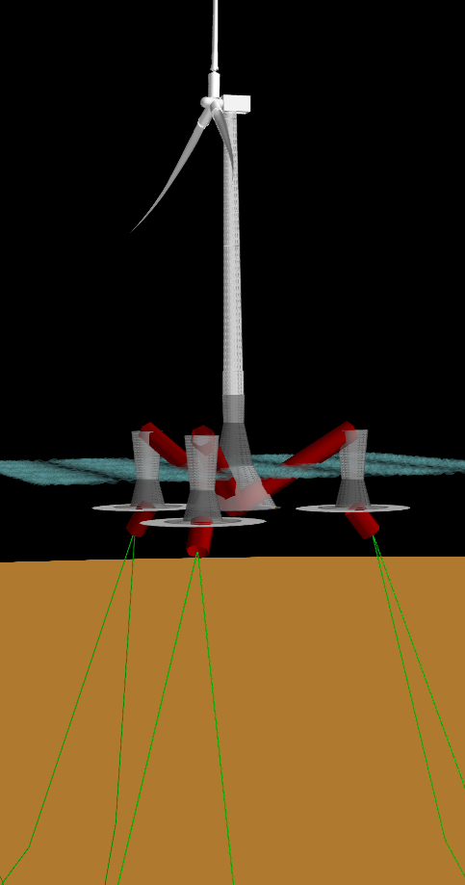
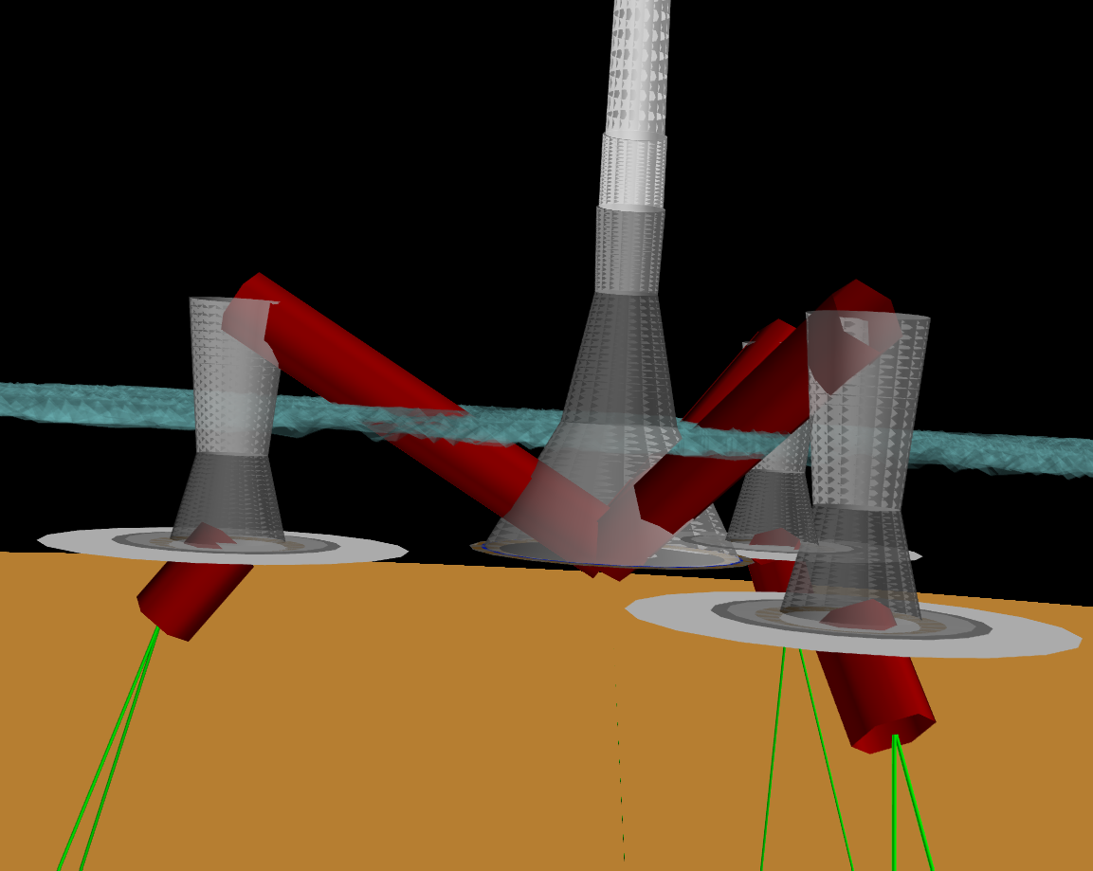
Semi Optimization
Semi optimization minimizes mass while maintaining hydrostatic stability
Chooses 3 offset columns and bell-bottom main column

Slide 6
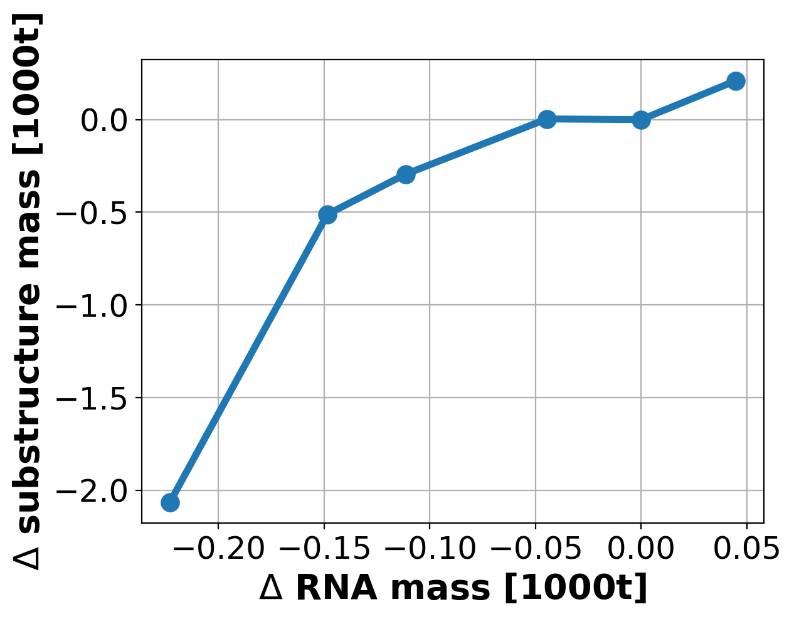
Sensitivity around optimized spar design
When minimizing weight, mass removed from the turbine means mass removed from the substructure
Approximately linear 1:1 reduction in substructure mass for reduction in RNA mass
Mass sensitivity around optimized Semi design

Slide 7
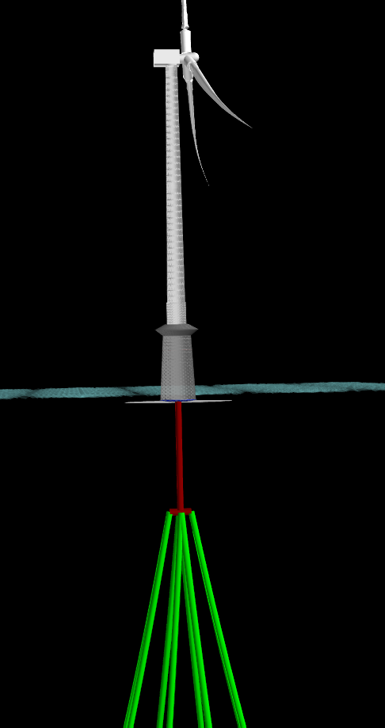
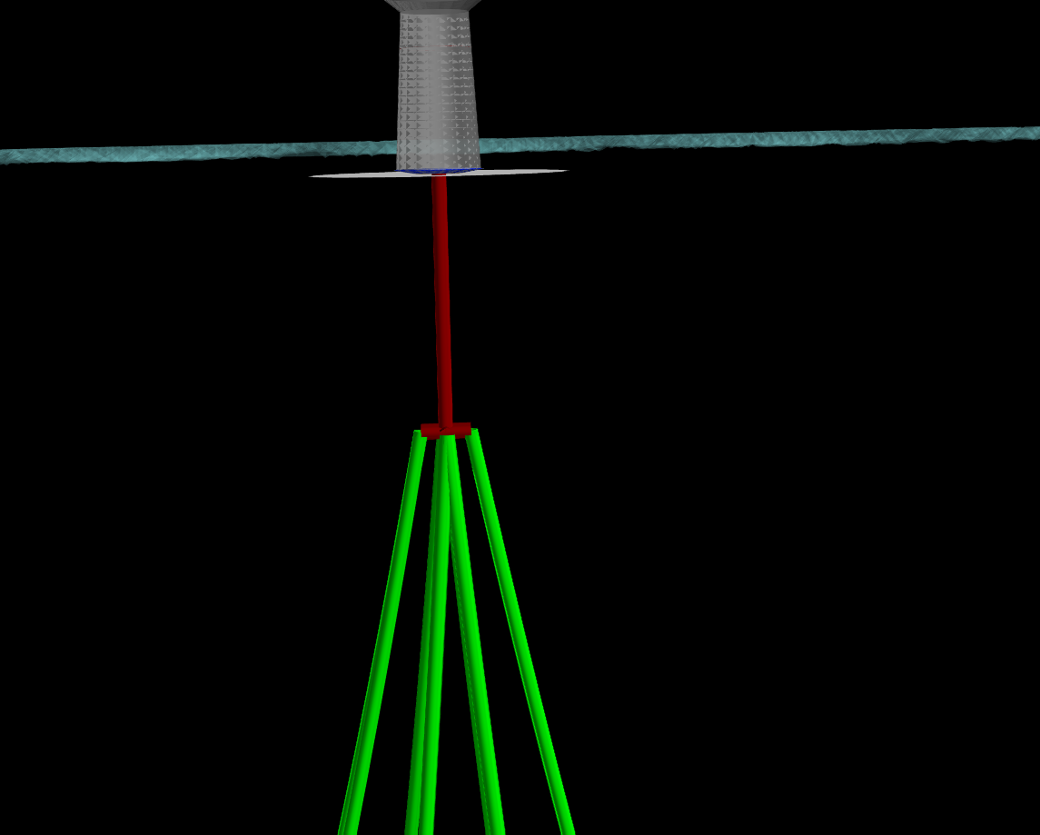
TLP Optimization
TLP optimization minimizes mass while maintaining hydrostatic stability
Minimal mass below water- had to double check for neutral buoyancy

Slide 8
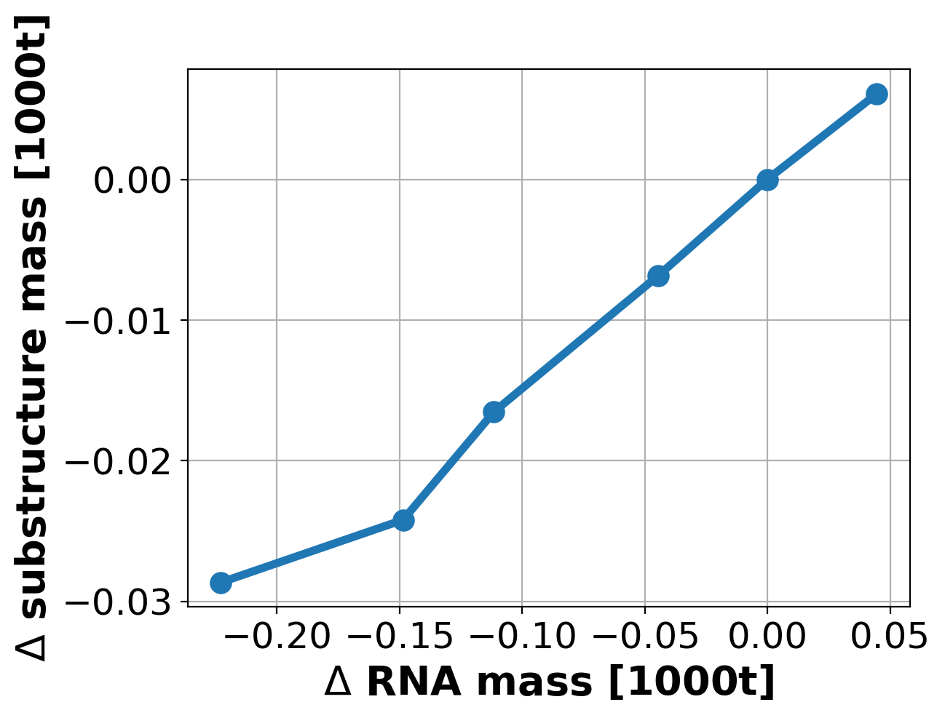
Mass sensitivity around optimized TLP design
When minimizing weight, mass removed from the turbine means mass removed from the substructure
Approximately linear (1/8):1 reduction in substructure mass for reduction in RNA mass
Does not including mass of mooring lines
Much less mass below water line as stability comes from mooring system
Mass sensitivity around optimized TLP design

Slide 9
Next Steps
Near Term (by end of FY18)
Dive in to sensitivity more
What is changing: Diameter / ballast / thicknesses, etc?
Compare to Senu’s old results
Breakeven cost analysis
Write a study report detailing methodology and findings, polish FloatingSE documentation
Long Term (FY19 and beyond)
Hydrostatics-only, single DLC approach might be too low of fidelity to give credible results
A linear potential-flow, frequency-domain approach might be more credible yet still fast enough for optimization
(this improvement will be feature part of “Concept Paper Proposal”)

