Slide 1
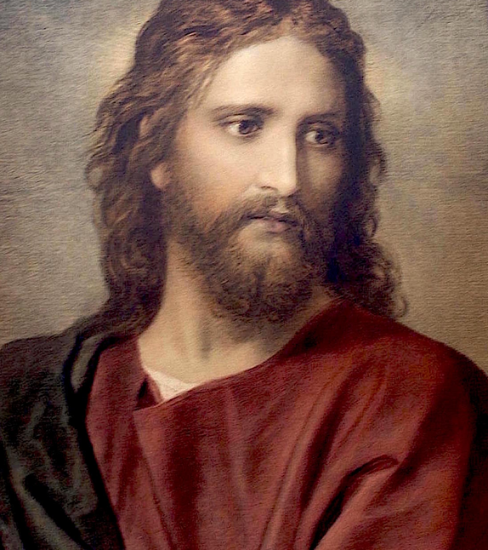

God’s solutions to burnout
Guy Baseke
Grace Message Tabernacle, Mississauga, Ontario
This Photo by Unknown Author is licensed under CC BY-SA-NC

Slide 2
Isaiah 40:28-31
²⁸ Hast thou not known? hast thou not heard, that the everlasting God, the Lord, the Creator of the ends of the earth, fainteth not, neither is weary? there is no searching of his understanding.
²⁹ He giveth power to the faint; and to them that have no might he increaseth strength.

Slide 3
Isaiah 40:28-31
³⁰ Even the youths shall faint and be weary, and the young men shall utterly fall:
³¹ But they that wait upon the Lord shall renew their strength; they shall mount up with wings as eagles; they shall run, and not be weary; and they shall walk, and not faint.

Slide 4
Psalm 23:1-3
¹ The Lord is my shepherd; I shall not want.
² He maketh me to lie down in green pastures: he leadeth me beside the still waters.
³ He restoreth my soul: he leadeth me in the paths of righteousness for his name's sake.

Slide 5
Psalm 127:1-2
¹ Except the Lord build the house, they labour in vain that build it: except the Lord keep the city, the watchman waketh but in vain.
² It is vain for you to rise up early, to sit up late, to eat the bread of sorrows: for so he giveth his beloved sleep.

Slide 6
Why
Why is it that so many of God's children, in this very last hour, feel :
empty,
tired,
dried up
— and do not know that the Shepherd Himself is inviting them to lie down?

Slide 7
Settings
We are living in the Laodicean age —
an age of rich churches and
tired saints,
of busy programs and empty altars,
of believers who can quote the Message but cannot rest in the Messenger's Christ.

Slide 8
Settings
The devil cannot take the Bride's salvation,
so he attacks her strength:
he wears her out,
pushes her past her capacity,
silences her prayer life through exhaustion

Slide 9
Settings
Brother Branham said the whole Christian principle is based upon rest — and in this hour, Satan is pushing her into a burnout. But the Shepherd is walking through His flock tonight, laying tired sheep down in green pastures.

Slide 10
Settings
My story of Burnout.

Slide 11
Vacation
A vacation is a period of time away from work, school, or daily responsibilities, typically used for rest, travel, or recreation. It is a scheduled break or "leave of absence" to relax or engage in leisure activities.

Slide 12
For self Employed
Zeal

Slide 13
Analysis
Identify possible causes
Identify cause and effect
Verify analysis with data (Give examples)

Slide 14
The Plot
The character should have 2 needs or problems
– one obvious, one hidden
Hidden need related to emotions, wounds in the past
Inner journey = Character Change
Character lives in a world has needs and a personality

Slide 15
Action
Evaluate all possible solutions
Make it relevant to the hearer
Identify barriers

Slide 16
Develop a plan to test solution
Goal (Keeps the users interested)
Overriding concern
A dramatic question (It is related to the goal)
Is it going to work?
Why, Who did it?

Slide 17
outcome
Describe new way
Develop a plan to implement and control
Assign dates and people actions

Slide 18
Implement
Complications that can arise to prevent reaching the goal (at least 3)
Control (The stakes, What are you risking, Standardize (Rewards))

Slide 19
Exhort
Promises
A declaration or assurance that God will do a particular thing or that a particular thing will happen.
Exhort
Strongly encourage or urge (someone) to do something.

Slide 20
Rebuke
Reproof
Correct with authority and sharply

Slide 21
Deeper Look
The prophetic
Foretelling events
The revelatory
Expose more, typically hidden parts
Doctrine
a belief or set of beliefs held and taught by a Church,

Slide 22
3 Elements
1. Humanistic – Hope
2. Divine revelation – Anchored in the heart
3. Vision – Thus saith the Lord, Perfectly positive

Slide 23
Conclusion
Help the character
Do not leave him hopeless
Lesson
Epiphany
See things in a new light
Develop list of unsolved issues
Summarize (Give hope)

Slide 24
When the Fire Dies Down
A word for the weary saint
Based on 1 Kings 19 and Matthew 11
Scripture: "It is enough" — 1 Kings 19:4
You are seen. You are loved.

Slide 25
Something the Bible Understands
The word "burnout" is modern
The experience is as old as Eden
God's greatest servants knew this valley
He never once rebuked them for it
Tonight we find ourselves in good company

Slide 26
You Are Not the First
Moses cried, "It is too heavy" (Num 11:14)
Elijah asked God to take his life
David wept until his bed swam
Jeremiah tried to quit preaching
Paul "despaired even of life" (2 Cor 1:8)
Even Jesus grew weary (John 4:6)

Slide 27
Elijah After the Victory
He had just called down fire
He ran a day into the wilderness
He sat beneath a juniper tree
"Take away my life" — 1 Kings 19:4
Great victory often precedes great weariness

Slide 28
God's First Response: Food and Sleep
No sermon. No correction. No demand.
"Arise and eat" — 1 Kings 19:5
An angel baked him bread
He slept. He ate. He slept again.
Sometimes the holiest act is rest

Slide 29
The Juniper Tree Is a Gift
"I'm glad that there is a juniper tree"
— Bro. Branham, What hearest thou, Elijah?
God planted it there on purpose
A place to get quiet before Him
Your breakdown may be an appointment

Slide 30
The Prophet Was There Too
"Frankly, I'm right under it now"
— Bro. Branham, What doest thou here?
He testified of his darkest hour
God held back his hand from harm
If the prophet wept, you may too

Slide 31
The Root: Carrying What God Never Gave
Jethro to Moses: "Thou wilt surely wear away"
Exodus 18:18 — "too heavy for thee"
You were never meant to carry alone
God sent seventy elders to help
Help is not weakness; it is wisdom

Slide 32
The Root: Strength That Is Not His
"Even the youths shall faint" — Isaiah 40:30
Self-strength always runs dry
Waiting on the Lord renews us
Eagles mount up; they do not strain
Rest is the soil of new strength

Slide 33
A Quiet Day with Jesus
"Come ye apart… and rest awhile" — Mark 6:31
The disciples had no time to eat
Jesus prescribed a desert place
Not laziness — holy recovery
Even the Master needed the mountain

Slide 34
The Still Small Voice
Not in the wind, earthquake, or fire
A quiet whisper after the storm
God meets us in gentleness
He asks, "What doest thou here?"
He is not shouting at you tonight

Slide 35
A Rock in a Weary Land
Isaiah 32:2 — shelter in the storm
"If you are weary, speak to the rock"
— Bro. Branham, Without money or without price
You don't have to pay Him
Just speak. He hears the weakest voice.

Slide 36
Come Unto Me
"All ye that labour and are heavy laden"
Matthew 11:28 — His open invitation
The rest Jesus gives is the Holy Ghost
"Take my yoke… my burden is light"
He carries the heavy end of every yoke

Slide 37
Cast Your Care
1 Peter 5:7 — cast it on Him
"For he careth for you"
Not some of it — all of it
Psalm 55:22 — He will sustain thee
You do not carry Him; He carries you

Slide 38
Weary in Well Doing
Galatians 6:9 — "be not weary"
"In due season we shall reap"
Hebrews 12:3 — consider Him who endured
Your labor is not in vain
The harvest is nearer than you think

Slide 39
Arise and Eat
The journey is too great for thee (1 Kings 19:7)
But He has bread for your table
He has a juniper for your shade
He has a whisper for your heart
Beloved, the fire is not out — rest first
"They that wait upon the LORD shall renew their strength"

