Slide 1
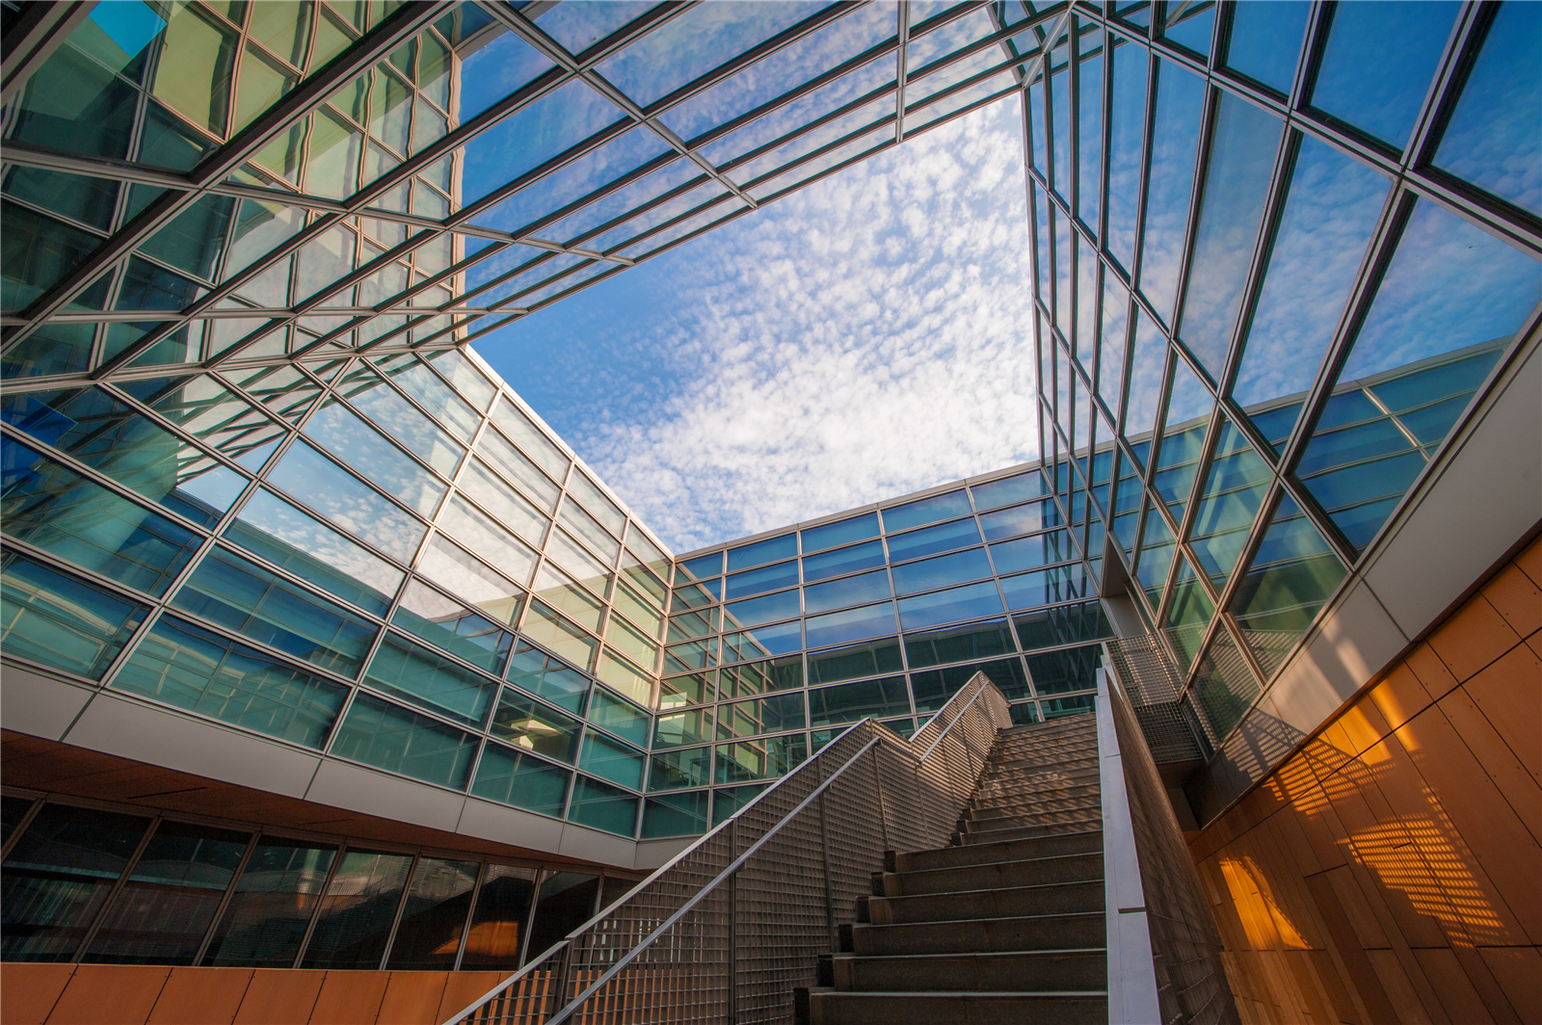

“大湾区超构材料与微纳光学”专题研讨会
南方科技大学图书馆第一报告厅
2018年6月1日-3日
主办单位：南方科技大学、香港科技大学、深圳大学、哈尔滨工业大学（深圳）
承办单位：南方科技大学材料科学与工程系

Slide 2
“大湾区超构材料与微纳光学”专题研讨会
组委会成员：
陈子亭 香港科技大学
袁小聪 深圳大学
李贵新 南方科技大学
Jensen Li 香港科技大学
宋清海 哈工大深圳
会议联系人：
李贵新（18898592606，ligx@sustc.edu.cn）

Slide 3
2018 南方科技大学大湾区波动材料会议
the Greater Bay Area Symposium for Wave Functional Materials
2nd June 2018
Speaker | Time | Topic
 | 08:30-08:50 | Opening ceremony
Xuehua Wang (王雪华) | 08:50-09:15 | 微纳结构中光与物质相互作用调控研究
Che Ting Chan(陈子亭) | 09:15-09:40 | Some unusual effects enabled by photonic crystals
GuoPing Wang(汪国平) | 09:40-10:05 | Grating metasurfaces for opticalfield controllingandsuper-resolutionimaging
 | 10:05-10:45 | Coffee Break
Kok Wai Cheah（谢国伟） | 10:45-11:10 | Plasmonic Coupling of nano-metals
Wing Yim Tam(谭永炎) | 11:10-11:35 | Zak phase of 1D photonic crystals
QingHai Song(宋清海) | 11:35-12:00 | Microlaser based highly-sensitive optical sensors
午休
Ting Lei（雷霆） | 14:30-14:55 | Singular optical beam multiplexing communication towards high performance computing applications
JianWen Dong(董建文) | 14:55-15:20 | 全介质能谷光子晶体：拓扑纳米光子学新途径
LuPing Du(杜路平) | 15:20-15:45 | Metasurface-assisted plasmonic wavefront modulation with incident polarization

Slide 4
2018 南方科技大学大湾区波动材料会议
the Greater Bay Area Symposium for Wave Functional Materials
Conference Program in 2nd
June 2018
Speaker | Time | Topic
 | 15:45-16:10 | Coffee Break
ShuMin Xiao(肖淑敏) | 16:10-16:35 | 全介质超构表面的研究（All-dielectric Metasurfaces） Opening ceremony
ZhiYu Yang(杨志宇) | 16:35-17:00 | Coherent wave manipulations
GuanCong Ma(马冠聪) | 17:00-17:25 | Controlling complex sound field with spatial sound modulator
Alex Wong(王文瀚) | 17:25-17:55 | Arbitrary Electromagnetic Wave Manipulation with a Huygens’ metasurface

Slide 5
2018 南方科技大学大湾区波动材料会议
the Greater Bay Area Symposium for Wave Functional Materials
3rd June 2018
Speaker | Time | Topic
Nicholas Fang(方绚莱) | 08:30-08:55 | Engineered Light Emission Rate in Two-dimensional Molecular Aggregates
Kam Sing Wong(黃錦聖) | 08:55-09:20 | Ultrafast dynamics and nonlinear optics in metamaterial/plasmonic structures
BaoJun Li (李宝军) | 09:20-09:55 | 用光纤探针操控微粒和细胞
DangYuan Lei(雷党愿) | 09:55-10:20 | Some interesting nano-optics phenomena in plasmonic particle-on-film nanocavities
 | 10:20-10:45 | Coffee Break
ZhangKai Zhou(周张凯) | 10:45-11:10 | 基于等离激元结构的功能图像器件
Chongjun Jin（金崇君） | 11:10-11:35 | Sensors based on surface plasmon polaritons
HuaKang Yu(虞华康) | 11:35-12:00 | 低维纳米材料的光学二倍频效应
午休
XiangPing Li(李向平) | 14:30-14:55 | Metahologram from vectorial polarization to atomic thickness
ShuBo Wang (王书波) | 14:55-15:20 | Controlling wave propagation by manipulating angular momentum
XinLun Cai (蔡鑫伦) | 15:20-15:45 | Hybrid Silicon and Lithium Niobate Mach–Zehnder Modulators for 100 Gbit/s and Byond

Slide 6
2018 南方科技大学大湾区波动材料会议
the Greater Bay Area Symposium for Wave Functional Materials
Conference Program in 3nd
June 2018
Speaker | Time | Topic
 | 15：45-16:10 | Coffee Break
Jack Ng(吴紫辉) | 16:10-16:35 | Optical Tractor Beam with Macroscopic Range
YaoYu Cao(曹耀宇) | 16:35-17:00 | Optical beam lithography (OBL) facilitated nanophotonics: new challenges and opportunities
LI Jensen Tsan Hang(李赞恒) | 17:00-17:25 | Elastic metasurfaces
GuiXin Li (李贵新) | 17:25-17:40 | Nonlinear Photonic Metasurfaces

Slide 8
2018 南方科技大学“大湾区超构材料与微纳光学”专题研讨会
Advanced Photonics Conference: Greater Bay Area Symposium for Wave Functional Materials
2ndJune 2018
Speaker | Time | Topic
 | 08:30-08:50 | Opening ceremony
Che Ting Chan(陈子亭) | 08:50-09:15 | Some unusual effects enabled by photonic crystals
Xuehua Wang (王雪华) | 09:15-09:40 | 微纳结构中光与物质相互作用调控研究
GuoPing Wang(汪国平) | 09:40-10:05 | Grating metasurfaces for opticalfield controllingandsuper-resolutionimaging
 | 10:05-10:25 | Coffee Break
Wenshan Cai （蔡文山） | 10:25-10:45 | Femtosecond Light Modulation Expedited by Hot Carriers in Plasmonics
Kok Wai Cheah（谢国伟） | 10:45-11:10 | Plasmonic Coupling of nano-metals
Wing Yim Tam(谭永炎) | 11:10-11:35 | Zak phase of 1D photonic crystals
QingHai Song(宋清海) | 11:35-12:00 | Microlaser based highly-sensitive optical sensors
午休
XinLun Cai (蔡鑫伦) | 14:30-14:55 | Hybrid Silicon and Lithium Niobate Mach–Zehnder Modulators for 100 Gbit/s and Byond
JianWen Dong(董建文) | 14:55-15:20 | 全介质能谷光子晶体：拓扑纳米光子学新途径
Alex Wong(王文瀚) | 15:20-15:45 | Arbitrary Electromagnetic Wave Manipulation with a Huygens’ metasurface

Slide 9
2018 南方科技大学“大湾区超构材料与微纳光学”专题研讨会
Advanced Photonics Conference: Greater Bay Area Symposium for Wave Functional Materials
Conference Program in 2nd June 2018
Speaker | Time | Topic
 | 15:45-16:10 | Coffee Break
ShuMin Xiao(肖淑敏) | 16:10-16:35 | 全介质超构表面的研究（All-dielectric Metasurfaces） Opening ceremony
ZhiYu Yang(杨志宇) | 16:35-17:00 | Coherent wave manipulations
GuanCong Ma(马冠聪) | 17:00-17:25 | Controlling complex sound field with spatial sound modulator
XiaoFeng Wang(王晓峰) | 17:25-17:40 | Advanced Photonics杂志介绍

Slide 10
2018 南方科技大学“大湾区超构材料与微纳光学”专题研讨会
Advanced Photonics Conference: Greater Bay Area Symposium for Wave Functional Materials
3ndJune 2018
Speaker | Time | Topic
Nicholas Fang(方绚莱) | 08:30-08:55 | Engineered Light Emission Rate in Two-dimensional Molecular Aggregates
Kam Sing Wong(黃錦聖) | 08:55-09:20 | Ultrafast dynamics and nonlinear optics in metamaterial/plasmonic structures
DangYuan Lei(雷党愿) | 09:20-09:55 | Some interesting nano-optics phenomena in plasmonic particle-on-film nanocavities
ZhangKai Zhou(周张凯) | 09:55-10:20 | 基于等离激元结构的功能图像器件
 | 10:20-10:45 | Coffee Break
Chongjun Jin（金崇君） | 10:45-11:10 | Sensors based on surface plasmon polaritons
HuaKang Yu(虞华康) | 11:10-11:35 | 低维纳米材料的光学二倍频效应
午休
XiangPing Li(李向平) | 14:00-14:25 | Metahologram from vectorial polarization to atomic thickness
Ting Lei(雷霆) | 14:25-14:50 | Singular optical beam multiplexing communication towards high performance computing applications
Jack Ng(吴紫辉) | 14:50-15:15 | Optical Tractor Beam with Macroscopic Range

Slide 11
2018 南方科技大学“大湾区超构材料与微纳光学”专题研讨会
Advanced Photonics Conference: Greater Bay Area Symposium for Wave Functional Materials
Conference Program in 3ndJune 2018
Speaker | Time | Topic
 | 15:15-15:40 | Coffee Break
YaoYu Cao(曹耀宇) | 15:40-16:05 | Optical beam lithography (OBL) facilitated nanophotonics: new challenges and opportunities
LuPing Du(杜路平） | 16:05-16:30 | Metasurface-assisted plasmonic wavefront modulation with incident polarization
LI Jensen Tsan Hang(李赞恒) | 16:30-16:45 | Elastic metasurfaces
GuiXin Li (李贵新) | 16:45-17:00 | Nonlinear Photonic Metasurfaces

