Slide 2
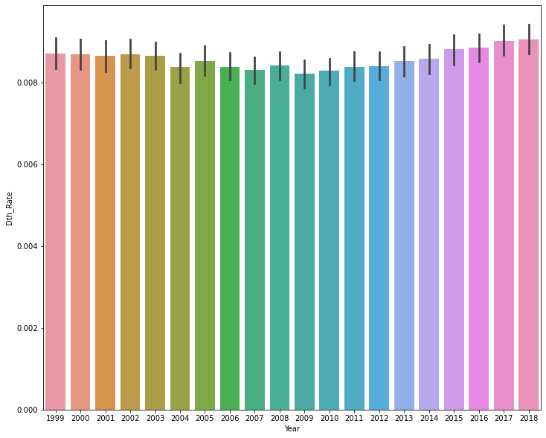
US Overall Death Rates for the last 10 years

Slide 3
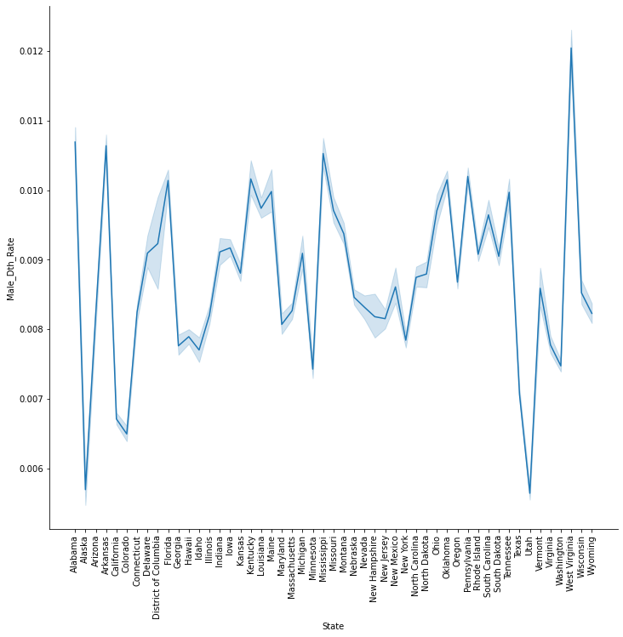
US Overall Male Death Rates by State for the last 10 years

Slide 4
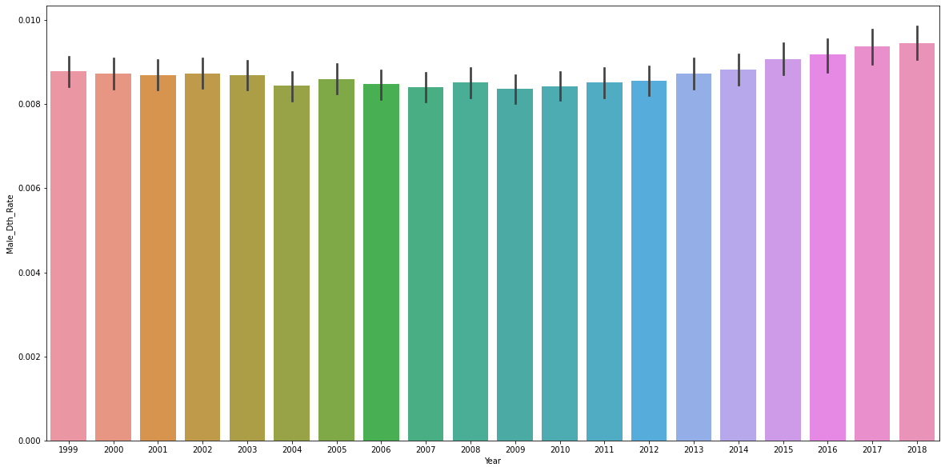
US Overall Male Death Rates by Year for the last 10 years

Slide 5
US Overall Female Death Rates by State for the last 10 years

Slide 6
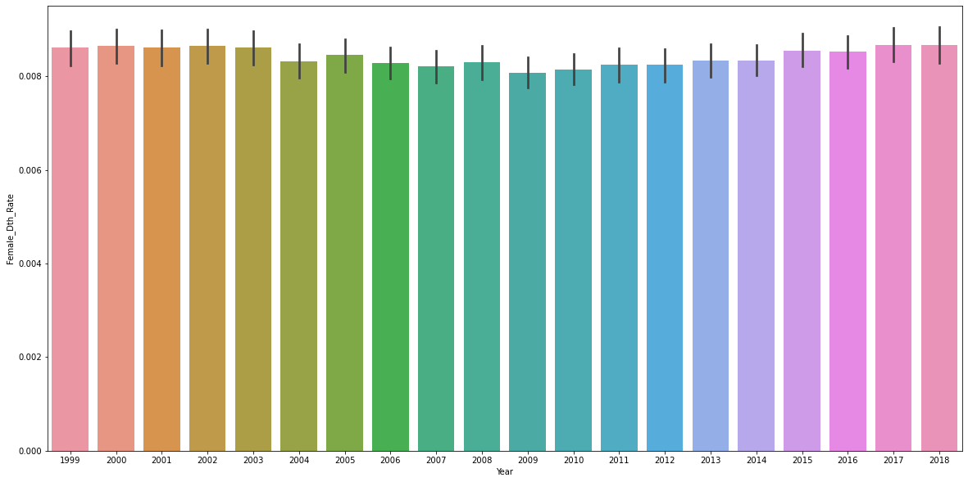
US Overall Female Death Rates by Year for the last 10 years

Slide 7
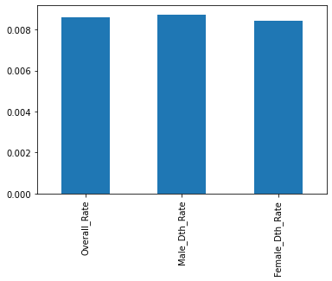
US Overall Death Rates and Gender Rates mean for the last 10 years
In the last 10 yrs Male death rates are trending a little higher

Slide 8
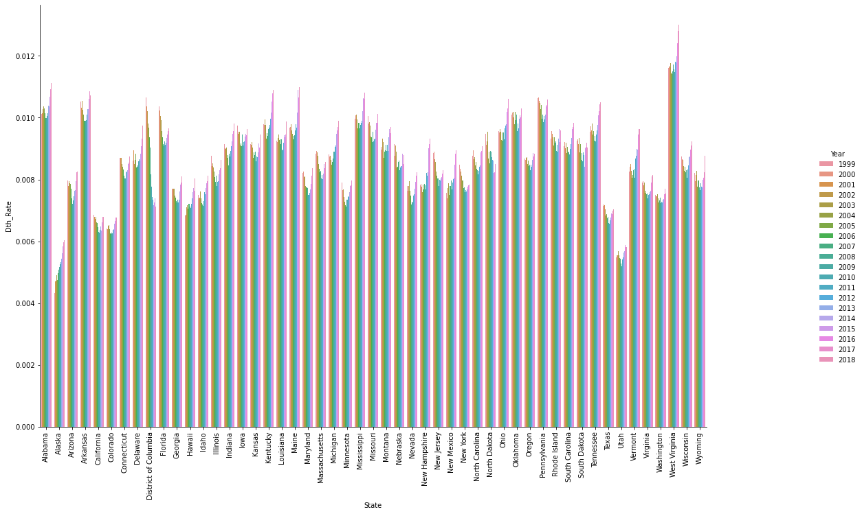
Overall Death Rate by State with Years
It appears that the death rate has been going up in the last few years in a few states i.e. AL,Ak,WV,KY,MN

Slide 9
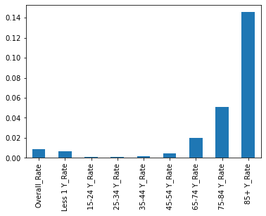

Slide 10
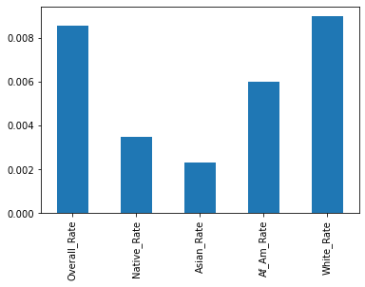
Race data

