Slide 2
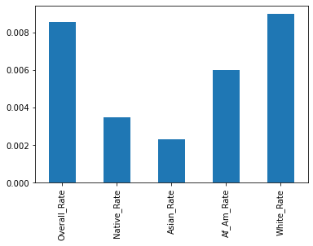
10 Year Death Rate by Race
Whites have the highest rates. Asians have the lowest

