Slide 1
Course Sign Up
Application
Guilherme Bauso

Slide 2
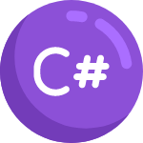

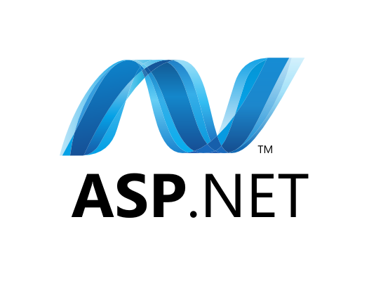






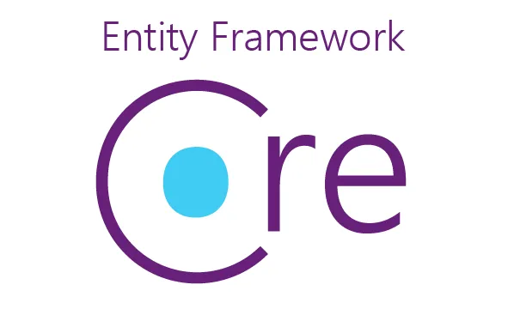

Tech Stack

Slide 3
Architecture and Design Topics
Domain
CQRS x Business Layer
Part 1: API for signing up
Part 2: Scaling out
Part 3: Querying
Challenges faced
Improvements

Slide 4
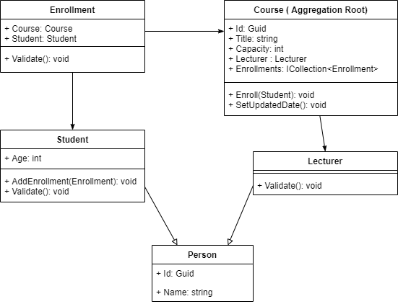
Domain

Slide 5
CQRS x Business Layer
Single responsibility.
Code cleaner and testable.
Optimized dependency injection.
Credits to jbogard (https://github.com/jbogard) for provide MediatR to developers.

Slide 6
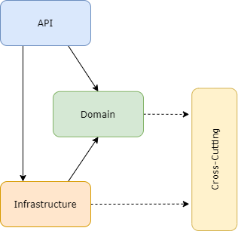
Part 1: API for signing up
3 layers (API, Domain and Infrastructure).
The Domain contains Contracts (Repositories, Interfaces), Services (Commands, Handlers) and Domain Entities (Aggregation root)
API contains DI, HTTP communication and Error Handling
Infrastructure implements Repositories interfaces of Domain.
Cross-Cutting contains the common exceptions

Slide 7
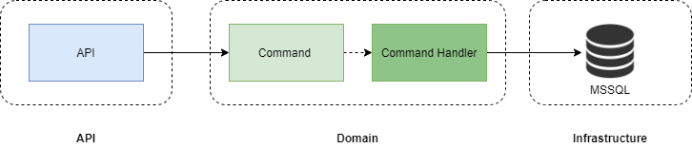
Part 1: Flow

Slide 8
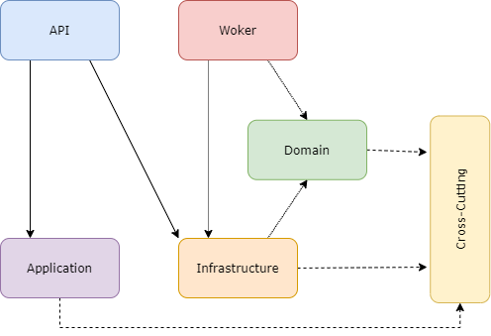
Part 2: Scaling out
Added a worker that subscribes to the course queue and communicates with the domain.
The old endpoint invokes a command that publishes to the course queue.
Cross-Cutting has the Service Bus interfaces.
Infrastructure implements the Service Bus interfaces.

Slide 9
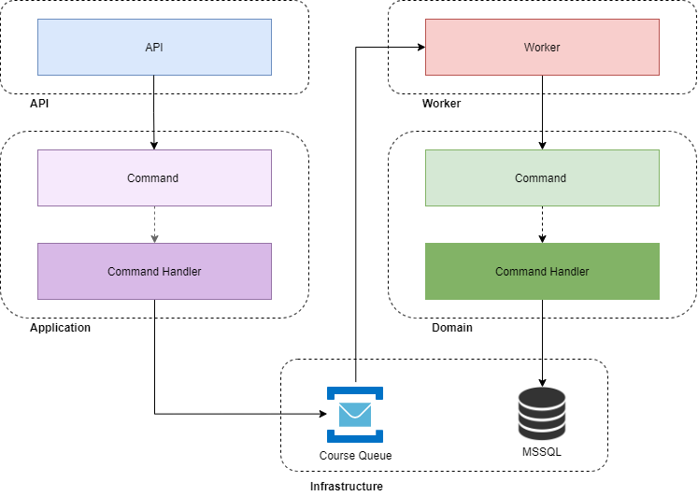
Part 2: Flow

Slide 10
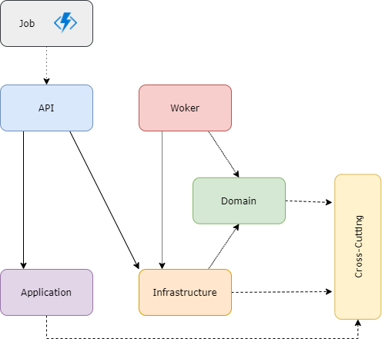
Part 3: Querying
Added an Azure Function with a cron trigger that invokes a job endpoint on API.
Application Layer retrieves data from Command Database and converts it to Query Data, writing on Cosmos DB.

Slide 11
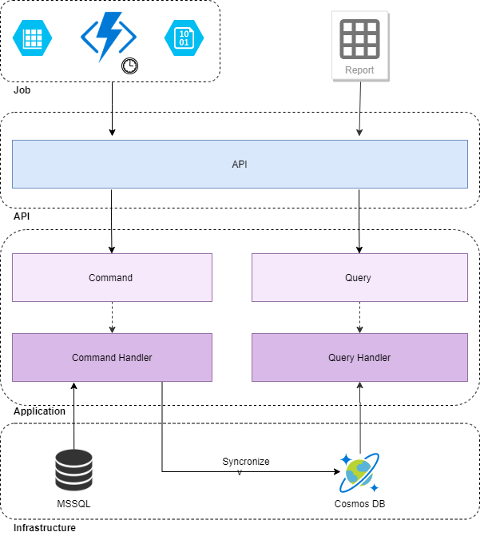
Part 3: Flow

Slide 12
Challenges faced
Handle concurrency on Worker project (It has to be improved).
Worker dependency injection (Only supports singleton).
Performance on Azure Table (retrieving the successful job executions).
Figuring out the best time to synchronize databases.

Slide 13
Improvements
Concurrency on Worker or figure out another way.
Service Bus configuration (lock and retries)
CI/CD
Containerization
Moving the synchronization process to Worker.

