Slide 1
COMP3074 Mobile App Development I
Week 5

Slide 2
Launch Map with an Intent
Launch the map.
Uri.parse("http://maps.google.com/maps?saddr=43.67023,-79.38676&daddr=45.42349,-75.69793"));
Uri.parse(”geo://43.67023,-79.38676"));
Is it WebView or Launch an app ?
Do we need Internet permission ?
Notes:
2

Slide 3
Using Location-Based Services (LBS) APIs
Objectives:
Upon the completion of this work the student will have a good understanding of Android Global Positioning Services (GPS).
The student will learn how to use GPS Features in Your Applications for finding location, emulating locating in the emulator, geocoding locations, mapping locations, mapping intents, mapping views, etc.

Slide 4
Using Location-Based Services (LBS) APIs
To use many LBS services, you should use Android Virtual Device (AVD) configurations that target the Android SDK with the Google APIs.
Using the Google APIs target puts applications like the Maps on the emulator.
Create a new AVD for this purpose
LBS design and testing is best done on a real Android device.

Slide 5
Using Global Positioning Services (GPS)
The Android SDK provides means for accessing location via a built-in GPS hardware, when it’s available
You can declare that your application uses or requires specific LBS services using the <uses-feature> tag of the Android Manifest file
<uses-feature android:name="android.hardware.location" />
If your application requires a precise location fix (that is, the device has functional GPS hardware, use the following <uses-feature> tag instead:
<uses-feature android:name="android.hardware.location.gps" />

Slide 6
Using the Google Maps Android API v2
Download and configure the Google Play services SDK.
The Google Maps Android API is distributed as part of this SDK.
Users of the Google Maps Mobile SDK for Business must download and configure the Google Maps Mobile SDK for Business static library.
Create a Google Maps project
Obtain an API key. To do this, you will need to register a project in the Google APIs Console, and get a signing certificate for your app.
Specify settings in the Application Manifest.
Add a map to a new or existing Android project.
Publish your application!

Slide 7
Getting Started
This guide is a quick start to adding a map to an Android app:
https://developers.google.com/maps/documentation/android-api/start
Let’s follow the example above. See next page for the support library.
This Treehouse tutorial is also good:
http://blog.teamtreehouse.com/beginners-guide-location-android
Notes:
Maptest in SecondHalf.

Slide 8
Support Library
v4 Support Library: com.android.support:support-v4:23.2.1
Fragment - Adds support for encapsulation of user interface and functionality with Fragments, enabling applications to provide layouts that adjust between small and large-screen devices.
v7 appcompat library com.android.support:appcompat-v7:23.2.1This library adds support for the Action Bar user interface design pattern. This library includes support for material designuser interface implementations.
http://developer.android.com/tools/support-library/features.html#v4

Slide 9
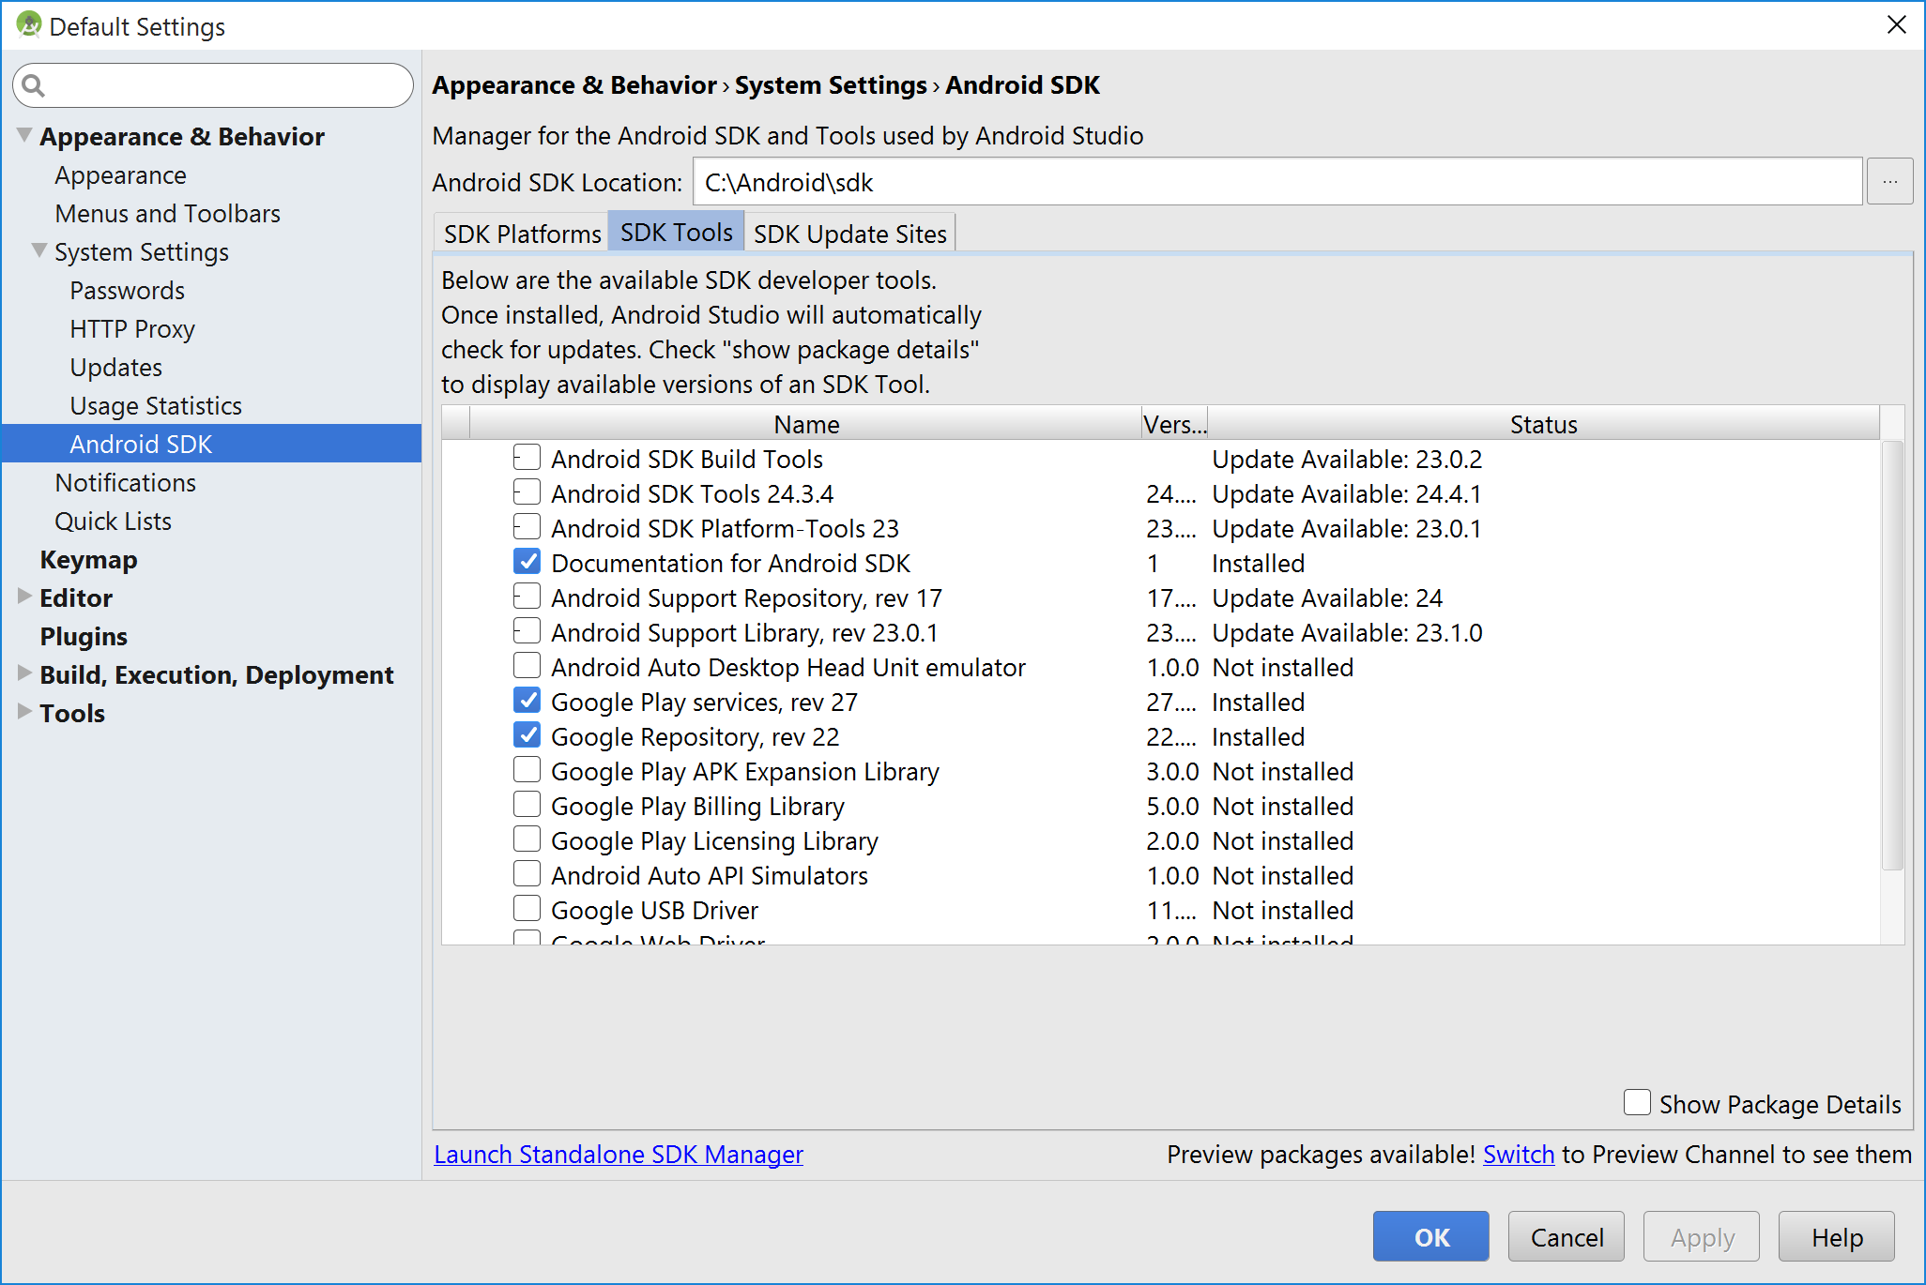
Installing Google Play Services

Slide 10
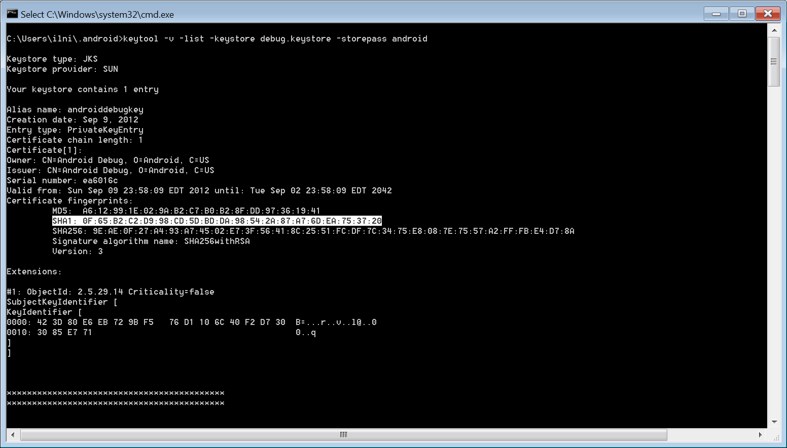
Getting the Google Maps API key
Generate SHA-1 fingerprint using java keytool. From command line, execute the following command to generate SHA-1 fingerprint

Slide 11
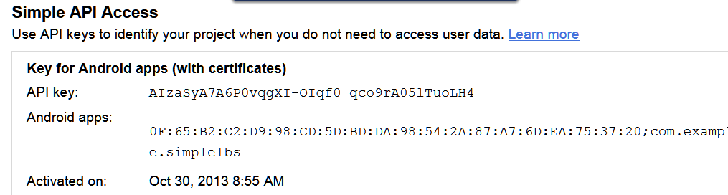
Getting the Google Maps API v2 key
Copy the key for Android apps.

Slide 12
Getting the Google Maps API key
keytool -list -v -keystore ~/.android/debug.keystore -alias androiddebugkey -storepass android -keypass android

Slide 13
Adding the API Key to your application
The final step is to add the API key to your application.
It goes in your application's manifest, contained in the file AndroidManifest.xml.
From there, the Maps API reads the key value and passes it to the Google Maps server, which then confirms that you have access to Google Maps data.
See video: https://www.youtube.com/watch?v=eiexkzCI8m8
Notes:
https://www.youtube.com/watch?v=eiexkzCI8m8

Slide 14
Adding the API Key to your application
To add the key to your application:
In AndroidManifest.xml, add the following element as a child of the <application> element, by inserting it just before the closing tag </application>:
<meta-data android:name="com.google.android.maps.v2.API_KEY" android:value="API_KEY"/> substituting your API key for API_KEY.
This element sets the key com.google.android.maps.v2.API_KEY to the value API_KEY and makes the API key visible to any MapFragment in your application.

Slide 15
Specifying Permissions
You must add the following permissions in order to use the Google Maps Android API:
android.permission.INTERNET - used by the API to download map tiles from Google Maps servers.
android.permission.ACCESS_NETWORK_STATE - allows the API to check the connection status in order to determine whether data can be downloaded.
com.google.android.providers.gsf.permission.READ_GSERVICES - allows the API to access Google web-based services.
android.permission.WRITE_EXTERNAL_STORAGE - allows the API to cache map tile data in the device's external storage area.
Above required to find device location.

Slide 16
Specifying Permissions
Optional permissions:
android.permission.ACCESS_COARSE_LOCATION - allows the API to use WiFi or mobile cell data (or both) to determine the device's location.
android.permission.ACCESS_FINE_LOCATION - allows the API to use the Global Positioning System (GPS) to determine the device's location to within a very small area.

Slide 17
Specifying Permissions
<uses-permission android:name="android.permission.INTERNET"/>
<uses-permission android:name="android.permission.ACCESS_NETWORK_STATE"/>
<uses-permission android:name="android.permission.WRITE_EXTERNAL_STORAGE"/>
<uses-permission android:name="com.google.android.providers.gsf.permission.READ_GSERVICES"/> <!-- The following two permissions are not required to use Google Maps Android API v2, but are recommended. -->
<uses-permission android:name="android.permission.ACCESS_COARSE_LOCATION"/>
<uses-permission android:name="android.permission.ACCESS_FINE_LOCATION"/>
Notes:
Not really tested, see maptest app with no permission and Google Map was displayed!.

Slide 18
Requiring OpenGL ES version 2
The Google Maps Android API uses OpenGL ES version 2 to render the map.
If OpenGL ES version 2 is not installed, your map will not appear.
Add the following<uses-feature> element as a child of the <manifest> element inAndroidManifest.xml:
<uses-feature android:glEsVersion="0x00020000" android:required="true"/>
This notifies external services of the requirement.
In particular, it has the effect of preventing Google Play Store from displaying your app on devices that don't support OpenGL ES version 2.
Notes:
OpenGL for Embedded Systems (OpenGL ES or GLES) is a subset of the OpenGL computer graphics rendering application programming interface (API)
for rendering 2D and 3D computer graphics such as those used by video games, typically hardware-accelerated using a graphics processing unit (GPU).

Slide 19
Adding a Map
After you've added references to the Google Play services SDK, added your key and customized your Android Manifest, you can try adding a map to your application.
The easiest way to test that your application is configured correctly is to add a simple map.
You will have to make changes in two files: main.xml and MainActivity.java.

Slide 20
Adding a Map
In main.xml, add the following fragment:
<?xml version="1.0" encoding="utf-8"?> <fragment xmlns:android="http://schemas.android.com/apk/res/android" android:id="@+id/map" android:layout_width="match_parent" android:layout_height="match_parent" android:name="com.google.android.gms.maps.MapFragment"/>
MapFragment is a Map component in an app.
This fragment is the simplest way to place a map in an application
Notes:
Longitude: -79.3871
gms Google Mobile Services are the applications and services provided by Google in order to enhance the user's mobile experience. Google Mobile Services are distinct from Android; they remain under a completely "separate license" from Google

Slide 21
Adding a Map
In MainActivity.java, add the following code.
package com.example.mapdemo; import android.app.Activity; import android.os.Bundle; public class MainActivity extends Activity { @Override protected void onCreate(Bundle savedInstanceState) { super.onCreate(savedInstanceState); setContentView(R.layout.main); } }

Slide 22
Finding Your Location
Retrieve an instance of the LocationManager using a call to the getSystemService() method using the LOCATION_SERVICE.
Add an appropriate permission to the AndroidManifest.xml file, depending on what type of location information the application needs.
Choose a provider using either the getAllProviders() method or the getBestProvider() method.
Implement a LocationListener class.
Call the requestLocationUpdates() method with the chosen provider and the LocationListener object to start receiving location information.

Slide 23
Finding Your Location
The following code retrieves an instance of the LocationManager object:
import android.location.*;
...
LocationManager location =
(LocationManager)getSystemService(Context.LOCATION_SERVICE);
The following block of XML provides the application with both coarse and fine location permissions when added within the AndroidManifest.xml permissions file:
<uses-permission
android:name="android.permission.ACCESS_FINE_LOCATION" />
<uses-permission
android:name="android.permission.ACCESS_COARSE_LOCATION" />

Slide 24
Finding Your Location
Determine what provider to use for location information.
The following code configures a Criteria object and requests the provider based on this information:
Criteria criteria = new Criteria();
criteria.setAccuracy(Criteria.NO_REQUIREMENT);
criteria.setPowerRequirement(Criteria.NO_REQUIREMENT);
String bestProvider = location.getBestProvider(criteria, true);

Slide 25
Finding Your Location
The setAccuracy() method can take values for ACCURACY_COARSE and ACCURACY_FINE that can be used to request a provider that the application has permissions to use.
You can use the setPowerRequirement() method to find a provider that fits certain power use requirements, such as POWER_HIGH or POWER_LOW.
The Criteria object also enables us to specify if the provider can incur a monetary cost to the user, whether altitude is needed, and some other details.
A Boolean parameter of the getBestProvider() method enables the application to ask for only enabled providers.

Slide 26
Finding Your Location
The application needs to provide an implementation of LocationListener interface (four methods)
To tell the application whether the provider has been disabled or enabled
To give the status about the provider (such as the number of satellites the GPS receiver can see)
To tell the application location information.
The following is a sample implementation for the last method, the onLocationChanged() method:

Slide 27
Finding Your Location
public void onLocationChanged(Location location) {
String locInfo = String.
format("Current loc = (%f, %f) @ (%f meters up)",
location.getLatitude(), location.getLongitude(),
location.getAltitude() );
if (lastLocation != null) {
float distance = location.distanceTo(lastLocation);
locInfo += String.
format("\n Distance from last = %f meters", distance);
}
lastLocation = location;
status.setText(locInfo);
}

Slide 28
Finding Your Location
The Location argument has the most recent location information from the chosen provider.
The code prints out the location, including the altitude, which might or might not be returned by the provider.
It uses a utility method of the Location object, distanceTo(), to calculate how far the handset has moved since the last time onLocationChanged() was called.

Slide 29
Locating Your Emulator
The Android emulator can simulate location-based services, but as you would expect, it does not have any “underlying hardware” to get a real satellite fix.
The Android SDK provides a means to simulate location data with the use of a single location point, GPX file, or KML file.
This works only with the emulator, not the physical handset, but it can be useful for testing your location-based application.

Slide 30
Locating Your Emulator
Launch the emulator. If you’re running an application, press the Home button or navigate to the Home screen.
Choose the Maps application. If you did not include the Google APIs as part of the AVD platform target, you do not have the Maps application.
Within the Maps application, click the Menu button.
Choose the My Location menu item. (It looks like a target.)
Within Android Studio, click the Dalvik Debug Monitor Service (DDMS) perspective in the top-right corner of IDE.

Slide 31
Locating Your Emulator
In the top-left pane, select the emulator instance to which you want to send location information (if there is more than one emulator running).
Within the Emulator Control pane, scroll down to the Location Controls.
Manually enter the longitude and latitude coordinates you want to send to the emulator. For example, CN Tower has the coordinates:
Latitude: 43.6426
Longitude: -79.3871
Click Send.

Slide 32
LocationServices Example
compile 'com.android.support:support-v4:22.1.1' compile 'com.google.android.gms:play-services:4.2+’
<uses-permission android:name="android.permission.ACCESS_NETWORK_STATE" /> <uses-permission android:name="android.permission.ACCESS_FINE_LOCATION" />
compileSdkVersion 22
Notes:
How can we fix it locationS22.

Slide 33
LocationServices 3 Example
How can we now solve the problem with Target SDK compilation 23.
if (ContextCompat.checkSelfPermission(this, android.Manifest.permission.ACCESS_FINE_LOCATION) == PackageManager.PERMISSION_GRANTED || ContextCompat.checkSelfPermission(this, android.Manifest.permission.ACCESS_COARSE_LOCATION) == PackageManager.PERMISSION_GRANTED) {
Notes:
Build Tool version available under
Open Module Setting -> Build Tool Version
http://inthecheesefactory.com/blog/things-you-need-to-know-about-android-m-permission-developer-edition/en

Slide 34
Geocoding Locations
Determining the latitude and longitude is useful for precise location, tracking, and measurements; however, it’s not usually descriptive to users.
The Android SDK provides some helper methods to turn raw location data into addresses and descriptive place names.
These methods can also work in reverse, turning place names or addresses into raw location coordinates.

Slide 35
Geocoding Locations
Geocoding is the process of finding associated geographic coordinates (often expressed as latitude and longitude) from other geographic data, such as street addresses, or ZIP codes (postal codes).
The Geocoder object can be used without any special permissions.
The following block of code demonstrates using the Geocoder object to get the location names of a Location object passed in to the onLocationChanged() method of a LocationListener:

Slide 36
Geocoding Locations
Geocoder coder = new Geocoder(this);
try {
Iterator<Address> addresses = coder
.getFromLocation(location.getLatitude(),
location.getLongitude(), 3).iterator();
if (addresses != null) {
while (addresses.hasNext()) {
Address namedLoc = addresses.next();
String placeName = namedLoc.getLocality();
String featureName = namedLoc.getFeatureName();

Slide 37
Geocoding Locations
String country = namedLoc.getCountryName();
String road = namedLoc.getThoroughfare();
locInfo += String.format("\n[%s][%s][%s][%s]",
placeName, featureName, road, country);
int addIdx = namedLoc.getMaxAddressLineIndex();
while (addIdx >= 0 ) {
String addLine = namedLoc.getAddressLine(addIdx);
locInfo += String.
format("\nLine %d: %s", addIdx, addLine);
addIdx—;
}
}
}
} catch (IOException e) {
Log.e("GPS", "Failed to get address", e);
}

Slide 38
Geocoding Locations
Note that a particular location might have multiple Address results in the form of a List<Address> object.
Typically, the first Address is the most detailed, and the subsequent Address objects have less detail and describe a broader region.
The first method is to query for specific information, such as by using the getFeatureName() method or the getLocality() method
The second method for querying information is by “address lines.”This is generally used for displaying the “address” of a location to the user.
Simply use the getMaxAddressLineIndex() and getAddressLine() methods to iterate through the addresses.

Slide 39
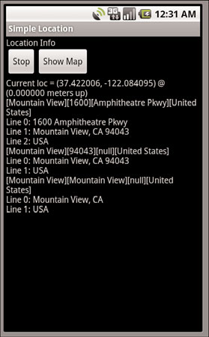
Geocoding Locations
The figure on the right shows a sample location with three resulting addresses.

Slide 40
Geocoding Locations
The Geocoder object also supports using named locations or address lines to generate latitude and longitude information.
The input is forgiving and returns reasonable results in most cases.
For instance, all the following returns valid and correct results:“Eiffel Tower,” “London, UK,”“Iceland,”“BOS,”“Yellowstone,” and “1600 Pennsylvania Ave, DC.”

Slide 41
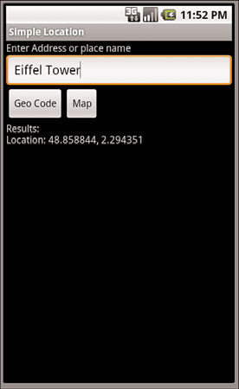
Geocoding Locations
The following code demonstrates a button handler for computing location data based on user input of this kind:
public void onClick(View v) {
String placeName = name.getText().toString();
try {
List<Address> geocodeResults =
coder.getFromLocationName(placeName, 3);
Iterator<Address> locations = geocodeResults.iterator();
String locInfo = "Results:\n";
while (locations.hasNext()) {
Address loc = locations.next();
locInfo += String.format("Location: %f, %f\n",
loc.getLatitude(), loc.getLongitude());
}
results.setText(locInfo);
} catch (IOException e) {
Log.e("GeoAddress", "Failed to get location info", e);
}
}

Slide 42
Mapping Locations
The Android SDK provides two different methods to show a location with Google Maps.
The first method is to use a location Uri to launch the built-in Google Maps application with the specified location.
The second method is to use a MapView embedded within your application to display the map location.

Slide 43
Mapping Intents
The following code shows how to map the location using the built-in maps:
//create a String that conforms to the URI handled by the mapping application
String geoURI = String.format("geo:%f,%f", lat, lon);
//create a new Uri object for creating a new ACTION_VIEW Intent
Uri geo = Uri.parse(geoURI);
Intent geoMap = new Intent(Intent.ACTION_VIEW, geo);
startActivity(geoMap)
This is a fast-and-easy method to use when user needs no details and Google Maps is enough.

Slide 44
Mapping Views
To have the map integrated into our application for a more seamless user experience add a small map show the location immediately to the users when they enter a place name.
The following block of XML shows the change needed within the layout file to include a widget called the MapView:
<com.google.android.maps.MapView
android:id="@+id/map"
android:apiKey="yourMapKey"
android:layout_width="fill_parent"
android:layout_height="wrap_content" />

Slide 45
Mapping Views
The MapView XML is a little different.
First, the tag name is the fully qualified name.
And second, an apiKey attribute is needed.
The AndroidManifest.xml file also needs to be modified to allow for using the MapView with Google Maps.
Here are the two changes needed:
<application
...
<uses-library
android:name="com.google.android.maps" />
</application>
<uses-permission
android:name="android.permission.INTERNET" />

Slide 46
Mapping Views
You can use a MapView only within a MapActivity.
Accessing a MapView from outside a MapActivity results in an error.
The MapActivity is similar to a normalActivity, but it requires implementing the isRouteDisplayed() method.
This method must return true if a route will be displayed. Otherwise, false must be returned.
Here is the default implementation for when no route is displayed:
@Override
protected boolean isRouteDisplayed() {
// we do not display routes
return false;
}

Slide 47
Mapping Views
Now the application can use the MapView to display locations to the user.
The following block of code demonstrates retrieval of a MapController object, which is used to control the location that the MapView displays:
MapView map = (MapView) findViewById(R.id.map);
map.setSatellite(true);
final MapController mapControl = map.getController();
mapControl.setZoom(17);
These lines of code set the display to show the satellite view, which is visually interesting.
The MapController object then sets the zoom level of the map.
Larger values are zoomed in farther, with 1 zoomed all the way out

Slide 48
Mapping Views
Building on the previous example, the following lines of code are added to the button handler for geocoding a place name:
GeoPoint newPoint = new
GeoPoint((int)(lat * 1E6), (int)(lon * 1E6));
mapControl.animateTo(newPoint);
In this case, we create a new GeoPoint to use with the animateTo() method.
A GeoPoint object uses microdegrees, so we must multiply the result of the geocoding by 1E6 (1,000,000 or one million).
The animateTo() method smoothly animates the MapView to the new location.
The setCenter() method can set the center of the map.

Slide 49
Mapping Example
When you have successfully completed the steps to get your key, you can then reference your map key in the Layout file definition for the MapView you use:
<com.google.android.maps.MapView
android:id="@+id/map"
android:clickable="true"
android:apiKey="0ABIe_e-yb54jZByEAushEbxeLAr7fP96x0yqQA"
android:layout_width="fill_parent"
android:layout_height="wrap_content" />

Slide 50
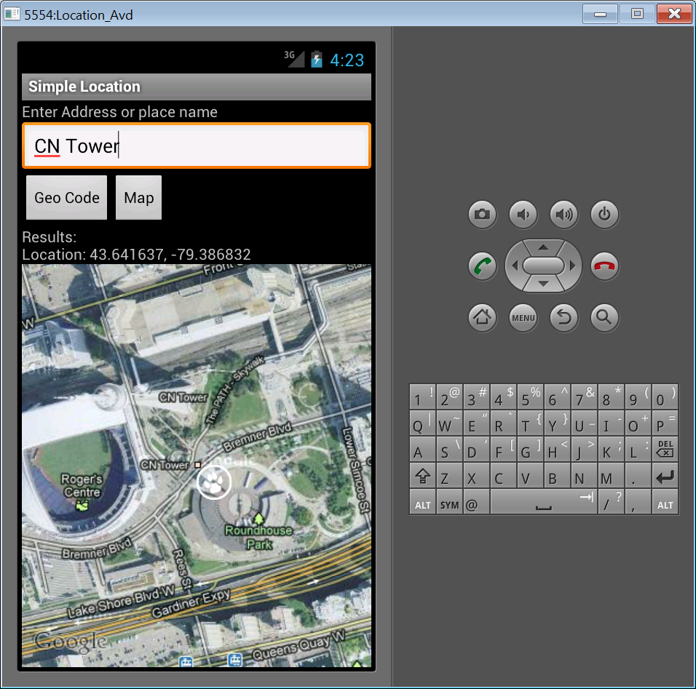
Mapping Example

Slide 51
Panning the Map View
Panning the map (click and drag the map to the desired location) can be activated by enabling clicking from within the layout file:
<com.google.android.maps.MapView
android:id="@+id/map"
android:clickable="true"
android:apiKey="mapApiKey"
android:layout_width="fill_parent"
android:layout_height="wrap_content" />

Slide 52
Zooming the Map View
Users might want to zoom in or out from the same location.
To implement this simply enable the built-in zoom controls as follows:
map.setBuiltInZoomControls(true);

Slide 53
Marking the Spot
Sometimes is helpful if we marked the point of interest directly on the map?
The Android SDK provides a few different ways to do this:
use the MapView as a container for an arbitrary View object that can be assigned using a GeoPoint instead of typical screen or View coordinates.
use ItemizedOverlay, which is especially useful if you have more than one place to mark.
Finally, you can manually draw items over the map using the Overlay and implement the onDraw() method.

Slide 54
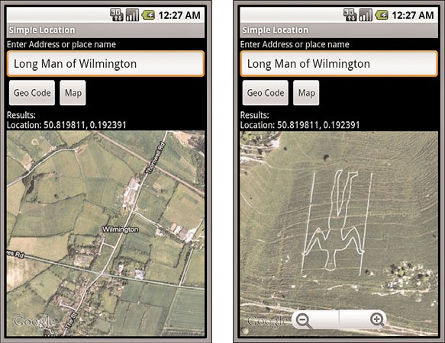
Marking the Spot
On the left, you see a bird’s eye view of the town of Wilmington, but zoom in to the south and you see The Long Man of Wilmington as shown on the right.

Slide 55
References
Textbook
Android Documentation

Slide 56
Marking the Spot
Use the MapView as a container for an arbitrary View object that can be assigned using a GeoPoint instead of typical screen or View coordinates:
GeoPoint newPoint = new GeoPoint((int)(lat * 1E6), (int)(lon*1E6));
// add a view at this point
MapView.LayoutParams mapMarkerParams = new
MapView.LayoutParams(LayoutParams.WRAP_CONTENT,
LayoutParams.WRAP_CONTENT,
newPoint, MapView.LayoutParams.TOP_LEFT );
ImageView mapMarker = new ImageView(getApplicationContext());
mapMarker.setImageResource(R.drawable.paw);
map.addView(mapMarker, mapMarkerParams);

Slide 57
Marking the Spot
You can use markers identify locations on the map. The default marker uses a standard icon, common to the Google Maps look and feel.
It's possible to change the icon's color, image or anchor point via the API.
Markers are objects of type Marker, and are added to the map with theGoogleMap.addMarker(markerOptions) method.
private GoogleMap mMap; mMap = ((MapFragment) getFragmentManager().findFragmentById(R.id.map)).getMap(); mMap.addMarker(new MarkerOptions() .position(new LatLng(0, 0)) .title("Hello world"));

Slide 58
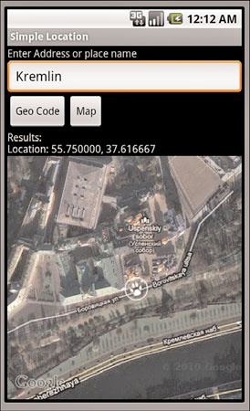
Marking the Spot
The MapView layout parameters enable you to set a GeoPoint.
Doing this enables the added View to stay put at a geographic location and pan with the map, as shown in the figure.

Slide 59
References
Textbook
Android Documentation - https://developers.google.com/maps/documentation/android-api/start
This Treehouse tutorial is also good:
http://blog.teamtreehouse.com/beginners-guide-location-android

