Slide 1
Colic in Horses
Gabrielle Beinars, DSC 530

Slide 2
Background
Libraries Utilized:
Pandas as pd
Numpy as np
Thinkstats2
Scipy.stats
Statsmodels.formula.api as smf
Thinkplot
Matplotlib
Data:
https://www.kaggle.com/uciml/horse-colic

Slide 3
Research questions
Is there a correlation between any of the variables?
Are there any outliers?
Are there any major differences observed in horses that survived and horses that did not?
Is there a statistically significant relationship between any of the variables and the outcome?

Slide 4
Variables
Hospital Number: Numeric identifier assigned to the horse.
Age: This I recoded as 1 (one) for an adult horse and 2 (two) for a horse less than 6 months.
Rectal Temperature: The temperature is reported in degrees Celsius and a normal temperature is 37.8 °C. This parameter will usually change as the problem progresses and an elevated temperature is an indication of infection.
Pulse: The pulse is measured in beats/minute. A low or high pulse may indicate a heart condition. A normal pulse for an adult horse is 30-40 beats/minute, although athletic horses may have a lower rate of 20-25 beats/minute. Horses that may have painful lesions or are suffering from circulatory shock may have an elevated pulse.
Respiratory Rate: A normal respiratory rate of a horse is 8 to 10.
Packed Cell Volume: This is the number of red cells by volume in the blood. The normal range is 30 to 50, but the level may rise as circulation becomes compromised or as the horse becomes dehydrated.
Total Protein: Normal values are 6-7.5 gms/dL, and with higher values the greater dehydration the horse may be exhibiting.
Outcome: This I recoded as 1 (one) for lived, 2 (two) for died and 3 (three) for euthanized.

Slide 5
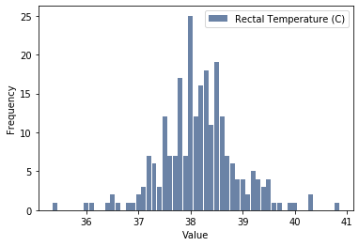
Rectal Temperature
The distribution of rectal temperature can be observed as roughly bell-shaped and somewhat symmetrical, visually, and as the mean and mode are close in value. We would expect deviations of ~0.7 degrees. Spread describes the variability. Variance can be difficult to interpret as the units are degrees squared.
Mean: 38.2
Mode: 38.0
Spread: 0.43
Standard Deviation: 0.66
Tails: somewhat symmetrical

Slide 6
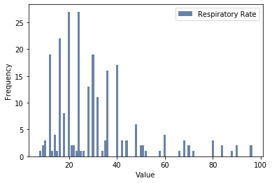
Respiratory Rate
The distribution of respiratory rate is slightly skewed right. We can observe a bimodal distribution, meaning two modes.
Mean: 29.4
Mode: bi-modal, 20.0 and 24.0
Spread: 256.0
Standard Deviation: 16.0
Tails: Slightly skewed right

Slide 7
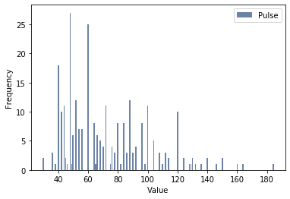
Pulse
The distribution of pulse is also slightly skewed right.
Mean: 71.4
Mode: 48.0
Spread: 759.3
Standard Deviation: 27.6
Tails: Slightly skewed right

Slide 8
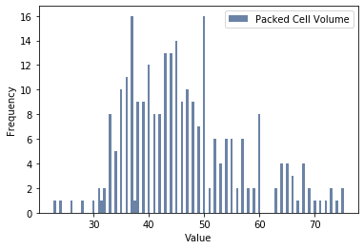
Packed Cell Volume
The distribution of respiratory rate is slightly skewed right. We can observe a bimodal distribution, meaning two modes.
Mean: 46.2
Mode: 37.0, 50.0
Spread: 98.5
Standard Deviation: 9.9
Tails: slightly skewed right, slightly
bell-shaped

Slide 9
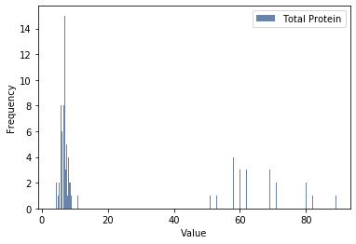
Total Protein
The distribution of total protein is slightly skewed right.
Mean: 22.4
Mode: 6.5
Spread: 693.6
Standard Deviation: 26.3
Tails: Slightly skewed right

Slide 10
Missing data
Number of missing data points by variable:
Rectal Temperature, 60
Pulse, 24
Respiratory Rate, 58
Packed Cell Volume, 29
Total Protein, 33
As the data set contains 299 observations, I did not want to drop any data.
After computing the descriptive statistics and creating histograms of each variable, I replaced the missing data points with the median value.

Slide 11
Outliers
Smallest
Rectal Temperature (°C) | Count
35.4 | 1
36.0 | 1
36.1 | 1
36.4 | 1
36.5 | 2
36.6 | 1
36.8 | 1
36.9 | 1
37.0 | 2
37.1 | 3
Largest
Rectal Temperature (°C) | Count
40.8 | 1
40.3 | 2
40.0 | 1
39.9 | 1
39.7 | 1
39.6 | 1
39.5 | 4
39.4 | 3
39.3 | 4
39.2 | 5
Smallest
Respiratory Rate | Count
8.0 | 1
9.0 | 2
10.0 | 3
12.0 | 19
13.0 | 1
14.0 | 4
15.0 | 1
16.0 | 22
18.0 | 8
20.0 | 27
Largest
Respiratory Rate | Count
96.0 | 2
90.0 | 2
88.0 | 1
84.0 | 2
80.0 | 3
72.0 | 1
70.0 | 2
68.0 | 3
66.0 | 1
60.0 | 4

Slide 12
Outliers
Smallest
Pulse | Count
30.0 | 2
36.0 | 3
38.0 | 1
40.0 | 18
42.0 | 10
44.0 | 11
45.0 | 2
46.0 | 1
48.0 | 27
49.0 | 1
Largest
Pulse | Count
184.0 | 1
164.0 | 1
160.0 | 1
150.0 | 2
146.0 | 1
140.0 | 2
136.0 | 1
132.0 | 1
130.0 | 2
129.0 | 1
Smallest
Packed Cell Volume | Count
23.0 | 1
24.0 | 1
26.0 | 1
28.0 | 1
30.0 | 1
31.0 | 2
31.5 | 1
32.0 | 2
33.0 | 8
34.0 | 5
Largest
Packed Cell Volume | Count
75.0 | 2
74.0 | 1
73.0 | 2
72.0 | 1
71.0 | 1
70.0 | 1
69.0 | 2
68.0 | 4
67.0 | 1
66.0 | 3

Slide 13
outliers
Smallest
Total Protein | Count
3.3 | 1
4.0 | 1
4.5 | 2
4.6 | 1
4.7 | 1
4.9 | 2
5.0 | 1
5.3 | 2
5.5 | 4
5.7 | 3
Largest
Total Protein | Count
89.0 | 1
86.0 | 1
85.0 | 1
82.0 | 1
81.0 | 2
80.0 | 2
77.0 | 2
76.0 | 1
75.0 | 3
74.0 | 2
I did not observe any major outliers that I felt should be removed. It would have been helpful to have a better understanding of the methodology of the study. I would be curious if horses were sedated prior to obtaining vitals and medical data, or if these samples were taken on an interval basis.
I had concern when comparing the data to research I’d obtained about colic in horses, as to what might be ‘normal’ conditions for horses, compared to the data set.

Slide 14
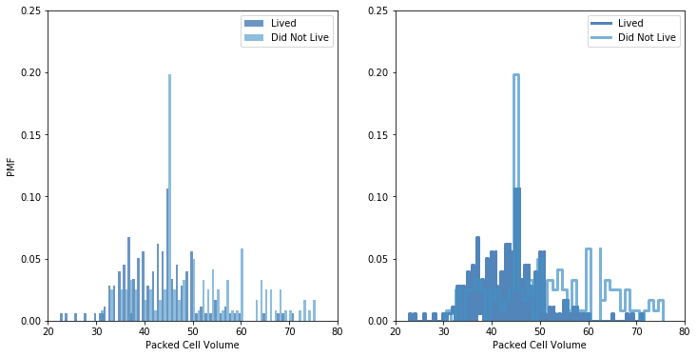
Probability Mass function (pmf)
Another way to represent a distribution is a probability mass function, which maps each value to its probability. Above is a bar graph plot and step function plot that shows PMF of packed cell volume for surviving horses and those that did not survive. Knowing that the mean of the entire distribution is 46.2 for packed cell volume, we can observe a higher probability of a packed cell volume above the mean for horses that did not live, than horses that lived.

Slide 15
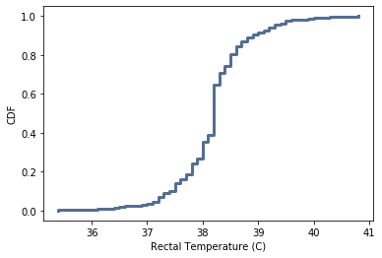
Cumulative Distribution Function (CDF)
As the number of values increases, the probability associated with each value gets smaller and the effect of random noise increases. The CDF is a function that maps each value to its percentile rank. It appears that about 20% of the rectal temperatures were below 38.0 °C. We can also observe about 90% is below 39.0 °C.

Slide 16
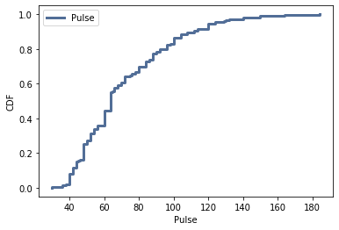
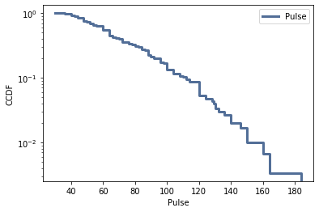
Analytical distribution
An analytical distribution is characterized by a CDF that is a mathematical function. While exponential distributions are more common with series of events, the CDF of Pulse resembled a similar shape as that of an exponential distribution (top, left). The second plot shows the complementary CDF, where a straight line is observed. We only see a short straight line when looking at this variable.

Slide 17
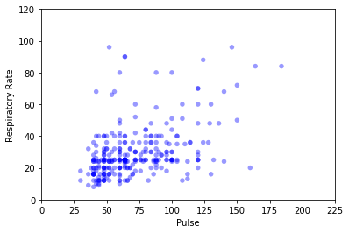
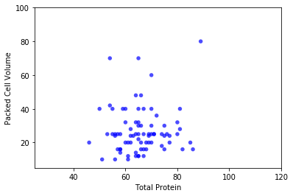
Correlation
Pearson’s correlation is best used for a linear, normal distribution, while Spearman’s correlation mitigates the effect of outliers and skewed distributions. Knowing this, we can conclude that there is not much of a difference between the correlation results of pulse and respiratory rate. A larger difference can be observed in the correlation results of total protein and packed cell volume, indicating the presence of outliers or a skewed distribution.
Pulse and Respiratory Rate:
Pearson’s correlation, 0.43
Spearman’s correlation, 0.42
Moderate, positive correlation
Total Protein and Packed Cell Volume:
Pearson’s correlation, -0.05
Spearman’s correlation, 0.16
Very weak correlation

Slide 18
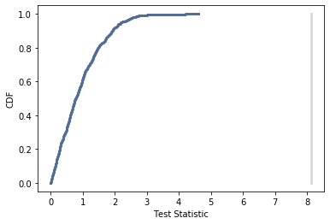
Hypothesis testing
Null hypothesis: There is no difference between horses that survived and those that did not. The packed cell volume for both groups have the same distribution.
Test statistic: Testing a difference in mean of packed cell volume.
No intersection observed of CDF
P-value: 0.0, the difference in packed cell volume is statistical significant.

Slide 19
Regression
Dependent variable: packed cell volume
Explanatory variables: outcome – living, respiratory rate, and pulse
All p-values, except respiratory rate, were below 0.05 indicating a statistically significant relationship
R², coefficient of determination, is 0.2, which indicates that 20% of the variation in the outcome is explained by predicting the outcome using the predictors in the model. This is a low result indicating that the model may not be a good fit for the data.

Slide 20
conclusions
Weak correlation between total protein and packed cell volume
Moderate, positive correlation between pulse and respiratory rate
No outliers that needed to be removed
Horses that did not survive were observed to have a higher probability of having a higher packed cell volume
20% of rectal temperatures were below 38.0 C, while 90% were below 39.0 C
CDF of pulse appeared to show an exponential pattern, but the complementary CDF disputed this theory
The difference in packed cell volume between horses that survived and did not survive is statistically significant.
Regression results indicate that there is a statistically significant relationship between packed cell volume, the horse surviving, and pulse.

Slide 21
References
https://www.kaggle.com/uciml/horse-colic
PetMD. (2019, December 20). Colic in Horses: Signs, Causes and Treatment. Retrieved from https://www.petmd.com/horse/conditions/digestive/c_hr_equine_colic

