Slide 1
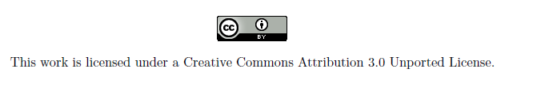
PrivText
A secure and lightweight messaging protocol for SMS
Gary Belvin

Slide 2
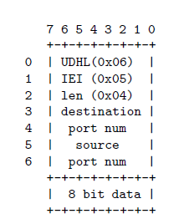
A word about SMS
SMS has 140 byte payload size
Normally users send 160 character 7bit packed ACII text.
GSM supports a binary message format with port numbers
This “User Data Header” takes minimum of 7 bytes of payload space. In practice, 9 bytes with Android.
User Data Header

Slide 3
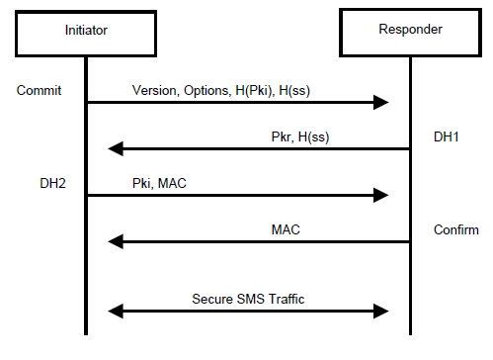
Secure Conversation Setup

Slide 4
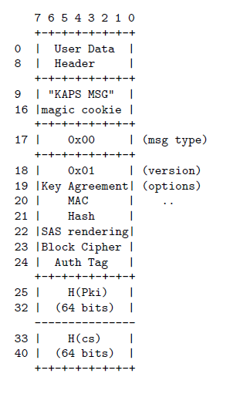
Alice Commits to Bob
Hello, I’d like to talk
Here’s the options we’ll use
I’ll tell you my secret in a moment, but here’s something to prove I won’t change my mind
I think we’ve talked before.. Do you recognize this?

Slide 5
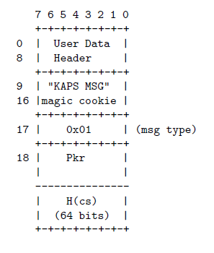
Bob replies with DH1
Here’s a fresh public key
I think we’ve talked before too.. Does this look familiar?
If Bob doesn’t support Alice’s options, Bob cancels and sends his own commit.

Slide 6
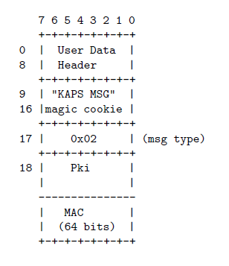
Alice continues with DH2
Here’s my public key I was telling you about
And here’s a little test to verify we’re on the same page

Slide 7
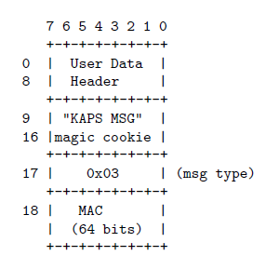
Bob completes the setup
Yep, we’re on the same page Here’s a little test from my end to prove that I’m on the same page too.

Slide 8
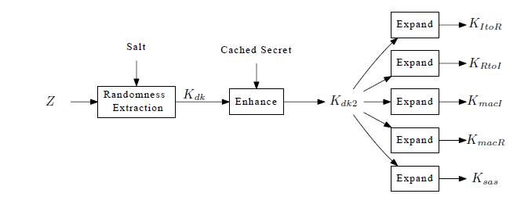
Now we have a shared secret
But we need to turn it into strong key material
Strengthen it with info about our identities
And how we’re going to use the key material 1 key for encrypting each direction 1 key for authenticating each direction

Slide 9
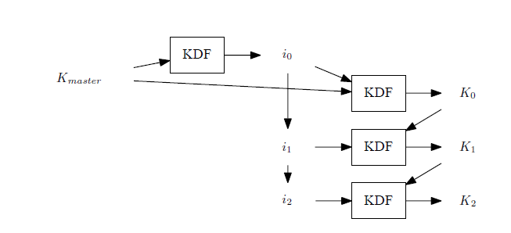
Perfect Forward Secrecy
Each message gets its own key in a hash chain and is deleted as soon as possible.
Seizing the phone will not reveal keys for previously sent messages

Slide 10
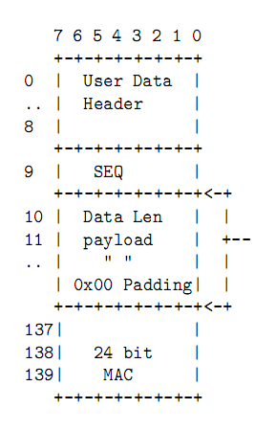
Sending your message
Sequence numbers are obfuscated by a random start index
Encrypted payload has 90% space efficiency (126 / 140) octets
Adjustable size MAC

