Slide 1
DEVELOPMENT OF A PLAIN INPUT MATHEMATICAL COMPUTING SOFTWARE.
PRESENTED BY:
JIBOYE Oluwagbemiro Olaoluwa
CSC/2005/089
AUGUST, 2010.

Slide 2
OUTLINE
Problem Definition
Scope of Study
Project Justification
Aim and Objectives
Methodology
System Design
Project Results.
Literature Review
Conclusion.

Slide 3
PROBLEM DEFINITION
Software users find it inconvenient to learn difficult command syntax before they start using a mathematical computing software application. This project helps them by introducing a mathematical computing software application that uses highly convenient syntax to represent mathematical expression input and then solve them.

Slide 4
SCOPE OF STUDY
Development of application software for plain input mathematical computations.

Slide 5
PROJECT JUSTIFICATION
The productivity of a user on a given software system is dependent on the user’s understanding of how to perform input and receive output from the software. This understanding directly maps onto the ease of performing input into the system.

Slide 6
AIM AND OBJECTIVES
The aim is to develop a mathematical software that solves diverse mathematical problems, using plain expressions as input.
The objectives are to:
design a system of mathematical parsers, each one having a specific target mathematical problem which it will solve.
design a mathematical interface through which the user will interact with the parsers.
implement the two designs above.

Slide 7
METHODOLOGY
Rapid application development methodology
UML-Modules
J2SE

Slide 8
LITERATURE REVIEW
The development of MathParser (Murray, 2009), who under-studied previous work done in the field by Graham,1975.
The MathWorks.Inc,1984 developed the all-popular MatLab software for easing solutions to mathematical problems.

Slide 9
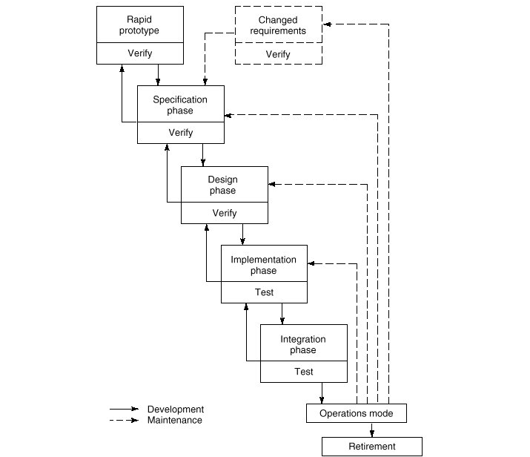
Rapid Application Development

Slide 10
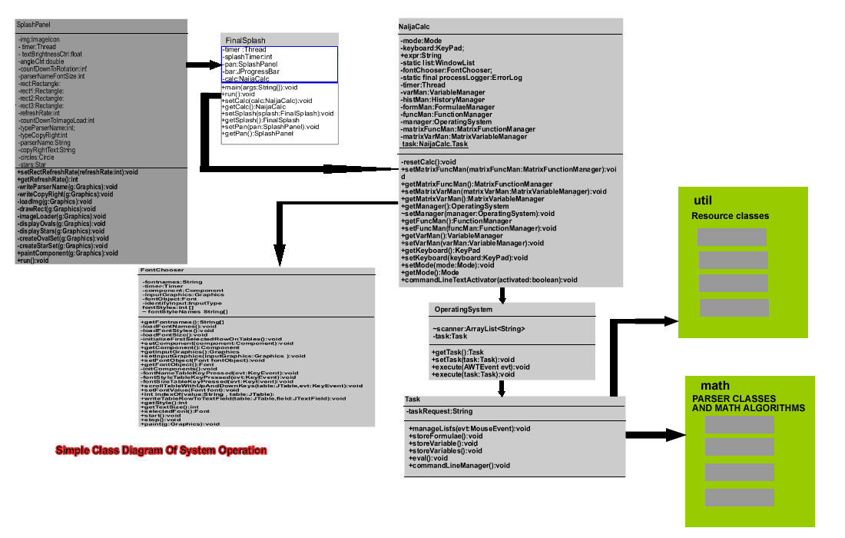
SYSTEM DESIGN

Slide 11
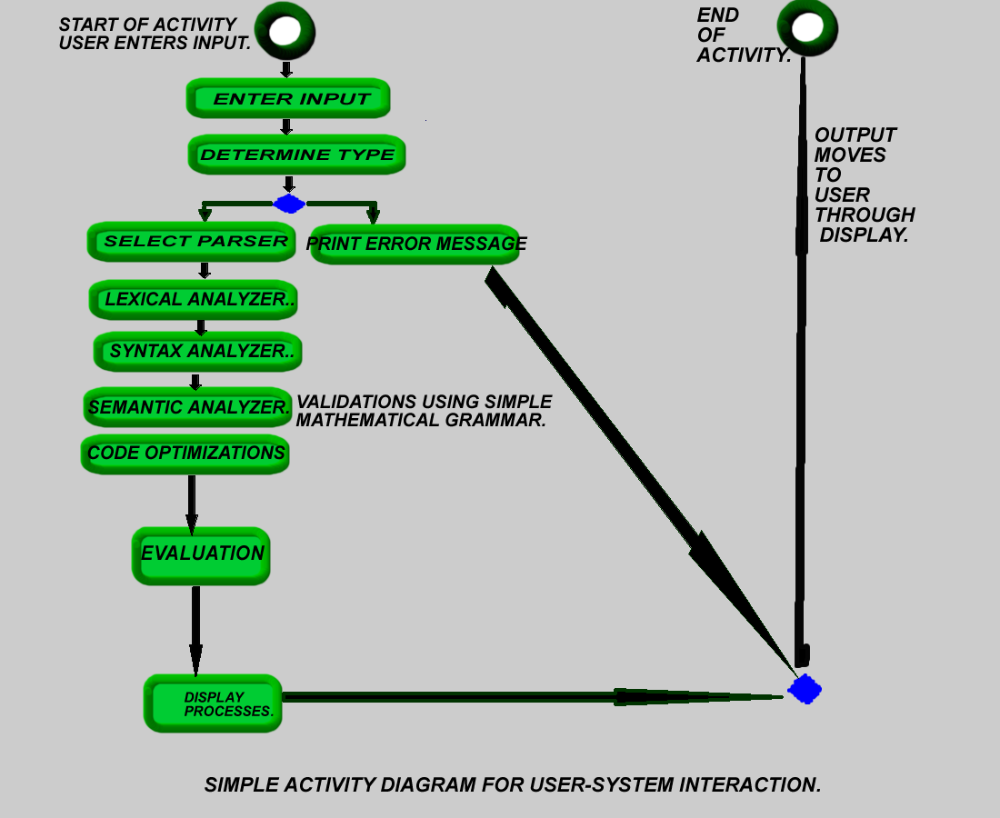

Slide 12
PROJECT RESULTS
Some images that follow show the output of the system. They represent in order:
The NetBeans IDE used to code the system.
The system’s splash screen.
The system in its initial state (No Input).
Using the system as a simple scientific calculator to compute an algebraic expression.
Using the system as a computational tool to:

Slide 13
PROJECT RESULTS(cont’d)
Perform numerical integration.
Solve a 7x7 system of linear equations.
Plot a simple 2D graph.

Slide 14
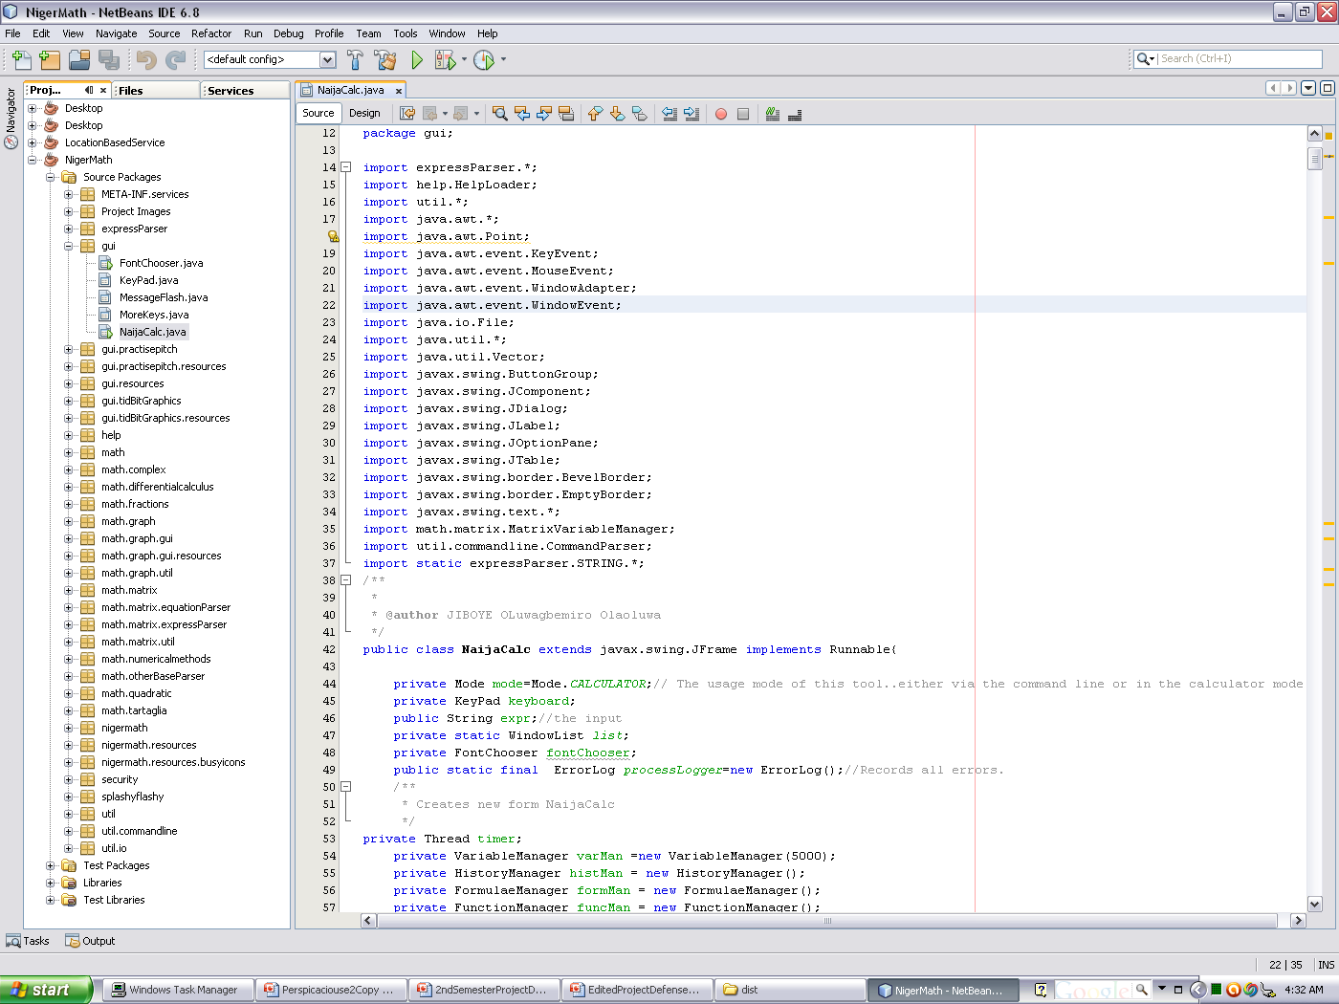

Slide 15
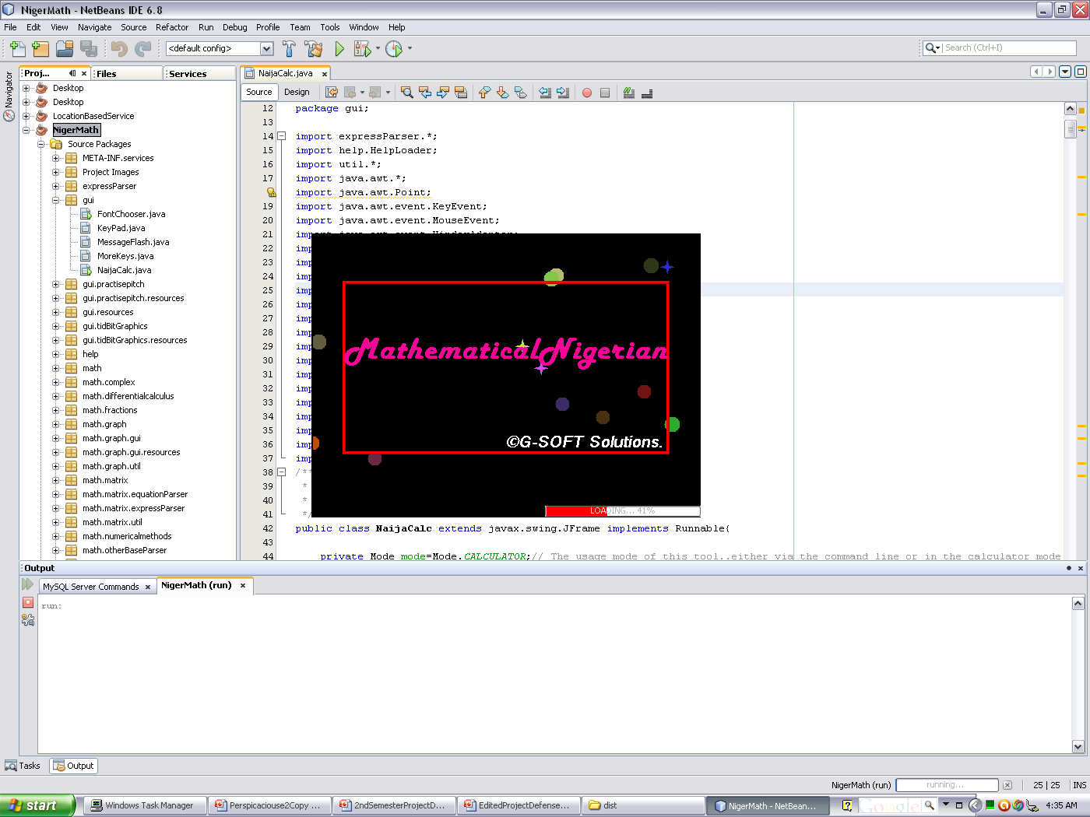

Slide 16
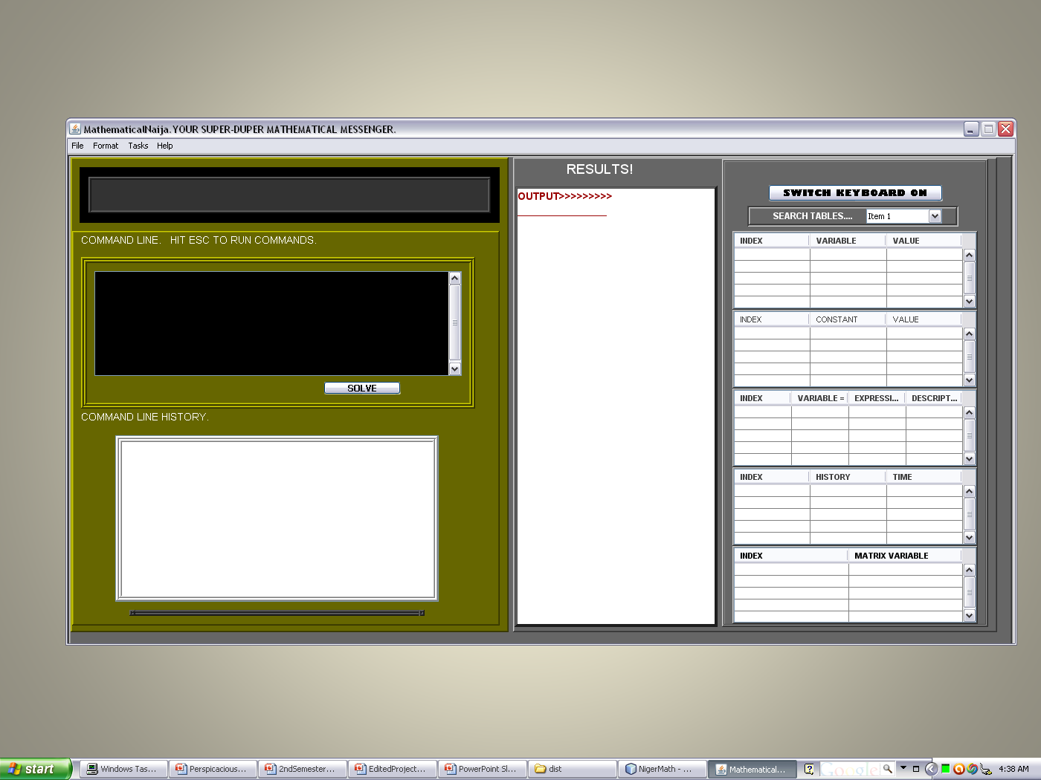

Slide 17
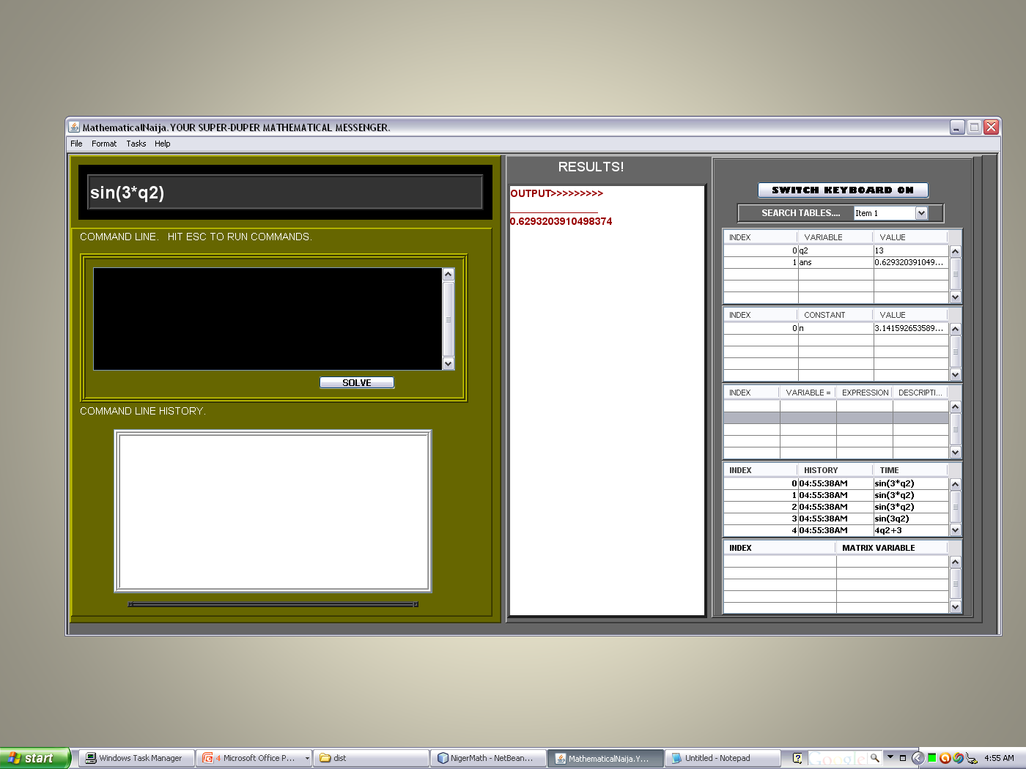

Slide 18
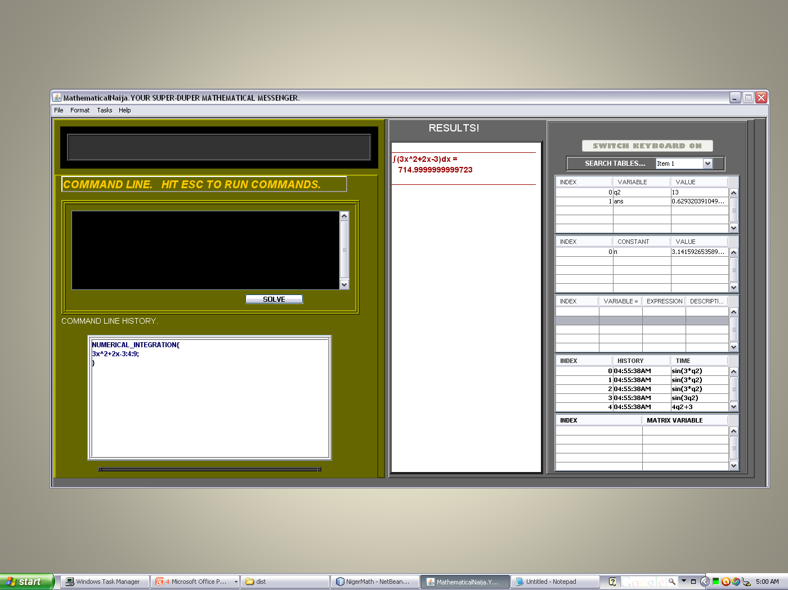

Slide 19
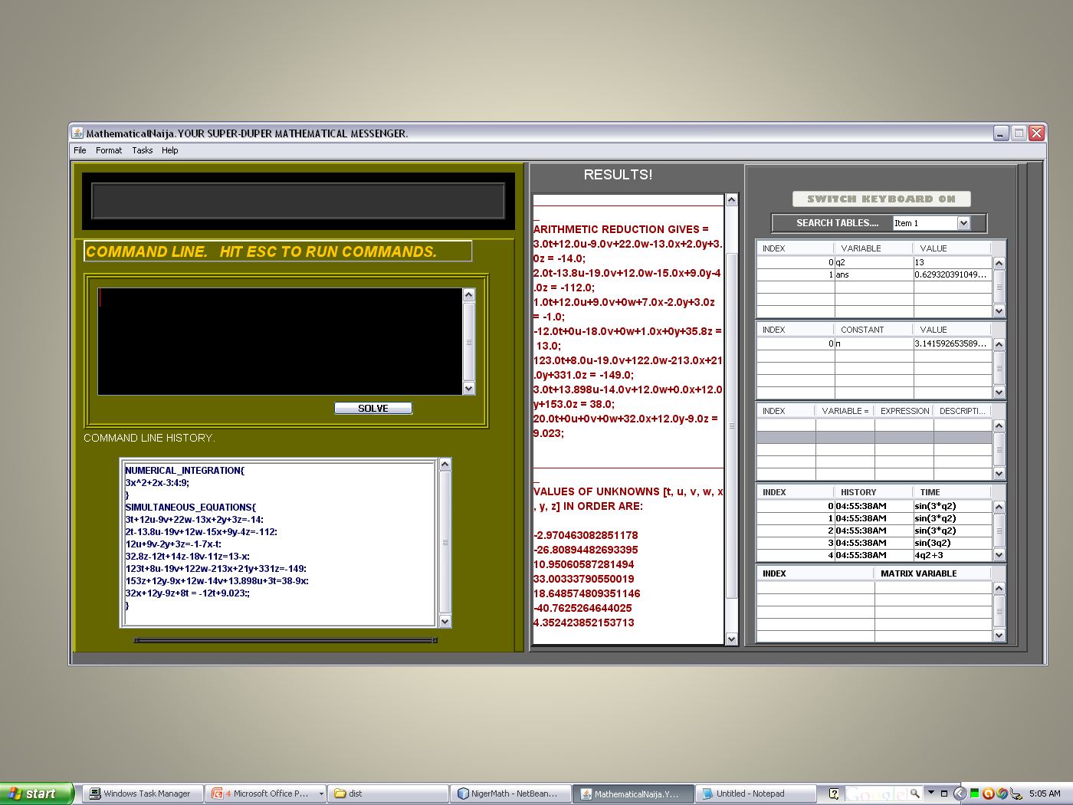

Slide 20
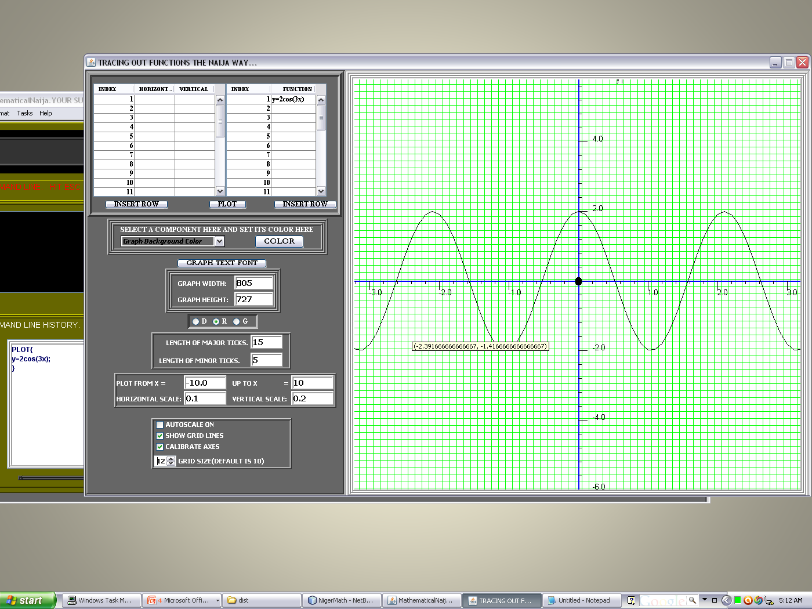

Slide 21
CONCLUSION
In view of some of the functionality available on the system and the simplicity of the commands used to access them, this project presents an avenue for users to quickly obtain high power math-ware and start using them productively, almost immediately.

Slide 22
THANKS FOR
LISTENING!

