Slide 1
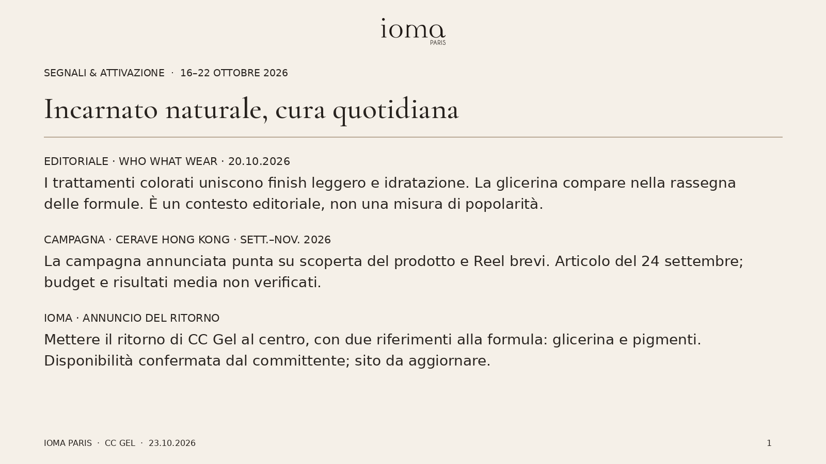
Notes:
{"source_links": [], "availability": {"user_confirmed": true, "site_update": "previously deferred by user"}}

Slide 2
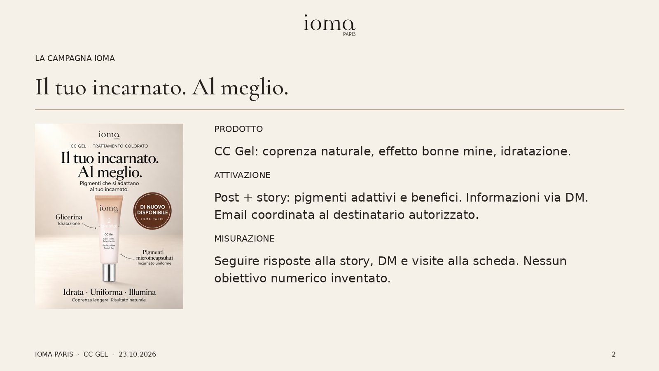
Notes:
{"source_links": [], "availability": {"user_confirmed": true, "site_update": "previously deferred by user"}}

Slide 3
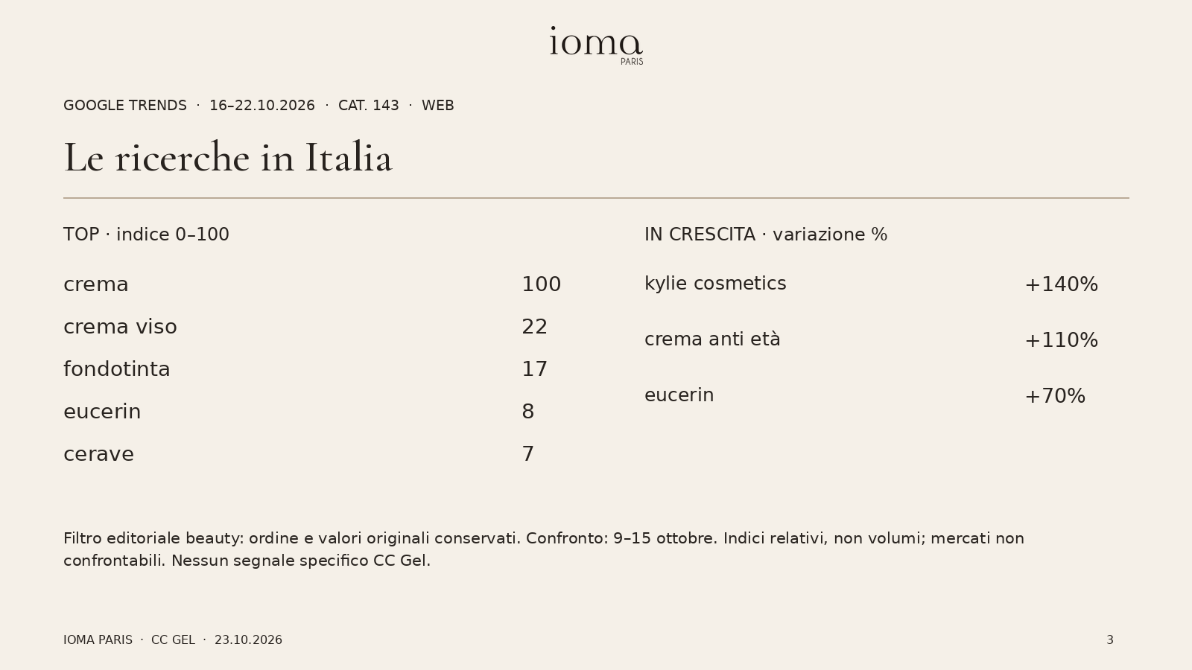
Notes:
{"source_links": ["https://trends.google.com/trends/explore?cat=143&date=2026-10-16+2026-10-22&geo=IT&hl=it"], "availability": {"user_confirmed": true, "site_update": "previously deferred by user"}}

Slide 4
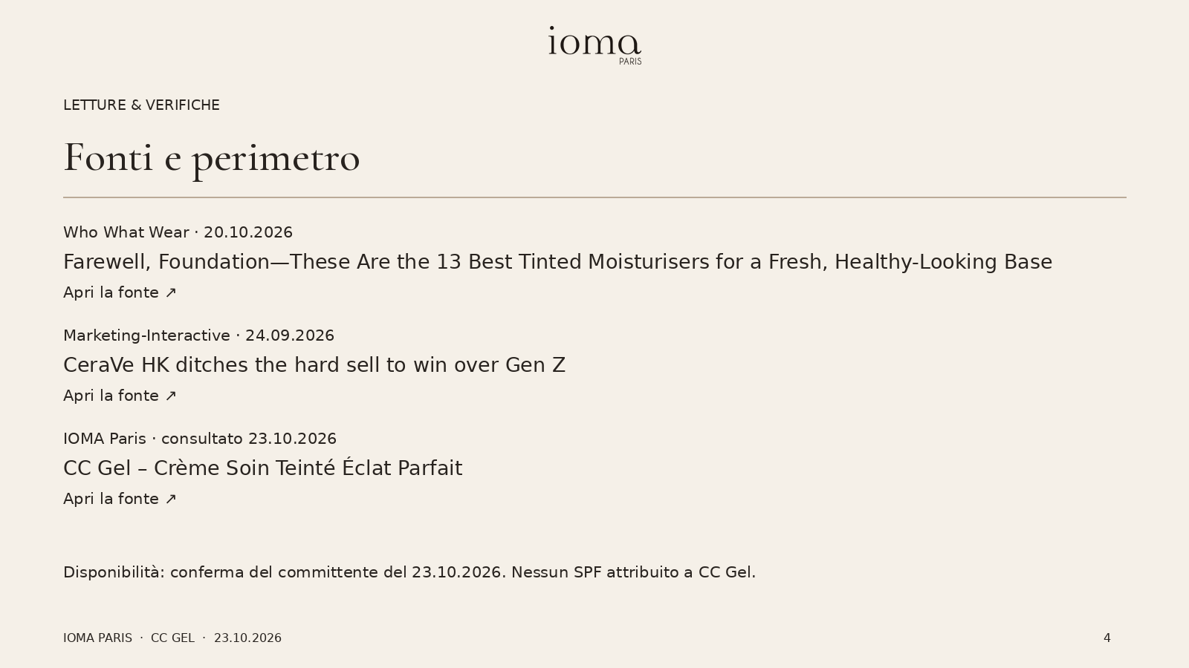
Notes:
{"source_links": ["https://www.whowhatwear.com/best-tinted-moisturiser", "https://www.marketing-interactive.com/cerave-hk-ditches-the-hard-sell-to-win-over-genz", "https://ioma-paris.com/products/cc-gel-soin-teinte-eclat-parfait"], "availability": {"user_confirmed": true, "site_update": "previously deferred by user"}}

