Slide 1
Python
Breif History
Why Python
Basics
Loops,OOPS
Exception Handling
Numpy,panda
CSV API
CRUD operations

Slide 2

History
Guido van Rossum, the author of Python Programming Language
His love for Monty Python was the reason for naming the language Python.
Python was conceived in the late 1980’s and its implementaion started in 1989.
Python is derived from ABC programming language system

Slide 3
Why to learn python
Simple,Easy to learn
Interactive
Object oriented
Open source
High level language
Portable
Intrepreted
Extensible
Embeddeble

Slide 4
Basics(String,Math,Variables)
print (‘this is an example for print function”)
print (len(‘string’))
1+3,2*4,10/2,3-1,4**4
a=10,b=“python”,c=1.474
print(a)---->10,print(b)---->python
(x,y)=(3,5), print(x)--->3, print(y)---->5

Slide 5
Standard Data Types
Numbers(int,float,long,complex)
String
List=[ 'abcd', 786 , 2.23, 'john', 70.2 ]
Tuple(read only list)=('abcd', 786 , 2.23, 'john')
Dictionary-key value pair like hash table in java
Dictionary= {"house" : "Haus", "cat":"Katze"}
t=true,f=false, print(type(t))---> class Bool
Print (t and f), print (t or f) ---> false,true

Slide 6
Loops & Conditions
If
If else
If elif else
For ----->(for x in list: print(x))
While
While True:(infinete loop, control c)
break

Slide 7
OOPS
Creating and instantiate class
Constructor(self keyword)
Instance variables,class variables
Propery Decorators
Instance methods(self), Class methods(cls),static methods()
Inheritance,override,no overload(takes latest implementation),Duck Typing

Slide 8
Exception Handling
try:
f=open(textfile.txt)
raise Exception
except Exception:
    print(“sorry file not found”)
else:
print(f.read())
  f.close()
finally:
print(‘executing finally’)

Slide 9
NumPy Library
Import numpy as np
Great library to work with arrays
Provides many functiones to create arrays
Array indexing
Integer array indexing
Datatypes
Array math
Braodcasting

Slide 10
Pandas library
Import pandas as pd
Series-1, homogenious,immutable
DataFrame,2 , heterogenious,mutable
Panel , 3, heterogenious,mutable
How to create a series
How to create a data frame
Read/write csv files
Read/write text files

Slide 11
Read/write from/tor CSV
CSV library
csv.reader(csvfile, dialect='excel', **fmtparams)
csv.writer(csvfile, dialect='excel', **fmtparams)
Reader Objects
Writer Objects
Dialects and Formatting Parameters
csv.DictReader
csv.DictWriter

Slide 12
Read /write to/from files
Open() function and syntax
Mode of operation(read/write)
‘r’ – Read mode which is used for read
‘w’ – Write mode which is for edit/write
‘a’ – Appending mode, to append data
‘r+’ – Special read and write mode, which is used to handle both actions when working with a file

Slide 13
Sample Script to write
file = open(“testfile.txt”,”w”)
file.write(“Hello World”)
file.write(“This is our new text file”)
file.write(“and this is another line.”)
file.write(“Why? Because we can.”)
file.close()

Slide 14
Sample script to read
file = open(“testfile.text”, “r”)
print file.read()
file = open(“testfile.txt”, “r”) print file.read(5)
file = open(“testfile.txt”, “r”) print file.readline(3):
file = open(“testfile.txt”, “r”)
for line in file:
print line,

Slide 15
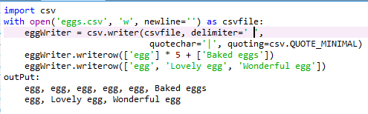
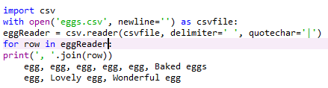
Sample script to read CSV

Slide 16
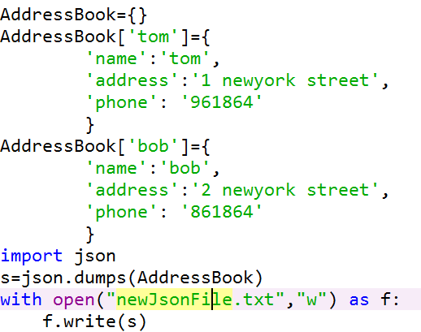
Create JSON from dictionary

Slide 17
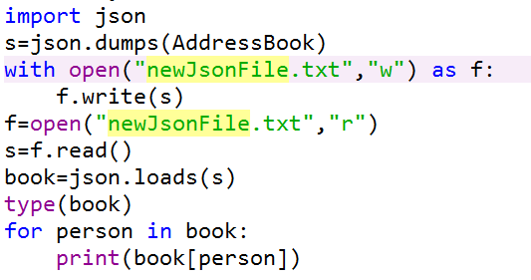
Read from json

Slide 18
Database interaction
Python supports different types of databases with several different modules for each type
All modules have same methods and same standards.
Some of them are mysql server, oracle,sqlite and many more
Connect(info),cursor(),execute(sql),fetchone() are some of methods for db interaction.

Slide 19
Connect(info)—to connect to database
Cursor()-get a cursor object to execute query
Execute(sql)—an sql query
Fetchone()—fetch only one row
Fetchall()—return lists of lists
Executemany()—parametrized query
Executescript()—execute a string of multiple SQL statements seperated by semicolon

Slide 20
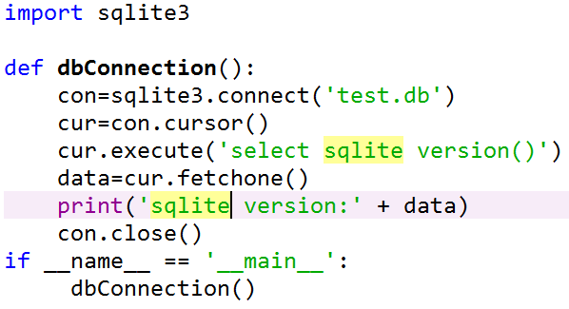
Sample Script to conenct db

Slide 21
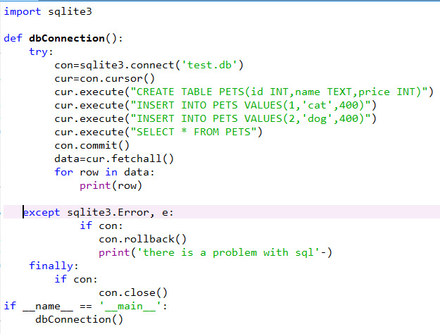

Slide 22
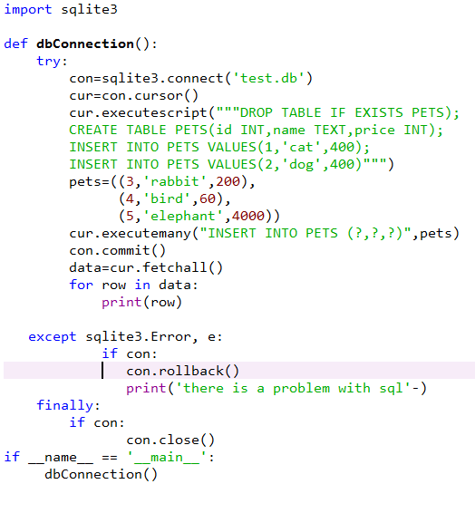

Slide 23
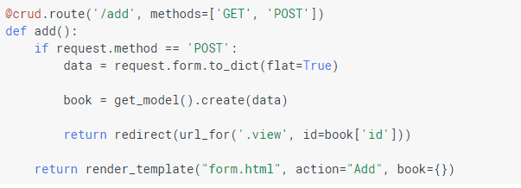
CRUD with cloud SQL https://github.com/GoogleCloudPlatform/getting-started-python/blob/master/2-structured-data/bookshelf/model_cloudsql.py

Slide 24
BigQuery
Preparing Data for Loading
Load data into bigquery
Load data with a post request
Streaming data into bigquery
Querying data
Updating data
Exporting data

