Slide 1
Predict if there is anybody injury
GUOBIN YU

Slide 2
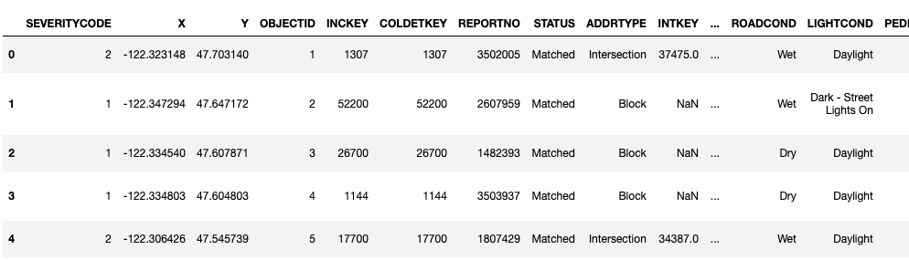
Raw data of collisions

Slide 3
Severity Code
1. property damage
2. injury
I use severity code to predict if there is anybody injury during the collision.

Slide 4
Values we need
1. ADDRTYPE
Block, Intersection, Alley
2. WEATHER
Clear, Raining, Overcast…
3. ROADCOND
Dry, Wet, Unknown…
4. LIGHTCOND
Daylight, Dark - Street Lights On, Unknown

Slide 5
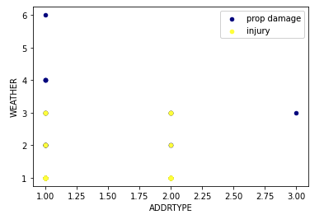
ADDRTYPE & WEATHER

Slide 6
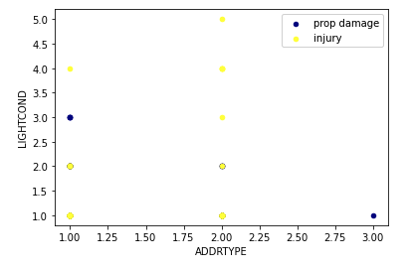
ROADCOND & LIGHTCOND

Slide 7
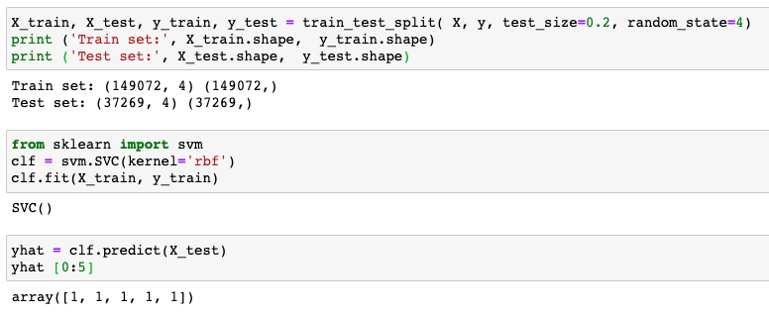
ML: SVM - RBF (Radial Basis Function)

Slide 8
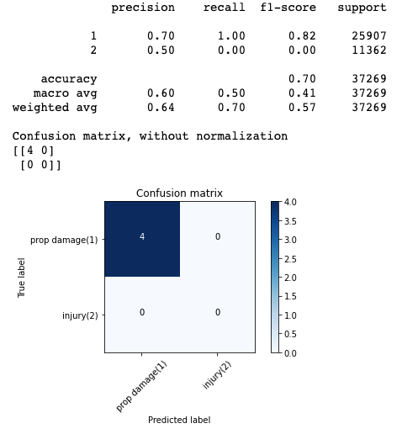
Evaluation

Slide 9

F1 score

