Slide 1




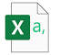
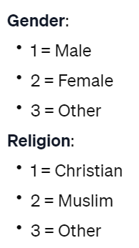



read_excel_workbook()
read_excel_files_from_dir()
read_gsheets()
read_csv_files_from_dir()
read_spss_data()
read_stata_data()
Spreadsheets
Flat files
Labelled data
Other functions in bulkreadr
CSV
pull_out()
convert_to_date()
fill_missing_values()
inspect_na()
generate_dictionary()
look_for()

Slide 2
Spreadsheets
Flat files
Labelled data
read_excel_workbook()
read_excel_files_from_dir()
read_gsheets()
read_csv_files_from_dir()
read_spss_data()
read_stata_data()
CSV
generate_dictionary()
look_for()
Other functions in bulkreadr
pull_out()
convert_to_date()
fill_missing_values()
inspect_na()

