Slide 1
‎
‎

Slide 2
R Programming Fundamentals

Slide 3
Learning Objectives
The goal of this section is to understand the history of R programming, explore its key milestones, and learn how to install and set up R and RStudio for effective programming.
Notes:
Before we begin this session, let me quickly show you what you are about to learn.

Slide 4
Table of content
History and Overview of R
R for Data Science
R as a Calculator
Atomic Data Type and Variable Assignment in R
Basic Data Structure in R
Write your own function in R

Slide 5
History of R

Slide 6
R Programming
R is a programming language and free software environment for statistical computations, data cleaning, data analysis, and graphical representation of data. The R language is widely used among statisticians and data miners for developing statistical software and data analysis.
In the year 2020, the R community celebrated the 20th year of R version 1.0.0. The current version of R programming is 4.1.0 with the nickname Camp Pontanezen.

Slide 7
History of R
R has released so many versions and you can see their list by using:
rversions::r_versions()
Please note that you will need to install rversions package before rversions::r_versions() can work.

Slide 8
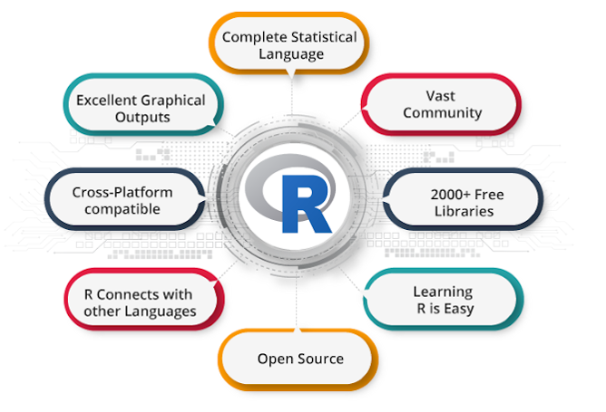
Why R programming?

Slide 9

Companies that use R for Analytics
Companies that use R for Analytics:

Slide 10
Source: https://www.quora.com/Which-companies-use-R

Slide 11
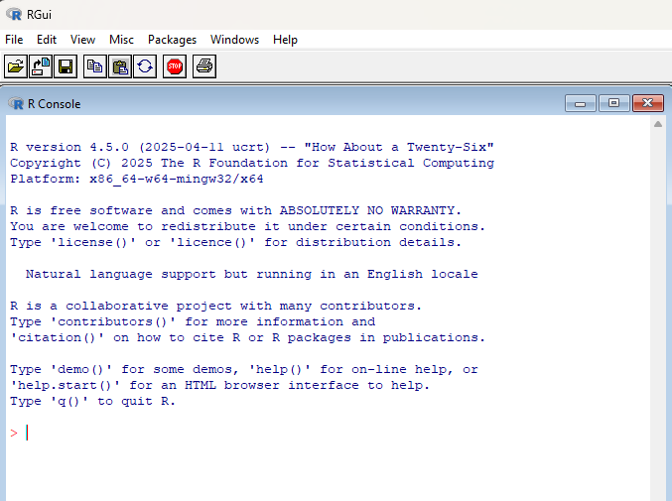
R programming interface

Slide 12
RStudio
RStudio is an integrated development environment (IDE) for R programming. RStudio makes programming easier and friendly in R.

Slide 13
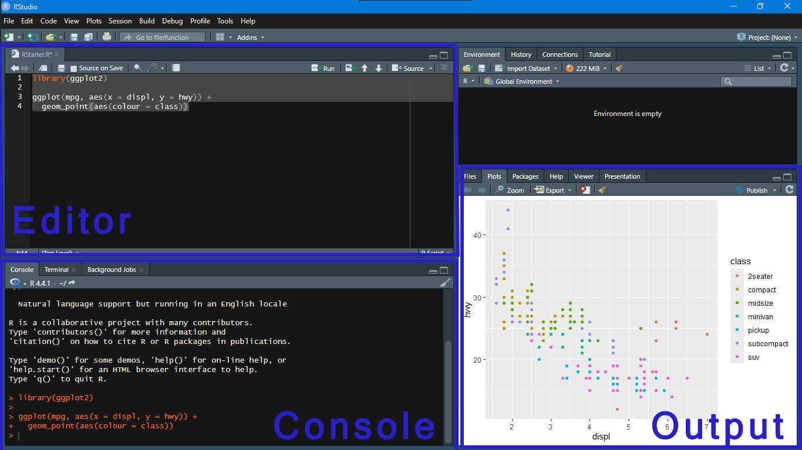
RStudio

Slide 14
Installing R and RStudio

Slide 15
Install R
You can install R on any operating system (OS).
For Windows :
Download R for Windows OS from https://cran.r-project.org/bin/windows/base/
Open the .exe file and install it.

Slide 16
Install R
You can install R on any operating system (OS).
For Mac :
Download R for Mac via the https://cran.r-project.org/bin/macosx/ page. Please make sure you click on the first .pkg link,
Open the .pkg file and install it.

Slide 17
Install R
You can install R on any operating system (OS).
For Linux:
For complete R System installation in Linux, follow the instructions provided on the CRAN website. https://cran.r-project.org/.
For Ubuntu with Apt-get installed, execute sudo apt-get install r-base in the terminal.

Slide 18
Install RStudio
You can install RStudio via
https://www.rstudio.com/products/rstudio/download/#download
Choose the appropriate installer file for your operating system, download it, and then run it to install RStudio.

