Slide 1
The Afroasiatic Morphological Archive: A Paradigm Database
Gene Gragg
Oriental Institute
Depts. Linguistics, Near Eastern Langs & Civs
University of Chicago

Slide 2
AAMA: Afroasiatic Morphological Archive (an extension of) COMA: Cushitic-Omotic Morphological Archive
Supported by Mellon Emeritus fellowship (Nov. 2008 – Mar. 2010)
Computer expertise supplied by Gregg Reynolds of National Opinion Research Center.
Notes:
Hi, I'm Gene Gragg and the project I'm reporting out of is something called, the Cushitic-Omotic Morophological Archive. It's abbreviated, not too appropriately, I hope, COMA. I have been aided in the project by numerous data-inputters, and by computer programmer and Sibawayhi maven Gregg Reynolds (here present).
The project, in one sense, is about paradigms, and this, the most ancient and intuitive format of linguistic notion, is on the one hand deeply rooted in millennia of language pedagogy and linguistic description. On the other its linguistic nature and theoretical status have been the object of increasing attention from what may be called a neo-paradigm (under-)current of linguistic thought.
Paradigms can be surprisingly complex entities, so let's take a look at a very sophisticated early example:

Slide 3
OUTLINE
OBGT: Homage to an Earlier Project
The AAMA Project: Goals
Collaborative Development Context: git
Linked Data: RDF
Morphological Data as Graph
Morphological Data as Network of Statements
(Excursus: Data Formats)
Querying Linked Data: SPARQL
Towards an Interface

Slide 4
1. OBGT: Homage to an earlier project: (cf. Landsberger et al. 1956, Black 1991, Huber 2007)

Slide 5
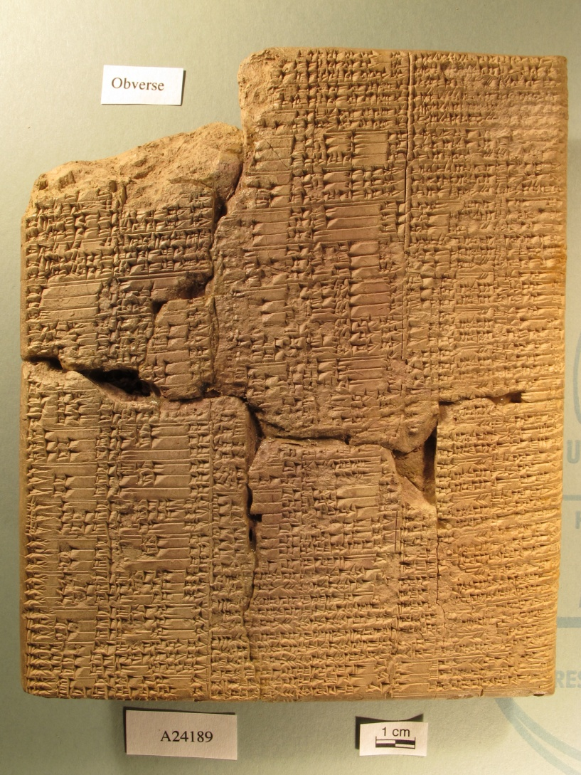
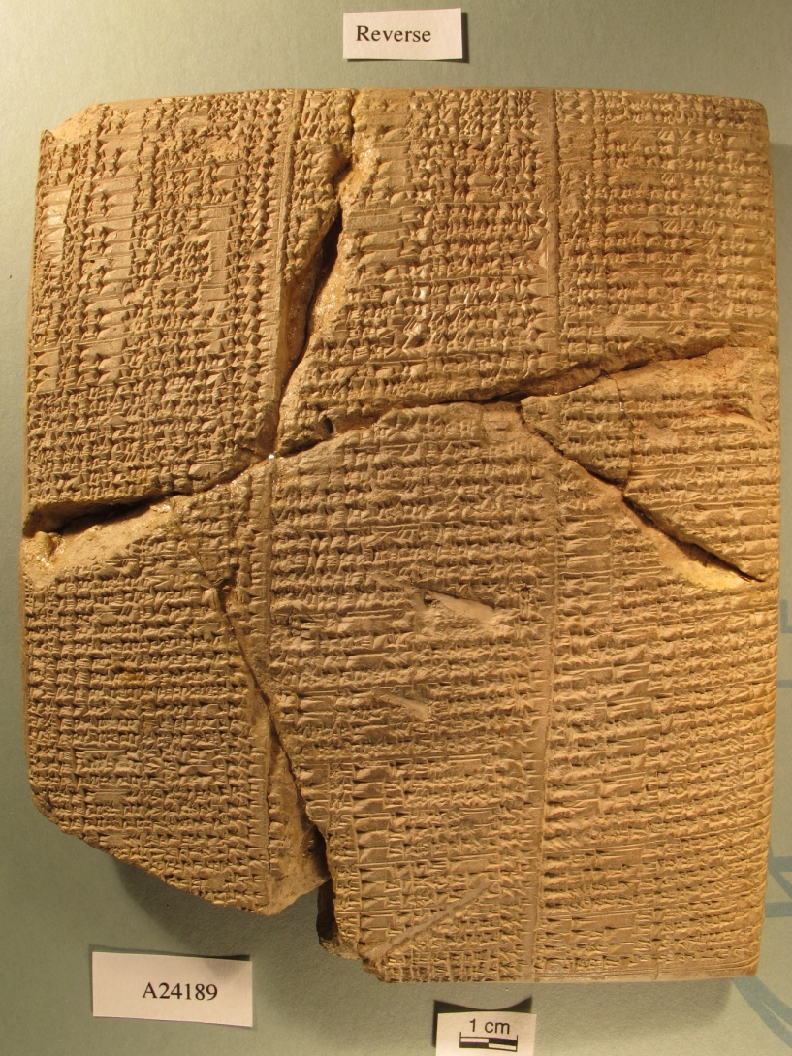
OBGT 7 (Old Babylonian Grammatical Texts 7)

Slide 6
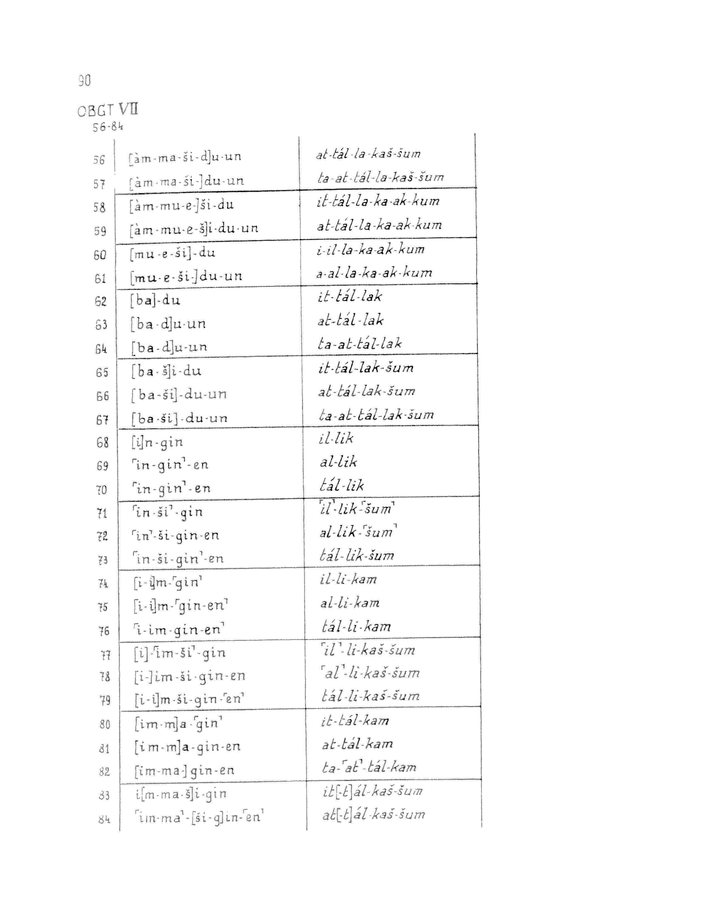
MSL 4 (1956) p. 90

Slide 7
Section | Line | ObjNum | SubjNum | Mood | Ventive | Stem | ObjPers | Tense-Aspect | SubjPers
20 | 58 | sg | sg | indicative | ventive | Gt | 2 | present | 3
 | 59 | sg | sg | indicative | ventive | Gt | 2 | present | 1
21 | 60 | sg | sg | indicative | ventive | G | 2 | present | 3
 | 61 | sg | sg | indicative | ventive | G | 2 | present | 1
22 | 62 | sg | sg | indicative | non-ven | Gt | Ø | present | 3
 | 63 | sg | sg | indicative | non-ven | Gt | Ø | present | 1
 | 64 | sg | sg | indicative | non-ven | Gt | Ø | present | 2
23 | 65 | sg | sg | indicative | non-ven | Gt | 3 | present | 3
 | 66 | sg | sg | indicative | non-ven | Gt | 3 | present | 1
 | 67 | sg | sg | indicative | non-ven | Gt | 3 | present | 2
24 | 68 | sg | sg | indicative | non-ven | G | Ø | preterite | 3
 | 69 | sg | sg | indicative | non-ven | G | Ø | preterite | 1
 | 70 | sg | sg | indicative | non-ven | G | Ø | preterite | 2
25 | 71 | sg | sg | indicative | non-ven | G | 3 | preterite | 3
 | 72 | sg | sg | indicative | non-ven | G | 3 | preterite | 1
 | 73 | sg | sg | indicative | non-ven | G | 3 | preterite | 2
26 | 74 | sg | sg | indicative | ventive | G | Ø | preterite | 3
 | 75 | sg | sg | indicative | ventive | G | Ø | preterite | 1
 | 76 | sg | sg | indicative | ventive | G | Ø | preterite | 2
27 | 77 | sg | sg | indicative | ventive | G | 3 | preterite | 3
 | 78 | sg | sg | indicative | ventive | G | 3 | preterite | 1
 | 79 | sg | sg | indicative | ventive | G | 3 | preterite | 2
Notes:
The table on this slide shows, in as close to hierarchical order as the tablet permits, for 20 lines starting toward the bottom of col one, values for the minimal set morphosyntactic categories necessary to distinguish the 318 forms of the "go" paradigm. There are eight of them: mood, stem, ventivity, and tense-aspect, object number and person, subject number and person. This set is only minimal, and there are a number of other realms of structure which we simply cannot get into here.
It is a matter of debate whether the OBGT are basically paradigms of Sumerian glossed in Akkadian, Akkadian explicated (?) by Sumerian, or parallel Sumerian and Akkadian showing, or perhaps theorizing, about equivalences and mappings between the very, very different morphosyntactic categories and morphological exponents in the two languages. It has been pointed out that a number of the individual Akkadian and Sumerian forms have never been attested, and may be artificial. This may or may not be the case, but if so, it affords this linguist a slightly uncomfortable twinge of recognition of an earlier member of the profession who was not about to let something like data get in the way of a really neat theory.

Slide 8
OBGT Paradigm Attributes and Values:
Object Num sg, pl
Subject Num sg, pl
Modal indicative, modal
Ventive ventive, non-ventive
Stem G, Gt, Š, N
Object Pers 1, 2, 3
TAM pres, pret, imprtv, opt, cohor
Subject Pers 1, 2, 3

Slide 9
2. The AAMA Project: Goals

Slide 10
AAMA: The challenge:
Create a paradigm database whose
data can be:
curated (edited/created) -- and hopefully shared!
inspected
manipulated
queried
on individual machine (initial display: browser)

Slide 11
The Term:
Paradigm: systematic listing, for a lexeme chosen as exemplary, of a set of word-forms illustrating all occurring value-combinations for each of a selected set of morphosyntactic attributes.
Taken together, the set of paradigms chosen for a language should illustrate all possible value-combinations for all possible attribute combinations attested in the language.
Notes:
Note on Paradigm Organization:
Each value combination in an exemplary paradigm should yield a single (exemplary) word-form or partial word-form ("partial" in this context extended to include not only base, stem, root, etc., but also lexeme-independent prefix, infix, suffix, template vowel pattern, etc.).
There would seem to be a (unique?) natural hierarchy of properties, starting with POS, and going through VALENCE and TAM, down to PNG (all of these cross-cut by ICLASS). This is at least the millennial practice reflected in the traditional preference for basic paradigms that show PNG values for any given combination of TAM and other properties. [And this is the case not only for traditional paradigms of Latin and Greek, but for the early second-millennium B.C. paradigms of Sumerian recorded in the Old Babylonian Grammatical texts.] This is of course the general pattern followed in COMA. THIS IS THE DEFINITION OF BASIC, OR DEFAULT, PARADIGM.

Slide 12
Paradigm: a persistent notion
Millennial pedagogical and descriptive practice
Recent reevaluation in linguistic main-stream
A radical (slightly earlier) view

Slide 13
The paradigm in the linguistic mainstream
Hockett 1954
Robins 1959
Matthews 1972
Zwicky 1985
Aronoff 1994
Stump 2001
Blevins & Blevins 2009

Slide 14
AAMA Objectives - 1
Archive: make available and comparable the major morphological paradigms of some fifty Cushitic and Omotic languages
longer term: tool that can help situate the morphologies of these two language families within Afroasiatic
Notes:
More generally: An attempt to address not only the documentary, but also the logical and linguistic challenges of such a database. (documentary linguistics)
Split this into 4 slides: Objectives (w/o text), 3 slides with text for each objective

Slide 15
AAMA Objectives - 2
Database: Query, contrast and configure the complex paradigmatic structures it contains, within a given language and between languages.
Notes:
More generally: An attempt to address not only the documentary, but also the logical and linguistic challenges of such a database. (documentary linguistics)
Split this into 4 slides: Objectives (w/o text), 3 slides with text for each objective

Slide 16
AAMA Objectives -3
Morphological Theory: Tool for exploration of typology and structure of the form of linguistic organization known as the paradigm.
Notes:
More generally: An attempt to address not only the documentary, but also the logical and linguistic challenges of such a database. (documentary linguistics)
Split this into 4 slides: Objectives (w/o text), 3 slides with text for each objective

Slide 17
3. Collaborative Development Context: git and GitHub
git: distributed version control system (VCS)
developed by Linus Torvalds (Linux)
GitHub: "social network" approach to projects
cf. "GitHub bootcamp" on https://github.com

Slide 18
AAMA (for now) . . .
https://github.com/gbgg/aama
(on branch "dev-aama": git checkout dev-aama)
download zip – see what's there
fork repository – follow, keep up to date
clone – work with it on your own machine

Slide 19
What is there . . .
Data (interface being developed elsewhere)
An extensive directory structure under a root aama/data
Overview (DocBook format):
aama/docs/docbook/AAMADocumentation.html
[A copy of this presentation will be found under:]
aama/docs/slides

Slide 20
The Language Data
Family | Lang | Family | Language | Family | Language | Family | Language
Beja | Arteiga | Omo-Tana | Somali |  | Kambaata |  | Koorete
 | Bishari |  | Rendille |  | Sidaama |  | Maale
 | Beniamer |  | Bayso | SE. Cush. | Tsamakko | (Semitic) | (Akkadian-OB)
 | Hadendowa |  | Boni-jara |  | Gawwada |  | (Hebrew)
 | Atmaan |  | Boni-kilii |  | Yaaku |  | (Syriac)
Agaw | Kemant |  | Arbore |  | Dahalo |  | (Arabic)
 | Awngi |  | Dhaasanac | S. Cush. | Burunge |  | (Geez)
 | Bilin |  | Elmolo |  | Iraqw | (Egypt.) | (middle)
 | Khamtanga | HE. Cush. | Alaaba | Omotic | Dizi |  | (Coptic-Sahidic)
Sah-Afar | Afar |  | B urji |  | Shinassha
 | Saho |  | Gedeo |  | Yemsa
Oromoid | Oromo |  | Hadiyya |  | Wolaytta

Slide 21
Format for Individual Language Documentation in Overview
II. Language Documentation: Beja
4. Beja-Arteiga Language Data
General Information
Location-Speakers
Bibliographic Source
Paradigm Lexemes
Morphosyntactic Properties
Attested Archive Paradigms
Phonological Inventory

Slide 22
4.1 Linked Data: Morphology as Graph

Slide 23
The Data
A number of formats possible, all roughly in the XML orbit
One chosen here is RDF datastore

Slide 24
RDF: the database
"The Resource Description Framework (RDF) is a family of World Wide Web Consortium (W3C) specifications originally designed as a metadata data model. It has come to be used as a general method for conceptual description or modeling of information that is implemented in web resources, using a variety of syntax formats."

Slide 25
Resource Description Framework (RDF)
"based upon the idea of making statements about resources (in particular Web resources) in the form of subject-predicate-object expressions"
graphic visualization: node-edge-node
subject
object
predicate
Notes:
Two nodes connected by labeled

Slide 26
Graph Notation
for example:
enseignement
"enseigner"
lexeme
Notes:
Two nodes connected by labeled

Slide 27
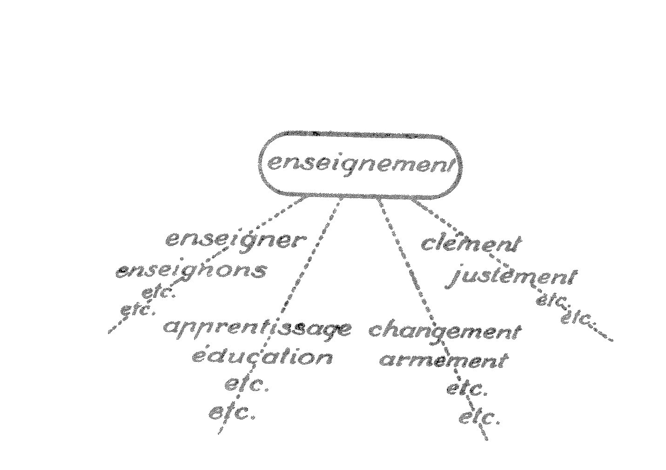
Saussure's generalization of "paradigm"
"rapports associatifs" (Cours, p. 175)

Slide 28
A radical view
langue = “un système où tout se tient"
the two axes of langue (Cours de linguistique générale, chs. 5 & 6):
rapports syntagmatiques
rapports associatifs
Viewed along its associative/paradigmatic axis:
LANGUE IS A GRAPH
Notes:
Before going on to practical use of RDF - - - Is this totally off the wall?
"system of interrelated terms"
"system, all parts of which organically cohere and interact"

Slide 29
From out point of view . . .
item situated with respect to resources
where "ns:" uniquely identifies the "namespace" of a resource – where you can find it (URI/URL)
cf. "dc:" ("Dublin Core") widely used by libraries for exchange of documents and catalogue references.
So . . . morphosyntactic attribute/value terminology is a RESOURCE
ITEM
ns:Value
ns:attribute
Notes:
Advantages of

Slide 30
So … given an Afar paradigm
lexeme=duur_, conjugation=prefixConj polarity=affirmative
tense number person gender shape
imperf sg p1 aduureh
imperf sg p2 taduureh
imperf sg p3 m yaduureh
imperf sg p3 f taduureh
imperf pl p1 naduureh
imperf pl p2 taduureenih
imperf pl p3 yaduureenih
Notes:
Paradigm itself (shown here in tab-delimited form). Can be entered paradigm-by-paradigm, or in one huge paradigm. Use MS Word tables, MS spreadsheet for cut-and-paste of col and row values. Permute columns and rows, sort, etc. Then save as tab-delimited text and paste into pdgm.txt.

Slide 31
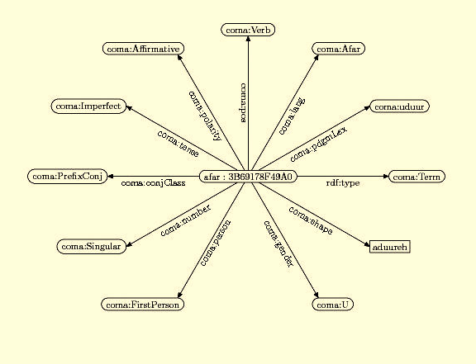
graph visualization: aduureh

Slide 32
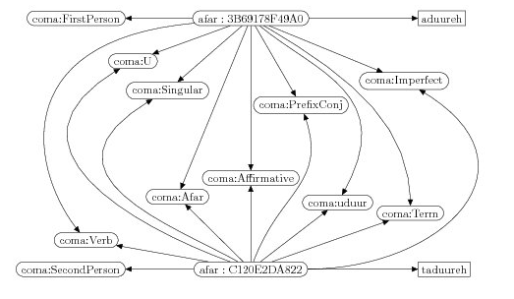
paradigm: aduureh, taduureh . . .

Slide 33
4.2 Linked Data: Morphology as Network of Statements

Slide 34
In Practice . . .
A network of statements ("triples")
Syntax: ttl
(pronounced/written-out:
"turtle": Terse RDF Triple Language)
Statement Format: "s p o ."
Generally with interpretation:
(morphological-)object property value .

Slide 35
Three Main Classes of Morphological Object ("Subject")
aamas:Term -- what you find in a pdgm cell
properties: tense, number, person, gender, etc. etc.
aamas:Lexeme -- the paradigm lexeme
properties: lemma, gloss, etc. etc.
aama:TermSet -- a "language"
properties: name, variety, family etc. etc.

Slide 36
Properties and Values: Namespace-controlled vocabularies
The namespace prefixes of AAMA:
@prefix rdf: <http://www.w3.org/1999/02/22-rdf-syntax-ns#> . @prefix rdfs: <http://www.w3.org/2000/01/rdf-schema#> .
@prefix aama: <http://id.oi.uchicago.edu/aama/2013/> .
@prefix aamas: <http://id.oi.uchicago.edu/aama/2013/schema/> .
@prefix aamav: <http://id.oi.uchicago.edu/aama/2013/value/> .

Slide 37
Properties and Values: Inference-1
aamas:Cluster rdfs:subClassOf rdfs:Class .
aamas:Lexeme rdfs:subClassOf aamas:Cluster .
aamas:MuExponent rdfs:subClassOf rdfs:Class .
aamas:muProperty rdfs:subProperty rdfs:Property .
aamas:MuScheme rdfs:subClassOf aamas:Cluster .
aamas:MuTerm rdfs:subClassOf aamas:Cluster .
aamas:Term rdf:type aamas:Lexeme .
aamas:Term rdf:type aamas:MuScheme .
aamas:Term rdf:type aamas:MuTerm .
aamas:Text rdfs:subClassOf rdfs:Class .
aamas:Token rdfs:subClassOf rdfs:Class .

Slide 38
Properties and Values: Inference-2
aamav:Absolutive aama:lang aama:Oromo .
aamav:Absolutive rdf:type aamav:Case .
aamav:Absolutive rdfs:label "Absolutive" .
aama:case rdfs:subPropertyOf aama:muProperty .
aama:case rdfs:label "case" .
aama:case rdfs:Range aamav:Case .
aama:case rdfs:Domain aamas:Term .
aama:case aama:lang aama:Oromo .
aamav:Case rdfs:subClassOf aamav:MuExponent .
aamav:Case rdfs:label "case exponents" .
aamav:Case aama:lang aama:Oromo .

Slide 39
Properties and Values: Alternate Terminologies
E.g.:
aamav:Aorist owl:SameAs reinisch1873:Plusquamperfectum
aamav:Aorist owl:SameAs somebody-else:PunctualPast

Slide 40
The end of the rainbow?
The GOLD standard: "gold:"
"General Ontology for Linguistic Description"
Terry Langendoen,
http://www.linguistics-ontology.org/
Cf. also e-Linguistics (Toolkit)
http://uakari.ling.washington.edu/e-linguistics/
Notes:
Obvious solution is to map "coma:" onto "gold:" – but premature.

Slide 41
ttl syntax morphology – verbose (ms/MS = "morphosyntactic") ("a" official abbreviation for "rdf:type")
ID _{x} a aama:MSObject_{i} .
ID _{x} aama:msAttribute_{a} aama:MSValue_{j} .
ID _{x} aama:msAttribute_{b} aama:MSValue_{k} .
ID _{x} aama:msAttribute_{c} aama:MSValue_{l} .
… …

Slide 42
ttl Morphology - concise
ID _{x} a aama:pdgmCell ;
aama:msAttribute_{a} aama:MSValue_{j} ;
aama:msAttribute_{b} aama:MSValue_{k} ;
aama:msAttribute_{c} aama:MSValue_{l} ;
… …
.

Slide 43
ttl: Afar
## sg,1,U,aduureh
afar:Tok_3B69178F49A0
a aama:Term ;
aama:pdgmLex aama:_uduur_;
aama:lang aama:Afar;
aama:pos aama:Verb;
aama:polarity aama:Affirmative;
aama:tense aama:Imperfect;
aama:conjClass aama:PrefixConj;
aama:number aama:Singular;
aama:person aama:FirstPerson;
aama:gender aama:U;
aama:shape "aduureh";
.
Notes:
Cf. number 3 on handouts

Slide 44
THUS:
all of Afar paradigmatic morphology can be stated as a (large) set of ttl statements .
all of the AAMA database can be stated as a (very large) set of ttl statements.
all of an Afroasiatic database could be stated as a mind-boggling huge set of ttl statements.
… … …
Notes:
This has important consequences:
To paraphrase Leo Oppenheim, who was parodying someone else: Heute Kuschitisch, morgen den ganzen Welt . . . "Tomorrow the world"

Slide 45
RDF Datastore:
Of course in ttl representations, you do not immediately see the connections between the various systems of attributes and values as in the earlier graphic representations (although you can always trace them through by hand).

Slide 46
RDF Datastore
But the point is that the software which is an integral part of an RDF datastore does see them, all of them, virtually at once .
Whence the ability of software that can handle ttl to respond to queries for: "all the 2nd pers fem forms in Berber, Cushitic, and Semitic", "all the imperfective and perfective suffixConjugation forms", etc. etc.

Slide 47
RDF Datastore
In short: RDF databases provide a tool not only for retrieving canonical paradigms, but for tearing them apart, and reassembling them in less canonical, but possibly insightful, ways.

Slide 48
Excursus: Data Formats

Slide 49
Any Convenient & Consistent Data Entry Format: e.g. data/beja/arteiga/src/beja-arteiga-pdgms.txt
PDGM:
ID: beja_H-VPrefAffCCCAor
NAME: beja_H-VPrefAffCCCAor
FEATURES:
lang = beja-arteiga
pos = verb
tam = aorist
polarity = affirmative
rootClass = CCC
conjClass = prefix
pdgmLex = dbl
FORMS:
number | person | gender | token
sg | p1 | - | ?-iidbíl
sg | p2 | m | t-iidbil- `a
sg | p2 | f | t-iidbil- `i
sg | p3 | m | ?-iidbíl
sg | p3 | f | t-iidbíl
pl | p1 | - | n-iidbíl
pl | p2 | - | t-iidbil- `na
pl | p3 | - | ?-iidbil- `na

Slide 50
Explicit Static (persistent) format
Need explicit format for
storage
basis for further format transformations
data exchange
XML is good (of course) . . .

Slide 51
Static Format: XML (pdgm term) data/beja/arteiga/beja-arteiga-pdgms.xml
<pdgm >
<common-properties>
<prop type="conjClass" val="Prefix"/>
<prop type="lang" val="Beja-Arteiga"/>
<prop type="lexlabel" val="dbl"/>
<prop type="polarity" val="Affirmative"/>
<prop type="pos" val="Verb"/>
<prop type="rootClass" val="CCC"/>
<prop type="tam" val="Aorist"/>
</common-properties>
<termcluster>
<term id="ID05c2c97a-8896-402b-9e3c-45f99d951510">
<prop type="gender" val="Masc"/>
<prop type="number" val="Singular"/>
<prop type="person" val="Person3"/>
<prop type="token" val="?-iidbíl"/>
</term>
. . . . . . .
</termcluster>
</pdgm>

Slide 52
Static format
XML is good (of course) . . . but for our purposes
JSON is better

Slide 53
Static format: JSON
pdgm = {
"pdgmattributes": {
"conjClass": "prefix",
"rootClass":"CCC",
"lang": "beja-arteiga",
"pdgmLex": "dbl",
"polarity": "affirmative",
"pos": "verb",
"tam": "aorist"
},
"forms": [
["number", "person", "gender", "token"],
["sg", "p1", "U", " ?-iidbíl "],
["sg", "p2", "m", " t-iidbil- `a "],
["sg", "p2", "f", " t-iidbil- `i "],
["sg", "p3", "m", " ?-iidbíl "],
["sg", "p3", "f", " t-iidbíl "],
["pl", "p1", "U", " n-iidbíl "],
["pl", "p2", "U", " t-iidbil- `na "],
["pl", "p3", "U", " ?-iidbil- `na "]
]
}

Slide 54
json Format (1)
short for JavaScript Object Notation
http://www.json.org/
"lightweight computer data interchange format . . . alternative to XML"
Notes:
I fell in love with it when I discovered that my previous basic data text format (originally for transformation into XML) was practically identical with JSON. I was speaking JSON without knowing it!

Slide 55
json Format (2)
text-based, human-readable natural format for registering paradigms
identical, or nearly so, with attribute/value arrays in many current scripting and programming languages
trivially transformable to XML

Slide 56
Finally - RDF (ttl) format: cf. a pdgm term in data/beja/arteiga/beja-arteiga-pdgms.ttl
aama:ID05c2c97a a aamas:Term ;
aamas:lexeme aama:Beja-Arteiga-dbl;
aama:conjClass aamav:Prefix ;
aama:lang aama:Beja-Arteiga ;
aama:polarity aamav:Affirmative ;
aama:pos aamav:Verb ;
aama:rootClass aamav:CCC ;
aama:tam aamav:Aorist ;
aama:gender aamav:Masc ;
aama:number aamav:Singular ;
aama:person aamav:Person3 ;
aama:token "?-iidbíl"
.

Slide 57
5. Querying Linked Data: SPARQL

Slide 58
RDF Databases
a number of SQL-like languages have been developed to query RDF databases:
SPARQL
(so-called "recursive name":
SPARQL Protocol And RDF Query Language)
there is an increasing use of RDF databases in many domains, including (documentary) linguistics

Slide 59
Display: Getting back the paradigms
SPARQL
W3C specifications:
http://www.w3.org/TR/rdf-sparql-query/
Bob DuCharme, Learning SPARQL: Querying and Updating with SPARQL 1.1 (O'Reilly, 2011)
Fuseki
http://jena.apache.org/
Set of queries for AAMA
aama/sparql/rq-ru/

Slide 60
Example of Simple SPARQL Query
SELECT ?number ?person ?gender ?token
WHERE
{
?s aamas:lexeme aama:Beja-Arteiga-dbl .
?s aama:conjClass aamav:Prefix .
?s aama:lang aama:Beja-Arteiga .
?s aama:polarity aamav:Affirmative .
?s aama:pos aamav:Verb .
?s aama:tam aamav:Present .
?s aama:number ?number .
?s aama:person ?person .
?s aama:gender ?gender .
?s aama:token ?token .
}
ORDER BY DESC(?number) ?person DESC(?gender)

Slide 61
SPARQL Query (2)
Of course in an actual user interface, query format details actually sent to datastore server would be hidden.
User would specify details and format of desired display from graphic pick-lists, drop-down lists, etc.

Slide 62
Output of query: Beja Verb, present.
num | pers | gen | shape
sg | 1 |  | ?a-danbíil
 | 2 | m | danbiil-`a
 |  | f | danbiil-`i
 | 3 | m | danbíil
 |  | f | danbíil
pl | 1 |  | n-eedbíl
 | 2 |  | t-eedbil-`na
 | 3 |  | ?-eedbil-`na

Slide 63
Add to Query (essentially):
{aama:tam aama:Present}
UNION
{aama:tam aama:Past}

Slide 64
Output of query:
num | pers | gen | tense
 |  |  | present | past
sg | 1 |  | ?a-danbíil | ?a-dbíl
 | 2 | m | danbiil-`a | ti-dbil-`a
 |  | f | danbiil-`i | ti-dbil-`i
 | 3 | m | danbíil | ?i-dbíl
 |  | f | danbíil | ti-dbíl
pl | 1 |  | n-eedbíl | ni-dbíl
 | 2 |  | t-eedbil-`na | ti-dbil-`na
 | 3 |  | ?-eedbil-`na | ?i-dbil-`na

Slide 65
Add to above:
{aama:lang aama:Beja-Arteiga}
UNION
{aama:lang aama:Afar}

Slide 66
tense | num | pers | gen | Beja | Afar
pres | sg | 1 |  | ?a-danbíil | asgaadeh
 |  | 2 | m | danbiil- `a | tasgaadeh
 |  |  | f | danbiil - `i | - -
 |  | 3 | m | danbíil | yasgaadeh
 |  |  | f | danbíil | tasgaadeh
 | pl | 1 |  | n-eedbíl | nasgaadeh
 |  | 2 |  | t-eedbil- `na | tasgaadeenih
 |  | 3 |  | ?-eedbil- `na | tasgaadeenih
past | sg | 1 |  | ?a-dbíl | usguudeh
 |  | 2 | m | ti-dbil- `a | tusguudeh
 |  |  | f | ti-dbil- `i | - -
 |  | 3 | m | ?i-dbíl | yusguudeh
 |  |  | f | ti-dbíl | tusguudeh
 | pl | 1 |  | ni-dbíl | nusguudeh
 |  | 2 |  | ti-dbil- `na | tusguudeenih
 |  | 3 |  | ?i-dbil- `na | tusguudeenih

Slide 67
Manipulate rows/cols of second paradigm – Row: pers gen. Col: tense num
pers | gen | pres |  | past
 |  | sg | pl | sg | pl
1 |  | ?a-danbíil | n-eedbíl | ?a-dbíl | ni-dbíl
2 | m | danbiil-`a | t-eedbil-`na | ti-dbil-`a | ti-dbil-`na
 | f | danbiil-`i |  | ti-dbil-`i
3 | m | danbíil | ?-eedbil-`na | ?i-dbíl | ?i-dbil-`na
 | f | danbíil |  | ti-dbíl

Slide 68
Manipulate rows/cols of third paradigm – Row: num pers gen. Col: lang tense
num | pers | gen | Beja |  | Afar
 |  |  | pres | past | imperf | perf
sg | 1 | com | ?a-danbíil | ?a-dbíl | asgaadeh | usguudeh
sg | 2 | m | danbiil-`a | ti-dbil-`a | tasgaadeh | tusguudeh
sg | 2 | f | danbiil -`i | ti-dbil-`i | - - | - -
sg | 3 | m | danbíil | ?i-dbíl | yasgaadeh | yusguudeh
sg | 3 | f | danbíil | ti-dbíl | tasgaadeh | tusguudeh
pl | 1 | com | n-eedbíl | ni-dbíl | nasgaadeh | nusguudeh
pl | 2 | com | t-eedbil-`na | ti-dbil-`na | tasgaadeenih | tusguudeenih
pl | 3 | com | ?-eedbil-`na | ?i-dbil-`na | tasgaadeenih | tusguudeenih

Slide 69
6. Towards an Interface

Slide 70
What's not there (yet) . . .
The interface for paradigm manipulation
Past prototype: Mozilla-Firefox XUL
The future: Cappuccino
http://www.cappuccino-project.org/

Slide 71
What could this lead to?
Agreement on format for exchange of paradigm data (JSON?).
Controlled (and inter-translatable) vocabularies for morphosyntactic attributes and values.
Uniform query language: SPARQL.
Given 1. & 2. (and possibly 3.), any number of display formats, datastore architectures, and front-ends can be constructed.

