Slide 1
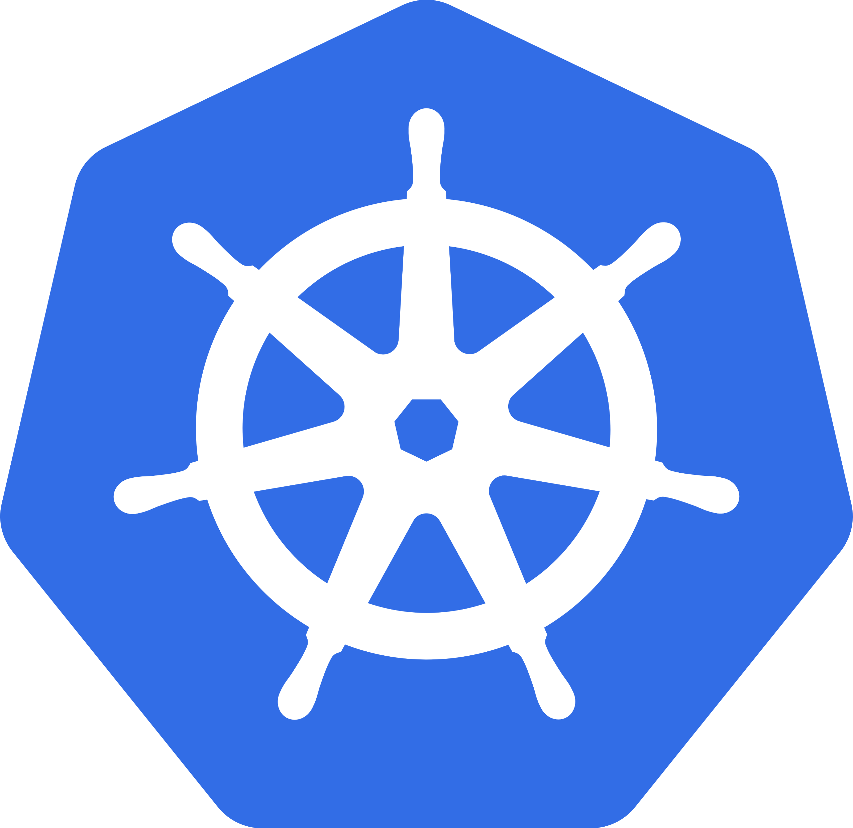
Kubernetes

Slide 2
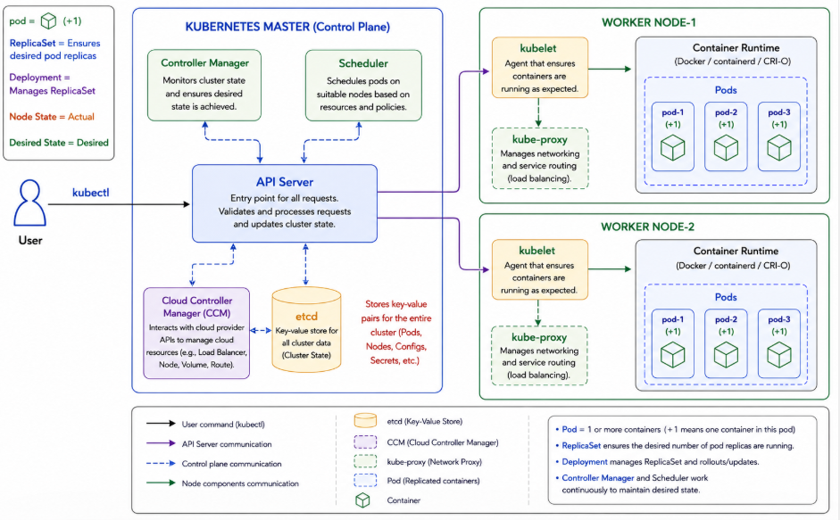
Kubernetes Architecture

Slide 3
Kubernetes Architecture Components
Master Node (Control Plane) Components | Worker Node (Data Plane) Components
API Server: Main entry point of Kubernetes. Validates requests and acts as the communication hub. Controller Manager: Monitors cluster state and ensures Desired State = Actual State. Recreates failed pods automatically. Scheduler: Selects the best worker node for pods based on CPU, Memory, Resources, and Node Conditions. Etcd: Distributed key-value database that stores cluster information such as Pods, Nodes, Configurations, and Secrets. | Kubelet: Agent running on each worker node. Receives instructions from the API Server and ensures pods are running correctly. kube-proxy: Handles cluster networking, service discovery, traffic routing, and load balancing. Container Runtime: Runs containers on worker nodes. Examples: Docker, containerd, CRI-O.
kubectl ↓ API Server ↓ Scheduler ↓ Worker Node (kubelet) ↓ Container Runtime ↓ Pods

Slide 4
What is Kubernetes?
Kubernetes (K8s) is an open-source container orchestration platform developed by Google and now maintained by the Cloud Native Computing Foundation.
It automates the deployment, scaling, management, and monitoring of containerized applications across a cluster of servers.
In simple terms:
Docker runs containers, while Kubernetes manages and orchestrates those containers at scale.
Why Kubernetes?
Imagine you have 100 containers running an application.
Without Kubernetes:
You must manually start containers.
Replace failed containers.
Scale containers during high traffic.
Perform updates without downtime.
With Kubernetes:
All these tasks are automated.
Key Features of Kubernetes:
1. Automated Deployment
2. Auto Scaling
3. Self-Healing
4. Load Balancing
5. Rolling Updates
6. Service Discovery
7. High Availability

Slide 5
Real-Time Example
Consider an e-commerce application:
User Traffic Increases ↓ Kubernetes detects high load ↓ Creates additional Pods ↓ Traffic is distributed ↓ Application remains responsive
If one pod crashes:
Pod Failure ↓ Kubernetes detects failure ↓ Creates new Pod automatically ↓ Desired State = Actual State

