Slide 1
DIGITAL PORTFOLIO
STUDENT NAME: Bhavana G
REGISTER NO & NMID: 212400869 – asunm161212400869
DEPARTMENT: II BCA B
COLLEGE: Prince Shri Venkateshwara Arts and Science College / Madras University

Slide 2
Project Title
📌 Digital Portfolio

Slide 3
Agenda
Introduction & Problem Statement
Project Overview
Target Users
Tools & Technologies Used
Portfolio Layout & Design
Features & Highlights
Results & Demonstrations
Conclusion
GitHub Repository

Slide 4
Problem Statement
In today’s job market, standing out requires more than a traditional CV.
Students and professionals lack an interactive way to present achievements.
Recruiters prefer visually appealing and easy-to-navigate profiles.
A digital portfolio bridges this gap by combining creativity with technical presentation.

Slide 5
Project Overview
A personal portfolio website designed to display:
Education & Academic details
Technical & Soft Skills
Project Work & Achievements
Contact Information & Links
Built with responsive design for mobile, tablet, and desktop.
Serves as a digital identity, boosting visibility and credibility.

Slide 6
Who Are the End Users?
Recruiters & HR Teams – Evaluate student profiles quickly.
Employers – Shortlist candidates for internships or jobs.
Peers & Professionals – Networking and collaborations.
Colleges & Institutions – Review for higher studies or project evaluation.
Clients – To assess technical capabilities before hiring.

Slide 7
Tools & Technologies
Frontend – HTML5, CSS3, JavaScript
Frameworks – Bootstrap/Tailwind for responsive design
Version Control – Git & GitHub for collaboration and hosting
Design – Responsive Web Design principles
Optional Add-ons – jQuery, animations for interactive UI

Slide 8
Portfolio Design & Layout
Sections included:
About Me – Educational background & career goals
Skills – Programming, technical tools & certifications
Projects – Real-time project details with images
Contact – Email, social links, phone no.
Design Highlights:
Clean, minimal UI with a professional color scheme
Responsive across all devices
Easy navigation & smooth scrolling

Slide 9
Features & Functionality
Mobile-friendly responsive design
Navigation bar with smooth scrolling
Project showcase with descriptions & visuals
Contact form for direct communication
Social media & GitHub links integrated
Easy to update and maintain

Slide 10
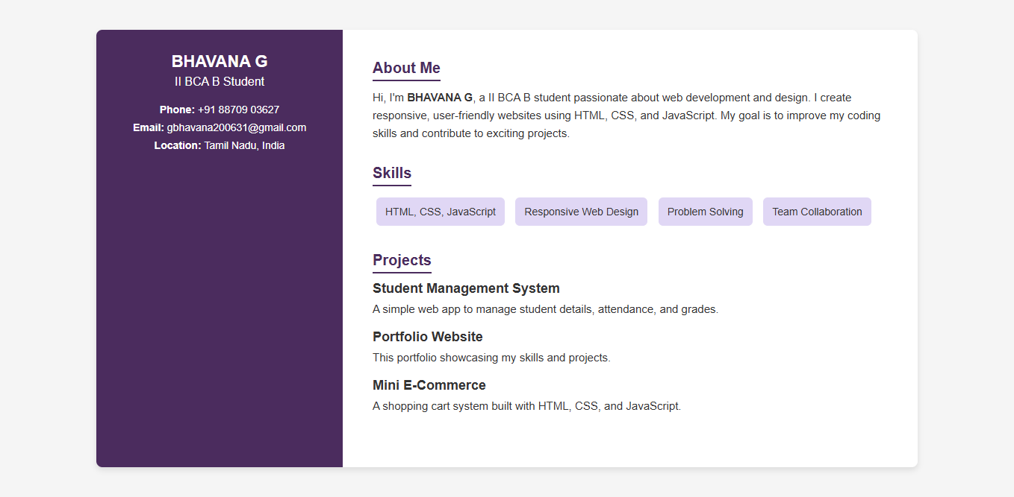
Results & Demonstrations

Slide 11
Conclusion
The portfolio strengthens professional identity.
Helps students present achievements effectively.
Acts as an online resume accessible anytime.
Future Enhancements:
Add blog section
Advanced animations
More projects & certifications

Slide 12
GitHub Link
https://gbhavana062007-art.github.io/My-portfolio-/

