Slide 1
week4

Slide 2
Outline
Loop
Switch
Operator

Slide 3
Loop

Slide 4
Three type of loop
for
while
do…while

Slide 5
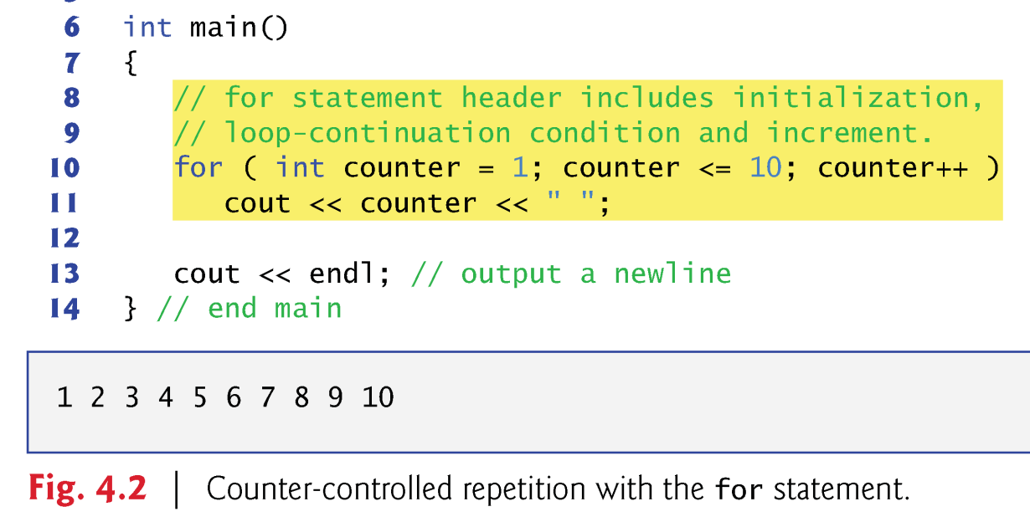
For

Slide 6
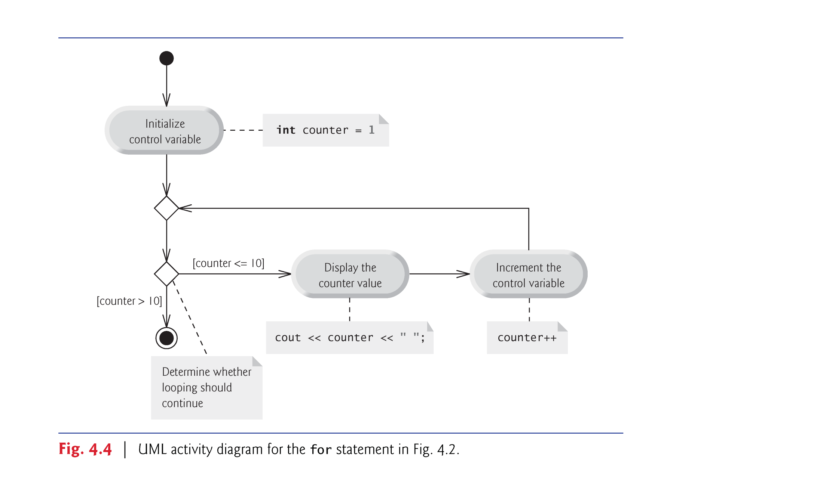
For

Slide 7
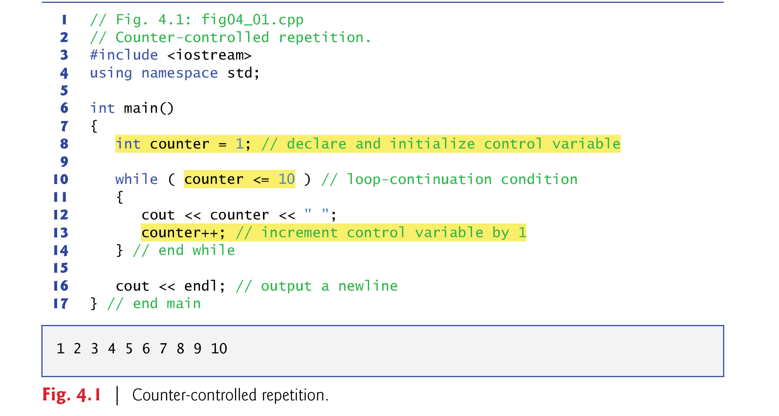
while

Slide 8
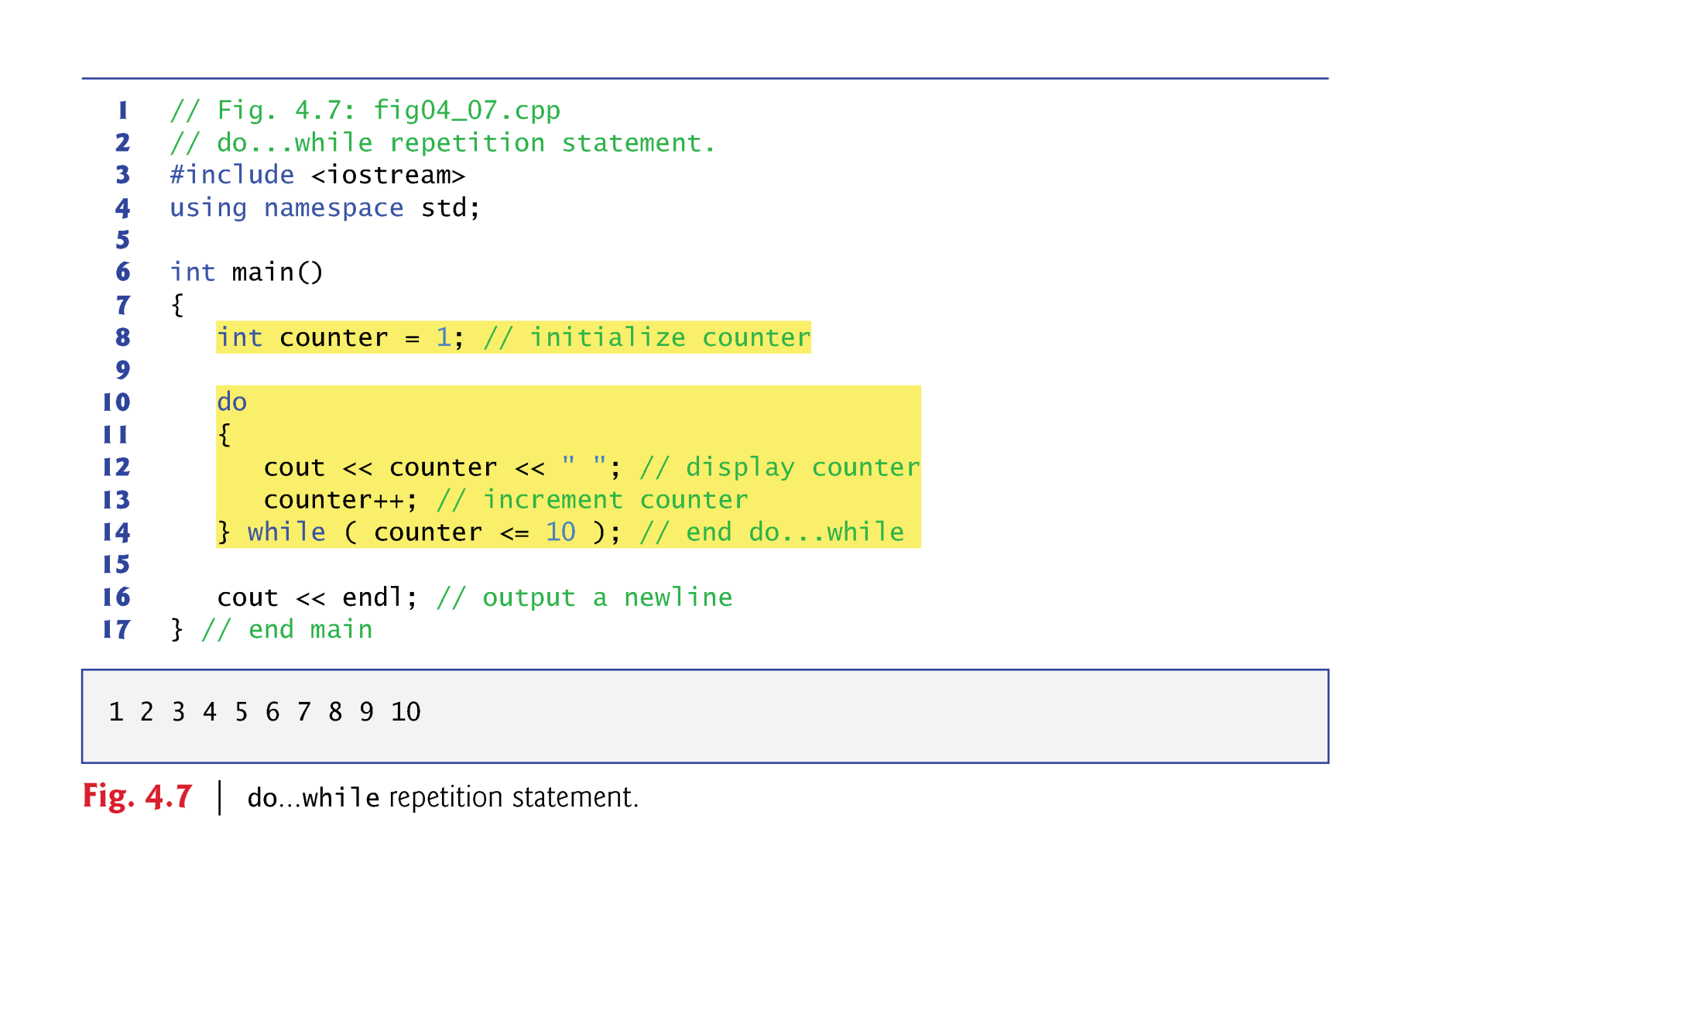
Do while

Slide 9
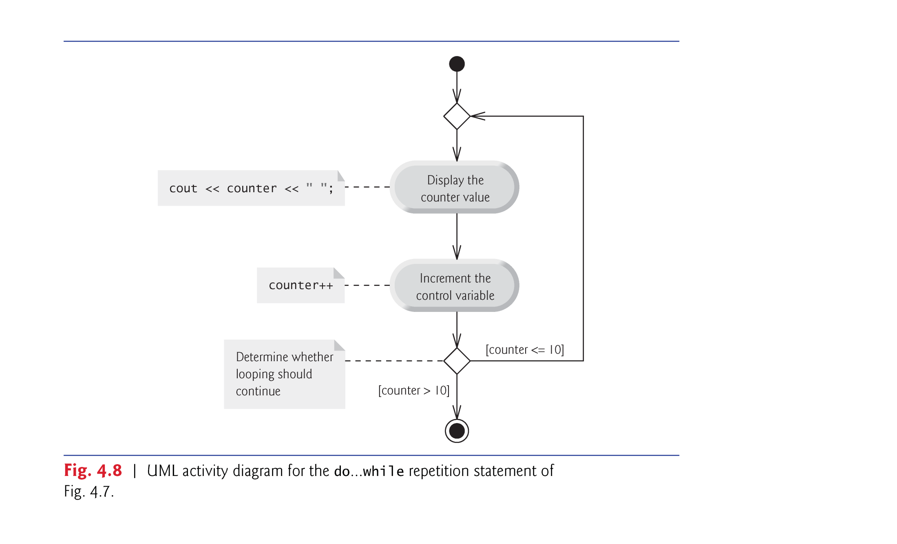
Do while

Slide 10
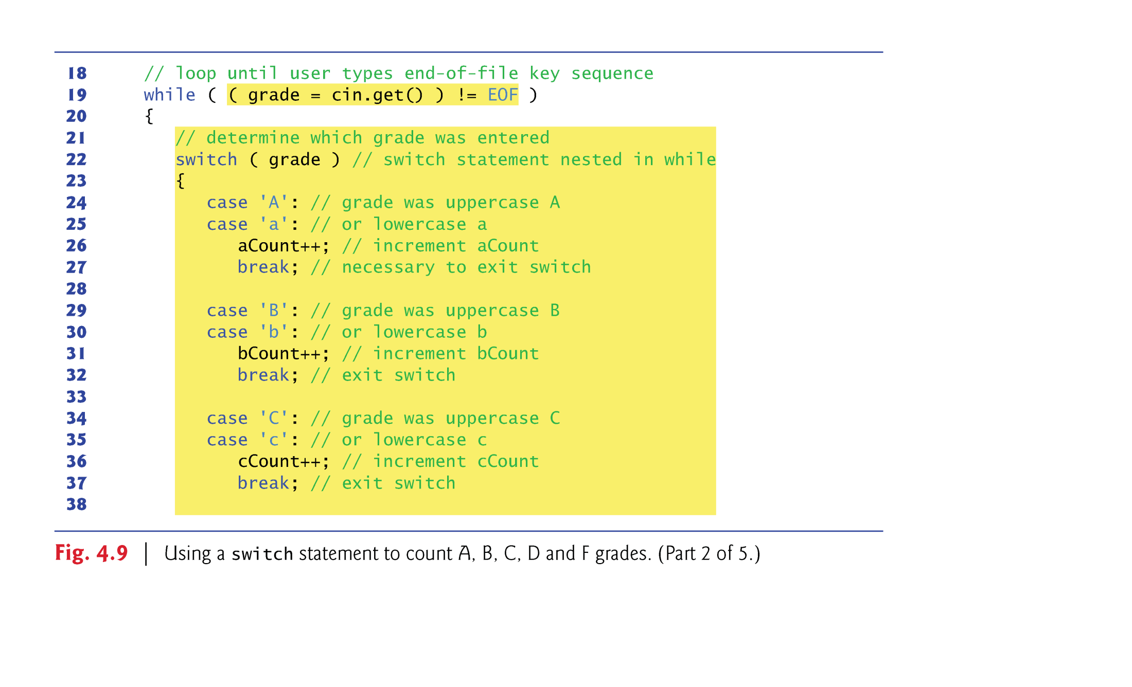
switch

Slide 11
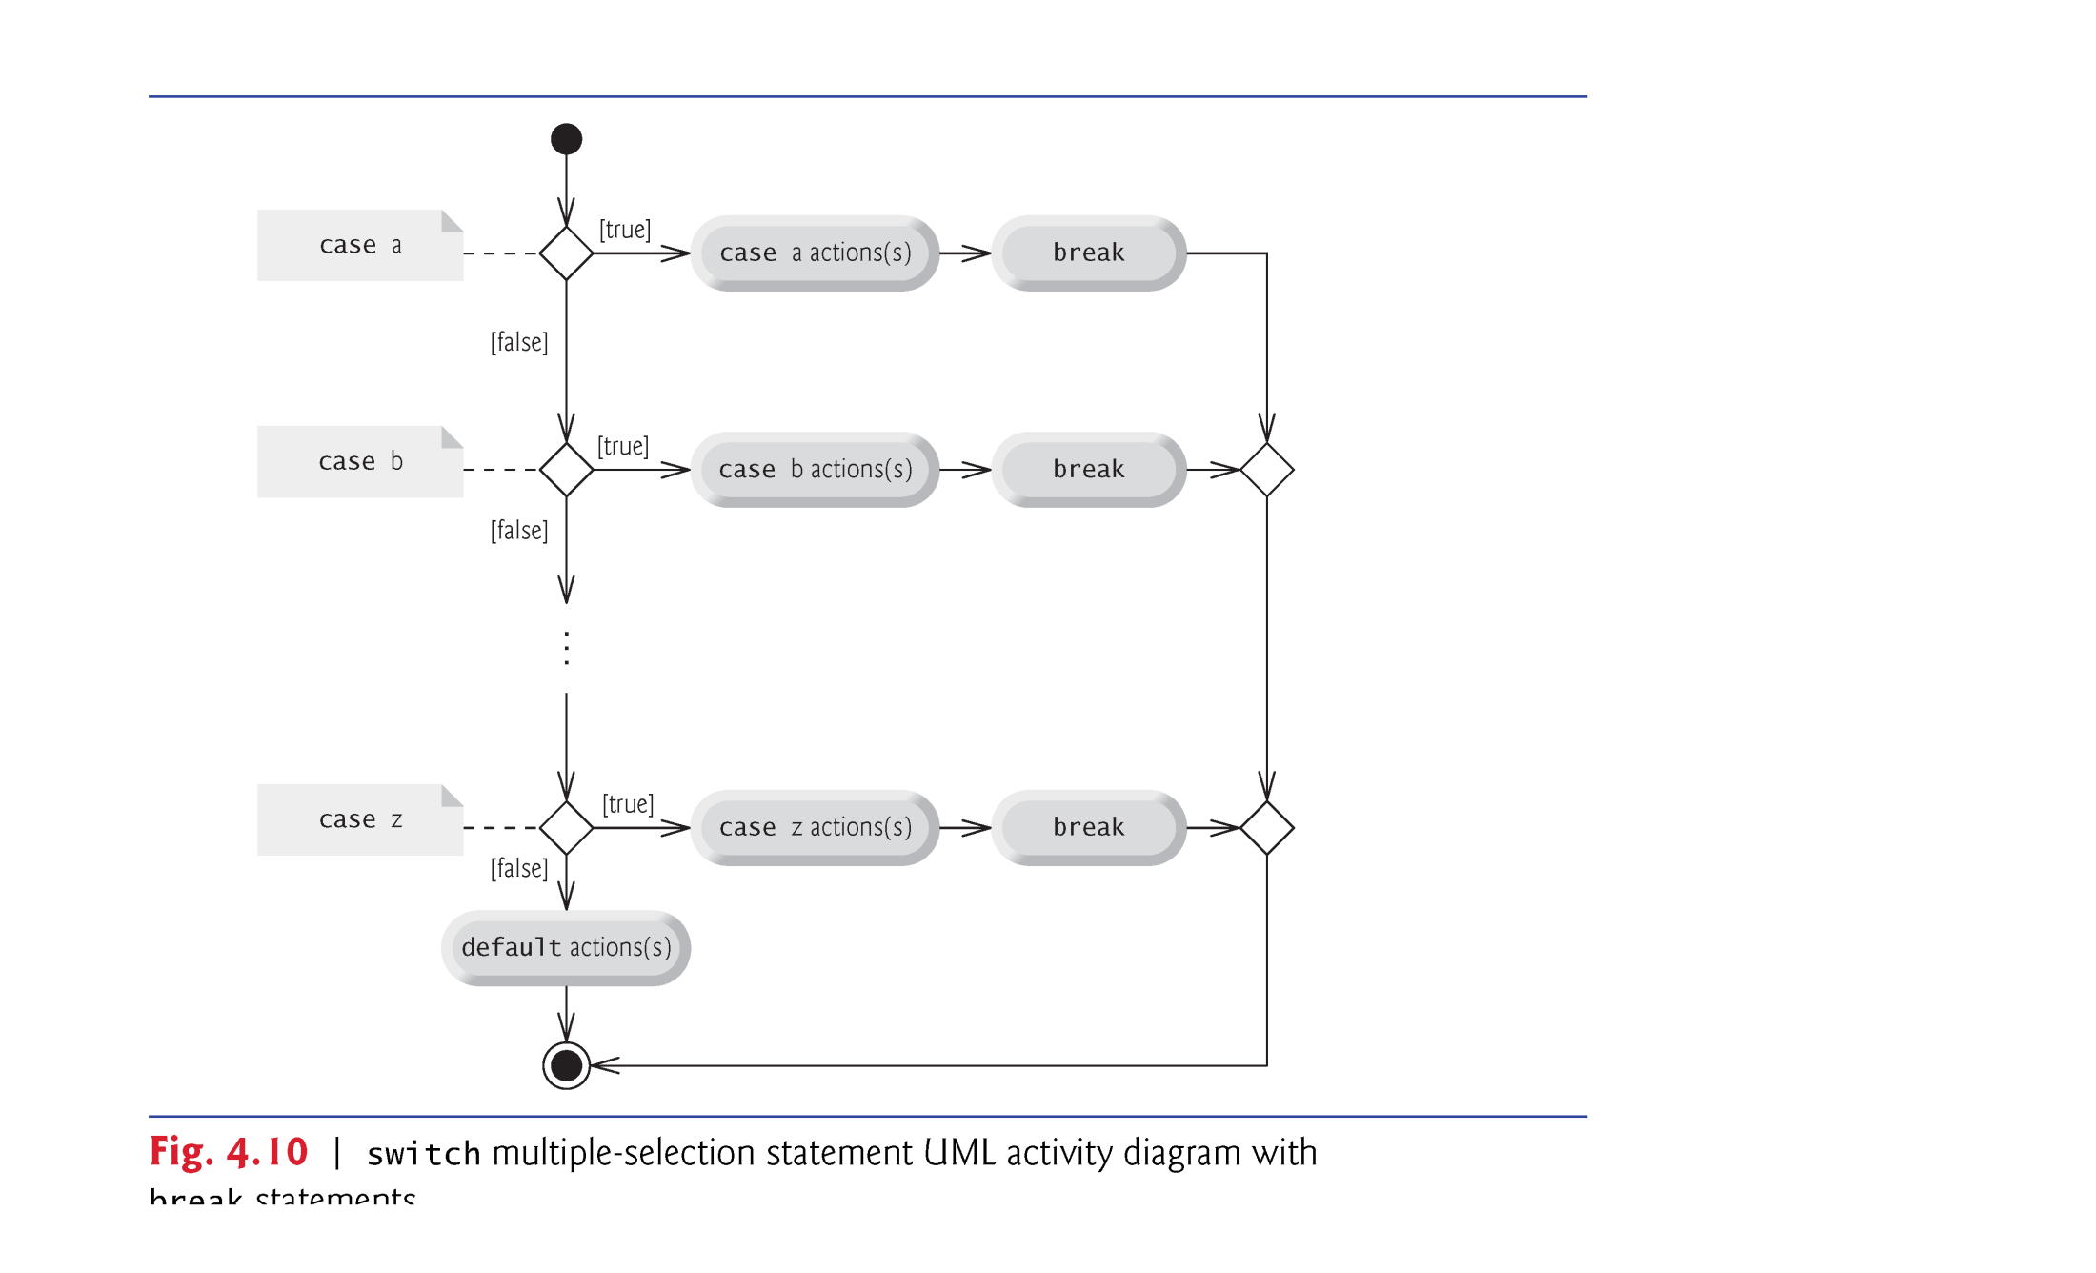
switch

Slide 12
Continue & break
Break
Jump out the current loop
Jump out the switch
Continue
Skip current iteration and execute next time

Slide 13
Logical Operator
&& and
|| or
! not

Slide 14
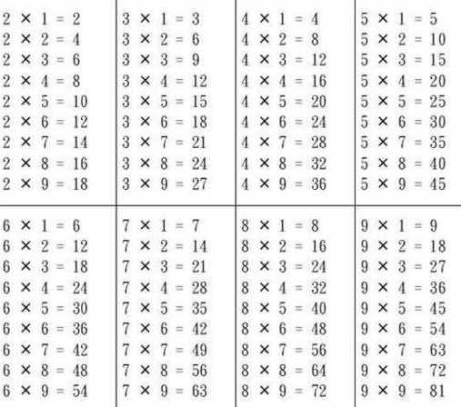
Practise
Please complete 9*9 multiplication table

Slide 15
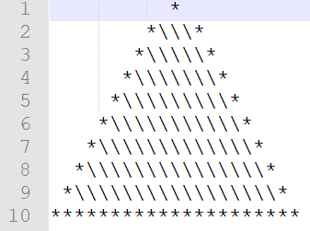
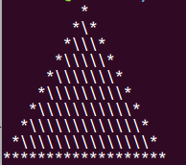
Homework
Please write a code to complete the image
10 layer pyramid

