Slide 1
Function
Week 5

Slide 2
Function
Also called subprogram, method.
Some code need to use again and again.
Define a function to save a lot of work.

Slide 3
Define a function in C++
Define Prototype
int square( int );
int main(){
cout << square(2) << endl;
return 0;
}
int square(int num){
return num*num;
}
Call the function
Define Body

Slide 4
Repeat Input
int main(){
int num;
while(cin >> num){
cout << num << endl;
}
cout << “End of Program.";
return 0;
}

Slide 5
Explain
cin return back true to “while” after cin got something and put into variable.
cin return back false to “while” after cin got EOF.
EOF means “End Of File” which is used to mention the program that no more input.
For Windows input “Ctrl+Z” then press enter to input EOF in cmd.exe
For Linux or MacOS press “Ctrl+D” to input EOF in terminal.

Slide 6
Exercise #3 Find Fibonacci and Factorial
Look at the Document Uploaded to LMS.

Slide 7
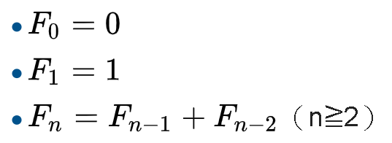
Fibonacci
0, 1, 1, 2, 3, 5, 8, 13, 21………

Slide 8
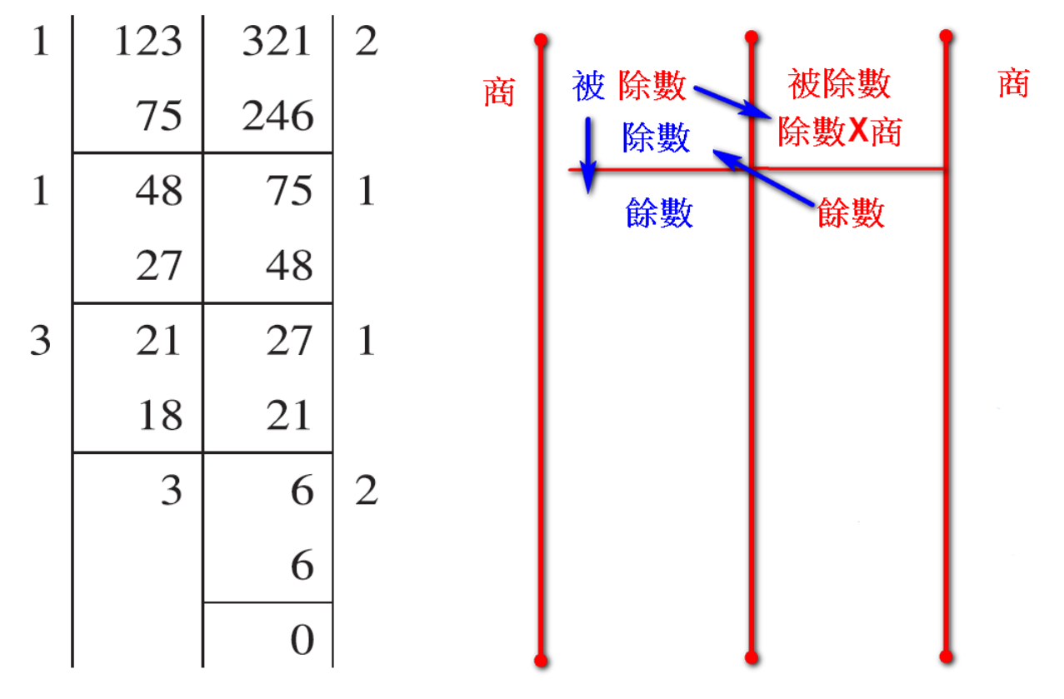
Euclidean algorithm

