Slide 1
Type, enum, random
2018/10/19

Slide 2
Type (signed)
Type | Size | Typical Range
char | 1 byte | -128～127
short (int) | 2 bytes | -32768～32767
int | 4 bytes | -2147483648～2147483647
long (int) | 4 bytes | -2147483648～2147483647
long long (int) | 8 bytes | -9223372036854775808 ～9223372036854775807

Slide 3
Type (unsigned)
Type | Size | Typical Range
unsigned char | 1 byte | 0～255
unsigned short (int) | 2 bytes | 0～65535
unsigned int | 4 bytes | 0～4294967295
unsigned long (int) | 4 bytes | 0～4294967295
unsigned long long (int) | 8 bytes | 0 ～18446744073709511615

Slide 4
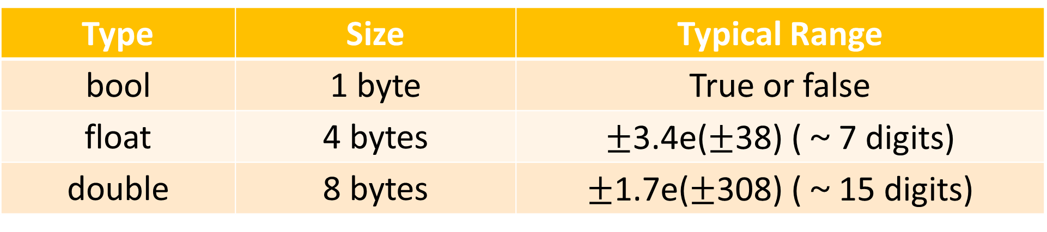
Type (others)
Type | Size | Typical Range
bool | 1 byte | True or false
float | 4 bytes | $±$3.4e($±$38) (～7 digits)
double | 8 bytes | $±$1.7e($±$308) (～15 digits)
Reference:
https://www.tutorialspoint.com/cplusplus/cpp_data_types.htm
https://msdn.microsoft.com/zh-tw/library/s3f49ktz.aspx

Slide 5

IEEE 754
float, double can present
inf $∞$
$−$inf $−∞$
NaN Not a number

Slide 6


Overflow (溢位)
The value that out of typical range of the type

Slide 7
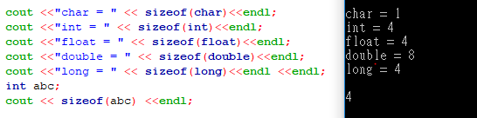
sizeof()
It will return the sizes of the fundamental type

Slide 8
enum (enumeration)
enum name{ enumerator1, enumerator2, enumerator3 ……… };
Each enumerator can also be named as you like, and you can assign the value to them
If you don’t give the value to enumerator, it will increase by degrees
The value of a enum variable can only be its enumerator

Slide 9
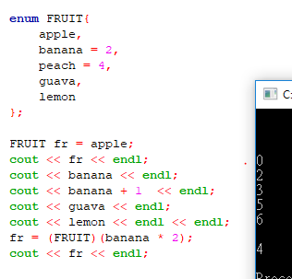

Slide 10

Invalid operation

Slide 11
random
#include <cstdlib> // random related function
rand() // this function will return a random int
RAND_MAX
//this variable is the maximum value which rand() can generate

Slide 12
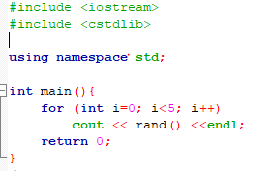
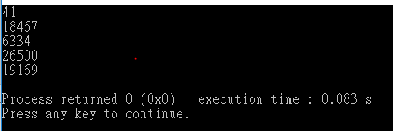
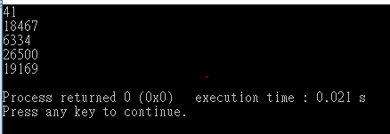
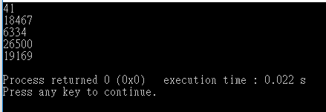

Slide 13
Why are the same?

Slide 14
Random is not actually random
It is just a complex calculation to reduce the number that looks like random
The calculation start with the seed of random
srand(unsigned int)
this function is used to set the seed of random as the argument which you put in, won’t return anything

Slide 15
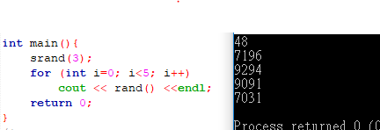
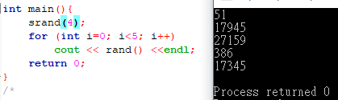

Slide 16
But it is tired to change the argument of srand() every time
We can use time() function to help us
#include <ctime> //time related function
time( NULL )
This function will return the seconds from 1970/1/1 00:00 to now
This function need argument, but it will be introduced in later chapters, you can just put NULL in it.

Slide 17
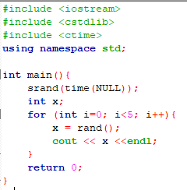
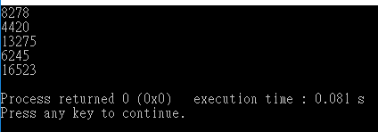
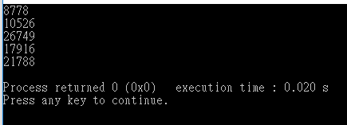
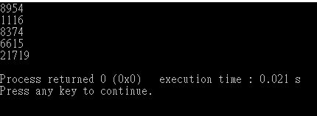
Combine random and time

Slide 18
The range of random
We can use mathematical operator (+-*/%) to get the random in certain range that we need

Slide 19
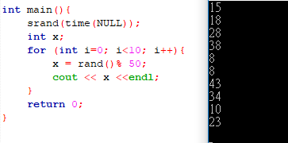
example
Ex1: integer in 0～49

Slide 20
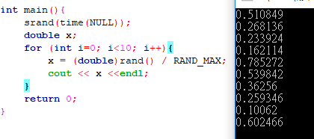
Ex2: float in 0～1

Slide 21
Exercise 4
Please check the file on the LMS

Slide 22
課程意見回饋
有想發表意見的歡迎填寫:D

