Slide 1
Call function & File

Slide 2
Call by value/ Pass by value
It only pass the copy of value to function
So what the function operate will not affect the original data.

Slide 3
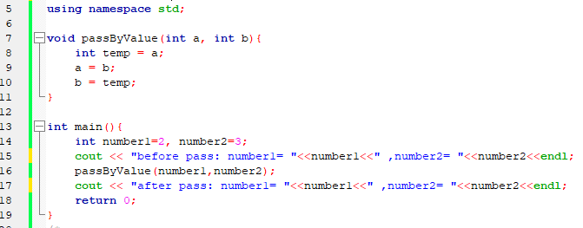
Call by value/ Pass by value

Slide 4
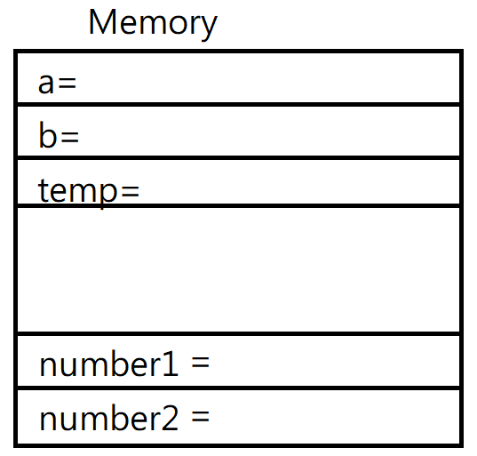

2
3
3
2
2
2
3
Output
before pass: number1= 2 ,number2= 3
after pass: number1= 2 ,number2= 3

Slide 5
Call by address/ Pass by address
It pass the address to function
So the object that function operate is the data of address
When we use a function with an array as parameter, it pass the address of array, so it’s pass by reference.

Slide 6
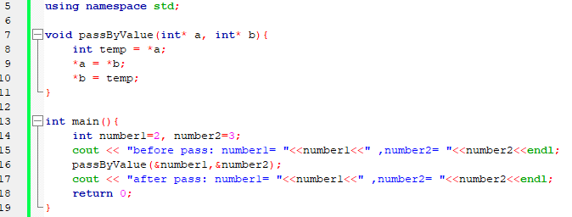
Call by address/ Pass by address

Slide 7
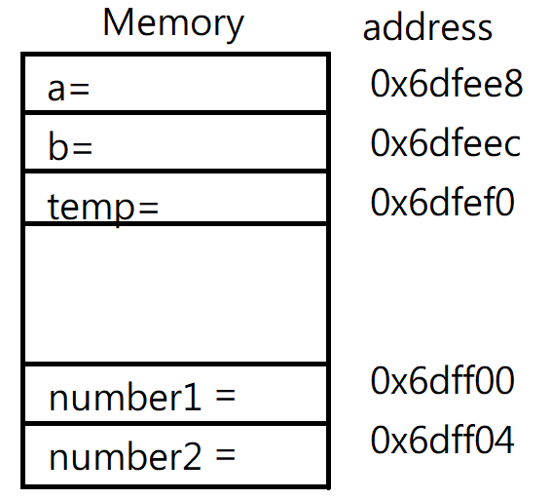

0x6dff00
0x6dff04
2
*a
*a
*b
*b
2
3
2
3
Output
before pass: number1= 2 ,number2= 3
after pass: number1= 3 ,number2= 2

Slide 8
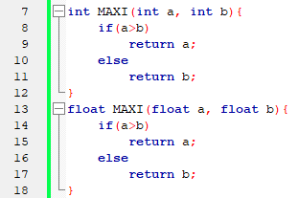
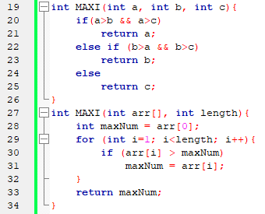
overloading
Several functions have the same function name, but different parameters (including type and length).
1
3
2
4

Slide 9
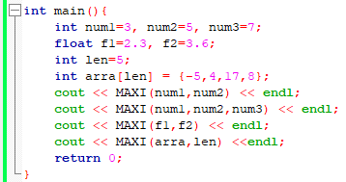
1
//5
//7
//3.6
//17
3
2
4

Slide 10





Slide 11
File
The related function of file is in the fstream library
#include <fstream> //file stream
Output file type : ofstream
Input file type : ifstream
P.S: exit(1) in the following code is in cstdlib library, it will terminate the program

Slide 12
operator
Use << to output the data to file. (like cout)
Use >> to input the data from file. (like cin)

Slide 13
ifstream
ifstream variable_name(“file_name”, open_mode);
or
ifstream variabl_name;
variable_name.open(“file_name”, open_mode);
open_mode means what the file will be used for.
ifstream default the open_mode as ios::in, and it can be ignored.

Slide 14
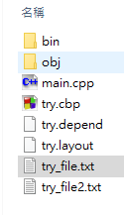
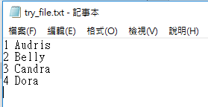
example

Slide 15
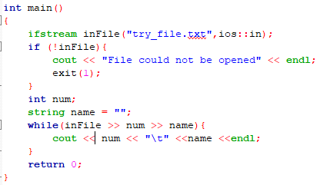
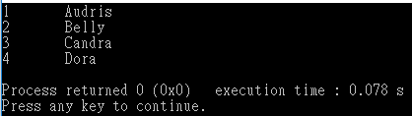

Slide 16
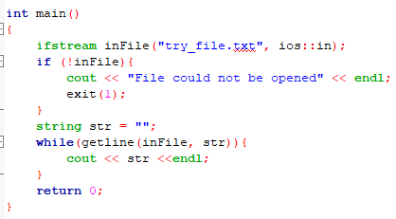
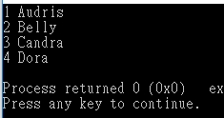
Of course you can use getline.

Slide 17
ofstream
ofstream variable_name(“file_name”, open_mode);
or
ofstream variable_name;
variable_name.open(“file_name”, open_mode);
If the file does not exist, the system will create a new file with the file name that you named.
ofstream default the open_mode as ios::out, and it can be ignored

Slide 18
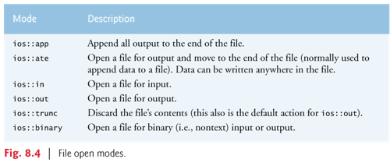
Be careful!
ios::out will clear all the content of the file and append you data.
ios::app will append your data at the end of the file without clear file.

Slide 19
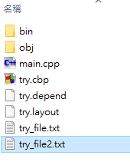
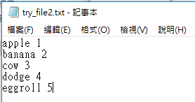
example

Slide 20
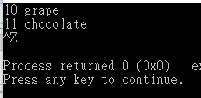
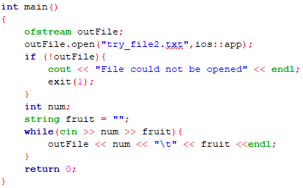
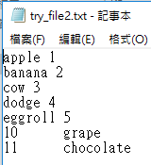

Slide 21
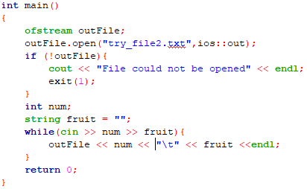
Watch out!!

Slide 22
Exercise
Try to write an overloading function to append element to an array.

Slide 23
~Feedback~

