Slide 1
Class

Slide 2
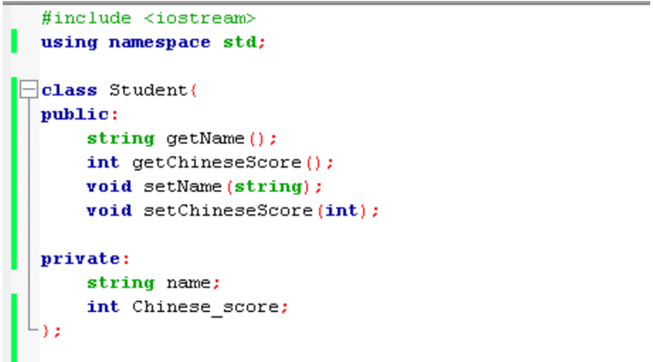
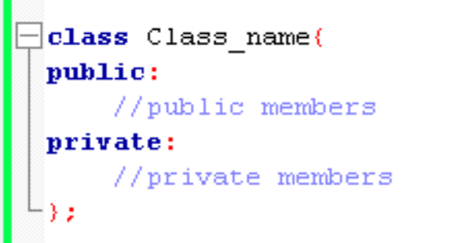
Class
Data Members
class
Member Functions

Slide 3
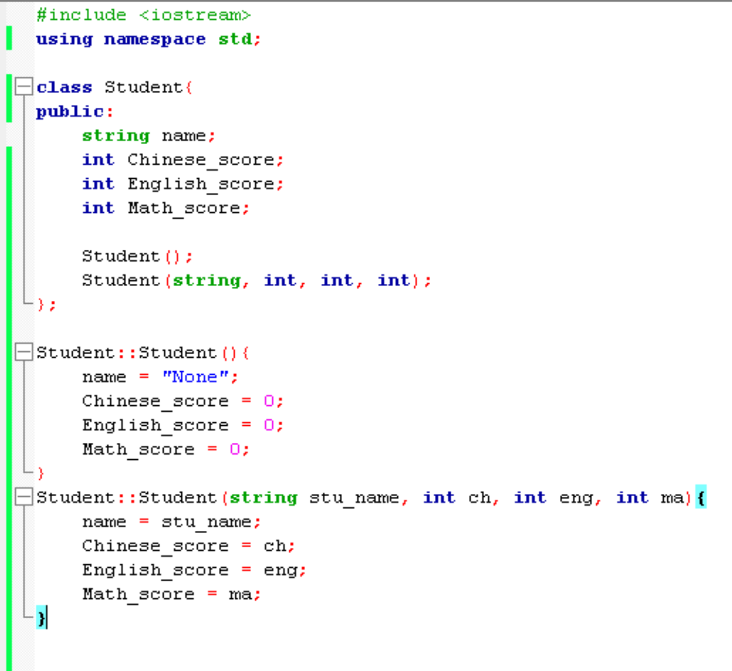
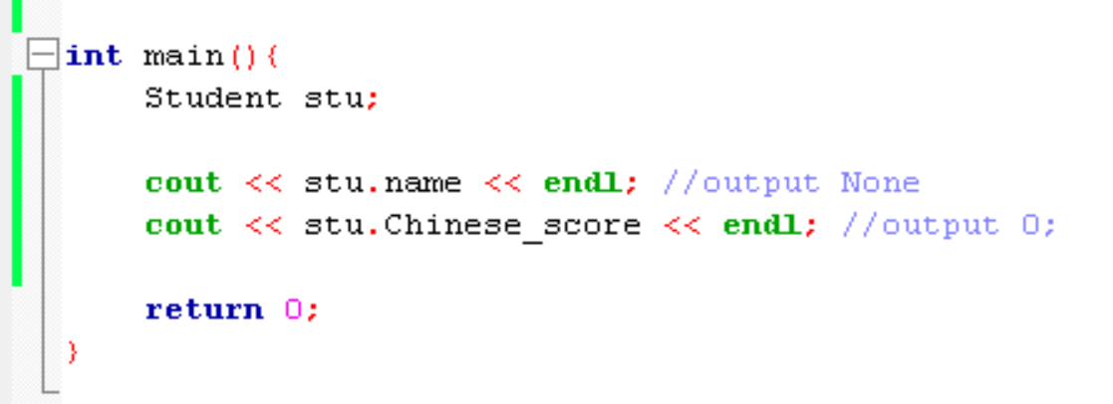
Object
The variable which created by the class is so called Object

Slide 4
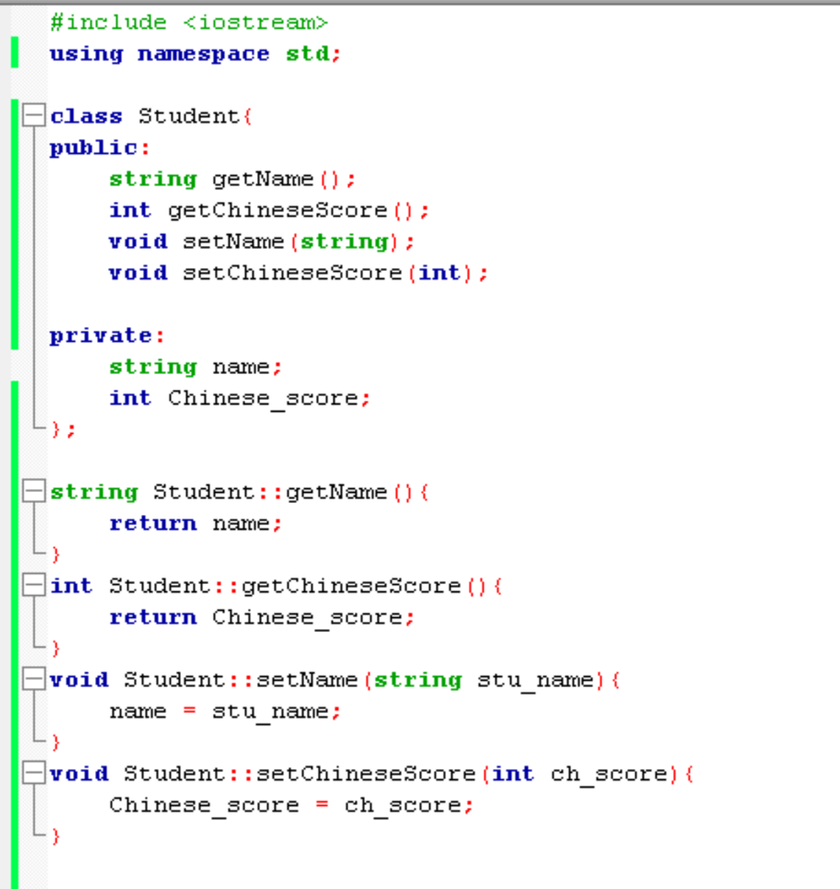
Class scope resolution operator ( :: )
類別範圍解析運算子
You have to assign the member functions to the class you implement
Class_name :: function_name(){
//…
}

Slide 5
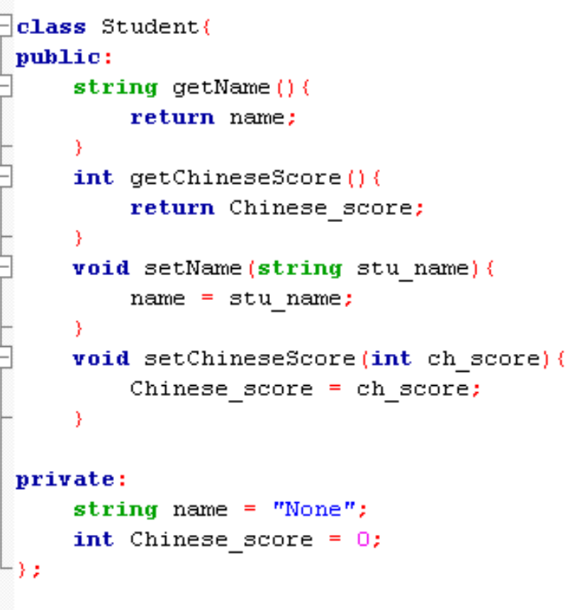
Members
You can also write like this…

Slide 6
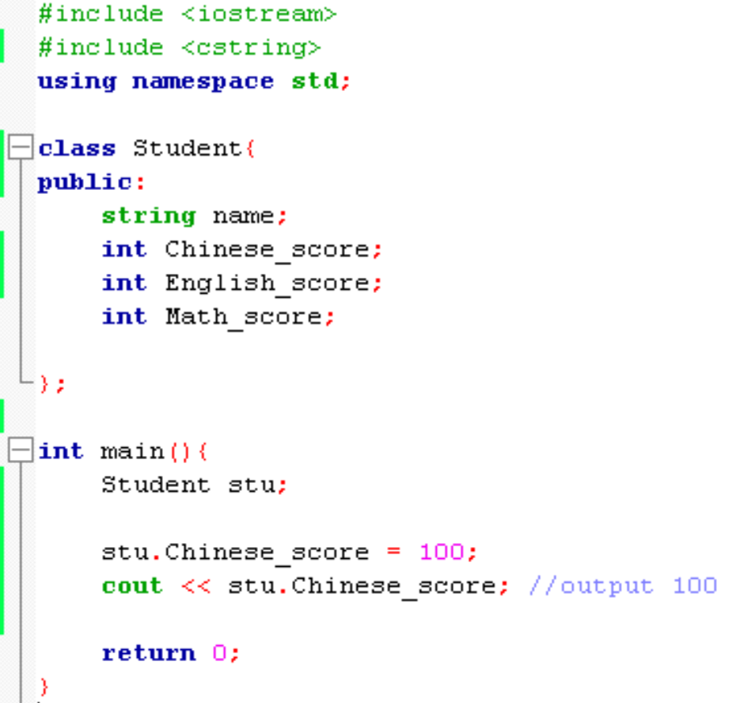
. operator
You can use . operator to access public members
Use Chinese_score variable in Student class

Slide 7
constructor
It’s used to initialize an object.
It doesn’t have return value.
Constructor name is same as Class name.

Slide 8
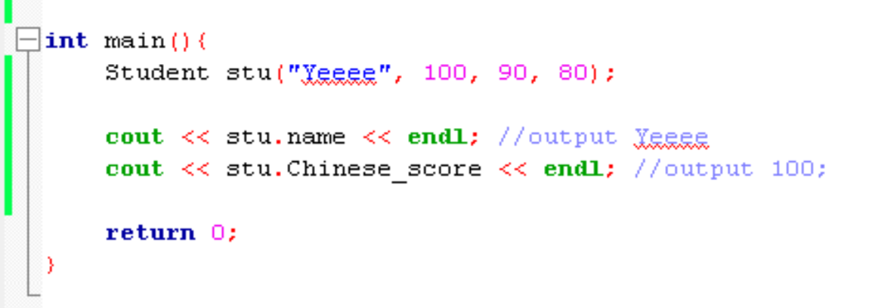
constructor

Slide 9
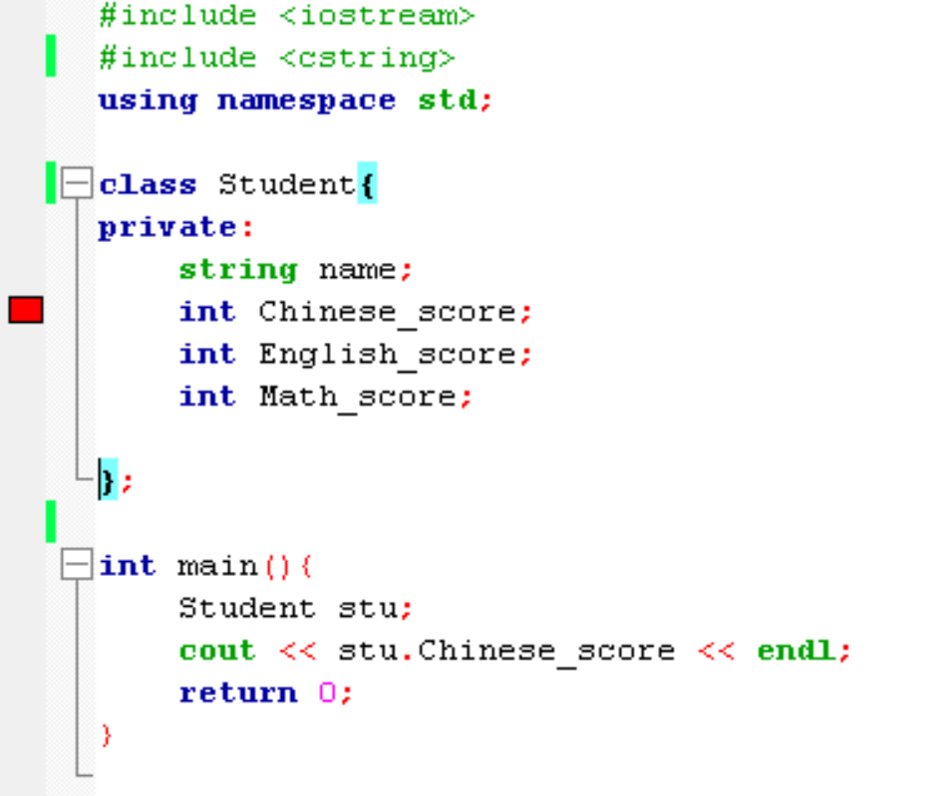
public & private
Error, because Chinese_score is private,
You cannot call it outside the class.
You can use Chinese_score by ‘stu’ object

Slide 10
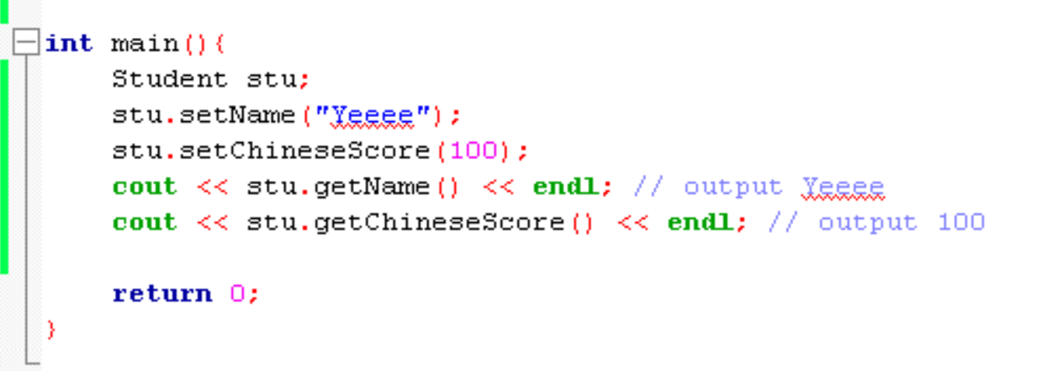
How to access private members
You can use public functions to access private members

Slide 11
Exercise

