Slide 1
2018/12/13

Slide 2
Pointer
Code
Memory Addr | Value
0x0012FF78 | 0x0012FF84
0x0012FF7C | 39
0x0012FF80 | 67
0x0012FF84 | 2
void main(){
int a = 2;
int b = 67;
int d = 39;
int* ptr = &a;
…
}
從此位置連續寫入 4 個 byte
(因為 int 佔 4 個 byte)

Slide 3
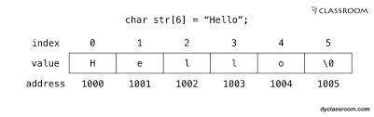
String
In c, a char pointer
char text[] = {'h', 'e', 'l', 'l', 'o', '\0'};
In c++, a class named string
Besides, c++ prodive many string function in string class
Implementation of character array is faster than std::string. Strings are slower when compared to implementation than character array.

Slide 4
Object
Object
(物件)
Properties
(屬性)
Methods
(方法)

Slide 5


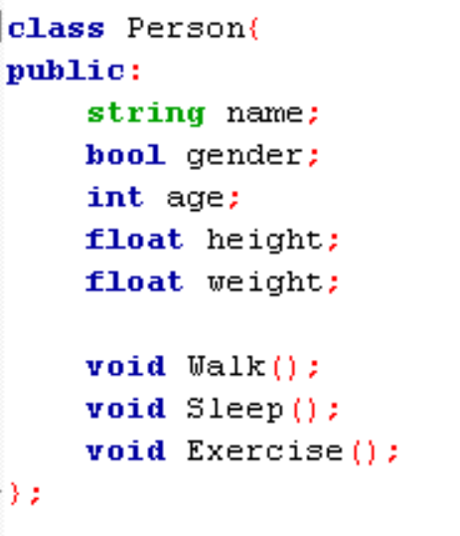
Object example: people
Each person is an object, so you can write like this
Properties:
Name : Wang
Height : 180
Weight : 60
Age : 20
Method:
Walk()
Sleep()
Exercise()
Properties:
Name : Lin
Height : 170
Weight : 50
Age : 18
Method:
Walk()
Sleep()
Exercise()

Slide 6
Object-oriented programming
Using Object to design program
The reason is
Encapsulation (封裝性)
Functions and data are inside objects.
Good way to protect data.
Inheritance (繼承性)
Children has parents’ properties.
Good for controlling lots of similar object.
Polymorphism (多型)
Same functions but in different objects.
Readable.
Animal
Walk()
int lag
Dog
Cat
Cow
Animal
Animal
Animal
Airplane
Fly()
Chicken
Fly()

Slide 7
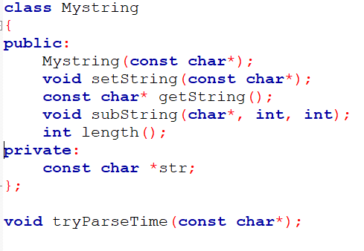
Class
Define the function and data member
Public:
Outside users can get/set any functions/data members directly
Private:
Outside users can’t do anything directly
get/set throw public function

Slide 8
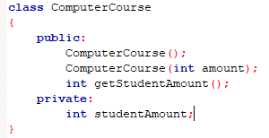
Define a class (XXXclass.h file)

Slide 9
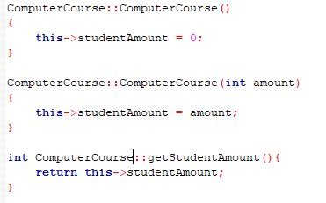
Implement a class (XXXclass.cpp file)

Slide 10
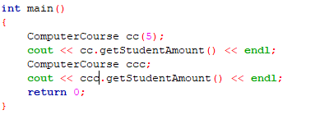
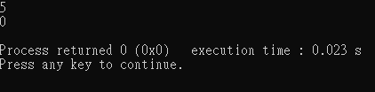
Usage a class

