Slide 1
Assembly Language for x86 Processors 7th Edition , Global Edition
Kip R. Irvine
Chapter 5: Procedures
Slides prepared by the author
Revision date: 1/15/2014
(c) Pearson Education, 2015. All rights reserved. You may modify and copy this slide show for your personal use, or for use in the classroom, as long as this copyright statement, the author's name, and the title are not changed.

Slide 2
Chapter Overview
Stack Operations
Defining and Using Procedures
Linking to an External Library
The Irvine32 Library
64-Bit Assembly Programming
Notes:
Defining and using Procedures -> call and return -> call and return instruction hyper link ok

Slide 3
Summary
Procedure – named block of executable code
Runtime stack – LIFO structure
holds return addresses, parameters, local variables
PUSH – add value to stack
POP – remove value from stack
Use the Irvine32 library for all standard I/O and data conversion
Want to learn more? Study the library source code in the c:\Irvine\Examples\Lib32 folder

Slide 4
55 64 67 61 6E 67 65 6E

Slide 5
Stack Operations
Runtime Stack
PUSH Operation
POP Operation
PUSH and POP Instructions
Using PUSH and POP
Example: Nested Loop
Example: Reversing a String
Related Instructions
Notes:
Example: Reversing a String 沒有說

Slide 6
Runtime Stack (1/3)
Imagine a stack of plates . . .
plates are only added to the top
plates are only removed from the top
Last In First Out (LIFO) structure
7
6
5
top
4
3
2
1
bottom

Slide 7
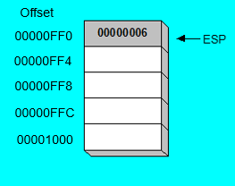

Runtime Stack (2/3)
Stack
Heap
Data
Code
Managed by the CPU, using two registers
SS (stack segment) (ignore for Flat Memory Model)
ESP (stack pointer) *
Code
Data
Heap
Stack
0000h
Low Addresses
Offset
00000FF0
Memory
00000FF4
00000FF8
00000FFC
00001000
00000006
High Addresses
Memory
FFFFh
* SP in Real-address mode

Slide 8
In real memory…
memeory
Offset
Low Addresses
0FFFh
00000FF0
1000h
06
ESP
00000FF4
1001h
00
00000FF8
1002h
00
00000FFC
1003h
00
00001000
00000006
1004h
High Addresses

Slide 9
Runtime Stack (3/3)
Low
Addresses
Stack
CPU
控制單元
(Control Unit)
Memory
Code
System bus
Data
算術邏輯單元 (ALU)
暫存器Register
Heap
Heap
Data
Code
ESP
Stack
EIP
High
Addresses

Slide 10
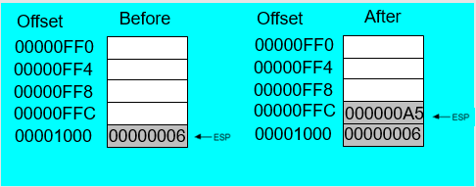
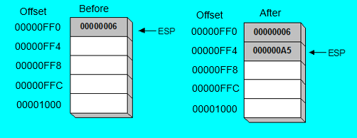
PUSH Operation (1 of 2)
A 32-bit push operation decrements the stack pointer by 4 and copies a value into the location pointed to by the stack pointer.
Offset
Before
Offset
After
00000FF0
00000FF0
00000FF4
00000FF4
00000FF8
00000FF8
00000FFC
00000FFC
000000A5
00001000
00000006
00001000
00000006

Slide 11
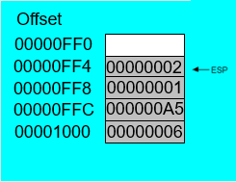
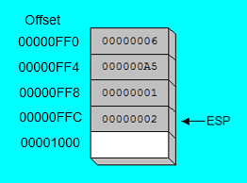
PUSH Operation (2 of 2)
Same stack after pushing two more integers:
Offset
Offset
After
00000FF0
00000FF0
00000FF4
00000002
00000FF4
00000FF8
00000001
00000FF8
00000FFC
000000A5
00000FFC
000000A5
00001000
00000006
00001000
00000006
The stack grows downward. The area below ESP is always available (unless the stack has overflowed).

Slide 12
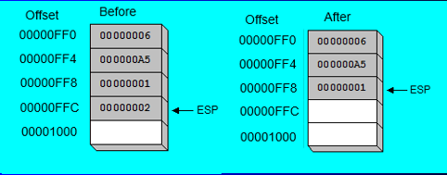
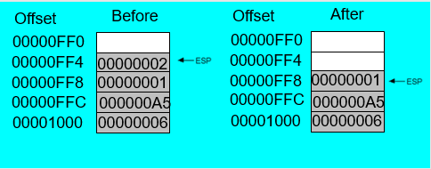
POP Operation
Copies value at stack[ESP] into a register or variable.
Adds n to ESP, where n is either 2 or 4.
value of n depends on the attribute of the operand receiving the data
Offset
Before
Offset
After
00000FF0
00000FF0
00000FF4
00000002
00000FF4
00000FF8
00000001
00000FF8
00000001
00000FFC
000000A5
00000FFC
000000A5
00001000
00000006
00001000
00000006

Slide 13
PUSH and POP Instructions
PUSH syntax:
PUSH r/m16
PUSH r/m32
PUSH imm32
POP syntax:
POP r/m16
POP r/m32

Slide 14
Using PUSH and POP
Save and restore registers when they contain important values. PUSH and POP instructions occur in the opposite order.
; DumpMem will use esi,
ecx, ebx
push esi ; push registers
push ecx
push ebx
mov esi,OFFSET dwordVal ; display some memory
mov ecx,LENGTHOF dwordVal
mov ebx,TYPE dwordVal
call DumpMem
pop ebx ; restore registers
pop ecx
pop esi

Slide 15
Example: Nested Loop
Compare to Chapter.4: Nested Loop
When creating a nested loop, push the outer loop counter before entering the inner loop:
mov ecx,100 ; set outer loop count
L1: ; begin the outer loop
push ecx ; save outer loop count
mov ecx,20 ; set inner loop count
L2: ; begin the inner loop
;
;
loop L2 ; repeat the inner loop
pop ecx ; restore outer loop count
loop L1 ; repeat the outer loop

Slide 16
Nested Loop (Older version – Ch.4)
If you need to code a loop within a loop, you must save the outer loop counter's ECX value. In the following example, the outer loop executes 100 times, and the inner loop 20 times.
.data
count DWORD ?
.code
mov ecx,100 ; set outer loop count
L1:
mov count,ecx ; save outer loop count
mov ecx,20 ; set inner loop count
L2: .
.
loop L2 ; repeat the inner loop
mov ecx,count ; restore outer loop count
loop L1 ; repeat the outer loop

Slide 17
Example: Reversing a String
Use a loop with indexed addressing
Push each character on the stack
Start at the beginning of the string, pop the stack in reverse order, insert each character back into the string
Source code
Q: Why must each character be put in EAX before it is pushed?
Because only word (16-bit) or doubleword (32-bit) values can be pushed on the stack.

Slide 18
Your turn . . .
Using the String Reverse program as a starting point,
#1: Modify the program so the user can input a string containing between 1 and 50 characters.
#2: Modify the program so it inputs a list of 32-bit integers from the user, and then displays the integers in reverse order.

Slide 19
Related Instructions
PUSHFD and POPFD
push and pop the EFLAGS register
PUSHAD pushes the 32-bit general-purpose registers on the stack
order: EAX, ECX, EDX, EBX, ESP, EBP, ESI, EDI
POPAD pops the same registers off the stack in reverse order
PUSHA and POPA do the same for 16-bit registers

Slide 20
Your Turn . . .
Write a program that does the following:
Assigns integer values to EAX, EBX, ECX, EDX, ESI, and EDI
Uses PUSHAD to push the general-purpose registers on the stack
Using a loop, your program should pop each integer from the stack and display it on the screen

Slide 21
What's Next
Stack Operations
Defining and Using Procedures
Linking to an External Library
The Irvine32 Library
64-Bit Assembly Programming

Slide 22
Defining and Using Procedures
Creating Procedures
Documenting Procedures
Example: SumOf Procedure
CALL and RET Instructions
Nested Procedure Calls
Local and Global Labels
Procedure Parameters
USES Operator
USES Example

Slide 23
Creating Procedures
Large problems can be divided into smaller tasks to make them more manageable
A procedure is the ASM equivalent of a Java or C++ function
Following is an assembly language procedure named sample:
sample PROC
.
.
ret
sample ENDP

Slide 24
Documenting Procedures
Suggested documentation for each procedure:
A description of all tasks accomplished by the procedure.
Receives: A list of input parameters; state their usage and requirements.
Returns: A description of values returned by the procedure.
Requires: Optional list of requirements called preconditions that must be satisfied before the procedure is called.
If a procedure is called without its preconditions satisfied, it will probably not produce the expected output.

Slide 25
Example: SumOf Procedure
;---------------------------------------------------------
SumOf PROC
;
; Calculates and returns the sum of three 32-bit integers.
; Receives: EAX, EBX, ECX, the three integers. May be
; signed or unsigned.
; Returns: EAX = sum, and the status flags (Carry,
; Overflow, etc.) are changed.
; Requires: nothing
;---------------------------------------------------------
add eax,ebx
add eax,ecx
ret
SumOf ENDP

Slide 26
CALL and RET Instructions
The CALL instruction calls a procedure
pushes offset of next instruction on the stack
copies the address of the called procedure into EIP
The RET instruction returns from a procedure
pops top of stack into EIP

Slide 27
CALL-RET Example (1 of 3)
main PROC
00000020 call MySub
00000025 mov eax,ebx
.
.
main ENDP
MySub PROC
00000040 mov eax,edx
.
.
ret
MySub ENDP
0000025 is the offset of the instruction immediately following the CALL instruction
00000040 is the offset of the first instruction inside MySub

Slide 28
CALL-RET Example (2 of 3)
Stack
EIP
00000020 00000025 00000040 | main PROC call MySub mov eax,ebx . . main ENDP MySub PROC mov eax,edx . . ret MySub ENDP
00000001
00000025
00000040
00000025
ESP
The CALL instruction pushes 00000025 onto the stack, and loads 00000040 into EIP

Slide 29
CALL-RET Example (3 of 3)
Stack
EIP
00000020 00000025 00000040 | main PROC call MySub mov eax,ebx . . main ENDP MySub PROC mov eax,edx . . ret MySub ENDP
00000001
00000040
00000025
00000025
ESP
The RET instruction pops 00000025 from the stack into EIP

Slide 30
Nested Procedure Calls
By the time Sub3 is called, the stack contains all three return addresses:
(ret to Sub2)
(ret to Sub1)
(ret to main)

Slide 31
Local and Global Labels
A local label is visible only to statements inside the same procedure. A global label is visible everywhere.
main PROC
jmp L2 ; error
L1:: ; global label
exit
main ENDP
sub2 PROC
L2: ; local label
jmp L1 ; ok
ret
sub2 ENDP

Slide 32
Procedure Parameters (1 of 3)
A good procedure might be usable in many different programs
but not if it refers to specific variable names
Parameters help to make procedures flexible because parameter values can change at runtime

Slide 33
Procedure Parameters (2 of 3)
The ArraySum procedure calculates the sum of an array. It makes two references to specific variable names:
ArraySum PROC
mov esi,0 ; array index
mov eax,0 ; set the sum to zero
mov ecx,LENGTHOF myarray ; set number of elements
L1: add eax,myArray[esi] ; add each integer to sum
add esi,4 ; point to next integer
loop L1 ; repeat for array size
mov theSum,eax ; store the sum
ret
ArraySum ENDP
What if you wanted to calculate the sum of two or three arrays within the same program?

Slide 34
Procedure Parameters (3 of 3)
This version of ArraySum returns the sum of any doubleword array whose address is in ESI. The sum is returned in EAX:
ArraySum PROC
; Receives: ESI points to an array of doublewords,
; ECX = number of array elements.
; Returns: EAX = sum
;-----------------------------------------------------
mov eax,0 ; set the sum to zero
L1: add eax,[esi] ; add each integer to sum
add esi,4 ; point to next integer
loop L1 ; repeat for array size
ret
ArraySum ENDP

Slide 35
USES Operator
Lists the registers that will be preserved
ArraySum PROC USES esi ecx
mov eax,0 ; set the sum to zero
etc.
MASM generates the code shown in gold:
ArraySum PROC
push esi
push ecx
.
.
pop ecx
pop esi
ret
ArraySum ENDP

Slide 36
USES Example (1/4)
main PROC
call MySub
exit
main ENDP
MySub PROC USES eax
mov eax, edx
ret
MySub ENDP
main PROC
call MySub
exit
main ENDP
MySub PROC
mov eax, edx
ret
MySub ENDP
Values of registers before calling MySub:
EAX | 0000000A | EBX | 7EF00000 | ECX | 00000000 | EDX | 00401065
ESI | 00000000 | EDI | 00000000 | EBP | 0018FF94 | ESP | 0018FF8C
Notes:
和沒有使用USES的比較

Slide 37
USES Example (2/4)
MySub PROC USES eax
mov eax, edx
ret
MySub ENDP
MySub PROC
mov eax, edx
ret
MySub ENDP
Values of registers:
Values of registers:
EAX | 0000000A | ESI | 00000000
EBX | 7EF00000 | EDI | 00000000
ECX | 00000000 | EBP | 0018FF94
EDX | 00401065 | ESP | 0018FF84
EAX | 0000000A | ESI | 00000000
EBX | 7EF00000 | EDI | 00000000
ECX | 00000000 | EBP | 0018FF94
EDX | 00401065 | ESP | 0018FF88
Stack Memory:
Stack Memory:
0018FF84 | 0000000A
0018FF88 | 00401078
0018FF8C | 00756D33
0018FF84 | ?
0018FF88 | 00401078
0018FF8C | 00756D33
Return
Address
Notes:
進入到MySub後，未執行任何指令

Slide 38
USES Example (3/4)
MySub PROC USES eax
mov eax, edx
ret
MySub ENDP
MySub PROC
mov eax, edx
ret
MySub ENDP
Values of registers:
Values of registers:
EAX | 00401065 | ESI | 00000000
EBX | 7EF00000 | EDI | 00000000
ECX | 00000000 | EBP | 0018FF94
EDX | 00401065 | ESP | 0018FF84
EAX | 00401065 | ESI | 00000000
EBX | 7EF00000 | EDI | 00000000
ECX | 00000000 | EBP | 0018FF94
EDX | 00401065 | ESP | 0018FF88
Stack Memory:
Stack Memory:
0018FF84 | 0000000A
0018FF88 | 00401078
0018FF8C | 00756D33
0018FF84 | ?
0018FF88 | 00401078
0018FF8C | 00756D33
Notes:
進入到MySub後，未執行任何指令

Slide 39
USES Example (4/4)
main PROC
call MySub
exit
main ENDP
main PROC
call MySub
exit
main ENDP
Values of registers:
Values of registers:
EAX | 0000000A | ESI | 00000000
EBX | 7EF00000 | EDI | 00000000
ECX | 00000000 | EBP | 0018FF94
EDX | 00401065 | ESP | 0018FF8C
EAX | 00401065 | ESI | 00000000
EBX | 7EF00000 | EDI | 00000000
ECX | 00000000 | EBP | 0018FF94
EDX | 00401065 | ESP | 0018FF8C
Stack Memory:
Stack Memory:
0018FF84 | ?
0018FF88 | ?
0018FF8C | 00756D33
0018FF84 | ?
0018FF88 | ?
0018FF8C | 00756D33
Notes:
進入到MySub後，未執行任何指令

Slide 40
When not to push a register
The sum of the three registers is stored in EAX on line (3), but the POP instruction replaces it with the starting value of EAX on line (4):
SumOf PROC ; sum of three integers
push eax ; 1
add eax,ebx ; 2
add eax,ecx ; 3
pop eax ; 4
ret
SumOf ENDP

Slide 41
What's Next
Stack Operations
Defining and Using Procedures
Linking to an External Library
The Irvine32 Library
64-Bit Assembly Programming

Slide 42
Linking to an External Library
What is a Link Library?
How the Linker Works

Slide 43
What is a Link Library?
A file containing procedures that have been compiled into machine code
constructed from one or more OBJ files
To build a library, . . .
start with one or more ASM source files
assemble each into an OBJ file
create an empty library file (extension .LIB)
add the OBJ file(s) to the library file, using the Microsoft LIB utility

Slide 44
How The Linker Works
Your programs link to Irvine32.lib using the linker command inside a batch file named make32.bat.
Notice the two LIB files: Irvine32.lib, and kernel32.lib
the latter is part of the Microsoft Win32 Software Development Kit (SDK)

Slide 45
What's Next
Stack Operations
Defining and Using Procedures
Linking to an External Library
The Irvine32 Library
64-Bit Assembly Programming

Slide 46
The Irvine32 Library
Calling Irvine32 Library Procedures
Library Procedures – Overview
Six Examples

Slide 47
Calling Irvine32 Library Procedures
Call each procedure using the CALL instruction. Some procedures require input arguments. The INCLUDE directive copies in the procedure prototypes (declarations).
The following example displays "1234" on the console:
INCLUDE Irvine32.inc
.code
mov eax,1234h ; input argument
call WriteHex ; show hex number
call Crlf ; end of line

Slide 48
Library Procedures - Overview (1 of 5)
CloseFile – Closes an open disk file
Clrscr - Clears console, locates cursor at upper left corner
CreateOutputFile - Creates new disk file for writing in output mode
Crlf - Writes end of line sequence to standard output
Delay - Pauses program execution for n millisecond interval
DumpMem - Writes block of memory to standard output in hex
DumpRegs – Displays general-purpose registers and flags (hex)
GetCommandtail - Copies command-line args into array of bytes
GetDateTime – Gets the current date and time from the system
GetMaxXY - Gets number of cols, rows in console window buffer
GetMseconds - Returns milliseconds elapsed since midnight

Slide 49
Library Procedures - Overview (2 of 5)
GetTextColor - Returns active foreground and background text colors in the console window
Gotoxy - Locates cursor at row and column on the console
IsDigit - Sets Zero flag if AL contains ASCII code for decimal digit (0–9)
MsgBox, MsgBoxAsk – Display popup message boxes
OpenInputFile – Opens existing file for input
ParseDecimal32 – Converts unsigned integer string to binary
ParseInteger32 - Converts signed integer string to binary
Random32 - Generates 32-bit pseudorandom integer in the range 0 to FFFFFFFFh
Randomize - Seeds the random number generator
RandomRange - Generates a pseudorandom integer within a specified range
ReadChar - Reads a single character from standard input

Slide 50
Library Procedures - Overview (3 of 5)
ReadDec - Reads 32-bit unsigned decimal integer from keyboard
ReadFromFile – Reads input disk file into buffer
ReadHex - Reads 32-bit hexadecimal integer from keyboard
ReadInt - Reads 32-bit signed decimal integer from keyboard
ReadKey – Reads character from keyboard input buffer
ReadString - Reads string from stdin, terminated by [Enter]
SetTextColor - Sets foreground/background colors of all subsequent text output to the console
Str_compare – Compares two strings
Str_copy – Copies a source string to a destination string
Str_length – Returns the length of a string in EAX
Str_trim - Removes unwanted characters from a string.

Slide 51
Library Procedures - Overview (4 of 5)
Str_ucase - Converts a string to uppercase letters.
WaitMsg - Displays message, waits for Enter key to be pressed
WriteBin - Writes unsigned 32-bit integer in ASCII binary format.
WriteBinB – Writes binary integer in byte, word, or doubleword format
WriteChar - Writes a single character to standard output
WriteDec - Writes unsigned 32-bit integer in decimal format
WriteHex - Writes an unsigned 32-bit integer in hexadecimal format
WriteHexB – Writes byte, word, or doubleword in hexadecimal format
WriteInt - Writes signed 32-bit integer in decimal format

Slide 52
Library Procedures - Overview (5 of 5)
WriteStackFrame - Writes the current procedure’s stack frame to the console.
WriteStackFrameName - Writes the current procedure’s name and stack frame to the console.
WriteString - Writes null-terminated string to console window
WriteToFile - Writes buffer to output file
WriteWindowsMsg - Displays most recent error message generated by MS-Windows

Slide 53
Example 1
Clear the screen, delay the program for 500 milliseconds, and dump the registers and flags.
.code
call Clrscr
mov eax,500
call Delay
call DumpRegs

Slide 54
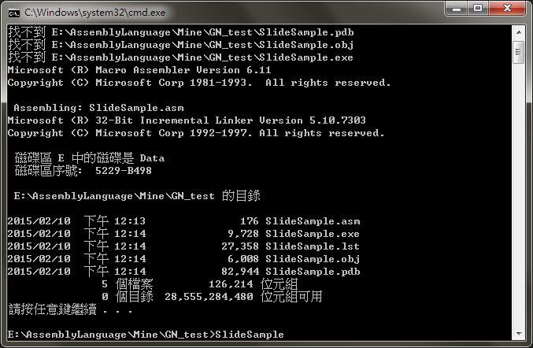
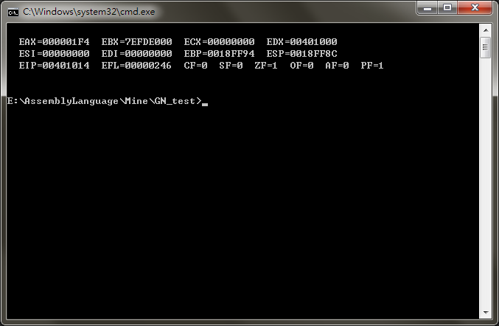
Example 1 - Sample Output

Slide 55
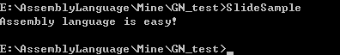
Example 2
Display a null-terminated string and move the cursor to the beginning of the next screen line.
.data
str1 BYTE "Assembly language is easy!",0
.code
mov edx,OFFSET str1
call WriteString
call Crlf
Sample output:

Slide 56
Example 2a
Display a null-terminated string and move the cursor to the beginning of the next screen line (use embedded CR/LF)
.data
str1 BYTE "Assembly language is easy!",0Dh,0Ah,0
.code
mov edx,OFFSET str1
call WriteString
Sample output:

Slide 57
Example 3
Display an unsigned integer in binary, decimal, and hexadecimal, each on a separate line.
IntVal = 35
.code
mov eax,IntVal
call WriteBin ; display binary
call Crlf
call WriteDec ; display decimal
call Crlf
call WriteHex ; display hexadecimal
call Crlf
Sample output:
0000 0000 0000 0000 0000 0000 0010 0011
35
23

Slide 58
Example 4
Input a string from the user. EDX points to the string and ECX specifies the maximum number of characters the user is permitted to enter.
.data
fileName BYTE 80 DUP(0)
.code
mov edx,OFFSET fileName
mov ecx,SIZEOF fileName – 1
call ReadString
A null byte is automatically appended to the string.

Slide 59
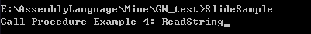
Example 4 - Sample Output

Slide 60
Example 5
Generate and display ten pseudorandom signed integers in the range 0 – 99. Pass each integer to WriteInt in EAX and display it on a separate line.
.code
mov ecx,10 ; loop counter
L1: mov eax,100 ; ceiling value
call RandomRange ; generate random int
call WriteInt ; display signed int
call Crlf ; goto next display line
loop L1 ; repeat loop

Slide 61
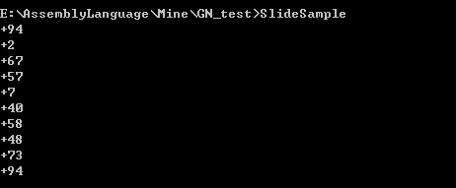
Example 5 - Sample Output

Slide 62
Example 6
Display a null-terminated string with yellow characters on a blue background.
.data
str1 BYTE "Color output is easy!",0
.code
mov eax,yellow + (blue * 16)
call SetTextColor
mov edx,OFFSET str1
call WriteString
call Crlf
The background color is multiplied by 16 before being added to the foreground color.

Slide 63
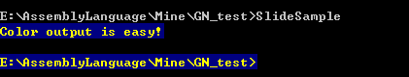
Example 6 - Sample Output

Slide 64
What's Next
Stack Operations
Defining and Using Procedures
Linking to an External Library
The Irvine32 Library
64-Bit Assembly Programming

Slide 65
64-Bit Assembly Programming
The Irvine64 Library
Calling 64-Bit Subroutines
The x64 Calling Convention

Slide 66
The Irvine64 Library
Crlf: Writes an end-of-line sequence to the console.
Random64: Generates a 64-bit pseudorandom integer.
Randomize: Seeds the random number generator with a unique value.
ReadInt64: Reads a 64-bit signed integer from the keyboard.
ReadString: Reads a string from the keyboard.
Str_compare: Compares two strings in the same way as the CMP instruction.
Str_copy: Copies a source string to a target location.
Str_length: Returns the length of a null-terminated string in RAX.
WriteInt64: Displays the contents in the RAX register as a 64-bit signed decimal integer.

Slide 67
The Irvine64 Library (cont'd)
WriteHex64: Displays the contents of the RAX register as a 64-bit hexadecimal integer.
WriteHexB: Displays the contents of the RAX register as an 8-bit hexadecimal integer .
WriteString: Displays a null-terminated ASCII string.

Slide 68
Calling 64-Bit Subroutines
Place the first four parameters in registers
Add PROTO directives at the top of your program
examples:
ExitProcess PROTO ; located in the Windows API
WriteHex64 PROTO ; located in the Irvine64 library

Slide 69
The x64 Calling Convention
Must use this with the 64-bit Windows API
CALL instruction subtracts 8 from RSP
First four parameters must be placed in RCX, RDX, R8, and R9
Caller must allocate at least 32 bytes of shadow space on the stack
When calling a subroutine, the stack pointer must be aligned on a 16-byte boundary.
See the CallProc_64.asm example program.

