Slide 1
Assembly Language for x86 Processors 7th Edition , Global Edition
Kip R. Irvine
Chapter 6: Conditional Processing
Slides prepared by the author
Revision date: 1/15/2014
(c) Pearson Education, 2015. All rights reserved. You may modify and copy this slide show for your personal use, or for use in the classroom, as long as this copyright statement, the author's name, and the title are not changed.

Slide 2
Chapter Overview
Boolean and Comparison Instructions
Conditional Jumps
Conditional Loop Instructions
Conditional Structures
Application: Finite-State Machines
Conditional Control Flow Directives
Notes:
Condtional loop instruction 跟 conditional structure 看時間教
下面finite-state machine 跟 conditional control flow directive舊版沒有

Slide 3
Summary
Bitwise instructions (AND, OR, XOR, NOT, TEST)
manipulate individual bits in operands
CMP – compares operands using implied subtraction
sets condition flags
Conditional Jumps & Loops
equality: JE, JNE
flag values: JC, JZ, JNC, JP, ...
signed: JG, JL, JNG, ...
unsigned: JA, JB, JNA, ...
LOOPZ, LOOPNZ, LOOPE, LOOPNE
Flowcharts – logic diagramming tool
Finite-state machine – tracks state changes at runtime

Slide 4
4C 6F 70 70 75 75 6E

Slide 5
Boolean and Comparison Instructions
CPU Status Flags
AND Instruction
OR Instruction
XOR Instruction
NOT Instruction
Applications
TEST Instruction
CMP Instruction
Boolean Instructions in 64-Bit Mode
Notes:
Cmp 可交可不交。如果要深入了解c-jmp 的實作原理時才交，沒時間就跳過
Test一定要交

Slide 6
Status Flags - Review
The Zero flag is set when the result of an operation equals zero.
The Carry flag is set when an instruction generates a result that is too large (or too small) for the destination operand.
The Sign flag is set if the destination operand is negative, and it is clear if the destination operand is positive.
The Overflow flag is set when an instruction generates an invalid signed result (bit 7 carry is XORed with bit 6 Carry).
The Parity flag is set when an instruction generates an even number of 1 bits in the low byte of the destination operand.
The Auxiliary Carry flag is set when an operation produces a carry out from bit 3 to bit 4

Slide 7
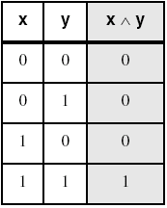
AND Instruction
Performs a Boolean AND operation between each pair of matching bits in two operands
Syntax:
AND destination, source
(same operand types as MOV)
AND
Applications
Notes:
舊版資訊補上

Slide 8
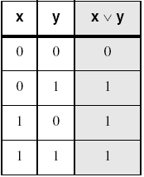
OR Instruction
Performs a Boolean OR operation between each pair of matching bits in two operands
Syntax:
OR destination, source
OR
Applications
Notes:
舊版資訊補上

Slide 9
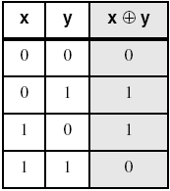
XOR Instruction
Performs a Boolean exclusive-OR operation between each pair of matching bits in two operands
Syntax:
XOR destination, source
XOR
Encrypting a String
XOR is a useful way to toggle (invert) the bits in an operand.
Notes:
舊版資訊補上

Slide 10
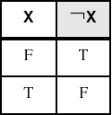
NOT Instruction
Performs a Boolean NOT operation on a single destination operand
Syntax:
NOT destination
NOT
Notes:
舊版資訊補上

Slide 11
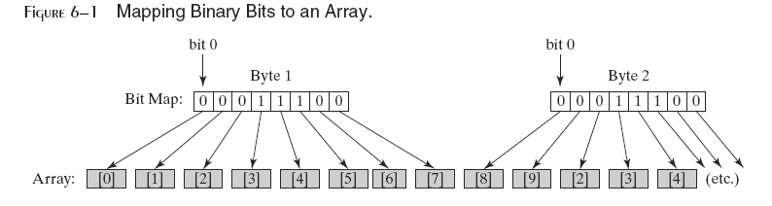
Bit-Mapped Sets
Binary bits indicate set membership
Efficient use of storage
Also known as bit vectors

Slide 12
Bit-Mapped Set Operations
Set Complement
mov eax,SetX
not eax
Set Intersection
mov eax,setX
and eax,setY
Set Union
mov eax,setX
or eax,setY

Slide 13
Applications (1 of 5)
Task: Convert the character in AL to upper case.
Solution: Use the AND instruction to clear bit 5.
ASCii Code:
 | Decimal | Binary |  | Decimal | Binary
‘A’ | 65 | 01000001 | ‘a’ | 97 | 01100001
‘B’ | 66 | 01000010 | ‘b’ | 98 | 01100010
‘C’ | 67 | 01000011 | ‘c’ | 99 | 01100011
‘D’ | 68 | 01000100 | ‘d’ | 100 | 01100100
‘E’ | 69 | 01000101 | ‘e’ | 101 | 01100101
mov al,'a' ; AL = 01100001b
and al,11011111b ; AL = 01000001b
‘a’ : 01100001b
‘A’ : 01000001b

Slide 14
Applications (2 of 5)
Task: Convert a binary decimal byte into its equivalent ASCII decimal digit.
Solution: Use the OR instruction to set bits 4 and 5.
mov al,6 ; AL = 00000110b
or al,00110000b ; AL = 00110110b
The ASCII digit '6' = 00110110b

Slide 15
Applications (3 of 5)
Task: Turn on the keyboard CapsLock key
Solution: Use the OR instruction to set bit 6 in the keyboard flag byte at 0040:0017h in the BIOS data area.
mov ax,40h ; BIOS segment
mov ds,ax
mov bx,17h ; keyboard flag byte
or BYTE PTR [bx],01000000b ; CapsLock on
This code only runs in Real-address mode, and it does not work under Windows NT, 2000, or XP.

Slide 16
Applications (4 of 5)
Task: Jump to a label if an integer is even.
Solution: AND the lowest bit with a 1. If the result is Zero, the number was even.
Decimal | Binary | Decimal | Binary | Decimal | Binary
1 | 00000001 | 5 | 00000101 | 9 | 00001001
2 | 00000010 | 6 | 00000110 | 10 | 00001010
3 | 00000011 | 7 | 00000111 | 11 | 00001011
4 | 00000100 | 8 | 00001000 | 12 | 00001100
mov ax,wordVal
and ax,1 ; low bit set?
jz EvenValue ; jump if Zero flag set
JZ (jump if Zero) is covered in Section 6.3.
Your turn: Write code that jumps to a label if an integer is negative.

Slide 17
Applications (5 of 5)
Task: Jump to a label if the value in AL is not zero.
Solution: OR the byte with itself, then use the JNZ (jump if not zero) instruction.
or al,al
jnz IsNotZero ; jump if not zero
ORing any number with itself does not change its value.

Slide 18
TEST Instruction
Performs a nondestructive AND operation between each pair of matching bits in two operands
No operands are modified, but the Zero flag is affected.
Usually used with jz (jump if ZF = 1) / jnz (jump if ZF = 0)
Example: jump to a label if either bit 0 or bit 1 in AL is set.
test al,00000011b ; ZF = 0, if either bit0 or bit1 is set
jnz ValueFound ; jump if ZF = 0
Example: jump to a label if bit 0 and bit 1 in AL are clear.
test al,00000011b ; ZF = 1, if both bit0 and bit1 are clear
jz ValueNotFound ; jump if ZF = 1
Notes:
Jump to and

Slide 19
CMP Instruction (1 of 3)
Compares the destination operand to the source operand
Nondestructive subtraction of source from destination (destination operand is not changed)
Syntax: CMP destination, source
Example: destination == source
mov al,5
cmp al,5 ; Zero flag set
Example: destination < source
mov al,4
cmp al,5 ; Carry flag set

Slide 20
CMP Instruction (2 of 3)
Example: destination > source
mov al,6
cmp al,5 ; ZF = 0, CF = 0
(both the Zero and Carry flags are clear)
Unsigned Integer
Case | ZF | CF
D = S | 1 | - | D – S = 0
D < S | 0 | 1 | D – S < 0 (Unsigned Overflow)
D > S | 0 | 0 | D – S > 0
Notes:
少一張table

Slide 21
CMP Instruction (3 of 3)
The comparisons shown here are performed with signed integers.
Example: destination > source
mov al,5
cmp al,-2 ; Sign flag == Overflow flag
Example: destination < source
mov al,-1
cmp al,5 ; Sign flag != Overflow flag
Signed Integer
Case | D | S | SF | OF
D > S | 0101 (5) | 1110 (-2) | 0 | 0
 | 0110 (6) | 1110(-2) | 1 | 1
D < S | 1110 (-2) | 0111 (7) | 0 | 1
 | 1111 (-1) | 0101 (5) | 1 | 0

Slide 22
Boolean Instructions in 64-Bit Mode
64-bit boolean instructions, for the most part, work the same as 32-bit instructions
If the source operand is a constant whose size is less than 32 bits and the destination is the lower part of a 64-bit register or memory operand, all bits in the destination operand are affected
When the source is a 32-bit constant or register, only the lower 32 bits of the destination operand are affected

Slide 23
What's Next
Boolean and Comparison Instructions
Conditional Jumps
Conditional Loop Instructions
Conditional Structures
Application: Finite-State Machines
Conditional Control Flow Directives

Slide 24
Conditional Jumps
Jcond Instruction
Jumps Based On . . .
Specific flags (not suggest to use)
Equality
Unsigned comparisons
Signed Comparisons
Applications
Encrypting a String
Bit Test (BT) Instruction
Notes:
Specific flags加上不建議使用

Slide 25
Jcond Instruction
A conditional jump instruction branches to a label when specific register or flag conditions are met
Specific jumps:
JB, JC - jump to a label if the Carry flag is set
JE, JZ - jump to a label if the Zero flag is set
JS - jump to a label if the Sign flag is set
JNE, JNZ - jump to a label if the Zero flag is clear
JECXZ - jump to a label if ECX = 0
Notes:
JB JC有什麼不同
建議使用前面的jump指令，後面的jump指令太過低階
In mips instruction, there are no condtional jump instruction, instead, there are some branch instruction.
beq Branches if the quantities of two registers are equal.
bne Branches if the quantities of two registers are NOT equal.
bgtz Branches if a quantity in a register is greater than zero (quantity is 32 bit, 2C).
bgez Branches if a quantity in a register is greater than or equal to zero (quantity is 32 bit, 2C).
bltz Branches if a quantity in a register is less than zero (quantity is 32 bit, 2C).
blez Branches if a quantity in a register is less than or equal to zero (quantity is 32 bit, 2C).
beq $rs, $rt, offset
bne $rs, $rt, offset
bgez $rs, offset
bgtz $rs, offset
blez $rs, offset
bltz $rs, offset
But I think we can consider that if you know these instructions, you can do all stuff you need to do.

Slide 26
Jcond Ranges
Prior to the 386:
jump must be within –128 to +127 bytes from current location counter
x86 processors:
32-bit offset permits jump anywhere in memory

Slide 27
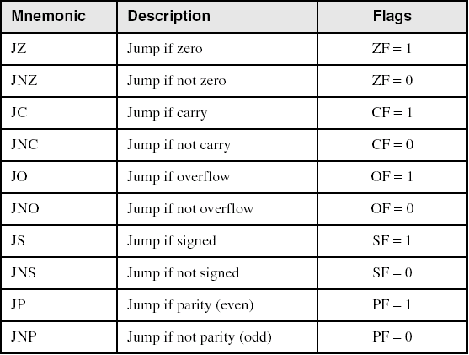
Jumps Based on Specific Flags
CMP leftop, rightop
JZ LabelName
NOT SUGGEST TO USE!!!!
Notes:
不建議使用(加上星星閃閃閃)
這一頁要加上cmp

Slide 28
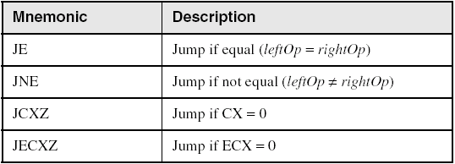
Jumps Based on Equality
CMP leftop, rightop
JE LabelName

Slide 29
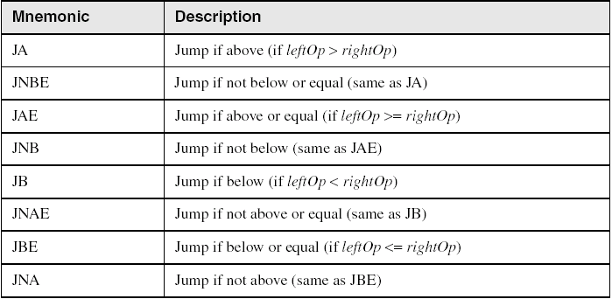
Jumps Based on Unsigned Comparisons
CMP leftop, rightop
JA LabelName
Note that 'a': 61h, 'A': 41h, 'B':42h Hence, 'a' > 'B' > 'A'

Slide 30
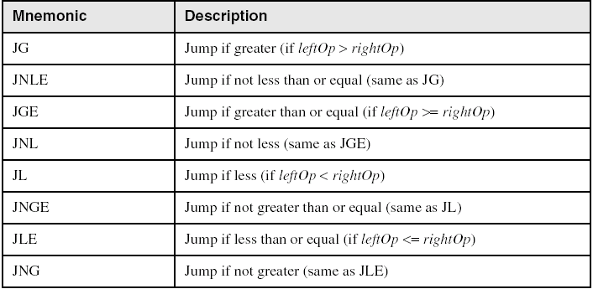
Jumps Based on Signed Comparisons
CMP leftop, rightop
JG LabelName

Slide 31
Applications (1 of 5)
Task: Jump to a label if unsigned EAX is greater than EBX
Solution: Use CMP, followed by JA
cmp eax,ebx
ja Larger
Task: Jump to a label if signed EAX is greater than EBX
Solution: Use CMP, followed by JG
cmp eax,ebx
jg Greater
Example

Slide 32
Application 1 – Example (1/2)
Jump to Larger if unsigned EAX > EBX
Unsigned integer (EAX) = 4294967295
mov eax, 0FFFFFFFFh
mov ebx, 0
cmp eax,ebx
ja Larger ; jump if unsignd eax > ebx
Jump to Greater if signed EAX > EBX
Signed integer (EAX) = -1
mov eax, 0FFFFFFFFh
mov ebx, 0
cmp eax,ebx
jg Greater ; jump if signd eax > ebx
Notes:
To compare instruction ja and jg.
在EAX = FFFFFFFFh, EBX = 0的情況下，ja會執行jump而jg不會

Slide 33
Application 1 – Example (2/2)
mov eax, 0FFFFFFFFh
mov ebx, 0
cmp eax,ebx
After comparing, flags are:
; (same as sub eax, ebx)
ZF | CF | SF | OF
0 | 0 | 1 | 0
ja and jg do jump while flags are set as below:
; jump if unsigned leftop > rightop
; jump if signed leftop > right
 | ZF | CF | SF | OF
ja | 0 | 0 | - | -
jg | 0 | - | SF == OF
Notes:
兩個程式碼，前三行的執行結果是一致
而ja和jg會有不同的結果是因為它們各別用於做判斷的Flags不同。

Slide 34
Applications (2 of 5)
Jump to label L1 if unsigned EAX is less than or equal to Val1
cmp eax,Val1
jbe L1 ; below or equal
Jump to label L1 if signed EAX is less than or equal to Val1
cmp eax,Val1
jle L1

Slide 35
Applications (3 of 5)
Compare unsigned AX to BX, and copy the larger of the two into a variable named Large
mov Large,bx
cmp ax,bx
jna Next
mov Large,ax
Next:
Compare signed AX to BX, and copy the smaller of the two into a variable named Small
mov Small,ax
cmp bx,ax
jnl Next
mov Small,bx
Next:

Slide 36
Applications (4 of 5)
Jump to label L1 if the memory word pointed to by ESI equals Zero
cmp WORD PTR [esi],0
je L1
Jump to label L2 if the doubleword in memory pointed to by EDI is even
test DWORD PTR [edi],1
jz L2

Slide 37
Applications (5 of 5)
Task: Jump to label L1 if bits 0, 1, and 3 in AL are all set.
Solution: Clear all bits except bits 0, 1,and 3. Then compare the result with 00001011 binary.
and al,00001011b ; clear unwanted bits
cmp al,00001011b ; check remaining bits
je L1 ; all set? jump to L1

Slide 38
Your turn . . .
Write code that jumps to label L1 if either bit 4, 5, or 6 is set in the BL register.
Write code that jumps to label L1 if bits 4, 5, and 6 are all set in the BL register.
Write code that jumps to label L2 if AL has even parity.
Write code that jumps to label L3 if EAX is negative.
Write code that jumps to label L4 if the expression (EBX – ECX) is greater than zero.

Slide 39
Encrypting a String
The following loop uses the XOR instruction to transform every character in a string into a new value.
KEY = 239 ; can be any byte value
BUFMAX = 128
.data
buffer BYTE BUFMAX+1 DUP(0)
bufSize DWORD BUFMAX
.code
mov ecx,bufSize ; loop counter
mov esi,0 ; index 0 in buffer
L1:
xor buffer[esi],KEY ; translate a byte
inc esi ; point to next byte
loop L1

Slide 40
String Encryption Program
Tasks:
Input a message (string) from the user
Encrypt the message
Display the encrypted message
Decrypt the message
Display the decrypted message
View the Encrypt.asm program's source code. Sample output:
Enter the plain text: Attack at dawn.
Cipher text: «¢¢Äîä-Ä¢-ïÄÿü-Gs
Decrypted: Attack at dawn.

Slide 41
BT (Bit Test) Instruction
Copies bit n from an operand into the Carry flag
Syntax: BT bitBase, n
bitBase may be r/m16 or r/m32
n may be r16, r32, or imm8
Example: jump to label L1 if bit 9 is set in the AX register:
bt AX,9 ; CF = bit 9
jc L1 ; jump if Carry

Slide 42
What's Next
Boolean and Comparison Instructions
Conditional Jumps
Conditional Loop Instructions
Conditional Structures
Application: Finite-State Machines
Conditional Control Flow Directives

Slide 43
Conditional Loop Instructions
LOOPZ and LOOPE
LOOPNZ and LOOPNE
Notes:
39

Slide 44
LOOPZ and LOOPE
Syntax:
LOOPE destination
LOOPZ destination
Logic:
ECX ← ECX – 1
if ECX > 0 and ZF=1, jump to destination
Useful when scanning an array for the first element that does not match a given value.
In 32-bit mode, ECX is the loop counter register. In 16-bit real-address mode, CX is the counter, and in 64-bit mode, RCX is the counter.

Slide 45
LOOPNZ and LOOPNE
LOOPNZ (LOOPNE) is a conditional loop instruction
Syntax:
LOOPNZ destination
LOOPNE destination
Logic:
ECX ← ECX – 1;
if ECX > 0 and ZF=0, jump to destination
Useful when scanning an array for the first element that matches a given value.

Slide 46
LOOPNZ Example
The following code finds the first positive value in an array:
.data
array SWORD -3,-6,-1,-10,10,30,40,4
sentinel SWORD 0
.code
mov esi,OFFSET array
mov ecx,LENGTHOF array
next:
test WORD PTR [esi],8000h ; test sign bit
pushfd ; push flags on stack
add esi,TYPE array
popfd ; pop flags from stack
loopnz next ; continue loop
jnz quit ; none found
sub esi,TYPE array ; ESI points to value
quit:

Slide 47
Your turn . . .
Locate the first nonzero value in the array. If none is found, let ESI point to the sentinel value:
.data
array SWORD 50 DUP(?)
sentinel SWORD 0FFFFh
.code
mov esi,OFFSET array
mov ecx,LENGTHOF array
L1: cmp WORD PTR [esi],0 ; check for zero
(fill in your code here)
quit:

Slide 48
. . . (solution)
.data
array SWORD 50 DUP(?)
sentinel SWORD 0FFFFh
.code
mov esi,OFFSET array
mov ecx,LENGTHOF array
L1: cmp WORD PTR [esi],0 ; check for zero
pushfd ; push flags on stack
add esi,TYPE array
popfd ; pop flags from stack
loope L1 ; continue loop
jz quit ; none found
sub esi,TYPE array ; ESI points to value
quit:

Slide 49
What's Next
Boolean and Comparison Instructions
Conditional Jumps
Conditional Loop Instructions
Conditional Structures
Application: Finite-State Machines
Conditional Control Flow Directives

Slide 50
Conditional Structures
Block-Structured IF Statements
Compound Expressions with AND
Compound Expressions with OR
WHILE Loops
Table-Driven Selection

Slide 51
Block-Structured IF Statements
Assembly language programmers can easily translate logical statements written in C++/Java into assembly language. For example:
if( op1 == op2 )
X = 1;
else
X = 2;
mov eax,op1
cmp eax,op2
jne L1
mov X,1
jmp L2
L1: mov X,2
L2:

Slide 52
Your turn . . .
Implement the following pseudocode in assembly language. All values are unsigned:
if( ebx <= ecx )
{
eax = 5;
edx = 6;
}
cmp ebx,ecx
ja next
mov eax,5
mov edx,6
next:
(There are multiple correct solutions to this problem.)

Slide 53
Your turn . . .
Implement the following pseudocode in assembly language. All values are 32-bit signed integers:
if( var1 <= var2 )
var3 = 10;
else
{
var3 = 6;
var4 = 7;
}
mov eax,var1
cmp eax,var2
jle L1
mov var3,6
mov var4,7
jmp L2
L1: mov var3,10
L2:
(There are multiple correct solutions to this problem.)

Slide 54
Compound Expression with AND (1 of 3)
When implementing the logical AND operator, consider that HLLs use short-circuit evaluation
In the following example, if the first expression is false, the second expression is skipped:
if (al > bl) AND (bl > cl)
X = 1;

Slide 55
Compound Expression with AND (2 of 3)
if (al > bl) AND (bl > cl)
X = 1;
This is one possible implementation . . .
cmp al,bl ; first expression...
ja L1
jmp next
L1:
cmp bl,cl ; second expression...
ja L2
jmp next
L2: ; both are true
mov X,1 ; set X to 1
next:

Slide 56
Compound Expression with AND (3 of 3)
if (al > bl) AND (bl > cl)
X = 1;
But the following implementation uses 29% less code by reversing the first relational operator. We allow the program to "fall through" to the second expression:
cmp al,bl ; first expression...
jbe next ; quit if false
cmp bl,cl ; second expression...
jbe next ; quit if false
mov X,1 ; both are true
next:

Slide 57
Your turn . . .
Implement the following pseudocode in assembly language. All values are unsigned:
if( ebx <= ecx
&& ecx > edx )
{
eax = 5;
edx = 6;
}
cmp ebx,ecx
ja next
cmp ecx,edx
jbe next
mov eax,5
mov edx,6
next:
(There are multiple correct solutions to this problem.)

Slide 58
Compound Expression with OR (1 of 2)
When implementing the logical OR operator, consider that HLLs use short-circuit evaluation
In the following example, if the first expression is true, the second expression is skipped:
if (al > bl) OR (bl > cl)
X = 1;

Slide 59
Compound Expression with OR (2 of 2)
if (al > bl) OR (bl > cl)
X = 1;
We can use "fall-through" logic to keep the code as short as possible:
cmp al,bl ; is AL > BL?
ja L1 ; yes
cmp bl,cl ; no: is BL > CL?
jbe next ; no: skip next statement
L1: mov X,1 ; set X to 1
next:

Slide 60
WHILE Loops
A WHILE loop is really an IF statement followed by the body of the loop, followed by an unconditional jump to the top of the loop. Consider the following example:
while( eax < ebx)
eax = eax + 1;
This is a possible implementation:
top: cmp eax,ebx ; check loop condition
jae next ; false? exit loop
inc eax ; body of loop
jmp top ; repeat the loop
next:

Slide 61
Your turn . . .
Implement the following loop, using unsigned 32-bit integers:
while( ebx <= val1)
{
ebx = ebx + 5;
val1 = val1 - 1
}
top: cmp ebx,val1 ; check loop condition
ja next ; false? exit loop
add ebx,5 ; body of loop
dec val1
jmp top ; repeat the loop
next:

Slide 62
Table-Driven Selection (1 of 4)
Table-driven selection uses a table lookup to replace a multiway selection structure
Create a table containing lookup values and the offsets of labels or procedures
Use a loop to search the table
Suited to a large number of comparisons

Slide 63
Table-Driven Selection (2 of 4)
Step 1: create a table containing lookup values and procedure offsets:
.data
CaseTable BYTE 'A' ; lookup value
DWORD Process_A ; address of procedure
EntrySize = ($ - CaseTable)
BYTE 'B'
DWORD Process_B
BYTE 'C'
DWORD Process_C
BYTE 'D'
DWORD Process_D
NumberOfEntries = ($ - CaseTable) / EntrySize

Slide 64
Table-Driven Selection (3 of 4)
Table of Procedure Offsets:

Slide 65
Table-Driven Selection (4 of 4)
Step 2: Use a loop to search the table. When a match is found, call the procedure offset stored in the current table entry:
mov ebx,OFFSET CaseTable ; point EBX to the table
mov ecx,NumberOfEntries ; loop counter
L1: cmp al,[ebx] ; match found?
jne L2 ; no: continue
call NEAR PTR [ebx + 1] ; yes: call the procedure
call WriteString ; display message
call Crlf
jmp L3 ; and exit the loop
L2: add ebx,EntrySize ; point to next entry
loop L1 ; repeat until ECX = 0
L3:
required for procedure pointers

Slide 66
What's Next
Boolean and Comparison Instructions
Conditional Jumps
Conditional Loop Instructions
Conditional Structures
Application: Finite-State Machines
Conditional Control Flow Directives

Slide 67
Application: Finite-State Machines
A finite-state machine (FSM) is a graph structure that changes state based on some input. Also called a state-transition diagram.
We use a graph to represent an FSM, with squares or circles called nodes, and lines with arrows between the circles called edges.

Slide 68
Application: Finite-State Machines
A FSM is a specific instance of a more general structure called a directed graph.
Three basic states, represented by nodes:
Start state
Terminal state(s)
Nonterminal state(s)

Slide 69
Finite-State Machine
Accepts any sequence of symbols that puts it into an accepting (final) state
Can be used to recognize, or validate a sequence of characters that is governed by language rules (called a regular expression)
Advantages:
Provides visual tracking of program's flow of control
Easy to modify
Easily implemented in assembly language

Slide 70
Finite-State Machine Examples
FSM that recognizes strings beginning with 'x', followed by letters 'a'..'y', ending with 'z':
FSM that recognizes signed integers:

Slide 71
Your Turn . . .
Explain why the following FSM does not work as well for signed integers as the one shown on the previous slide:

Slide 72
Implementing an FSM
The following is code from State A in the Integer FSM:
StateA:
call Getnext ; read next char into AL
cmp al,'+' ; leading + sign?
je StateB ; go to State B
cmp al,'-' ; leading - sign?
je StateB ; go to State B
call IsDigit ; ZF = 1 if AL = digit
jz StateC ; go to State C
call DisplayErrorMsg ; invalid input found
jmp Quit
View the Finite.asm source code.

Slide 73
IsDigit Procedure
Receives a character in AL. Sets the Zero flag if the character is a decimal digit.
IsDigit PROC
cmp al,'0' ; ZF = 0
jb ID1
cmp al,'9' ; ZF = 0
ja ID1
test ax,0 ; ZF = 1
ID1: ret
IsDigit ENDP

Slide 74
Flowchart of State A
State A accepts a plus or minus sign, or a decimal digit.

Slide 75
Your Turn . . .
Draw a FSM diagram for hexadecimal integer constant that conforms to MASM syntax.
Draw a flowchart for one of the states in your FSM.
Implement your FSM in assembly language. Let the user input a hexadecimal constant from the keyboard.

Slide 76
What's Next
Boolean and Comparison Instructions
Conditional Jumps
Conditional Loop Instructions
Conditional Structures
Application: Finite-State Machines
Conditional Control Flow Directives

Slide 77
Creating IF Statements
Runtime Expressions
Relational and Logical Operators
MASM-Generated Code
.REPEAT Directive
.WHILE Directive

Slide 78
Runtime Expressions
.IF, .ELSE, .ELSEIF, and .ENDIF can be used to evaluate runtime expressions and create block-structured IF statements.
Examples:
.IF eax > ebx
mov edx,1
.ELSE
mov edx,2
.ENDIF
.IF eax > ebx && eax > ecx
mov edx,1
.ELSE
mov edx,2
.ENDIF
MASM generates "hidden" code for you, consisting of code labels, CMP and conditional jump instructions.

Slide 79
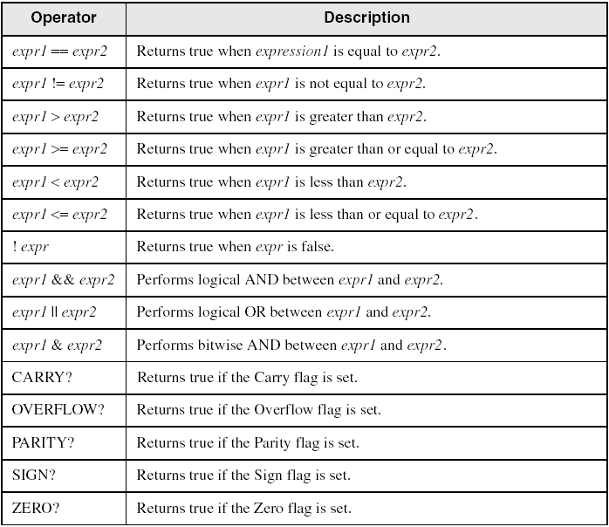
Relational and Logical Operators

Slide 80
Signed and Unsigned Comparisons
.data
val1 DWORD 5
result DWORD ?
.code
mov eax,6
.IF eax > val1
mov result,1
.ENDIF
Generated code:
mov eax,6
cmp eax,val1
jbe @C0001
mov result,1
@C0001:
MASM automatically generates an unsigned jump (JBE) because val1 is unsigned.

Slide 81
Signed and Unsigned Comparisons
.data
val1 SDWORD 5
result SDWORD ?
.code
mov eax,6
.IF eax > val1
mov result,1
.ENDIF
Generated code:
mov eax,6
cmp eax,val1
jle @C0001
mov result,1
@C0001:
MASM automatically generates a signed jump (JLE) because val1 is signed.

Slide 82
Signed and Unsigned Comparisons
.data
result DWORD ?
.code
mov ebx,5
mov eax,6
.IF eax > ebx
mov result,1
.ENDIF
Generated code:
mov ebx,5
mov eax,6
cmp eax,ebx
jbe @C0001
mov result,1
@C0001:
MASM automatically generates an unsigned jump (JBE) when both operands are registers . . .

Slide 83
Signed and Unsigned Comparisons
.data
result SDWORD ?
.code
mov ebx,5
mov eax,6
.IF SDWORD PTR eax > ebx
mov result,1
.ENDIF
Generated code:
mov ebx,5
mov eax,6
cmp eax,ebx
jle @C0001
mov result,1
@C0001:
. . . unless you prefix one of the register operands with the SDWORD PTR operator. Then a signed jump is generated.

Slide 84
.REPEAT Directive
Executes the loop body before testing the loop condition associated with the .UNTIL directive.
Example:
; Display integers 1 – 10:
mov eax,0
.REPEAT
inc eax
call WriteDec
call Crlf
.UNTIL eax == 10

Slide 85
.WHILE Directive
Tests the loop condition before executing the loop body The .ENDW directive marks the end of the loop.
Example:
; Display integers 1 – 10:
mov eax,0
.WHILE eax < 10
inc eax
call WriteDec
call Crlf
.ENDW

