Slide 1
ALA Modules for SBDI
Examples from Lund University
ZoaTrack / EcoData / BioCollect / SensorProject
Deployment and contributions to existing ALA Modules. Three examples from Lund University, and an upcoming project :
- 2019 – ZoaTrack
- 2020/2021 - BioCollect + EcoData
- 2022 – Sensor project

Slide 2
2019 – Deploying ZoaTrack
A platform ”designed to assist researchers and natural resource managers, store, analyse, visualise, synthesise and share their animal presence and movement information.”
Part of the BAS project
Designed to host datasets coming from our CanMove database

Slide 3
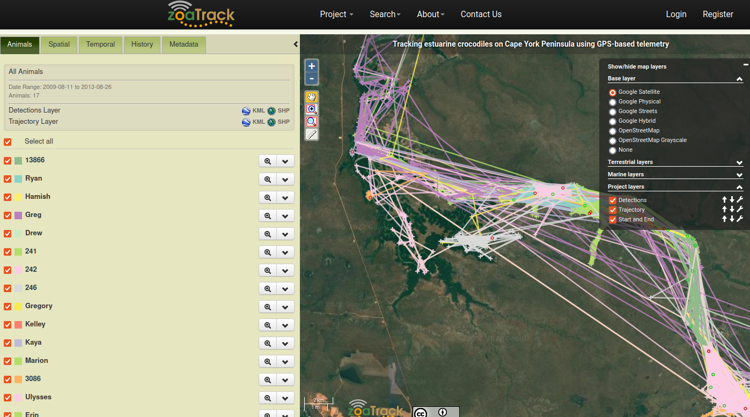
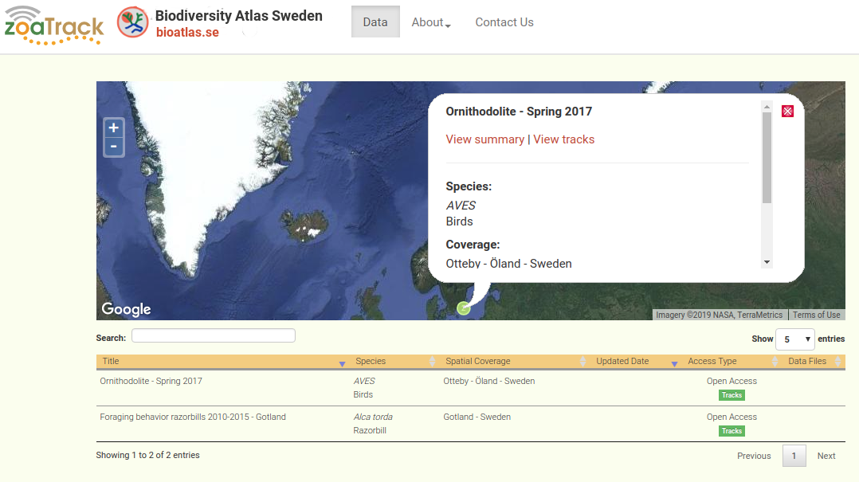
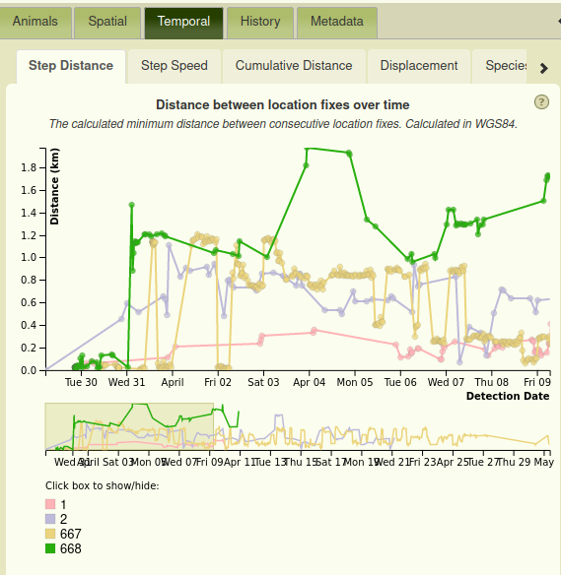
Notes:
Nobel laureates: Sune Bergström (Physiology or Medicine 1982) , Arvid Carlsson (Physiology or Medicine 2000), Bertil Ohlin (Economy 1977), Bengt Samuelsson (Physiology or Medicine 1982) , Manne Siegbahn (Physics 1924).
Prime minister: Swedish prime ministers Tage Erlander, Ernst Wigfors, Ingvar Carlsson.
President: Rupiah Banda, President of Zambia (2008–2001).

Slide 4
2019 – Deploying ZoaTrack
Stand-alone ALA module
Developped in 2014 (approx) by P: Newman and M. Hope
Java + RServe + Apache + Docker
PSQL/PGIS database
Deployed in 2019 in LU
EOL : no more development from ALA.
Discussions about the next version/generation ? SensorProject ?

Slide 5
2020 – BioCollect / EcoData
”BioCollect is an advanced, but simple-to-use data collection tool for biodiversity science.”
LU’s needs :
Store systematic monitoring projects and data
Publish web forms for users to report surveys
Deal with volunteers
Allow complex observations sites (points, lines, polygons, etc)

Slide 6
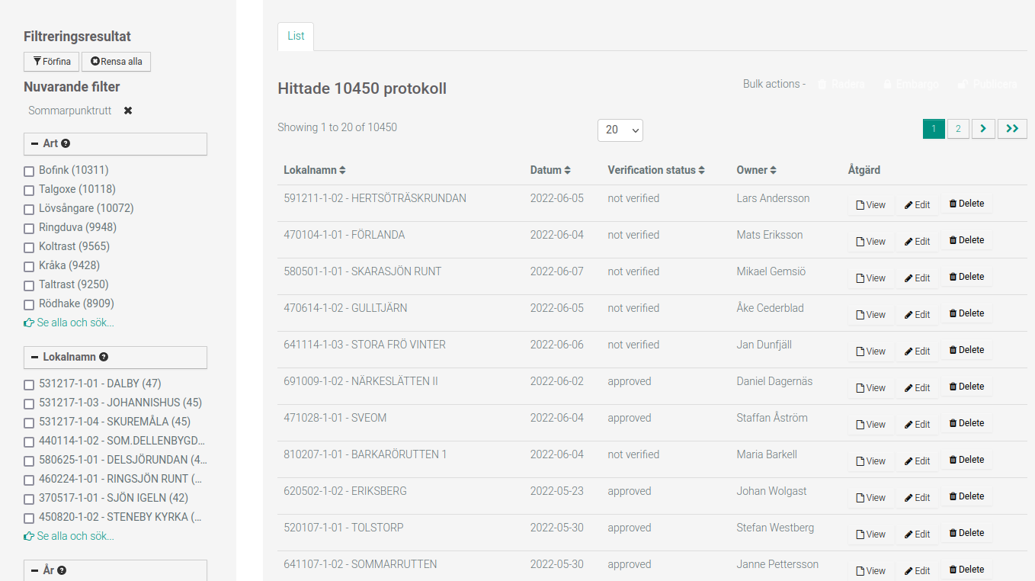
Notes:
Nobel laureates: Sune Bergström (Physiology or Medicine 1982) , Arvid Carlsson (Physiology or Medicine 2000), Bertil Ohlin (Economy 1977), Bengt Samuelsson (Physiology or Medicine 1982) , Manne Siegbahn (Physics 1924).
Prime minister: Swedish prime ministers Tage Erlander, Ernst Wigfors, Ingvar Carlsson.
President: Rupiah Banda, President of Zambia (2008–2001).

Slide 7
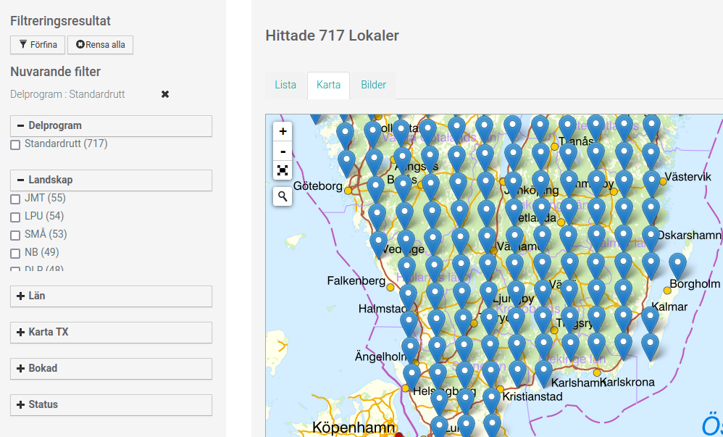
Notes:
Nobel laureates: Sune Bergström (Physiology or Medicine 1982) , Arvid Carlsson (Physiology or Medicine 2000), Bertil Ohlin (Economy 1977), Bengt Samuelsson (Physiology or Medicine 1982) , Manne Siegbahn (Physics 1924).
Prime minister: Swedish prime ministers Tage Erlander, Ernst Wigfors, Ingvar Carlsson.
President: Rupiah Banda, President of Zambia (2008–2001).

Slide 8
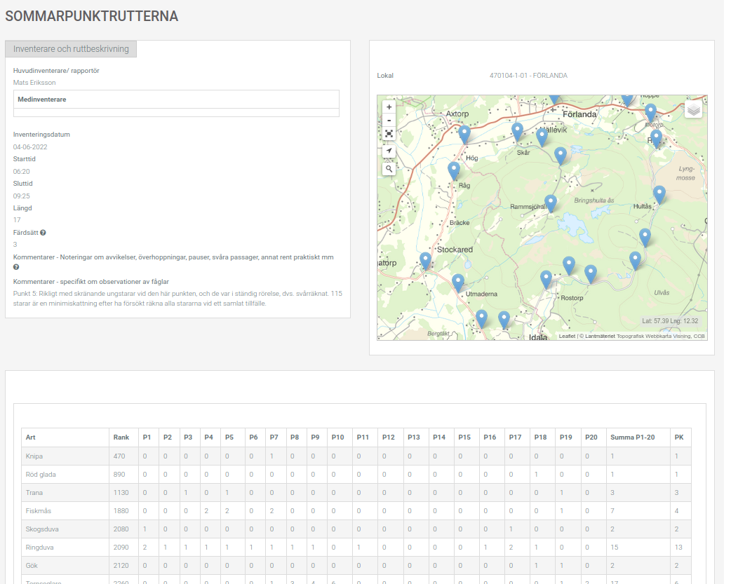
Notes:
Nobel laureates: Sune Bergström (Physiology or Medicine 1982) , Arvid Carlsson (Physiology or Medicine 2000), Bertil Ohlin (Economy 1977), Bengt Samuelsson (Physiology or Medicine 1982) , Manne Siegbahn (Physics 1924).
Prime minister: Swedish prime ministers Tage Erlander, Ernst Wigfors, Ingvar Carlsson.
President: Rupiah Banda, President of Zambia (2008–2001).

Slide 9
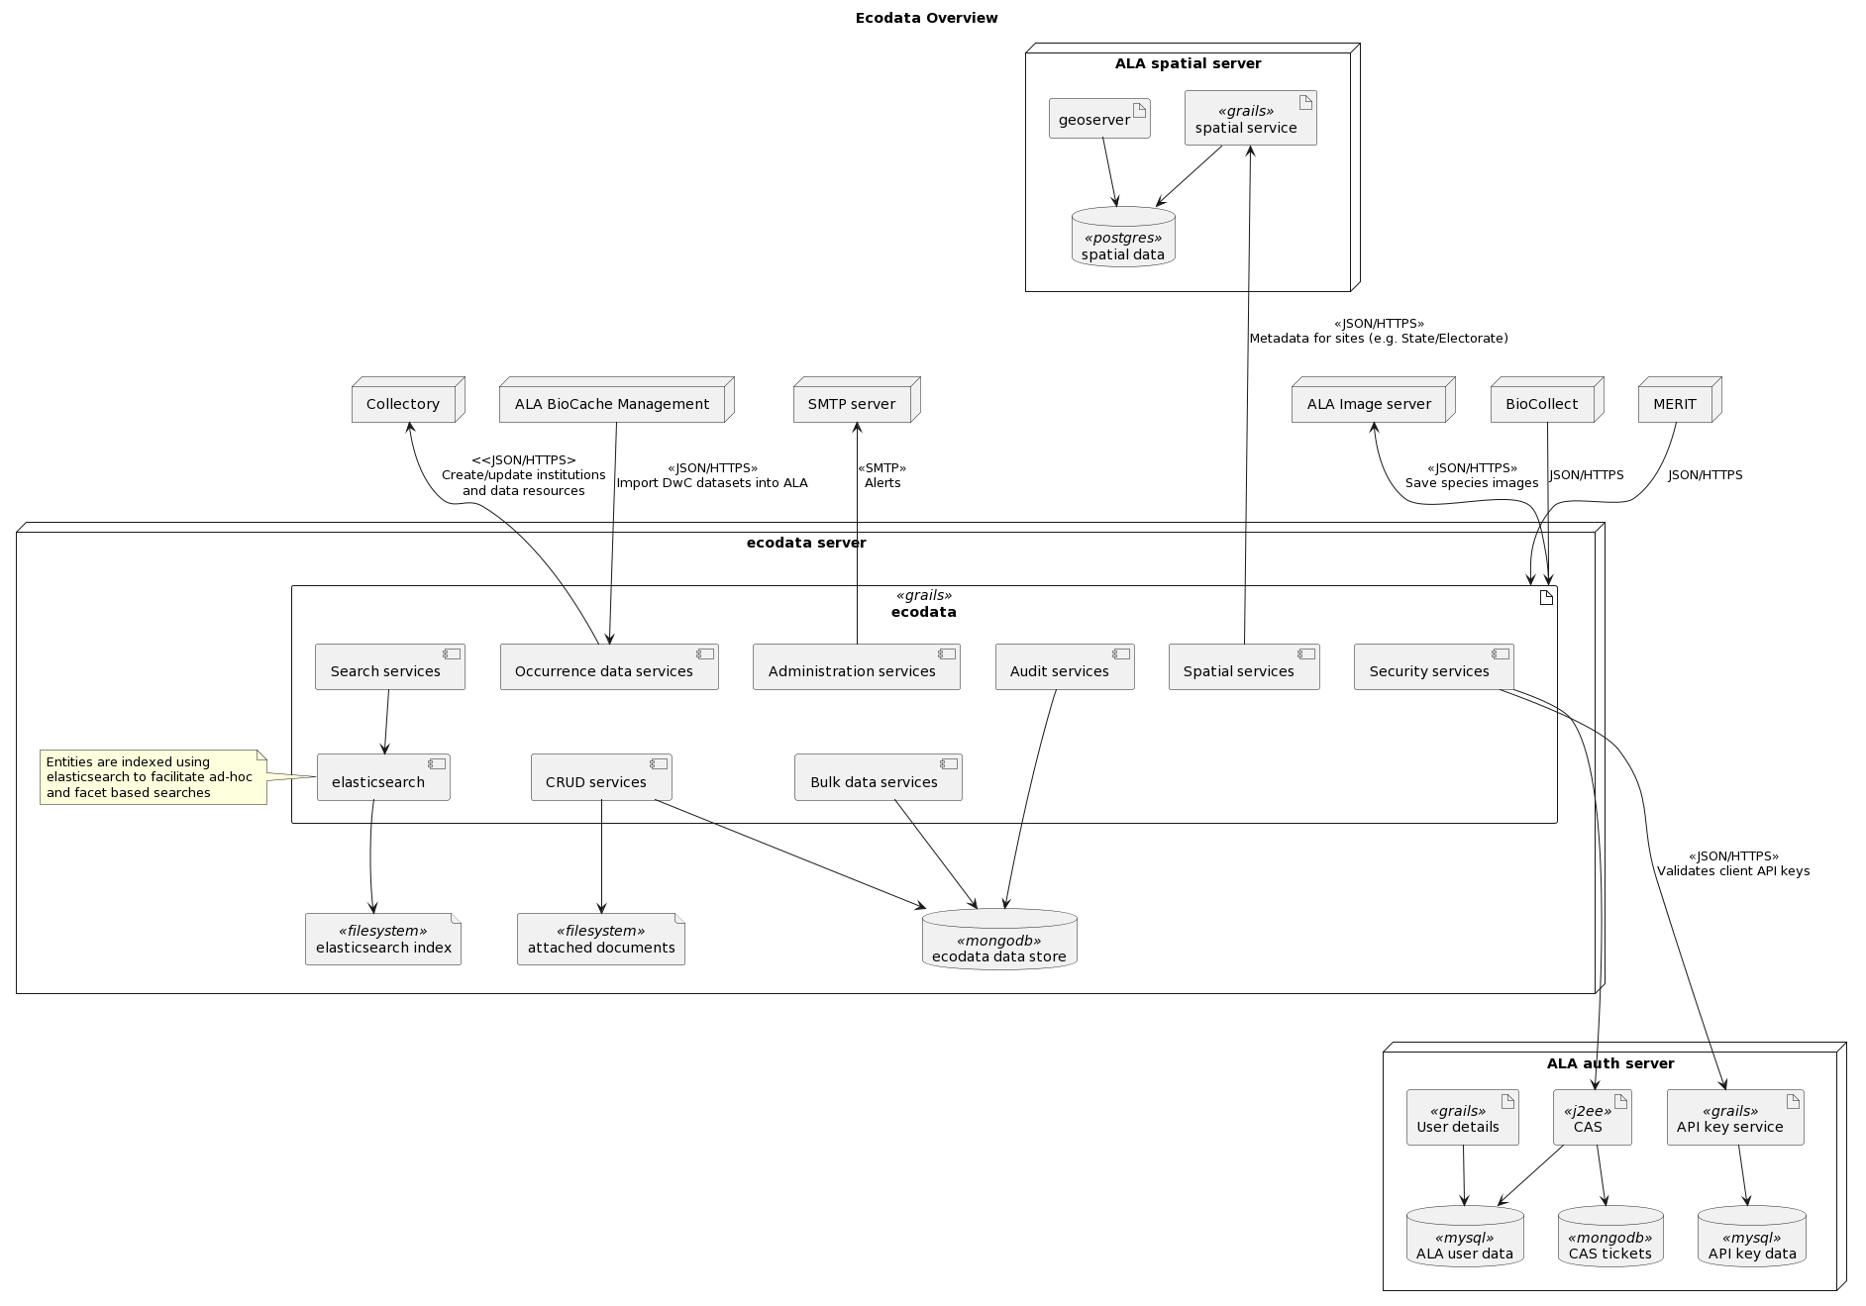

BioCollect / EcoData
boring diagram !

Slide 10
BioCollect / EcoData
Part of the ALA galaxy with many dependencies
Only used in Australia
Instances deployed by LU :
  https://biocollect.biodiversitydata.se
  https://ecodata.biodiversitydata.se
Modules required :
  CAS (authentication) => thanks Manash !
  Lists (species lists) => thanks Manash !
Java (Grails framework) + MongoDB + Geoserver + ElasticSearch

Slide 11
BioCollect / EcoData - Timeline
Dec 2019 : Aleksandra Magdziarek, full time developper
Jan 2020 : meetings with BioCollect team (Peter Brenton & Stathish Moorty)
First half 2020 : specifications, deploying instances, testing, listing the required modules
Second half 2020 : development of new features
Mars 2021 : 1st version released + double databases
May 2021 : switch to BioCollect/EcoData
Summer 2021 : open to volunteers
End of 2021 : new features

Slide 12
BioCollect – collaboration with ALA team
Many meetings in the beginning (specifications, features needed, timeline, agreement on collaboration)
Support needed for deploying the instances (lack of documentation)
Difficult start for us + absences in Australian team
“One-way” relationship with unbalanced advantages
Fork or not fork ? We did.
Updates

Slide 13
BioCollect – collaboration with ALA team
Examples of 3 different features
Accepted and integrated : internationalization module. Remove the hardcoded english text + adding translations.
Partly integrated : new site creation with hierarchical structure. Some pull requests never reviewed.
Not integrated : volunteers management feature. (Only LU was interested in that one).

Slide 14
BioCollect – collaboration with ALA team
Great experience and a brand new working tool for our researchers !
BUT :
Lack of resources from both sides to communicate more and work actively on pull requests.
Lack of experience in international open source project
Need of elaborating some good practices to discuss, plan, implement and review new features.

Slide 15
BioCollect – now what ?
Recap and open questions :
Best practices document for both sides ? Meeting frequency, resources allocated, ...
Governance ? How to prioritize the features ? How to make sure that the features are included and pull requests processed ?
Fork / not fork ? Shared bug and issues fixing ? Shared documentation ?

Slide 16
2022 - Sensor Project
Store various animal sensor data, coming from different devices. NOT ONLY geographic/movement data (but altitude, heartrates, temperature, …). Position is one sensor among many.
Store metadata (devices + projects infos)
=> need a flexible data modal and database (MongoDB)
Replace and/or complement both CanMove database, ZoaTrack and WRAM
Provide visualisation tools to explore data (spatial, diagrams, timelines)
Provide API for users (SOS, R / Mirroreum) for import/export
Use as much as possible existing ALA tools (CAS module + lists + spatial portal)

Slide 17
2022 - Sensor Project – data model
Inspired by DwC-A, WRAM, CanMove, Ecodata, …
2020 A.M.M. Sequeira - “A standardisation framework for bio-logging data to advance 2 ecological research and conservation”
TDWG meetings and works ?
Visualisation tools : existing (spatial portal, simple timeline java snippet) or new (actograms)

Slide 18
2022 - Sensor Project – collaboration ?
How to include the new tool in the ALA galaxy ?
Finding other users/developers interested in the project ?
The project is already started, with a quite advanced data model and some first pages created.
Main next step is to finish to convert several of our datasets and build an API.

Slide 19

End slide, logotype only

