Slide 1
Understanding Career Aspirations of Gen-Z
Sunny Gawande
Gleb Bikushev
Emmanuel Aloysious Bindu
Supervisor: Abhishek Mandal
Data Analytics
Computing Science and Mathematics Department
Dundalk Institute of Technology

Slide 2
Outline
The purpose of the study
Data importing and cleaning
Dashboard No1 (Gleb)
Dashboard No 2 (Sunny)
Dashboard No 3 (Emmanuel)
Strengths and weakness
Future work

Slide 3
The purpose of the study
The goal of this research may be to comprehend the variables that influence people's preferences for working environments, career decisions, and attitudes about different facets of employment. Employers, educational institutions, career counselors, and legislators may find it useful to utilize the study's insights to better understand and cater to the requirements and preferences of the workforce.

Slide 4
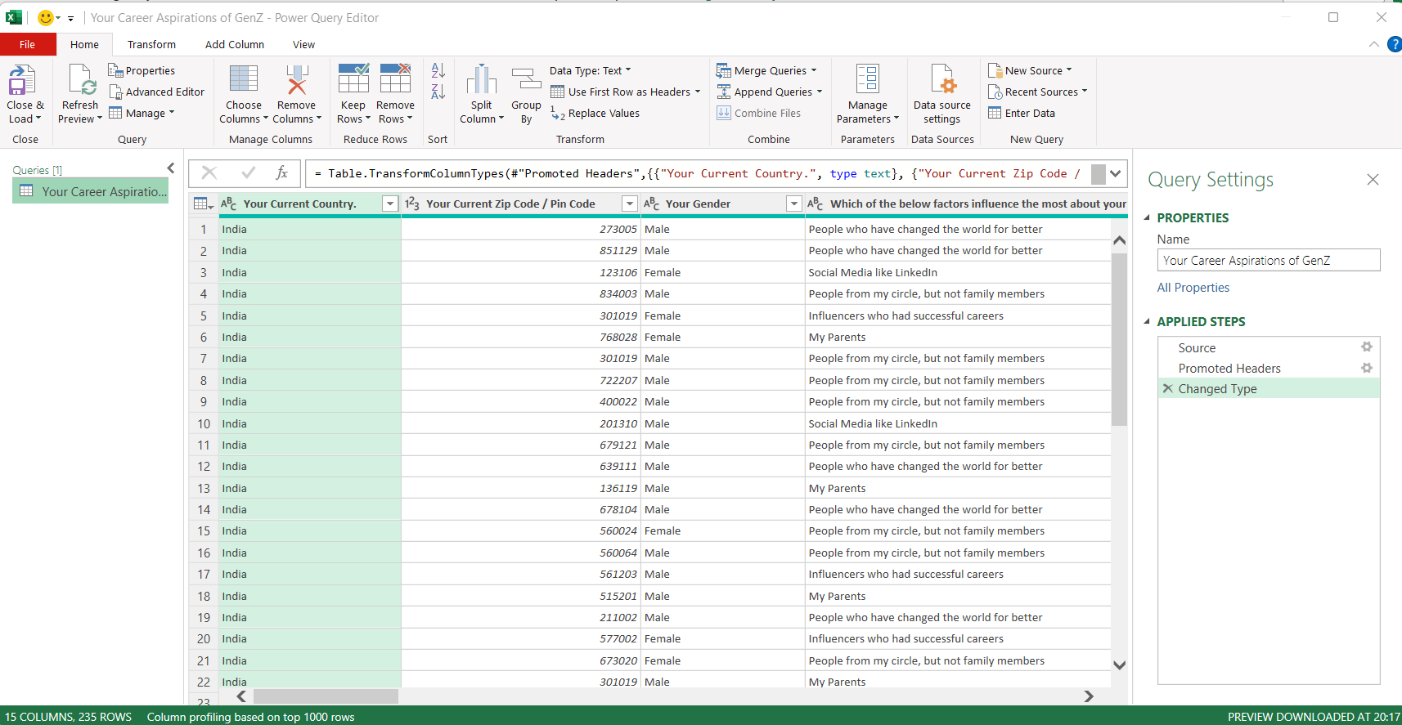
Data importing and cleaning
As you can see that all categorical features are in long format therefore by using power query editor in Microsoft Excel, we have made it short without changing its meaning for better visualization and data labelling.

Slide 5
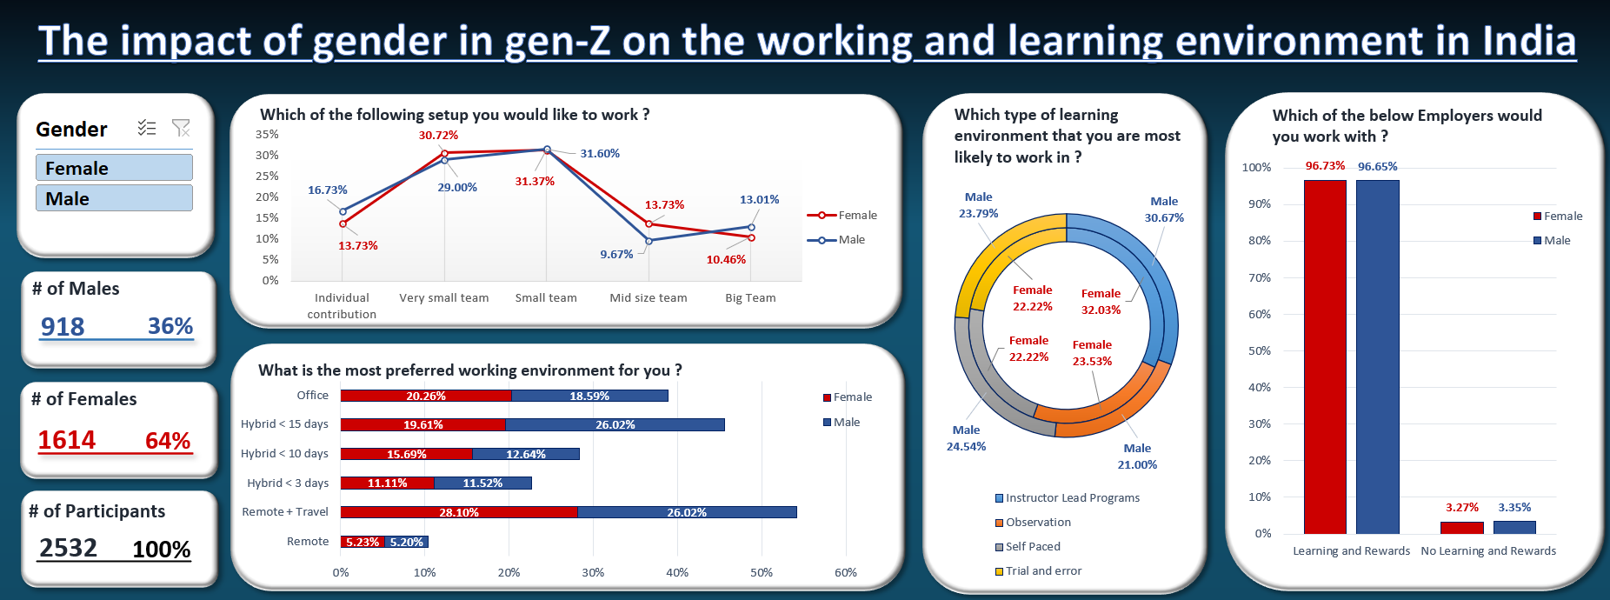
Dashboard No1 (Gleb)
RQ: how does gender affect the working and learning environments of people of generation Z in India?

Slide 6
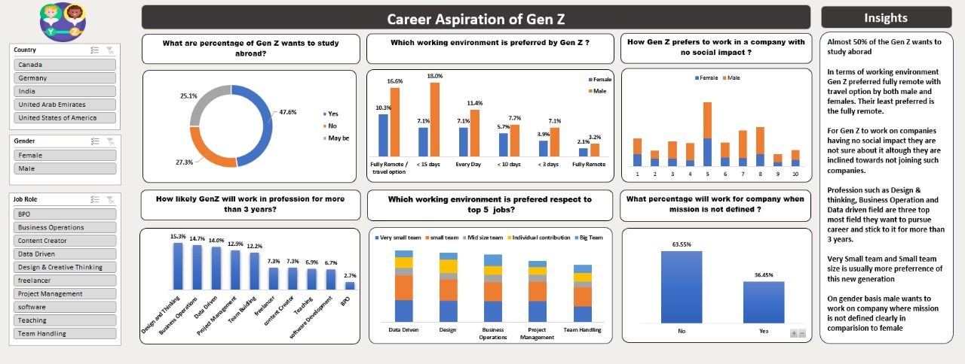
Dashboard No2 (Sunny)

Slide 7
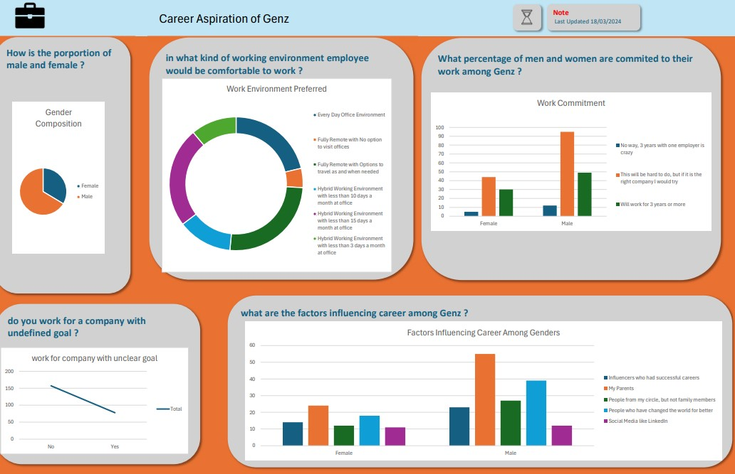
Dashboard No3 (Emmanuel)

Slide 8
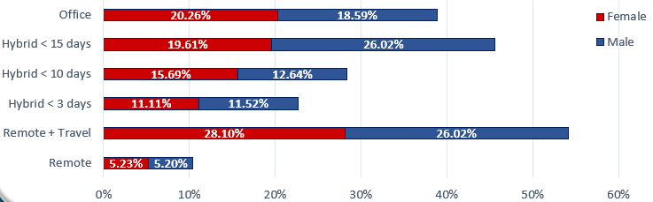
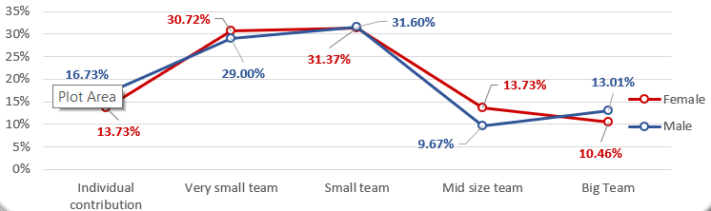
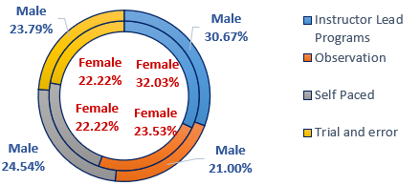
Strengths and weakness
 | Strengths | Weakness | Example
Stucked bar chart | Efficient Space Use Visualizing Proportions | Quantitative Comparison
Line chart | Trend Visualization Suitable for Many Data Points | Overlapping Lines
Donut chart | Comparisons Between Groups Space Efficiency | Suitable only for small number of categories

Slide 9
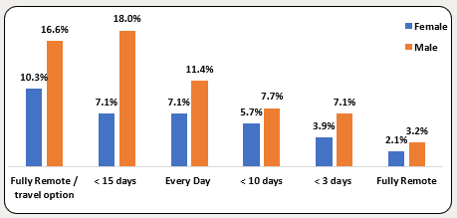
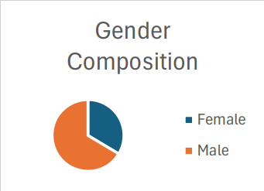
Strengths and weakness
 | Strengths | Weakness | Example
Clustered bar chart (column chart) | Clear Differentiation | Limited Number of Groups
Pie chart | Good for demonstrating proportions | Suitable only for small number of categories Can't be used for multiple groups (as opposed to donut chart)

Slide 10
Future work
As we learn about the career aspirations and preferences of generation Z, we also must consider how companies are altering and transforming to meet these wishes of young employees. That is why, future work might include the analysis of dataset that covers this companies' transformation.
Current dataset mainly consists the answers of participants of the survey from India. Future work might be supposed to include more participants from different countries to make comprehensive and multi-cultural analysis.

Slide 11
Insights
Almost 50% of the Gen Z wants to study aboard.
In terms of working environment Gen Z preferred fully remote with travel option by both male and females. Their least preferred is the fully remote.
Both males and females of Generation-Z in India prefer to work with employer who enables a learning environment and rewards you at the end.
Both males and females of Generation-Z in India prefers to work in small teams with 5-6 people, while the least preferred option for males is "7 to 10 people" for and "More than 10 people" for females.
Parents are the most influential factor for both the genders for deciding their career. In terms of least for the gender it is social media.

Slide 12
Thank you for your kind attention !!

